Slide 1

Supreme Court issues antidegradation ruling under Dripping Springs case
Nathan Vassar, Principal
Lloyd Gosselink Rochelle & Townsend, P.C.
TACWA July 2025 Meeting
JULY 18, 2025

Slide 2

Why do we care about this case?
State level deference to TCEQ decisions
Integrity of Antidegradation policy as implemented through Ips
Meaning of the phrase de minimus and whether certain % increases in particular parameters = unallowable degradation of water quality
Road map for protestants challenging TPDES permits

Slide 3
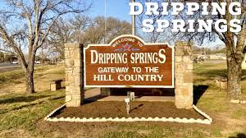
Background
2015 TPDES application for discharge up to 995,000 GPD ultimately to Onion Creek (via tributary)
Modeling showed that with permit conditions in place, a 5.0 mg/L in stream dissolved oxygen would be maintained
Included TP limit of 0.15 mg/L daily average, requiring enhanced treatment
EPA reviewed TCEQ’s application of antidegradation analysis and ultimately deemed the TCEQ approach sufficient.
Disinfection requirement due to Barton Springs Salamander

Slide 4


Protests to Application
Multiple initial protestants, but Save Our Springs Alliance, Inc. remained to the point of a contested case hearing.
SB 709 and “rebuttable presumption” at SOAH
SOAH PFD and TCEQ issuance of permit (and effect of permit issuance, even if appealed)

Slide 5
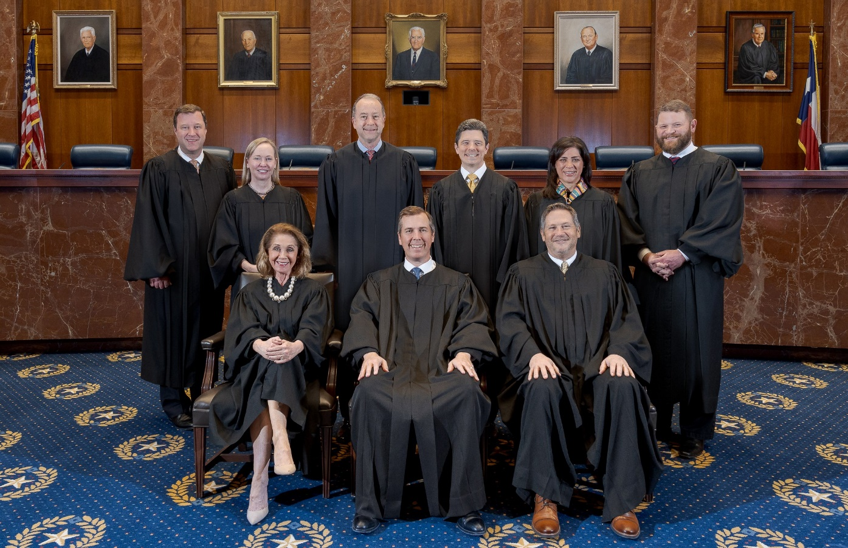



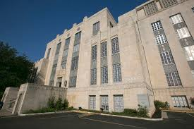
Path to the Supremes
Travis County District Court
El Paso Appellate Court
Supreme Court of Texas
Supreme Court of Texas
El Paso (8th) Court of Appeals
Travis County Dist. Court

Slide 6

Cut to the chase – what happened?
Supreme Court of Texas
El Paso (8th) Court of Appeals
Travis County Dist. Court

Slide 7
Was the permit issuance in doubt?
District Court initially ruled against TCEQ permit issuance
Contended the permit would “Turn the Clean Water Act Upside Down”
Focused on the total loadings of Phosphorous into stream
Adopted proposed Order/rationale of SOS

Slide 8

Supreme Court Analysis
Substantive question: Did TCEQ follow its own rules on antidegradation review?
Focus: 30 TAC Chapter 307 + IPs

Slide 9
Supreme Court Analysis
“IPs leave no doubt, however, that a parameter change is not the end of the matter. To the contrary, those procedures substantiate a qualitative whole-body approach that involves a somewhat subjective evaluation informed by both numerical and non-numeric information.”

Slide 10

Save Our Springs’ Arguments, addressed
10% reduction of DO is surely degradation more than a de minimus extent
Focus on TCEQ modeling
Arguments about EPA guidance

Slide 11

Preserve Status Quo? New Lessons?
No definition for “de minimus” through Court decision
How to approach new permit applications, particularly with high nutrient loadings
Accepting more stringent permit requirements and impacts to defense of permit

Slide 12


Questions?
Nathan Vassar, Principal Attorney
Lloyd Gosselink Rochelle & Townsend, P.C.
nvassar@lglawfirm.com; 512-322-5867

