Slide 1
Water Reuse Master Planning
Step One to Utilizing Reclaimed Water to Help Meet Long-term Water Supply Demands
Andrea Tom, PE
2025 TACWA Meeting
July 18th, 2025

Slide 2
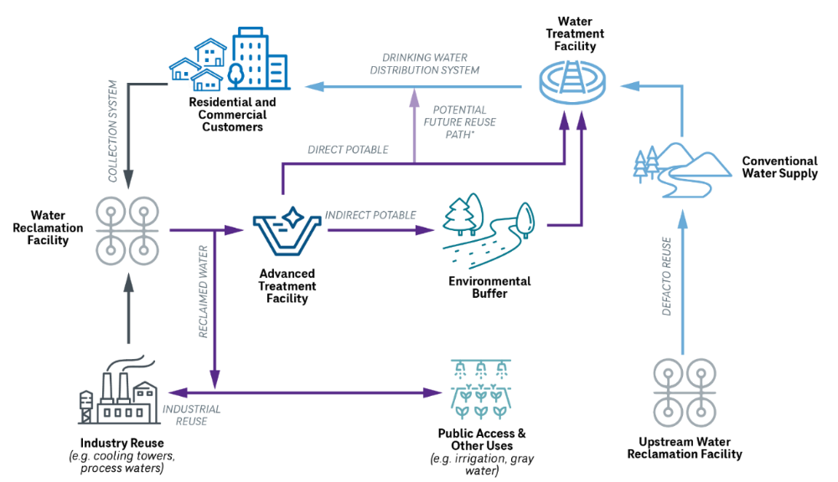
Types of Reuse
DPR
IPR
NON-POTABLE
2
Notes:
Most of you are probably familiar, but I want to briefly recap some terminology to get us on the same page. (go through slide – traditional, non-pot, IPR, DPR.

Slide 3
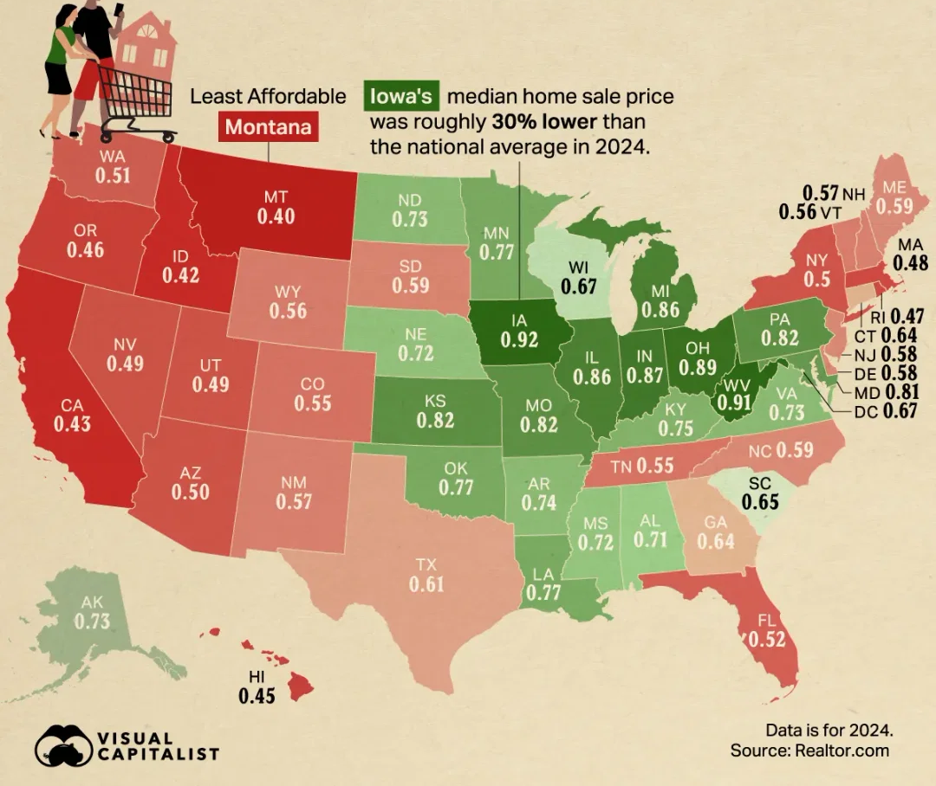
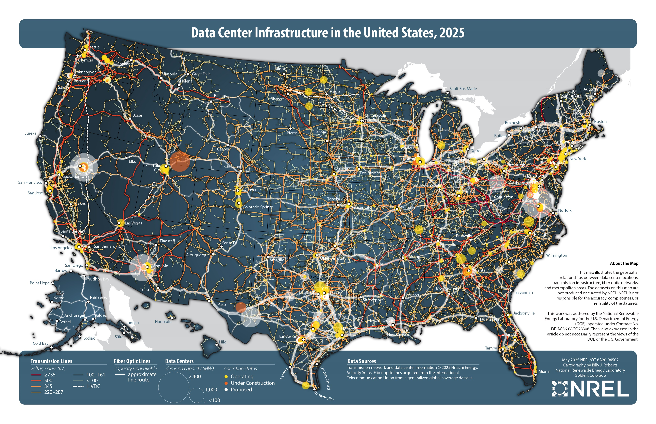
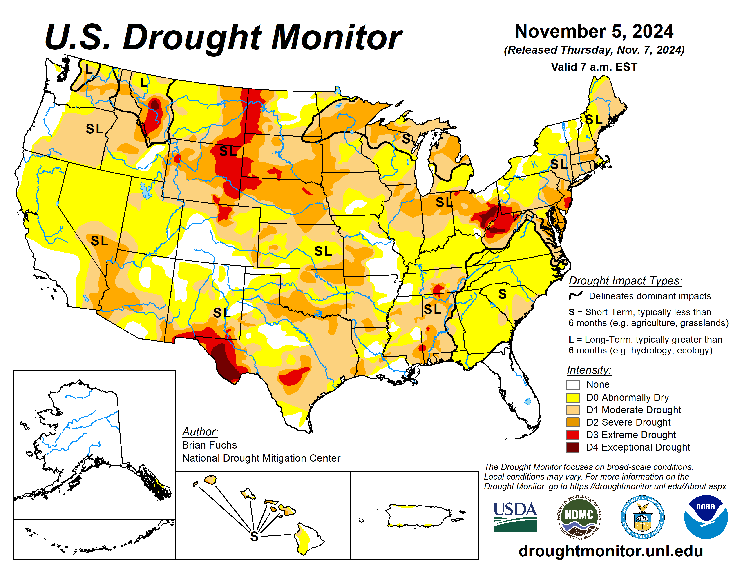
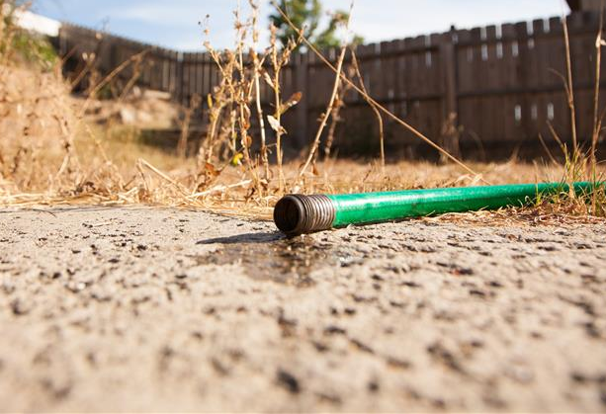
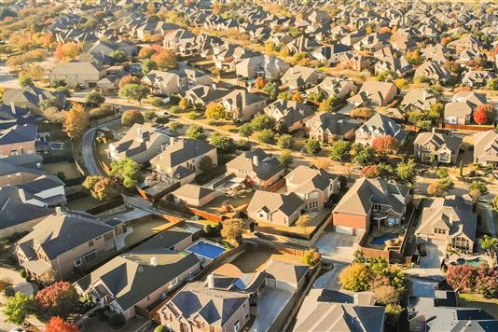
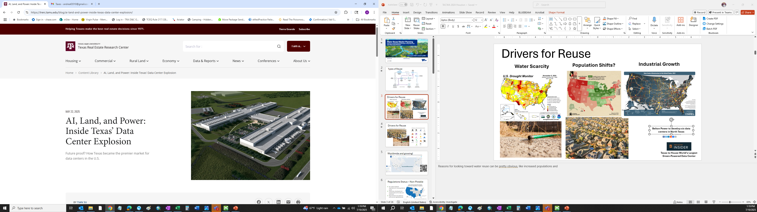
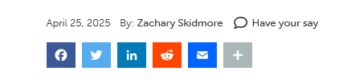
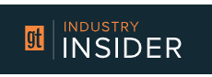
Drivers for Reuse
Water Scarcity
Population Shifts?
Industrial Growth
Belton Power to develop six data centers in North Texas
Texas to House World’s Largest Green-Powered Data Center
3
Notes:
Reasons for looking toward water reuse can be pretty straight forward, like water resource scarcity and water demands increasing due to population growth (everyone wants to move to our great state!). But more recently we’ve also seen an increase in non-potable reuse as industrial customers – like data centers – want to utilize recycled water to decrease impact on communities and meet their sustainability metrics. People just WANT reuse.

Slide 4
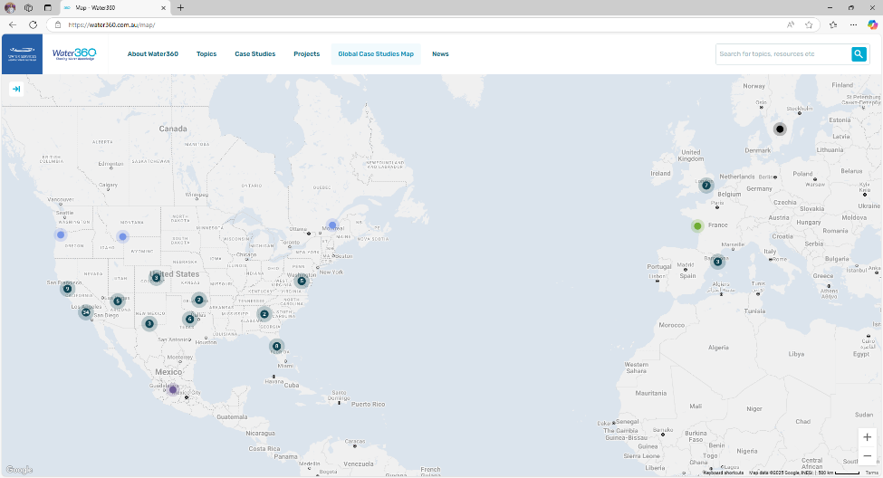

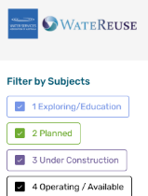
Worldwide and growing!
https://water360.com.au/map/
4
Notes:
Reuse around the world is growing as it is incorporated into more city’s water supply portfolios. This map documents & tracks POTABLE reuse projects around the world that are in the planning stage as well as operating facilities. It was compiled by the Water Services Association of Australia – and can be found at the link or QR code above. It’s a good resource for demonstrating that potable reuse is established and safe and has been practiced for decades.

Slide 5
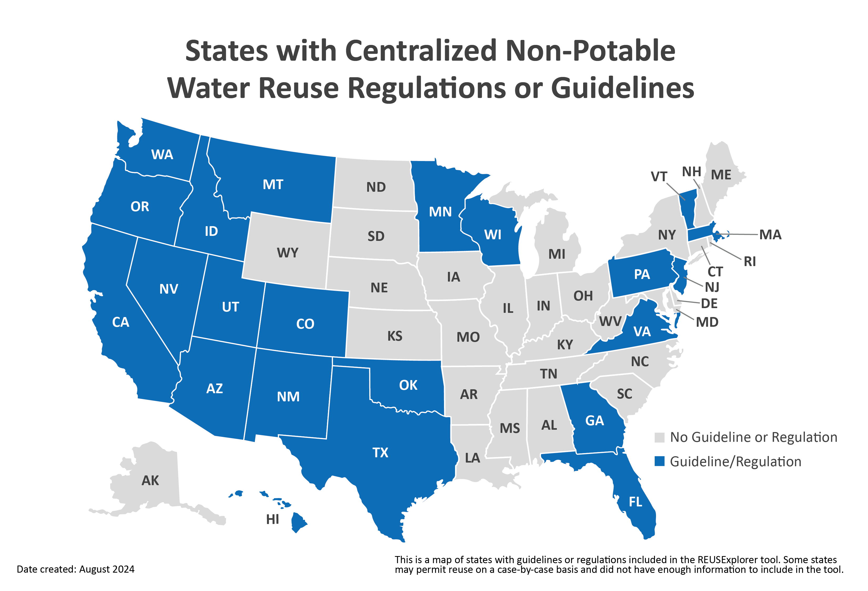
Regulations Status: Non-Potable
No uniform federal regulations for reuse guidance exists
Otherwise, developed and implemented at the state and local level
Requirements vary based on end-use and regulating body
5
Source: EPA: Maps of Status with Water Reuse Regulations or Guidelines
Notes:
In the US, no federal regulations exist for non-potable reuse. Many states have developed non-potable regulations and many of them have 2 or more levels of water quality that the effluents have to meet in order to be used for non-potable applications.

Slide 6
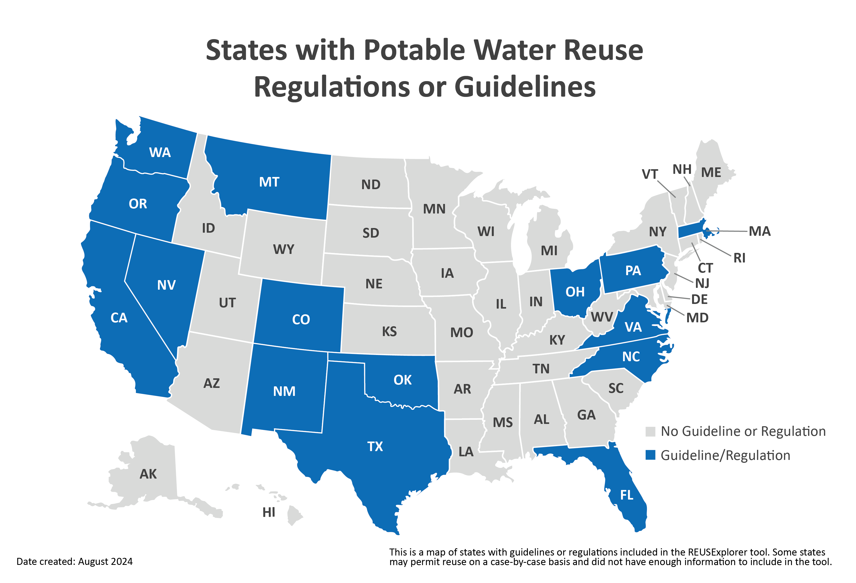
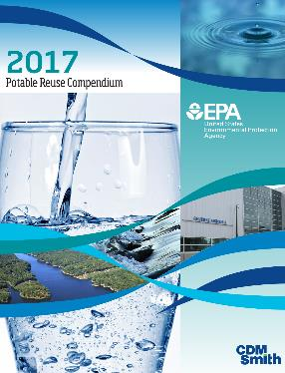
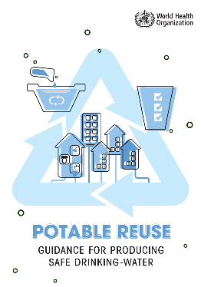
Regulations Status: Potable
US and Global Guidance
6
Source: EPA: Maps of Status with Water Reuse Regulations or Guidelines
Notes:
On the potable reuse side, the US EPA implements the safe drinking water act by establishing minimum standards for drinking water quality. The EPA does not have reuse regulations, though for potable reuse, drinking water standards must be followed. In 2018, however, the EPA published potable reuse guidelines that have been developed in partnership with CDM Smith.
Many states have developed or are starting to develop their own regulations for potable reuse. Some have regulations for DPR and IPR separately, and some lump both kinds together. In Texas we have Guidelines for DPR but no IPR Guidelines or regulations. Outside of the US, the World Health Organization also recently published guidelines for potable reuse.

Slide 7

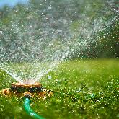
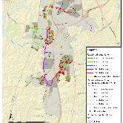
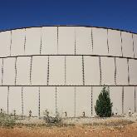
Traditional Reuse Planning
Non-potable reuse
  Large Water Users
  Outdoor water use
  Geospatial Analysis
  Storage Evaluation
7
Notes:
So I’m going to shift to the planning side of things. When we talk about “traditional reuse planning” we are usually referring to non-potable reuse, or what we call “purple pipe” because it is the oldest and most established type of reuse, typically used for irrigation of parks, golf, courses, etc or used by industry (or power plants) for cooling. The planning process for non-potable reuse is centered around identifying large water users (industrial or large irrigators), coupled with geospacial analysis of where those end users are in reference to reclaimed water sources. A storage evaluation is typically required to meet regulations and system pressure requirements.

Slide 8
Overall Planning Framework
Water/ Wastewater Master Plan
One Water Plan
Reuse Master Plan
Reuse Study/
Roadmap
Integrated Water Resources Plan (IWRP)
8
Notes:
Water reuse can show up in other planning efforts – such as an Integrated Water Resources Plan, where communities water supply alternatives and forecasted demands are analyzed & defined. Reuse can be identified as a water supply source through these types of planning efforts. Within a water or WW master plan, non-potable or potable reuse may show up or a stand-alone reuse master plan may be used to evaluate options within a specific system. And a one water plan can include all of the above but also storm water.

Slide 9
Municipal Reuse Master Planning Process
Understand Growth
Evaluate Large Water Users
Evaluate Current Infrastructure Capacity and Water Quality
Assess Current Water Reuse Systems
Define the Regulatory Pathway
Define Potential Projects and Develop Project Costs
9
Notes:
These are the typical steps we take during a Reuse Masterplan project. I’ll provide a little more detail about each step of the process in the following slides.

Slide 10
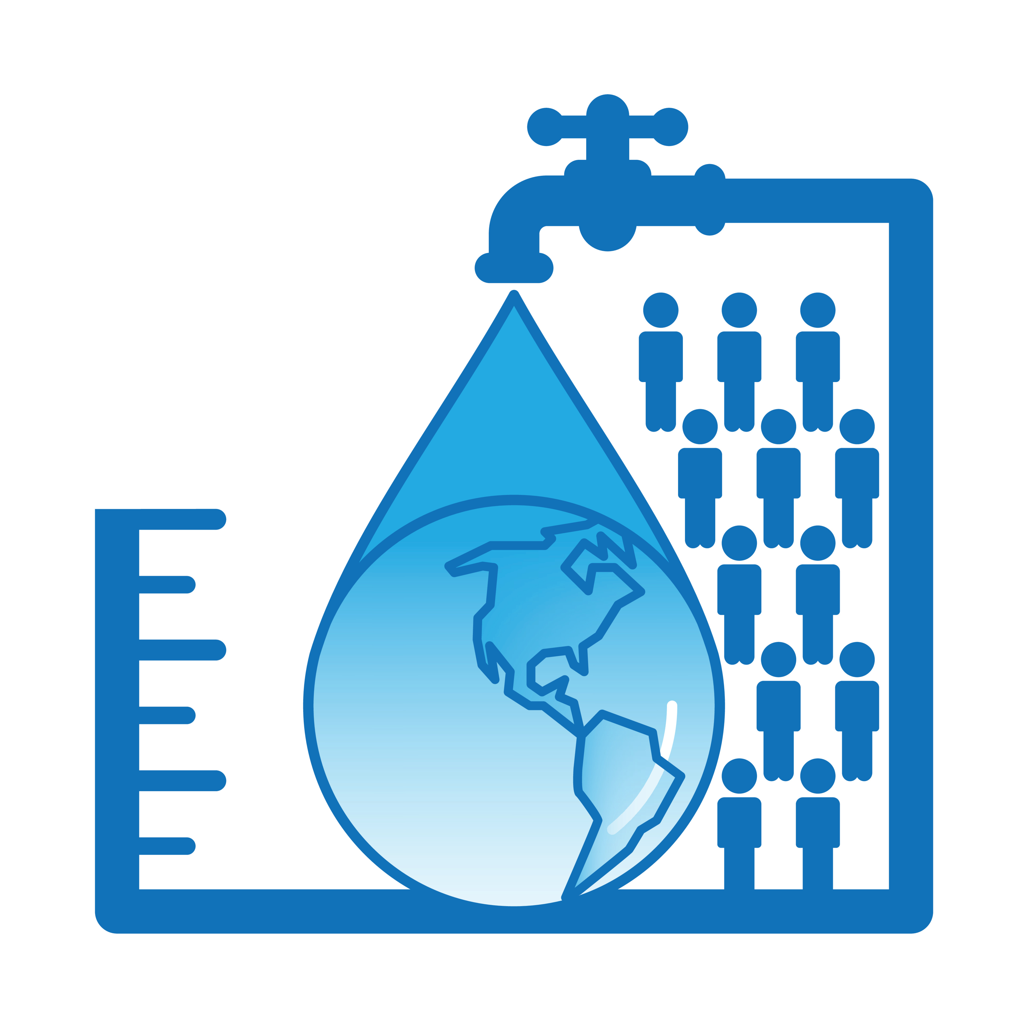
Understanding Growth
Population growth
Industrial Development
Water Demands
Wastewater Generation
10
Notes:
Understanding growth is a key component but is not unique to reuse master planning, therefore this can be done as part of other efforts as well. The first piece is to estimate population projections. We also want to look at what industrial development is in the pipeline, so being aware of commercial or industrial companies that are discussing facilities in the area. Then we must understand the water demands – some cities have new facilities and a great conservation program already in place and other will need to consider more conservative water usage numbers. And lastly, we want to consider wastewater available to actually serve as a source, including the timeline corresponding to the projected growth.

Slide 11
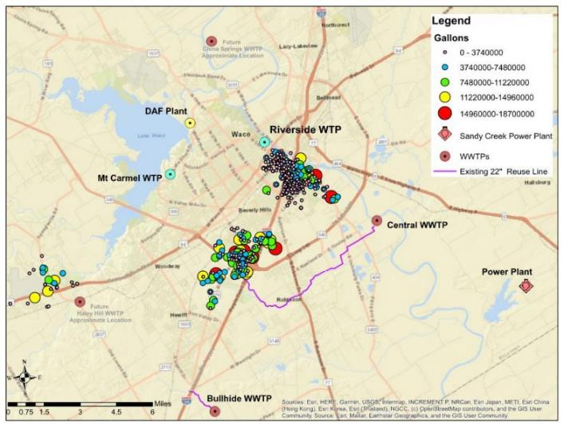
Evaluating Users
Industrial
Irrigation
Parks & Rec
Commercial
11
Billing Data
Map spatially
Current and future
Notes:
To evaluate large water users, we are usually able to analyze the utility’s billing data. Some billing data will tell us what kind of customer it is – commercial, residential, or industrial. The data also often times had GPS coordinates, and we are able to locate areas of the community that have one or more anchor users. Sometimes this is well defined in the data, and other times we have had to investigate a little further if there’s a large water user that is listed residential for example. We also want to consider where they are physically located in relation to the water and wastewater treatment plants, and we want to consider any known future expansion – this is usually possible as permits are also handled through the cities.

Slide 12
Existing Infrastructure Evaluation
Infrastructure
Condition assessments
Inventory of decentralized systems
Conveyance coverage of distribution system and potential future conveyance options
Evaluate Infrastructure, Capacity and Water Quality
WTPs, WWTPs, Conveyance
Storage Opportunities
Supplemental Study Recommendations
Quantity
Reclaimed water availability
Consider return flow requirements
Water Quality
Historical data
Regulatory compliance
Additional sampling
12
Notes:
Next is getting a good understanding of the existing infrastructure available to the utility. (read slide)

Slide 13
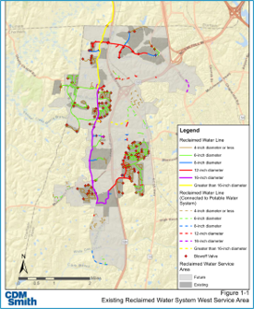
Existing Reclaimed Systems
Existing Users
Existing Contracts
Potential “Anchor” Users
13
Ability to expand (size, capacity, proximity)
Proximity to other potential “anchor” users
Notes:
The last piece of understanding existing components is assessing any existing reuse and tying it back to the water needs – can we expand transmission lines to meet any of those potential users? Can we increase any existing advanced treatment facilities capacity? This allows us to identify potential reuse projects that could minimize costs by reusing existing infrastructure.

Slide 14
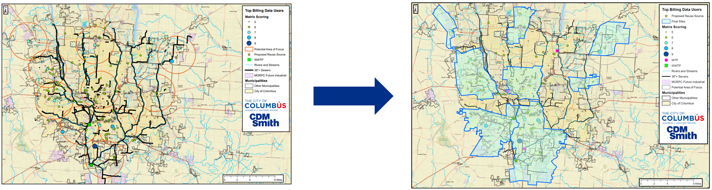
Identifying Demands and Develop System Layouts
Integrate the following into interactive GIS maps:
Billing Data
Average, maximum, seasonality, etc.
Planning Data
Proposed development plans
Infrastructure
Trunk lines, water mains, W/WWTPs
Water and Wastewater Modeling Demand, wastewater flows
Notes:
We utilize billing data, planning data, and the results of the evaluation of the existing systems to look at demands within the system and develop potential system layouts as shown above. In this case, seven areas were identified on the

Slide 15
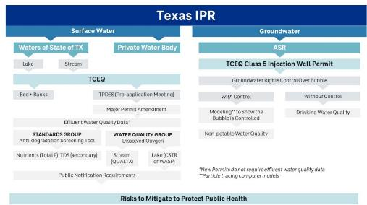
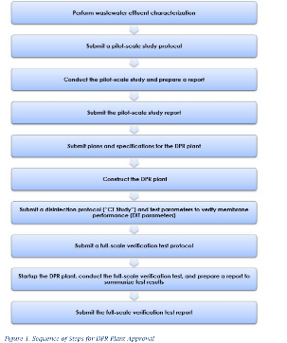
Regulatory Pathway
Potable or Non-Potable
Water Rights
Permitting Requirements
Texas DPR
15
Notes:
Once we have a good understanding of what is available, we must consider any regulatory requirements for the various reuse projects to consider. As I hinted earlier, this can really vary regionally and by application. Depending on the project complexity, regulatory permitting can turn out to be a significant cost and challenge. I like to use Texas as an example – in TX there are no “IPR Regulations”. What we consider IPR is regulated depending on the water source and permitting varies in complexity from needing only to meet discharge permits all the way to requiring drinking water standards.

Slide 16
Texas IPR
Surface Water
Groundwater
Waters of State of TX
Private Water Body
ASR
Lake
Stream
TCEQ Class 5 Injection Well Permit
TCEQ
Groundwater Rights Control Over Bubble
Bed + Banks
TPDES (Pre-application Meeting)
With Control
Without Control
Major Permit Amendment
Modeling** to Show the Bubble is Controlled
Drinking Water Quality
Effluent Water Quality Data*
STANDARDS GROUP
Anti-degradation Screening Tool
WATER QUALITY GROUP
Dissolved Oxygen
Non-potable Water Quality
Nutrients (Total P), TDS (secondary)
Stream (QUALTX)
Lake (CSTR or WASP)
*New Permits do not require effluent water quality data
**Particle tracing computer models
Public Notification Requirements
Risks to Mitigate to Protect Public Health
Notes:
Where is the Water Supply division?
Lake Dispersion Model is CDM Smith internal tool which aligns well with WASP
New outfall = major amendment

Slide 17
Texas Regulatory Pathway - DPR
Perform wastewater effluent characterization
Submit a pilot-scale study protocol
Conduct the pilot-scale study and prepare a report
Submit the pilot-scale study report
Submit plans and specifications for the DPR Plant
Construct the DPR Plant
Submit a disinfection protocol (“CT Study”) and test parameters to verify membrane performance
Submit a full-scale verification test protocol
Startup the DPR Plant, conduct the full-scale verification, & prepare report with test results
Submit the full-scale verification test report
Potable or Non-Potable
Water Rights
Permitting Requirements
17
Notes:
Once we have a good understanding of what is available, we must consider any regulatory requirements for the various reuse projects to consider. As I hinted earlier, this can really vary regionally and by application. Depending on the project complexity, regulatory permitting can turn out to be a significant cost and challenge. I like to use Texas as an example – in TX there are no “IPR Regulations”. What we consider IPR is regulated depending on the water source and permitting varies in complexity from needing only to meet discharge permits all the way to requiring drinking water standards.

Slide 18
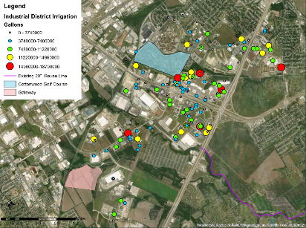

Collaboratively develop project alternatives for subsequent decision-making
Develop benefits and risks associated with each alternative​
Costs
Treatment (WWTP upgrades, advanced treatment)
Conveyance
Site Improvements
Storage
Pump stations
Supplemental (Source water characterization, piloting, permitting, public outreach)
O&M
Benefits​
Uses already-installed reuse pipeline​ Includes known large water demands with few customers​
Industrial Company
New purple pipe
Potential Risk​
City does not control industrial demands​ End-user binding contracts required​ Customers unwilling to use reclaimed water or change their demands​ If used for irrigation, could lead to distribution of contaminants that may be regulated in the future, including PFAS​
Form Projects and Develop Planning-Level Costs
18
Notes:
Lastly, we can develop real project alternatives and provide utilities with a list of potential projects and planning-level pricing so they can go back to them as things change in our ever unstable water climate. For each project, we are able to provide a level of effort and some initial layouts and sizing, planning-level costs for treatment, conveyance storage, transmission, operation and maintenance, and as required, sampling, piloting, permitting, and public outreach efforts. Each project should also list benefits and potential risks, as they need to be considered for project feasibility.

Slide 19
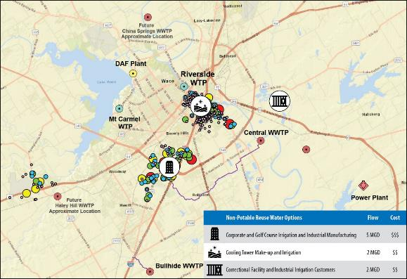
Examples
Evaluated
  Non-Potable options
  Indirect Potable Reuse
  Direct Potable Reuse
  Decentralized Reuse
Re-assess other areas and past recommendations
19
Notes:
In a reuse study with Waco, Texas, we followed those steps discussed in the reuse planning workflow and evaluated feasible options for non-potable, IPR and DPR as well as revisited recommendations made in the other master plans to make sure the City could be as efficient as possible with infrastructure, timing, and funding. We also are able to look at some potential creative projects, for example if there’s satellite facility that makes sense to service a cooling tower for a university since the WW collection line runs right by it and the WW plant is quite a bit further.

Slide 20
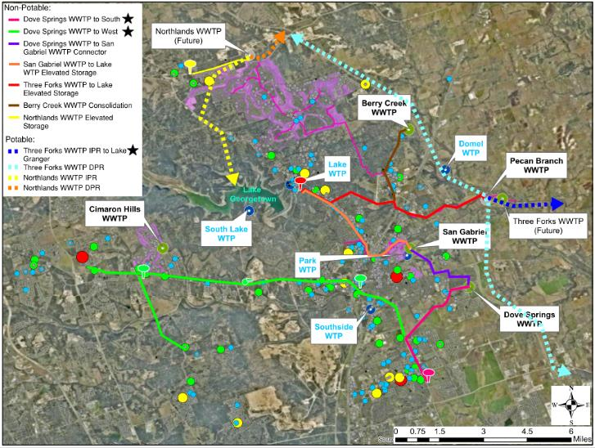
Provide Project Options
20
Notes:
In Georgetown, TX, we looked at a lot of different options, and developed a list of recommended projects based on feasibility. This map shows non-potable projects with the solid lines, and potable projects with the dashed lines. We then provided planning-level costs for each project and listed advantages and risks for each project. Only 2 projects will proceed to meet the target 8.4 MGD, but they now have a list of projects to pull from if things change, giving them flexibility and allowing for a robust and adaptable water supply.

Slide 21
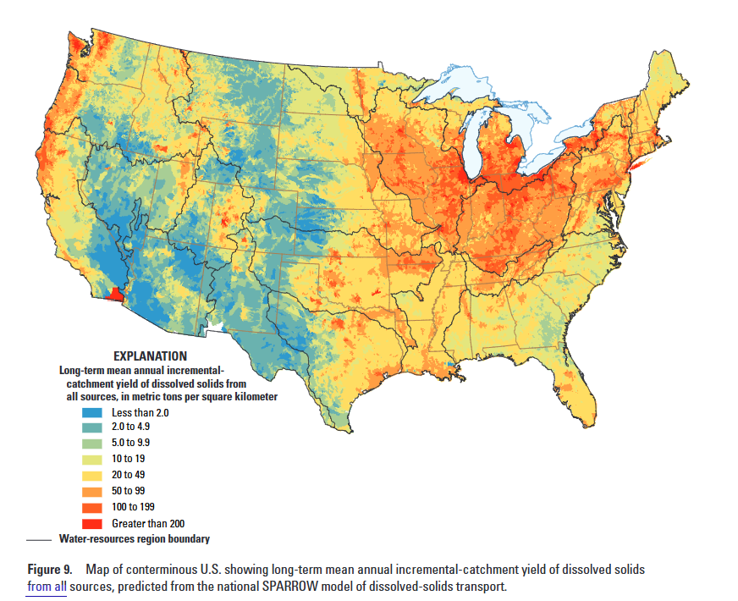
Emerging Challenges and Opportunities
Total Dissolved Solids (TDS) management
Potable reuse on the horizon?
Industrial Pretreatment
Parameter | Municipal Data | Industrial Request
TSS | 10-40 mg/L | <40 mg/L
E. Coli | <300 CFU/100 mL | <10,000 (<126*)
TDS | >600 | <400
Dissolved Solids Sources, Loads, Yields, and Concentrations in Streams of the Conterminous United States. National Water Quality Assessment Program. USGS. 2014
Notes:
As industrial end users utilize more recycled water, there can be a build up of TDS in the municipal wastewater system. Also, industrial end users often want lower TDS waters for processes like cooling. So, understanding the system mass balance for TDS is an important part of evaluating recycled water alternatives. Also, if potable reuse is on the horizon for a community, industrial pretreatment programs become source control programs – requiring more stringent discharge requirements and monitoring.

Slide 22
Tailoring to Your Needs
Countywide or Regional
City/Utility wide
Decentralized/ Sewer mining
22
Notes:
So….as you can see from just these few examples, there’s a wide range of projects and scope for reuse planning. The key is tailoring the planning efforts to meet the spatial, political, and technical requirements of your community.

Slide 23
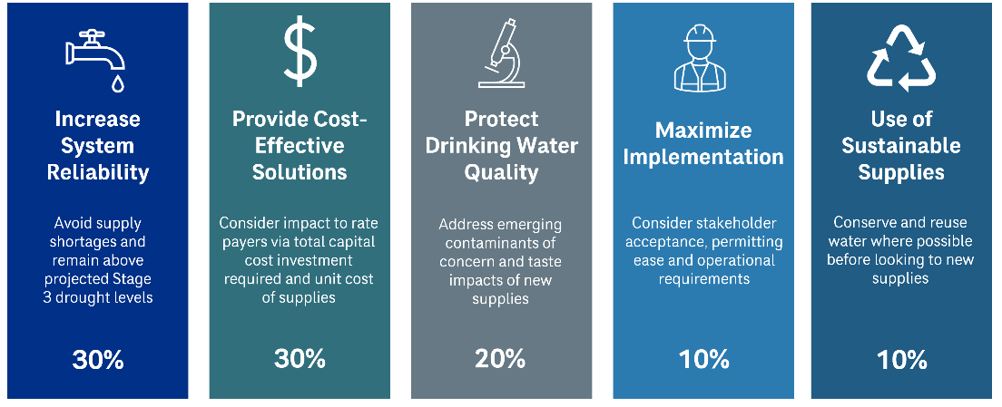
Take Aways
Avoid Supply Shortages
Feasible Projects Giving Flexibility
Shifting mindset for WW flows as a source
Utilize both non-potable and potable reuse projects
WW is a sustainable supply alternative –plan for the future!
23
Notes:
So as you can hopefully glean from this presentation, there are some great take-away benefits that doing some level of reuse master plan can provide a utility. (read slide)

Slide 24






“Thank You”s

Slide 25

QUESTIONS
Andrea Tom
tomam@cdmsmith.com
214-346-2858
Greta Zornes, Water Reuse Practice Leader
ZornesGL@cdmsmith.com
Jill Tedder, Southwest Reuse Discipline Lead
TedderJC@cdmsmith.com
John Sheets, Midwest Reuse Discipline Lead
SheetsJP@cdmsmith.com

Slide 26
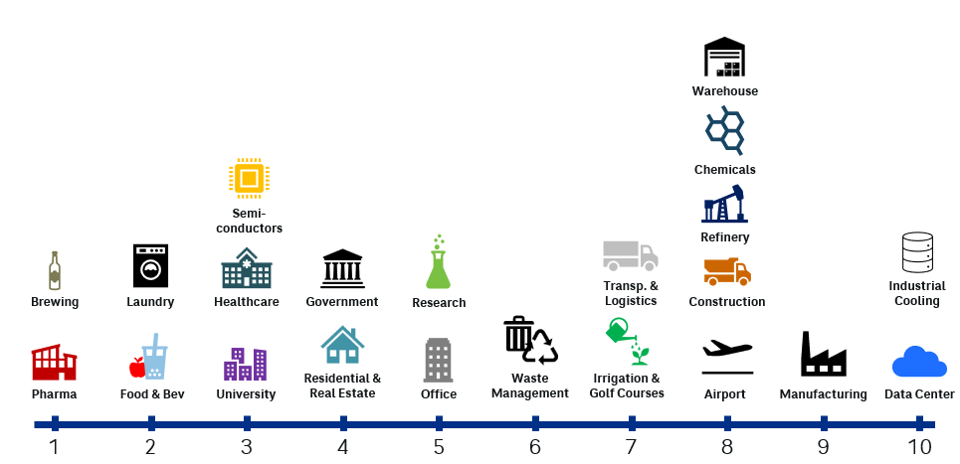
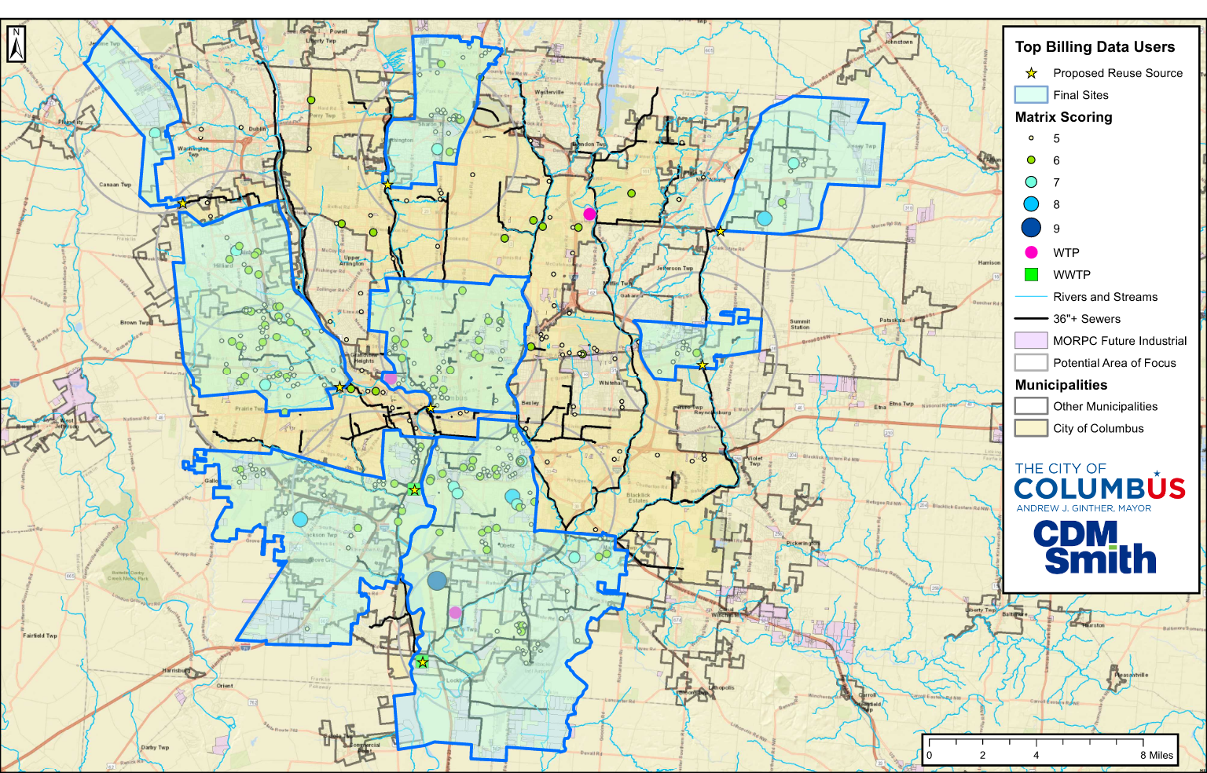
Market Analysis – Define the Users
Analyze & Map City Data
Identify Customers
Focus
Areas
Customer
Surveys
Area | Min. WW Flow | Future Demand | Distance | WW Quality | Rank
A |  |  |  |  | 3
B |  |  |  |  | 2
C |  |  |  |  | 1
Project Sites for Alternatives Analysis
Notes:
On the industrial side, evaluation steps are the same, but we have to do a more detailed definition of users. So we rank users based on a combination on how consistent their flow supply and demands are, their distance from the nearest reclaimed water source, and the water quality available and required for the specific purpose.

Slide 27
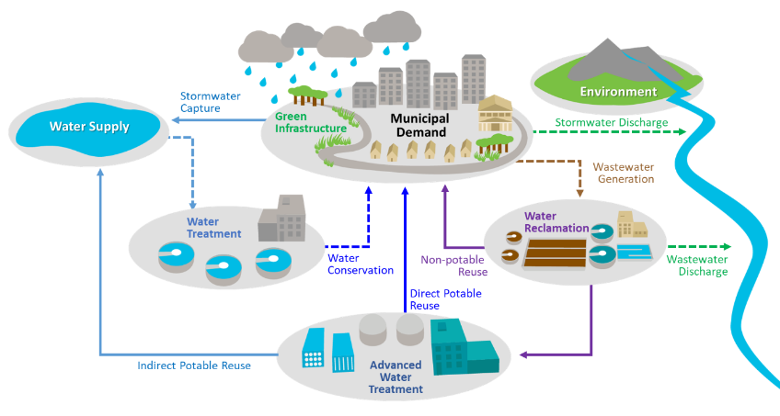
IWRP/One Water Approach
Integrated approach
Supply availability and risks, future treatment, and water supply conveyance needs
Identifies cost-effective, multi-benefit projects
Considers up to 100-year timeframe
27
Notes:
A closer look at the IWRP and One water shows how we can look at a community as a big water cycle that considers water, WW, and reuse under one umbrella. This allows the evaluation to focus on water supply availability and risks (for example, doing historical reservoir level review and running future drought and storm projections, identifying future treatment regulations (such as emerging contaminants) and water supply conveyance needs – for example if you have a great supply but it’s on the other side of the city as where growth is happening. Then with the assessment key takeaways, we can come up with a list of cost-effective and multi-benefit projects since there’s definitely potential overlap between water and wastewater. And lastly, we are able to consider a large timeframe, up to 100 years.

