Slide 1
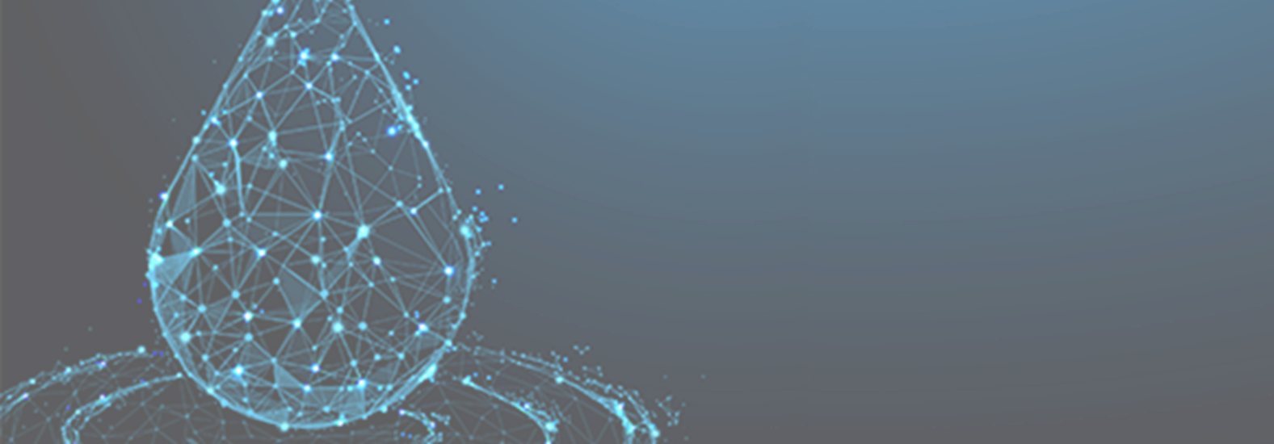


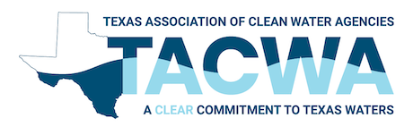
Corporate Water Stewardship:
Mitigating Data Center
Watershed Impacts
July 2025

Slide 2
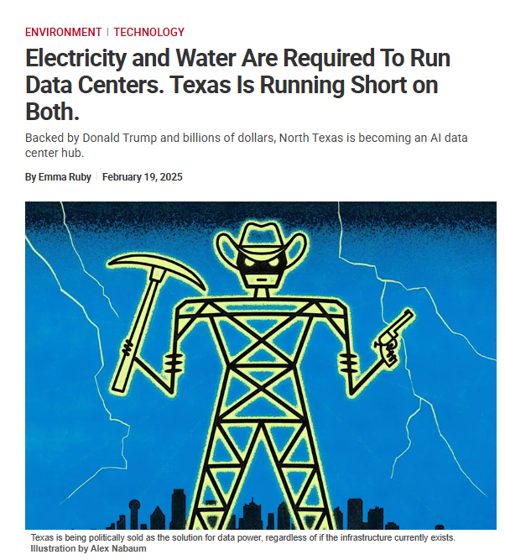
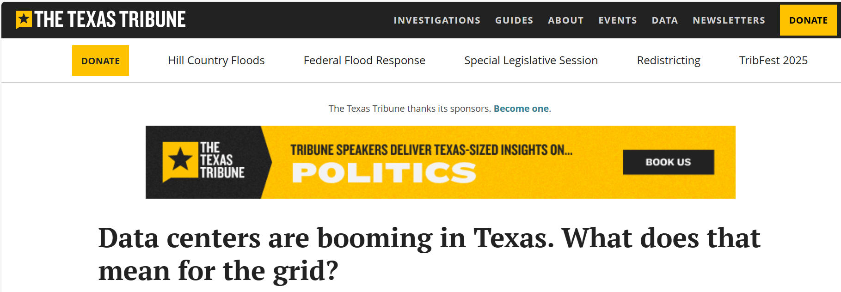
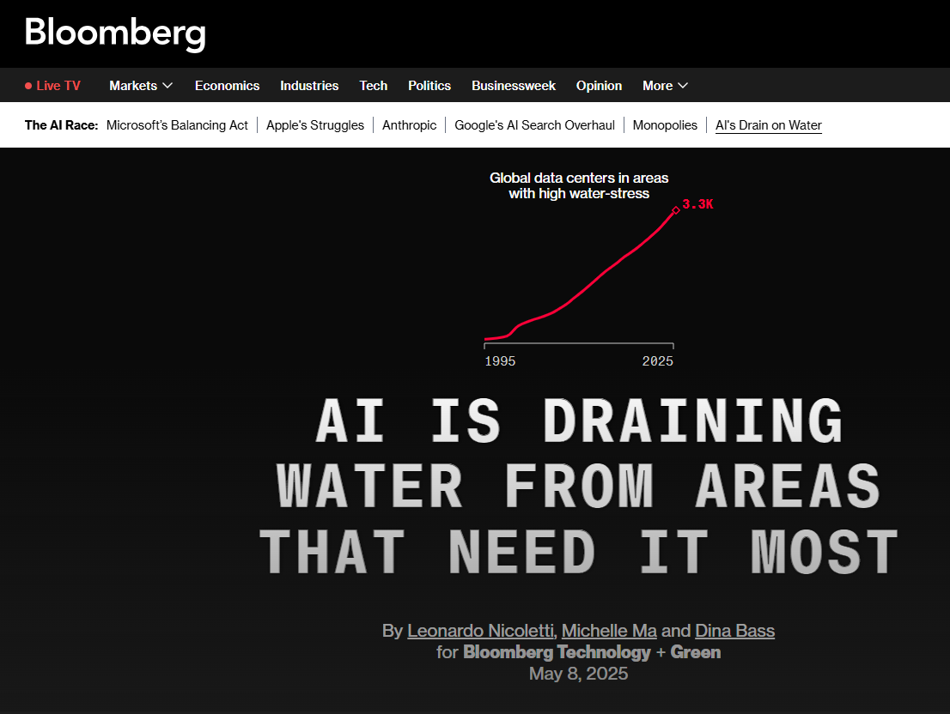
The Data Center Boom in Texas
Notes:
What comes to mind when you think about data centers
There is a lot of news and press about the water and energy needs of datacenters so lets explore what it actually means

Slide 3













Data Center Growth and Challenges
Setting the Context

Slide 4
AI is Driving a Surge in Data Center Demand
Cloud computing, AI, and big data analytics are driving growth.
Technology advancements mean further infrastructure needs.
Technology companies building these data centers are responding to a rapidly evolving and uncertain market.
Data center load growth has tripled over the past decade and is projected to double or triple by 2028.
Source: Lawrence Berkeley National Lab – 2024 U.S. Data Center Energy Usage Report
Notes:
Significant growth is driven by the increasing demand for cloud computing, artificial intelligence (AI), and big data analytics.
These processes require computers. Data centers are the facilities housing the physical infrastructure that makes AI possible.
Quote from 2024 U.S. Data Center Energy Usage Report
Advances in semiconductor technology are enabling faster processing speeds, more complex AI models, and further infrastructure needs.
Note numbers are difficult to predict, innovation to improve resource efficiency can play a big role.

Slide 5
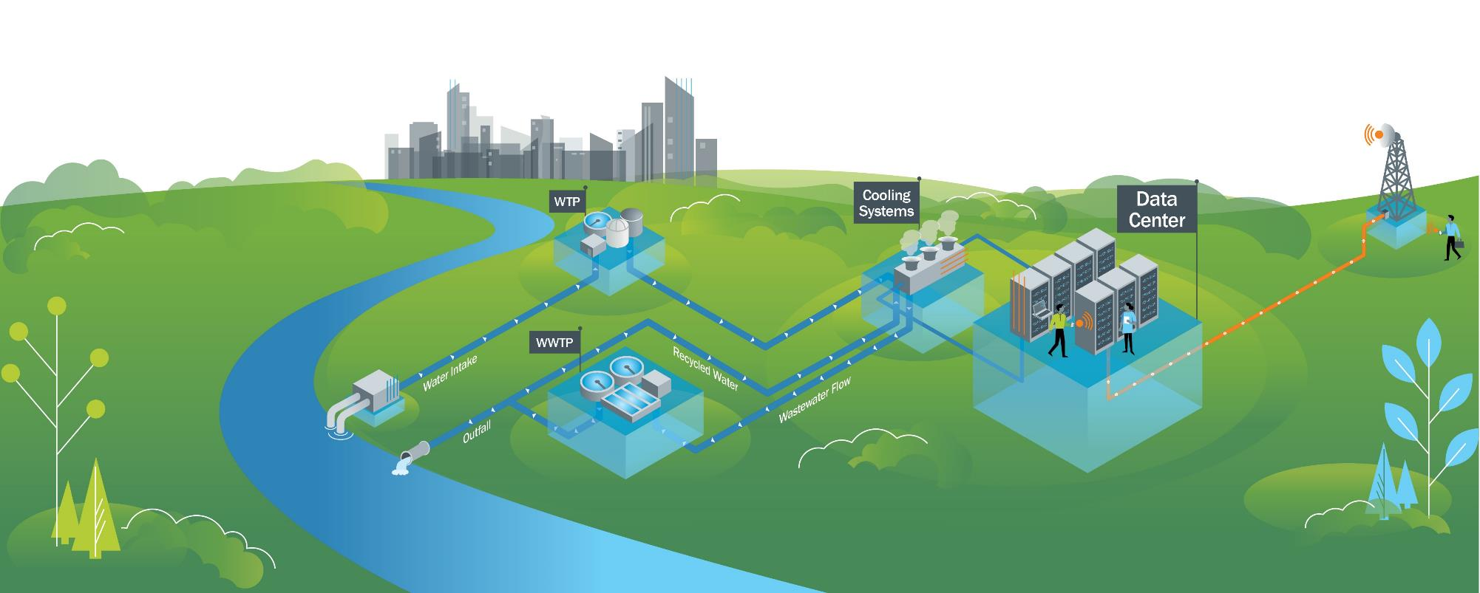
Data Center Water Lifecycle
Notes:
Here is what you may see if a data center comes into your service area

Slide 6

Data Center Water Lifecycle
Indirect water consumption for power production (depends on the power source)
Direct water consumption for cooling (depends on the cooling technology and local climate)
Notes:
For data centers using water for cooling, 98% of water demand goes to cooling system, 2% for domestic uses
Unpacking terms. ACC = air cooled chiller (water less), but uses more energy, so we need to consider indirect water consumption (from energy source). Liquid cooling = fluid (mineral oil, not water). Direct-to-chip liquid cooling and immersion cooling have become Increasingly popular choices for heat removal because of their efficiency, relative ease of deployment and scalability
[ACC work by drawing in ambient hot air from the surrounding environment and passing it over a heat exchanger. The X contains refrigerants, and as the air passes over the coils, it transfers its heat to the refrigerant, evaporating and absorbing the heat. The chiller does not generate cold; it dissipates heat, facilitates its transfer outside of the allocated space. ]
Wastewater is concentrated potable water

Slide 7
Corporate Water Stewardship

Slide 8
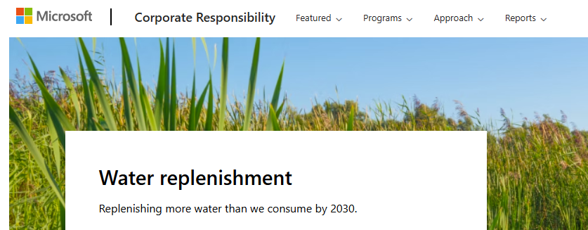
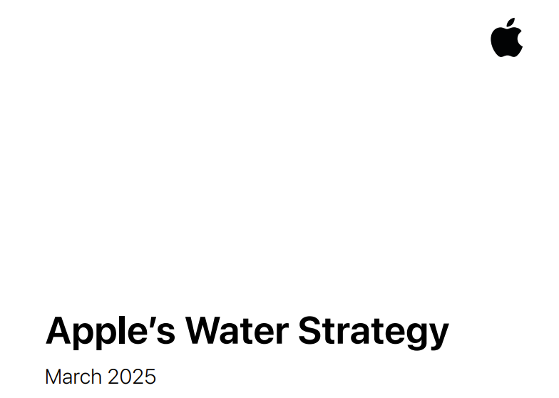
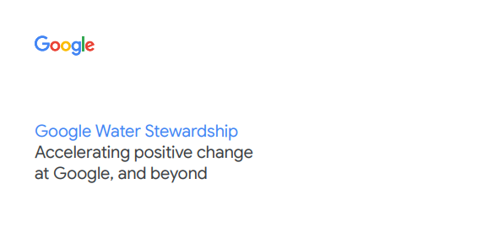
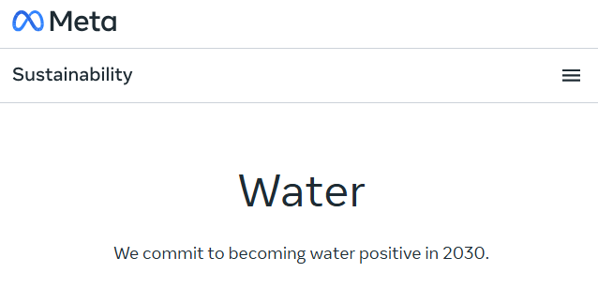
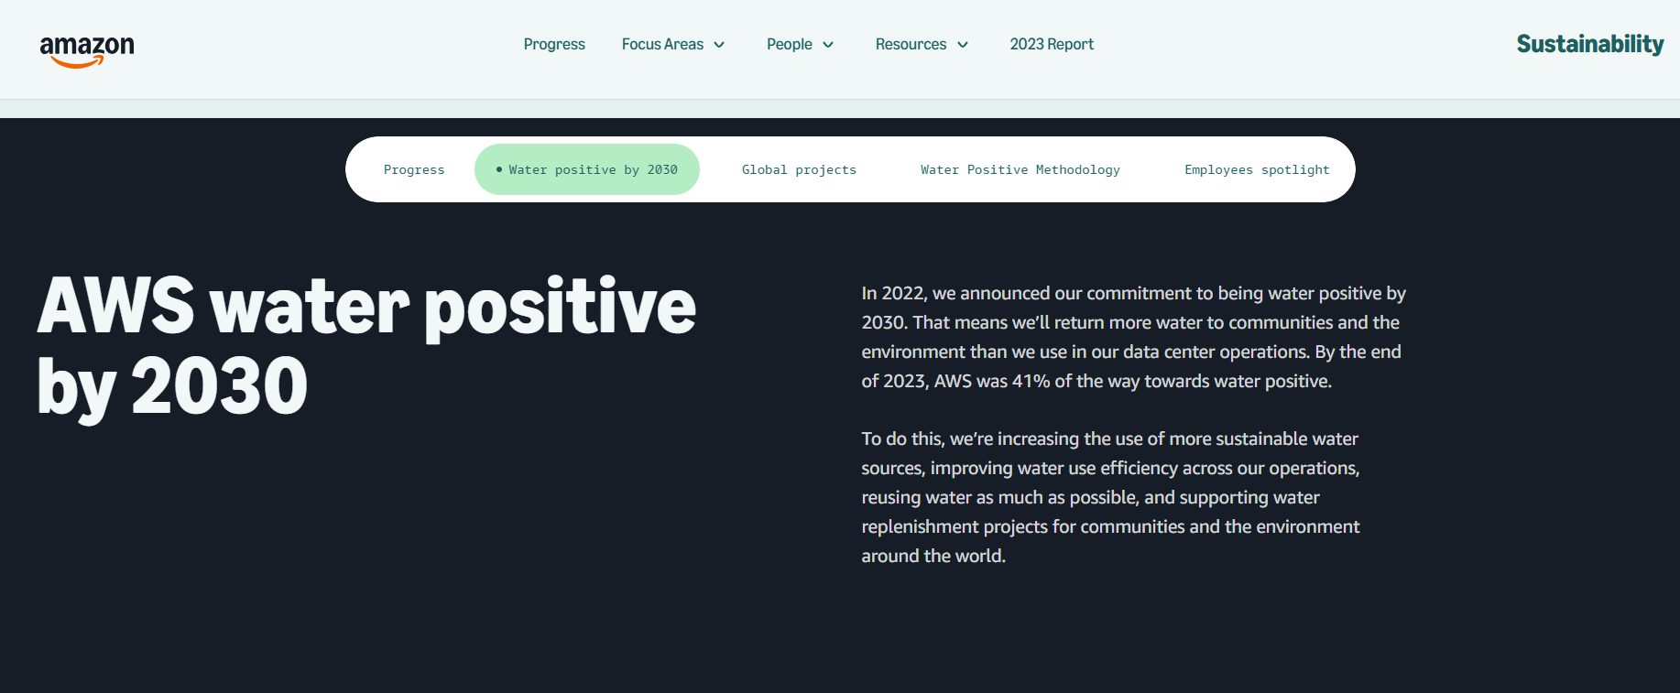
Water Stewardship Commitments
Water positive commitments
Restoring or “replenishing” more water than is consumed in operations
Improving water use efficiency
Collaborating with stakeholders
Notes:
The NA data center market is led by major players like AWS, Microsoft and Google, which are the same large corporations with CWS programs.
Tech sector corporations are enhancing their reporting efforts, largely driven by public pressure, the importance of brand image, and operational risks in water-stressed areas.
CWS commitments: 1) inside and 2) outside, which requires collaboration.

Slide 9
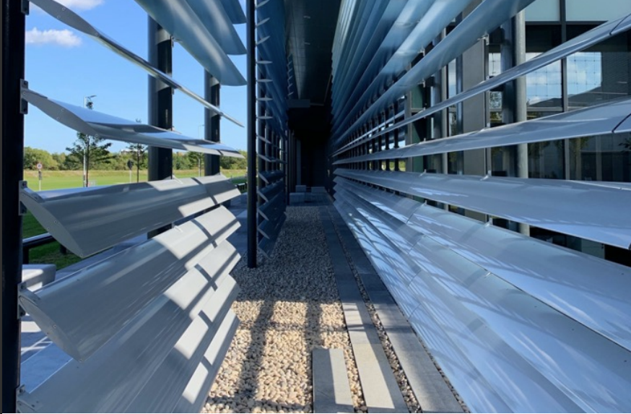
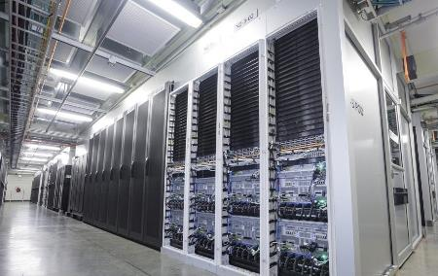
Inside the fence efforts: Water Efficiency
Case Studies
Meta
Piloted optimizing the relative humidity adjustments to lower the minimum from 30% to 13%, resulting in a 40% reduction in water use over 9 months.
Source: Meta Sustainability Case Study
Microsoft
Announced a commitment to zero-water liquid cooling solutions, using novel direct-to-chip cooling plates designed to use liquid coolants with lower energy requirements.
Source: Microsoft Sustainability Blog
Notes:
MSFT has already driven a reduction in data center cooling and power conditioning overheads with power usage effectiveness (PUE) as low as 1.12. Doing more requires a better understanding of the impacts of different cooling technologies, which can be provided by LCA. Microsoft quantifies environmental impacts of datacenter cooling from ‘cradle to grave’ in new Nature study - Source [reference to share]
Some companies have made the move to Air-cooled chillers, while others are investigating these new trends. [Water is still a much more efficient heat transfer medium. Water-cooled system may be more efficient than ACC, ACC may carry lower upfront cost but have higher energy demands.]
MSFT has investigated but is not currently using immersion cooling technologies in their operations (liquid PFAS, possibly making them unavailable in the future due to regs).
MSFT is already installing cold plates in its datacenters while also exploring other next-gen cooling techniques. Cold plates could be as good as the two immersion cooling methods.

Slide 10
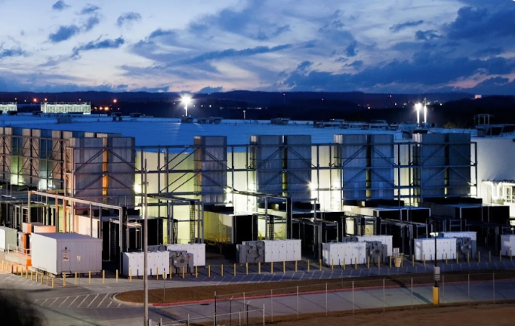
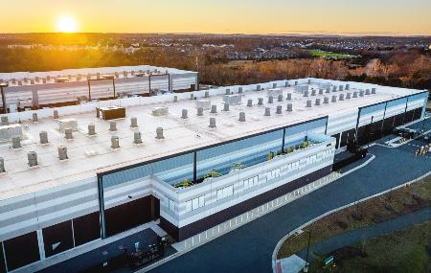
Inside the fence efforts: Reclaimed Water
Case Studies
Google, Douglas County, GA
Data center uses reclaimed water from the municipality for cooling purposes. Resulting wastewater is then treated at on-site effluent treatment plant and discharged into the Chattahoochee River.
Source: Google Sustainability Video
Amazon Web Services, Northern VA
Worked with Loudoun Water to become the first data center operator approved to use reclaimed water in combination with direct evaporative cooling technology.
Source: AWS Blog

Slide 11
Outside of the fence: Water Replenishment
Funding external projects through collaboration with stakeholders in the watersheds they operate in
NGOs
Utilities
Agricultural Community
“Replenish” = return water to the watershed that would otherwise have been lost.
Corporations are NOT attempting to make water available or acquire water
Notes:
To meet their water positive goals, corporations are also looking outside of their sites and making other investments in projects in watersheds they operate in that replenish water into the watershed.
Corporations are funding external projects to replenish the watershed, not acquiring water rights or making water available for their sites. The corporations are not seeking to own the water, rather to meet their water positive commitments.

Slide 12
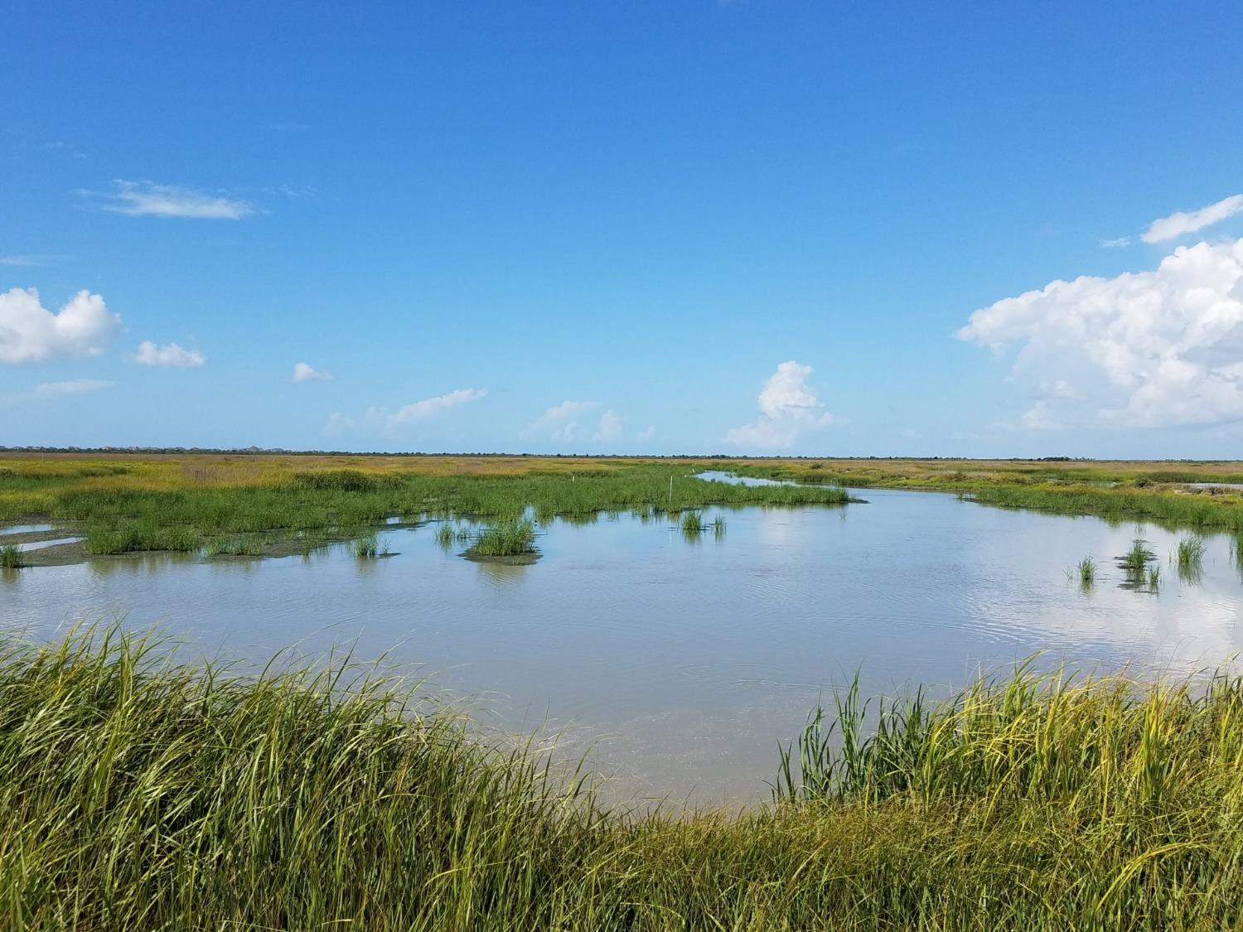
Water stewardship is a framework and set of practices that help businesses manage risks, cut costs, and build trust while promoting long-term water security for all.
CEO Water Mandate
Photo Source: Galveston Bay Foundation
Notes:
CWS, definition by prominent NGO.
WHY are companies doing this? WS is central to business resilience, risk mitigation, and long-term growth. [Businesses that adopt forward-thinking water strategies can turn risks into opportunities while strengthening their market position. ]
In the past, WS market has been dominated by NGOs working with corporates. In more recent years, there has been a recognition that utilities need to be part of the conversation.
Every industry depends on water and no company or government can build water resilience alone. --- collective action!

Slide 13
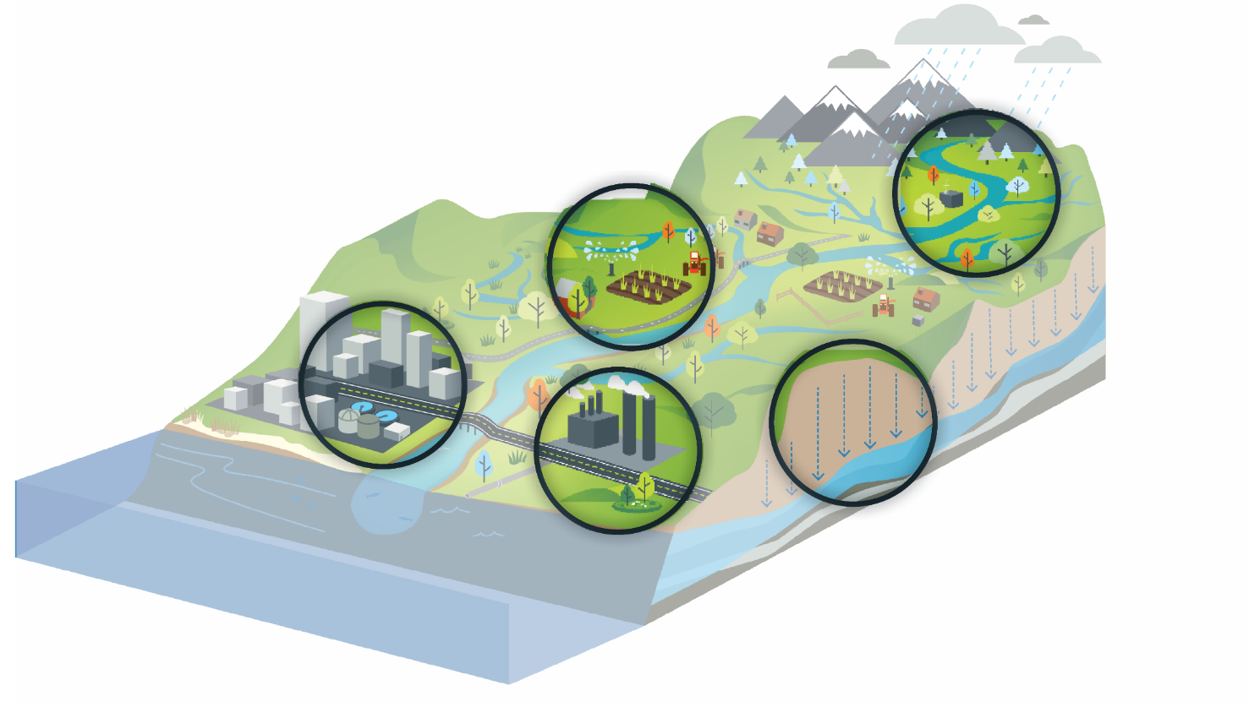
Example Projects
Source Protection and water quality improvements through NGO or Non-profit connections
Agriculture water management through NGOs and the Agriculture community
Municipal or Agency Utility collaborations for Water Efficiency and Water Reuse
Groundwater Protection with Aquifer Storage and Recovery and collaboration with Water agencies
Collaborative solutions through industrial Water Reuse
Notes:
Turning aspiration and commitments into real-world watershed outcomes
Connect corporate program goals to community objectives
Identify projects
Demand reduction/conservation​
Groundwater recharge​
Water reuse/ reclamation​
Water quality improvements ​
Stormwater capture and reuse

Slide 14
Google’s Corporate Water Stewardship Program
Notes:
BC has been working in this space since 2019
Supporting one of our clients for this RFI which is specifically tailored to utilities

Slide 15
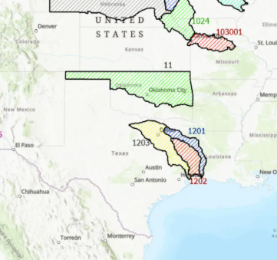
Google Corporate Water Stewardship RFI
Seeking to fund projects in the Trinity River watershed
Do not have to be within the boundaries of the watershed, only connected.
All y’all are eligible to apply!
Notes:
Turning aspiration and commitments into real-world watershed outcomes requires a rigorous and detailed program, a diverse multidisciplinary team, and intention to succeed.
Connect corporate program goals to community objectives
Identify projects

Slide 16
Finding the Right Fit
CORPORATION
UTILITY
Shovel-ready
Other benefits
Replenishment Volume
Other funding
available
Cost/MGY
Meets Schedule
Partnership
Notes:
Aligned with community goals e.g. regional water plan or city plans
Over 100 MGY
Construction to begin before 2028
Funding moves quickly and Google wants certainty in projects so projects that have progressed in design are ideal candidates
Other funding available – this means that with google’s contribution there is adequate funding from the utiltiies or from state funding sources etc. for the project to move forward
Google also considers co-benefits of the project. Co-benefits improve the chance for projects to move forward

Slide 17
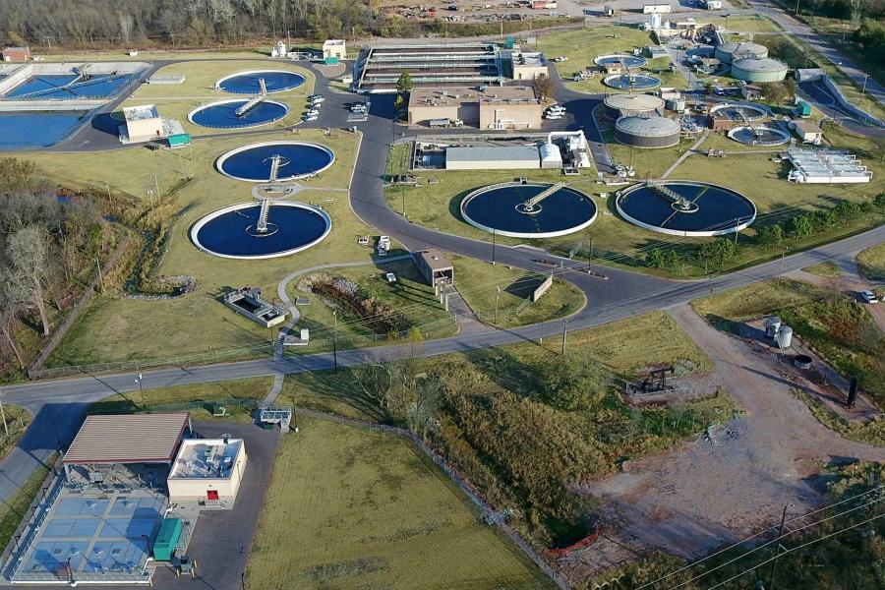
Connecting Private Funding to Public Projects
How It Can Work:
Google and City of Norman
City of Norman, OK Water Reclamation Facility
Google provided $500K grant for on-site non-potable reuse (offset potable demand starting 2026)
Supporting State of Oklahoma’s Water for 2060 Goal and Google’s 2030 Water Positive Goal
Notes:
Google has a 2030 Water positive goal to replenish more water than consumed in their operations.
Oklahoma not typically considered a water scarce region, but the state is focusing on improving water infrastructure and management, including a goal of consuming no more fresh water in 2060 than was consumed in 2012, despite growth.
Alignment of goals!
BC connected with Oklahoma Water Resources Board, who helped us identify innovative/forward-looking utilities in the state, connected with the City of Norman.
City of Norman has been doing some innovative research and exploring potential reuse options, this project was identified as a low-hanging fruit.
There was some existing infrastructure in place as there was a non-potable system previously used on-site that had to be abandoned due to other major construction projects.
There was no plan to bring the system back online until the opportunity of private funding allowed the utility to prioritize this project.
Non-potable water will be sourced directly from the Water Reclamation Facility’s effluent and used for cleaning and maintenance, cooling water, process water, and compost irrigation.
Funding available = $100K to $5M
Google facility is not within the City of Norman’s service area, but has a goal to address regional water challenges throughout the Arkansas River basin.

Slide 18


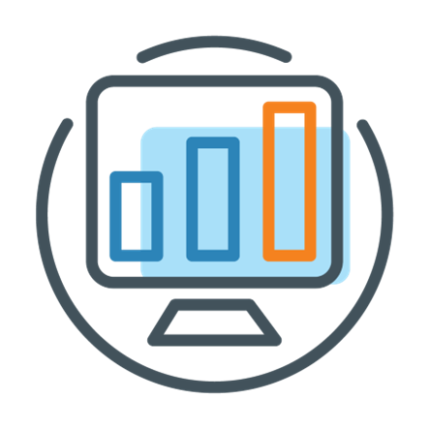
Advantages of Leveraging CWS Funding
Easy Application Process
No Cumbersome Stipulations
Simple Reporting Requirements
Notes:
Simple submission of the google form
Projects are selected for investment after evaluating the project and validating the water volume benefits
Funding is issued as a grant – no strings attached.
Funding contract is reviewed by both parties
No requirements for procurement, etc
ICONS

Slide 19
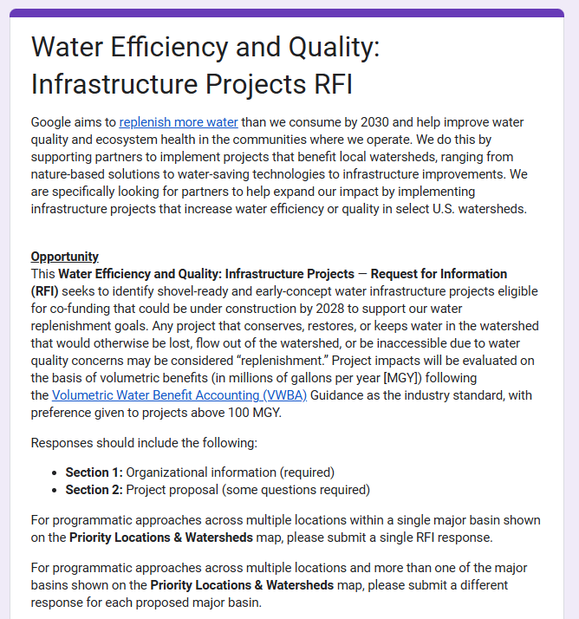

Submit Projects
Round 1 RFI submissions due September 30, 2025
Questions? Reach out: HMorriss@brwncald.com
Notes:
BC is helping Google to identify projects that may be good candidates for their CWS Program
Help you define your projects and metrics
Submit projects to Google on your behalf
Answer questions

Slide 20


Thank you.
RFI LINK:
Questions?
HMorriss@BrwnCald.com

Slide 21
