Slide 1
Process Simulation: the Modern-day Tool Kit for Process Designs
Prachi Salekar, PE
Process Engineer

Slide 2
What to Expect
Evolution of Process Design
Why Modelling?
Process Modelling Application: Examples
Benefits of Using Models
Common Pitfalls
Takeaway Message
Notes:
The focus of today’s presentation is Process Simulation as modern day toolkit and I would be going over the progression over the years in the process design, the reasons why you would do modelling, some case-studies to further talk through the whys, things to keep in mind, with some closeout thoughts.

Slide 3
Evolution of Process Design
“Rule of Thumb” Approach
Empirical Approach
Kinetic Equation Approach
Modelling Approach
Notes:
So, starting with evolution of process design. Let’s take a step back and look at how process design for wastewater treatment has evolved over time.

Slide 4
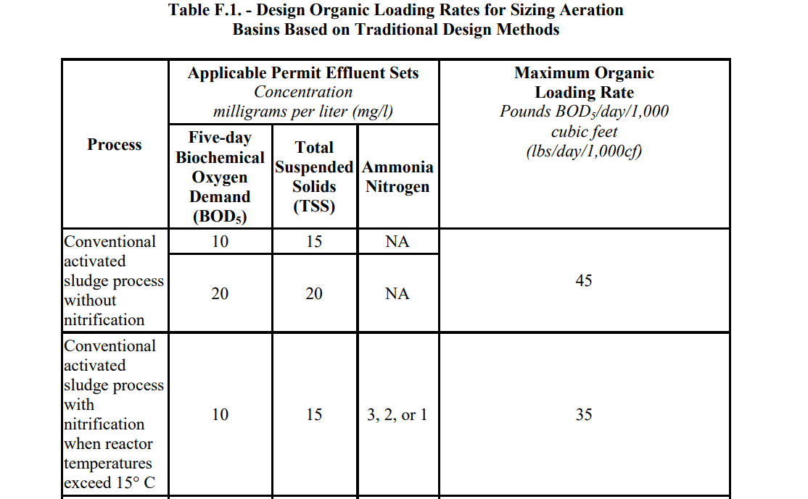
“Rule of Thumb” Approach
E.g. TCEQ Guidelines or Ten States Standards
Process should work well below a certain loading rate.
Loadings established based on many years of experience.
“Tried and true” rules of thumb.
Notes:
We started with rules of thumb, which are simple and experience-based estimates. TCEQ Regulations or Ten States Standards like the one over here is commonly used as it provides values which are tried and hold true for most design applications. For instance, we know if were to design an activated sludge system with nitrification and design it based on the 35 lbs/1000cf of organic loading rate, it is going to work just fine. So, simple yet effective.

Slide 5
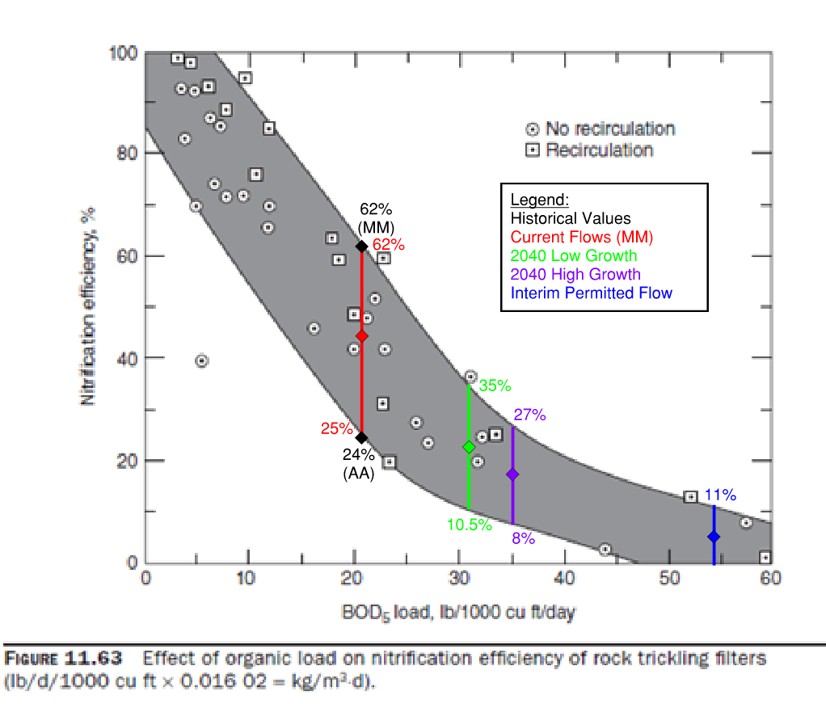
Empirical Data Approach
Design Curves
- E.g. Trickling Filter Removal Rates
Data points are actual performance values for several plants
Gray area shows range of expected performance
Notes:
The next one is the empirical approach. In the early 90s, the US EPA went out and collected actual performance and operational data from several full-scale plants across the US which was then evaluated and used to develop design curves for trickling filters, primary clarifiers and many more.
Unlike the rule of thumb approach where you relied one one value to design for, these curves allowed the engineers to adjust performance based on the loading rate giving some design flexibility. This approach still relied on experience-based data.

Slide 6
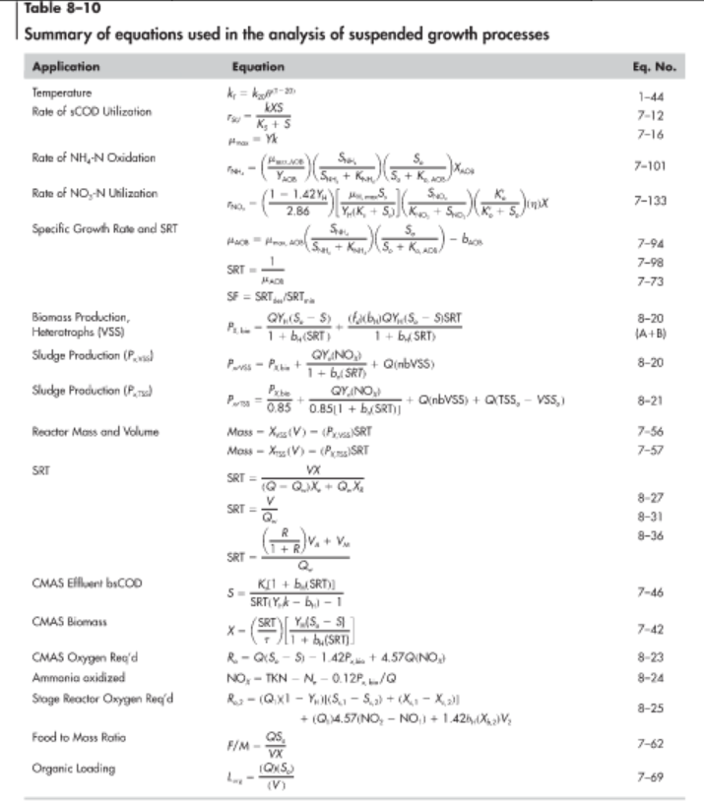
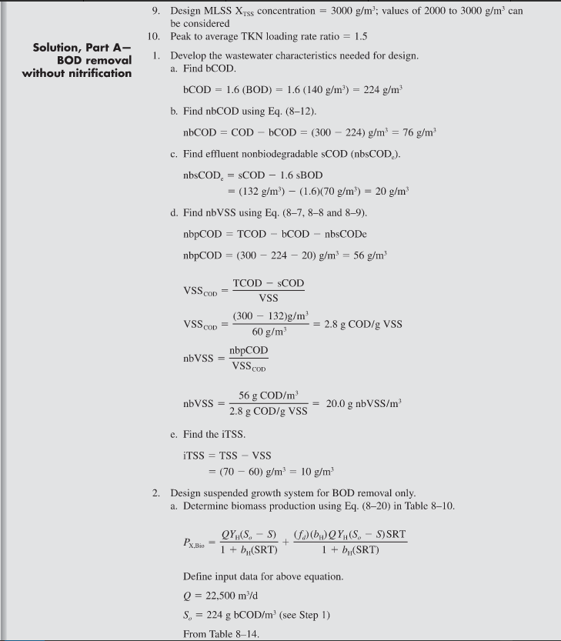
Kinetic Equation Approach
Metcalf & Eddy – Example using the biokinetic equations
Monod Equation
Derivations from the monod equation
Zoom in on the sludge estimation equation
WAS Production
Notes:
But empirical curves don’t quite explain why performance varies, and that’s where kinetic equation approach came in, which dives deeper into understanding the fundamentals of wastewater. We’ve all seen these long, equations starting from a simple Monod rate equation to complex derivations of the same, and probably the last time we’ve used it was in school. This is definitely a more sophisticated way of doing design, but not always the most convenient or user-friendly.
Here I have an example from Metcalf And Eddy, which most of us have used in our design class in school. This is especially helpful when you design for nutrient removal. But there is one major limitation, kinetic equations assume steady state conditions, in reality wastewater plants are anything but steady,

Slide 7
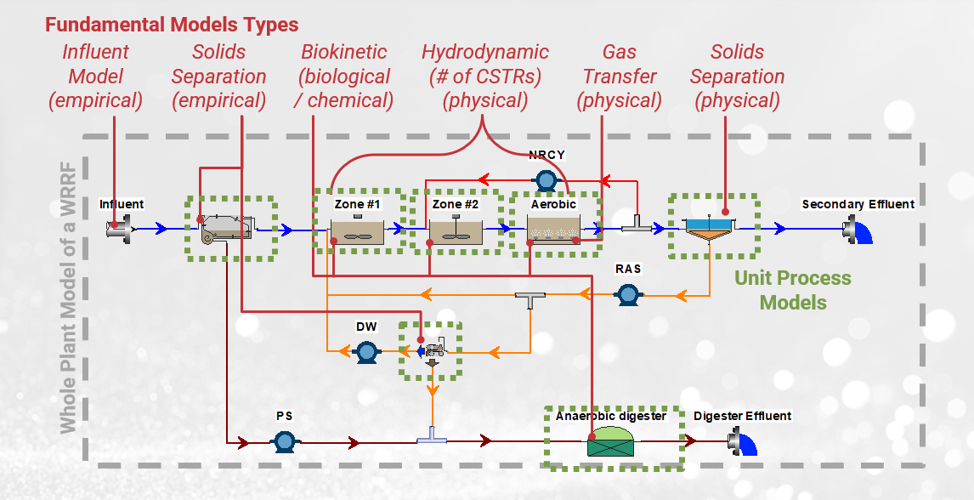
Use of Process Models
A sophisticated method combining both empirical and biokinetic equations
Notes:
Which brings us to use of process simulators and models, where they’ve taken all the fundamental equations and implemented it all into the process simulator. So, it not only included the biokinetics for biological treatment, but it also incorporated the solids separation sub-models for primaries and secondary clarifiers. Thus, providing a much powerful tool for the overall wastewater treatment design in a modular, and efficient way which was also accurate. So, while you can still do a lot of this in spreadsheet, it was just more convenient and user-friendly and saves a lot of time.

Slide 8
Why Modelling?

Slide 9
Why Modeling?
Cost Benefits
Modeling for Design and Operations
    Simple applications
    More complex applications
Favorable Approach for Nutrient Removal

Slide 10

Cost Benefits
Modeling is cheaper than piloting
Modeling is much cheaper than full-scale
Try things in Virtual Space before trying it in Real Space
Photo by Celyn Kang on Unsplash
$5k-$100k
$100k-$2M
$2M - ???
Model
Pilot
Full-scale

Slide 11
Modelling both Simple and Complex Scenarios
model
input
?
… predict
?
input
output
… understand
Can help bridge gaps in the data – useful for mass balancing.
model
input
output
… communicate
Notes:
First models help us to predict. We can simulate different flows and loading scenarios, seasonal variations, or what might happen if we change process configurations. This predictive capability is essential for planning upgrades and expansions.
Second, they help us understand. Sometimes, we have data gaps- or things just don’t add up. A model helps fill in the blanks through mass balancing and identifying inconsistencies, which is especially helpful during troubleshooting.
And finally, models are powerful communication tools. Whether it’s showing a client how a change will affect effluent quality or helping operators visualize what’s happening biologically, models make abstract processes easier to convey. Different parts of the plant interact with different data

Slide 12

Favorable Approach for Nutrient Removal
Plantwide Mass Balances
BNR design
Dynamic models give us max/min and averages
  Blower sizing
  Diffusers
  Pumping
Sensitivity analyses
“…modeling is the recommended approach for designing WWTP upgrades for biological nutrient removal (BNR) because of (1) its flexibility in enabling designers to quickly test many different configurations and operating scenarios and (2) its ability to simulate treatment performance under a wide range of conditions using dynamic modeling.”
Notes:
And Lastly, as nutrient limits become more stringent, and utilities look for designing upgrades for biological nutrient removal, models make it super convenient to test out different scenarios and configurations. The US EPA also recommends this as a favorable approach.

Slide 13
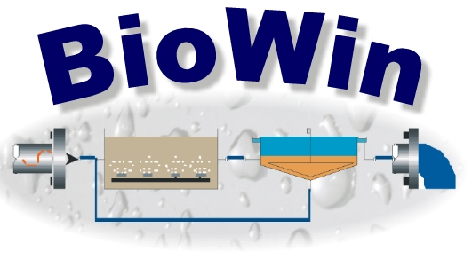
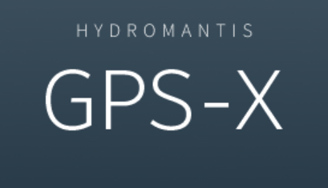
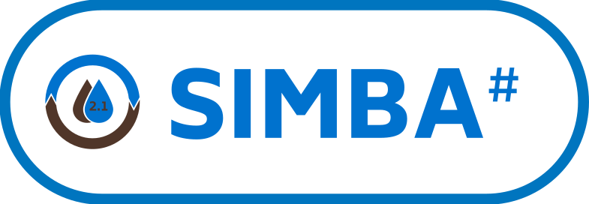

Simulator Options
BioWin (Envirosim)
GPS-X (Hatch/Hydromantis)
SIMBA# (IFAK / InCtrl Solutions)
SUMO (Dynamita)

Slide 14
Process Modelling Application Examples
Notes:
I have three case studies to varying from simple to increasing the complexity on the application which help demonstrate how process modelling can be used as a tool for design.

Slide 15
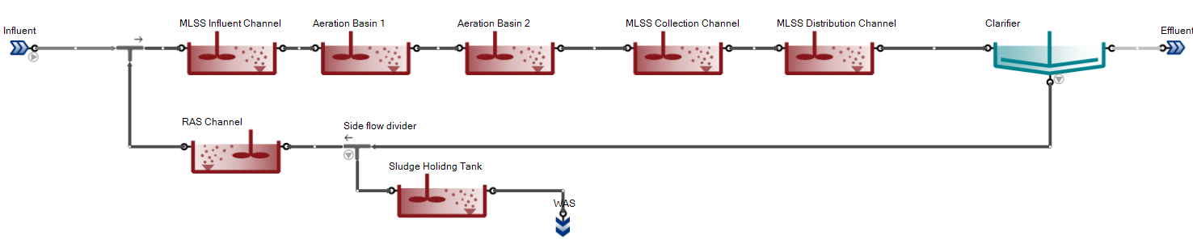
Treatment Plant Expansion (Houston Area)
Problem Statement- Waste Activated Sludge Pumps and Blowers Sizing
Approach
Size the basins based on TCEQ guidelines
Set up a calibrated model using design criteria
  Set up the SRT tool in the model to estimate WAS
  Extract Oxygen Uptake Rates (OURs) for the airflow calculation
Notes:
The first case study is a project we did for a utility in the Houston Metro. The problem statement seems straightforward, the plant will be expanded to handle future flows and loads and would be adding newer aeration basins and clarifiers. While we sized the basins based on TCEQ guidelines, we also built a simple process model to confirm the design but primarily to estimate the WAS and airflow requirements. We set up a SRT tool to control the wasting rate and estimated the wasting pound per day for different flow and loading scenarios. Similarly, set the desired DO concentrations for the channels and basins and estimated the oxygen uptake rate. Now, sizing WAS pumps and blowers can also be done using the traditional methods, but a model provides a more accurate range of operation on the flows, concentration . It allows us to test different operational scenarios, for instance we can always check how the wasting rate would change if I change my SRT or decrease flows.

Slide 16
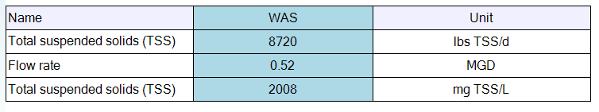
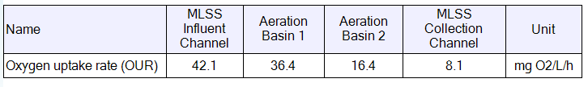

Treatment Plant Expansion (Houston Area)
WAS Pump Sizing
Blower Sizing
Model Outputs
Model Outputs
Operational Range
Concentration : 3000 to 6500 mg/L
Flow: 160 to 520 gpm
Operational Range
Airflow: 8100 to 15500 scfm
Model Benefit - More Accurate WAS Pump and Blower Sizing.
Notes:
Tend to oversize the blowers, so you save money sizing the right blowers

Slide 17

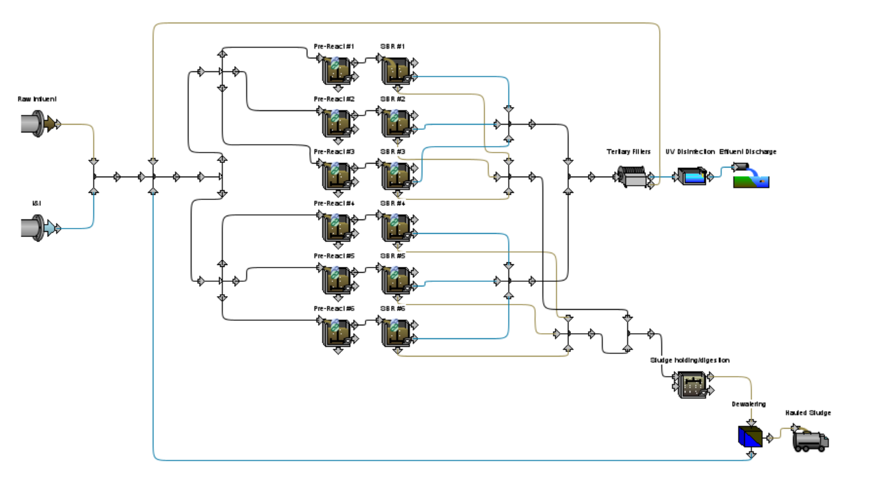
City of Pearland – Barry Rose WRF
Problem Statement – Modelling dynamic nature of a Sequencing Batch Reactor (SBR)
Approach –
Set up a calibrated SBR model and confirm the sizing and sequencing of the SBRs, blower requirements and WAS production
Notes:
The next case study that I’ll present is the work we did for City of Pearland where we designed the Sequencing Batch Reactors as a part of their recent expansion.
Wastewater flows and loads are never truly steady with diurnal and seasonal variations, but in conventional activated sludge systems, we can often get away with steady-state design assumptions. But with SBRs, it’s little different as the process itself is so dynamic. You are filling, reacting, settling, decanting and also wasting in time-based cycles all in the same tank. This makes it harder to apply the steady state assumptions accurately.
Air on/off, settling
The project that we did for Barry rose, we were adding six SBR basins as part of the expansion. We built a process model with six SBRs each operating in a different phase of the cycle at any given time. So, the complexity was not just modelling the timed cycles for one SBR but also operating the six basins simultaneously. Using the dynamic feature of the process model, really help understand what was happening in the different cycles and the real-time data plotting help optimize the cycle timings a bit more.

Slide 18
Barry Rose WRF Process Model

Slide 19
Barry Rose WRF - Diurnal Flow Factor

Slide 20
Oxygen Uptake Rates (OURs) (24-hr Cycle)
Model Benefit - Optimizing the blower sizing to match the dynamics
Notes:
There are periods in the day where the air is on and some when it’s off, and that feeds into the
Different peak demands thru the day, but even in a single cycle there is high at first and slowly drops down, so variations in both in a cycle and thru the day

Slide 21

Gulf Coast Authority– Bayport Facility
Problem Statement
Model a Pure Oxygen and Air Activated Sludge System for an Industrial Facility
Investigate Effluent Elevated Ammonia
Notes:
For the Gulf Coast Authority, as part of the Masterplan, we built a model for the entire facility to look at the capacity assessment and evaluation for their future flows and loads.
Two aspects of the model we’d like to talk about
Set up the model
Investigate

Slide 22
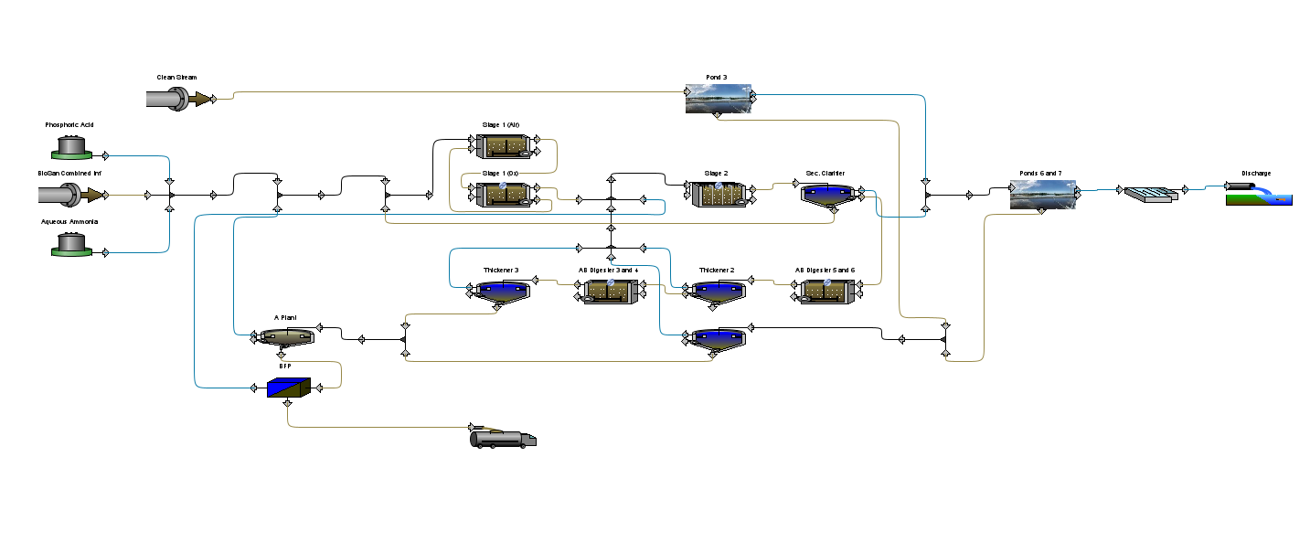
Bayport Facility Process Model
Combination of “Clean Stream” and Biologically-treated Stream
Modelling an Oxygen and Air System Together
3
2
Influent + Track Nutrient Requirements
1
4
Repurposed Tankage for Biosolids Handling
Notes:
Bayport is a complex facility and I’d to highlight some features
Firstly, we built a calibrated model for their Bayport Facility which is an industrial treatment plant receiving flows from several industrial users in the Pasadena area. Because it’s not the typical domestic wastewater, they have to dose ammonia and phosphorus on a regular basis to support the biological treatment. So, we added ammonia and phosphorus dosing which allowed the plant to track the nutrient needed with changing influent loads.
Secondly, first stage reactor has a combination of aeration and pure-ox system and we modelled that. (joke)
Added complexity- they repurposed old tanks from the original plant for biosolids, by having that in the model it helps us track the mass balance of solids from the solids treatment but also for the entire plant.
They are adding ammonia as a nutrient but they also have to remove it in the plant and they sometimes get elevated effluent ammonia, so we did an investigation.
assessing a system which has both aeration and pure oxygen system in the same basin becomes difficult, but modelling allowed to model it as a same sludge system while also allowing the flexibility to control and monitor the oxygen requirement on pure oxygen and aeration system, something that is not possible with any other approach. This being an industrial facility, had two types of streams, one was the main stream which required the biological treatment, while the other stream could just be added

Slide 23


Elevated Ammonia Investigation
Potential Cause | Approach | Model Findings
Ammonification Rate Low | Adjusted Ammonification Rates | Increased Effluent TKN not NH₄-N
Inhibition of Nitrification | Altering Half-saturation Coefficient | Increased Effluent NH₄-N
Competition with Heterotrophs | Nutrient N, P Deficiency | Increased Effluent NH₄-N
Model Benefit- Enabled to narrow the focus as the client is looking for answers
Notes:
Look under the hood- to see what might be causing the elevated ammonia
Two main ideas
1. Ammonification – no response to
Inhibition- we replicated the effluent ammonia
Bacteria that removes carbon (heterotrophs) and bact that oxidizes nitrogen (nitrifiers) – dig deeper into the population of hetetrotrophs and nitrifiers
Manipulate it in the model to artificially increase the effluent ammonia
So no concrete conclusion but narrowed it down to two possible reasons which can be explored further

Slide 24
Benefits of Using Process Simulators/Modeling
Modeling is cost-effective
Models useful for simple calculations
    Sludge Production and Airflow Requirements (1st case-study)
    Dynamic models give more information on ranges (2nd case-study)
Models for more complex applications
    Investigation or troubleshooting (3rd case-study)

Slide 25
“Rule of Thumb” Approach
Empirical Approach
Kinetic Equation Approach
Modelling Approach
Process Modelling: Modern Day Tool
Sophisticated tool to take care of simple and complex process questions

Slide 26
THANK YOU!
Contact Information:
Prachi Salekar
salekarpa@bv.com

Slide 27
Common Pitfalls
No Safety Factor. Ideally there is little or no safety factor in model. Engineering Judgement is necessary to know how “close to the wire” to push model.
Garbage In Equals Garbage Out. Need high quality data or compensate w/ more safety factor.
Adjusting the Appropriate Parameters. Models are “overparameterized” meaning there are many parameters which can be adjusted to reach the same result. Need judgement to know which parameters to adjust so that model is predictive and not just fit to the calibration dataset.
What Simulators Cannot Tell You. Using models to predict something they don’t predict (well).
Considering Minimum Conditions. Not considering startup/minimum conditions in design.
False Precision in Control Capability. Modeling in a way that the operators cannot operate.
Defining Worst-Case Conditions as Highest Loading. Worst for capacity (high load low temp) not worst for aeration (high load high temp) or BNR performance (low COD:N and COD:P).
Focus on Configurations that Conform to Modeling Capacity. Bias towards processes that are easier to model when selecting process technologies or strategies.

Slide 28

Modeling for Operations
 | OPERATION
7 | Optimise Aeration Control
 | A model is developed for an existing activated sludge plant with basic DO control. The model is used to adjust or modify the aeration control system to achieve one or more of the following goals: reduce energy costs; reduce greenhouse gas emissions (including N2O); maximise treatment capacity; maximise effluent quality.
8 | Test Effect of Taking Tanks Out of Service
 | In this application a model is developed for an existing plant to be used to test the effect of major process changes such as taking tanks out of service for maintenance or construction activities. The model is used to test if the change will cause the plant to fail its effluent requirements for ammonia, total nitrogen or total phosphorus (on a monthly or annual average basis).
9 | Use Model to Develop Sludge Wastage Strategy
 | A model is developed for an existing activated sludge plant to investigate different sludge wastage strategies. Different wastage frequencies, quantities and control strategies are tested. The investigation will look at the stability of the activated sludge treatment system, the quantities and scheduling of sludge produced and the potential impact on sludge treatment processes.
10 | Develop A Strategy to Handle Storm Flows
 | A model of an existing plant is constructed and it is subjected to storm flow conditions. Different control strategies are tested on the model to determine which provides the plant with the best ability to cope with storm conditions. The focus of the investigations is on the ability of the control strategy to provide process robustness to mitigate the effects of storm conditions (e.g. peak effluent concentrations are reduced) and the speed with which the plant recovers from the effects of the storm.
 | TRAINING
11 | Develop a General Model for Process Understanding
 | A model of an activated sludge plant is constructed for the purpose of training operators, engineers and/or other personnel to help increase their process understanding. The model may be based on an existing plant or it may be purely hypothetical. The model will be used for a 1-hour training session and the level of effort considered includes time to produce presentation materials.
12 | Develop a Site -specific Model for Operator Training
 | A model of an existing activated sludge plant is constructed. The model is used to train operators, engineers and/or other personnel on the impact of making process changes to their plant. The model and presentation material are used to provide a total of 8 hours of training including some interactive "hands-on" work and model demonstration runs.
Training
Troubleshooting
Optimization (?)

