Slide 1

UV Disinfection Design and Procurement Guidelines
Andrea Tom, PE

Slide 2
New UV Equipment Steps
Understand Influent and Effluent Water Quality
Establish Design Criteria
Proper Sizing
Procurement
Design Considerations
Construction, Start-up, and Testing

Slide 3

Understanding Water Quality and Establishing Design Criteria
Notes:
They are interrelated

Slide 4
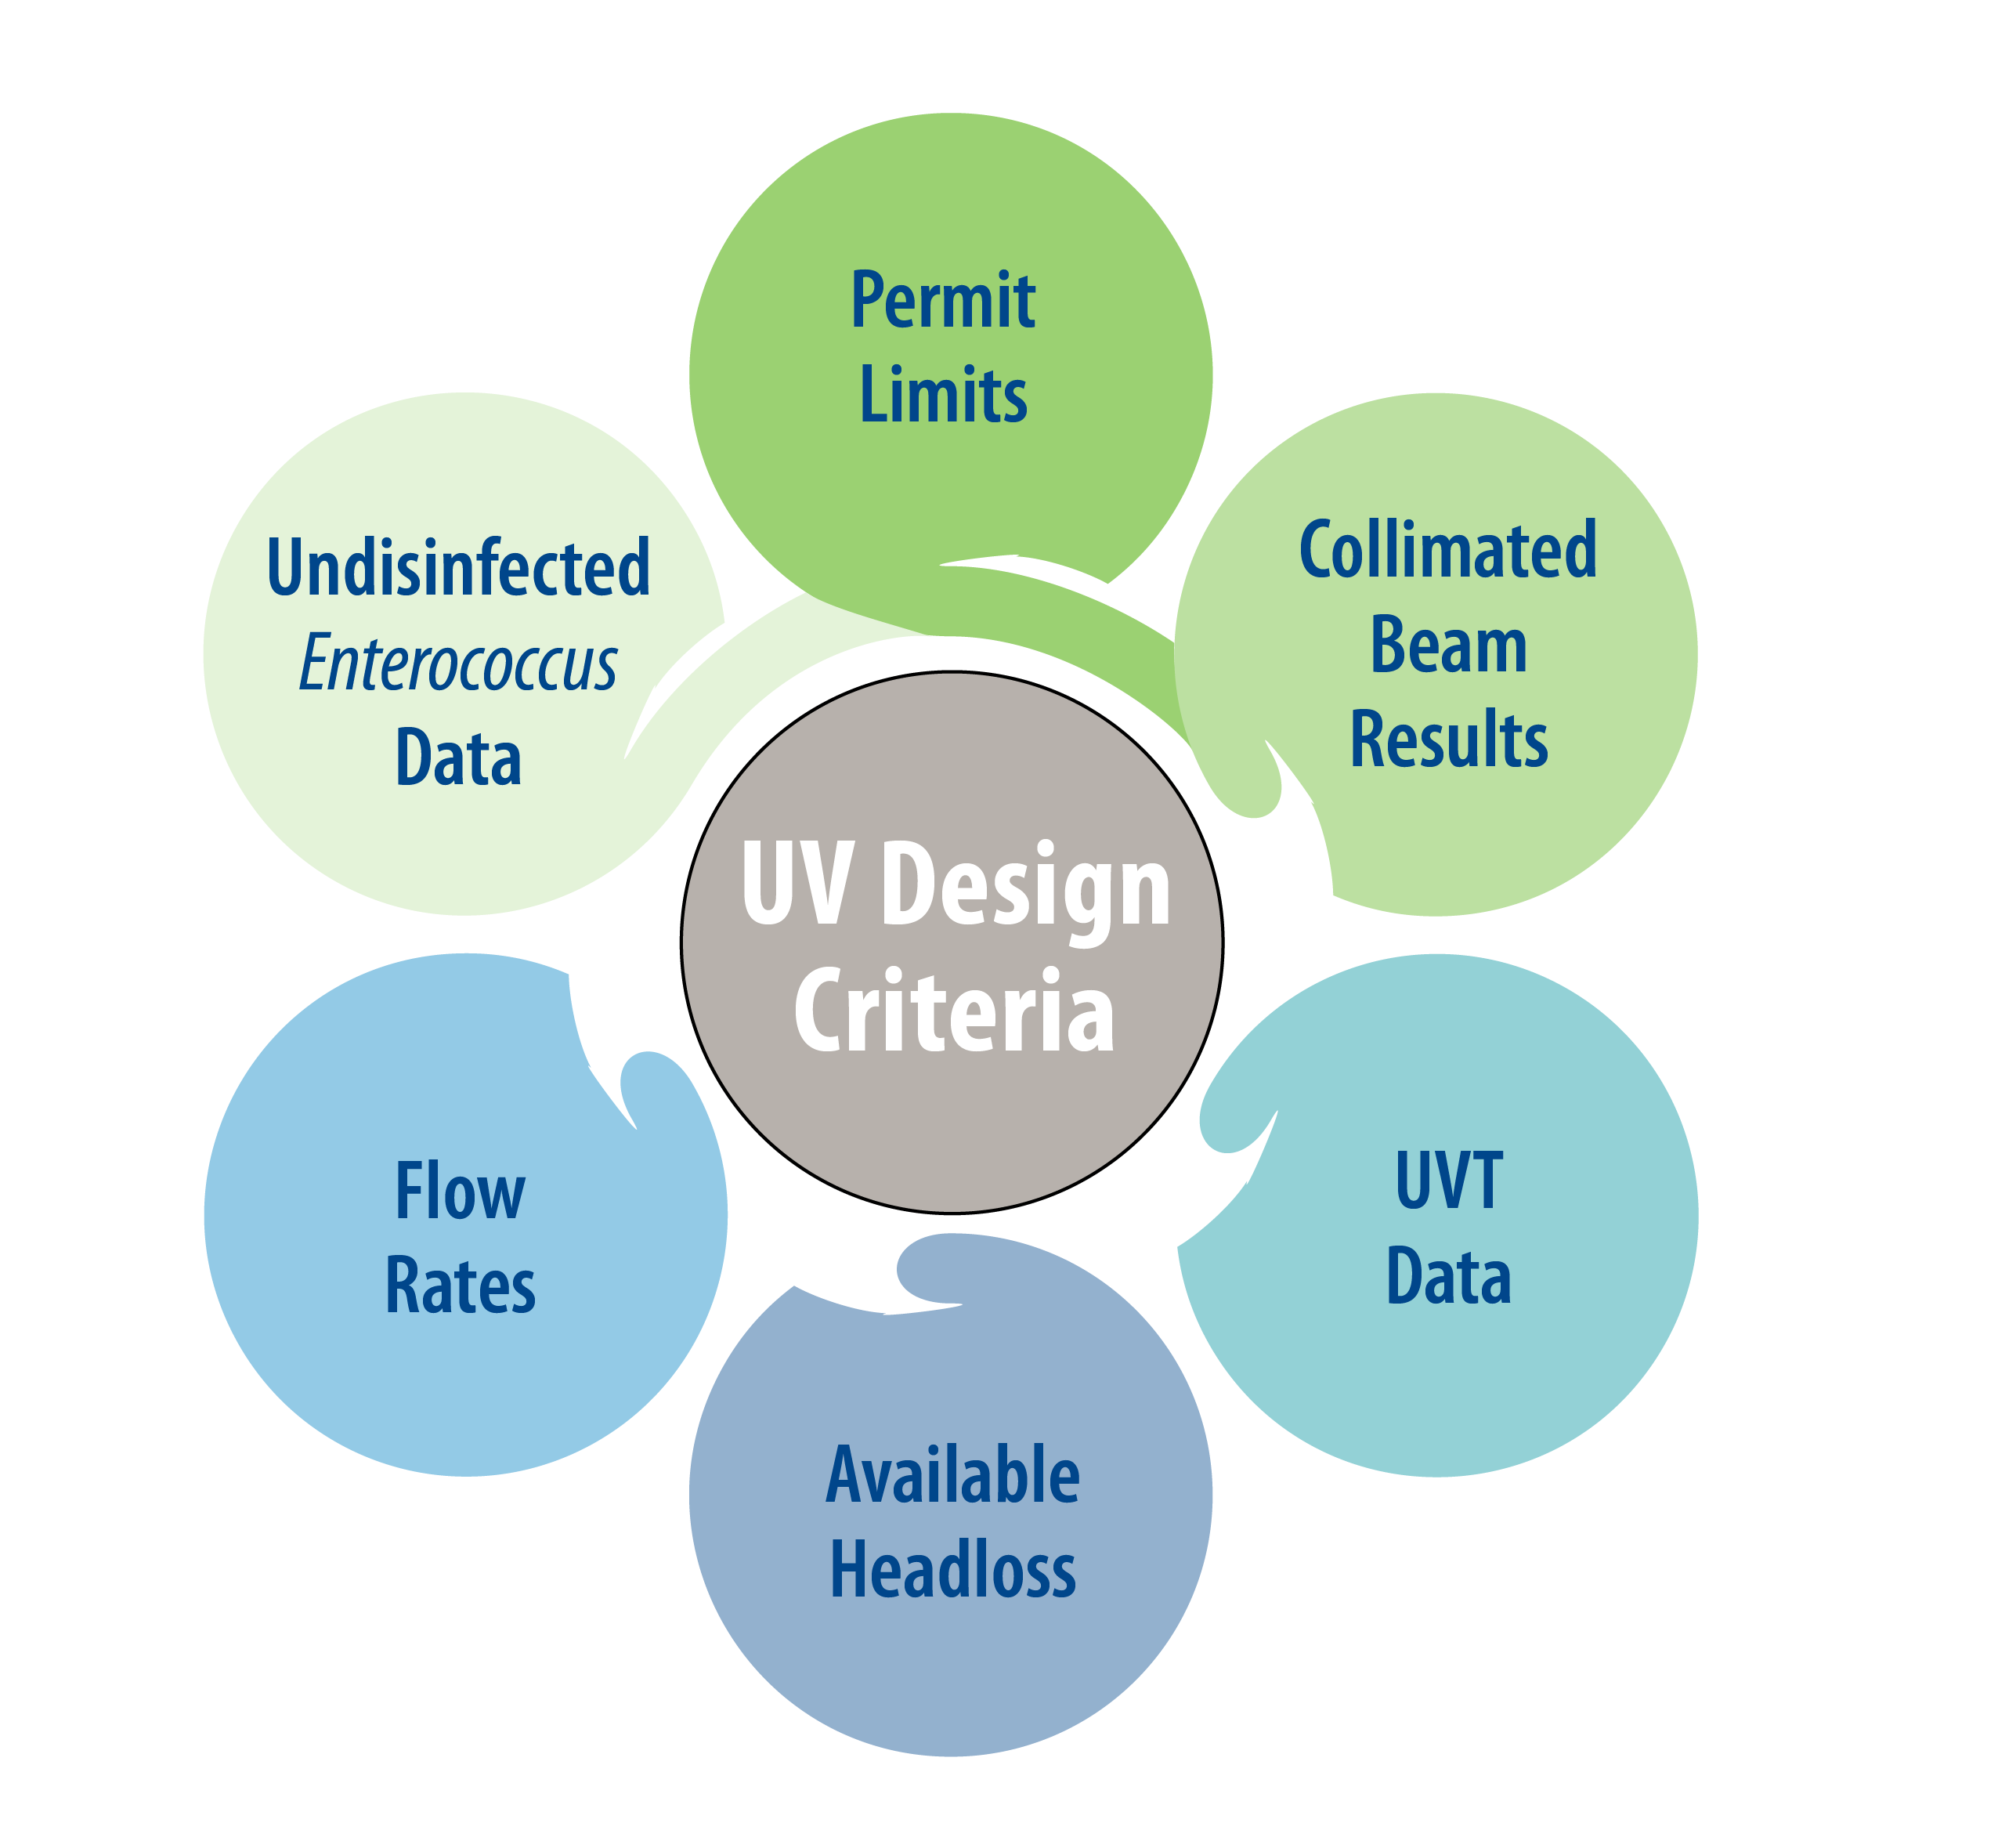
Notes:
Collimated beam is like a UV response testing
When get to 10% increase in UVT, you can approx. cut the lamps in half!

Slide 5
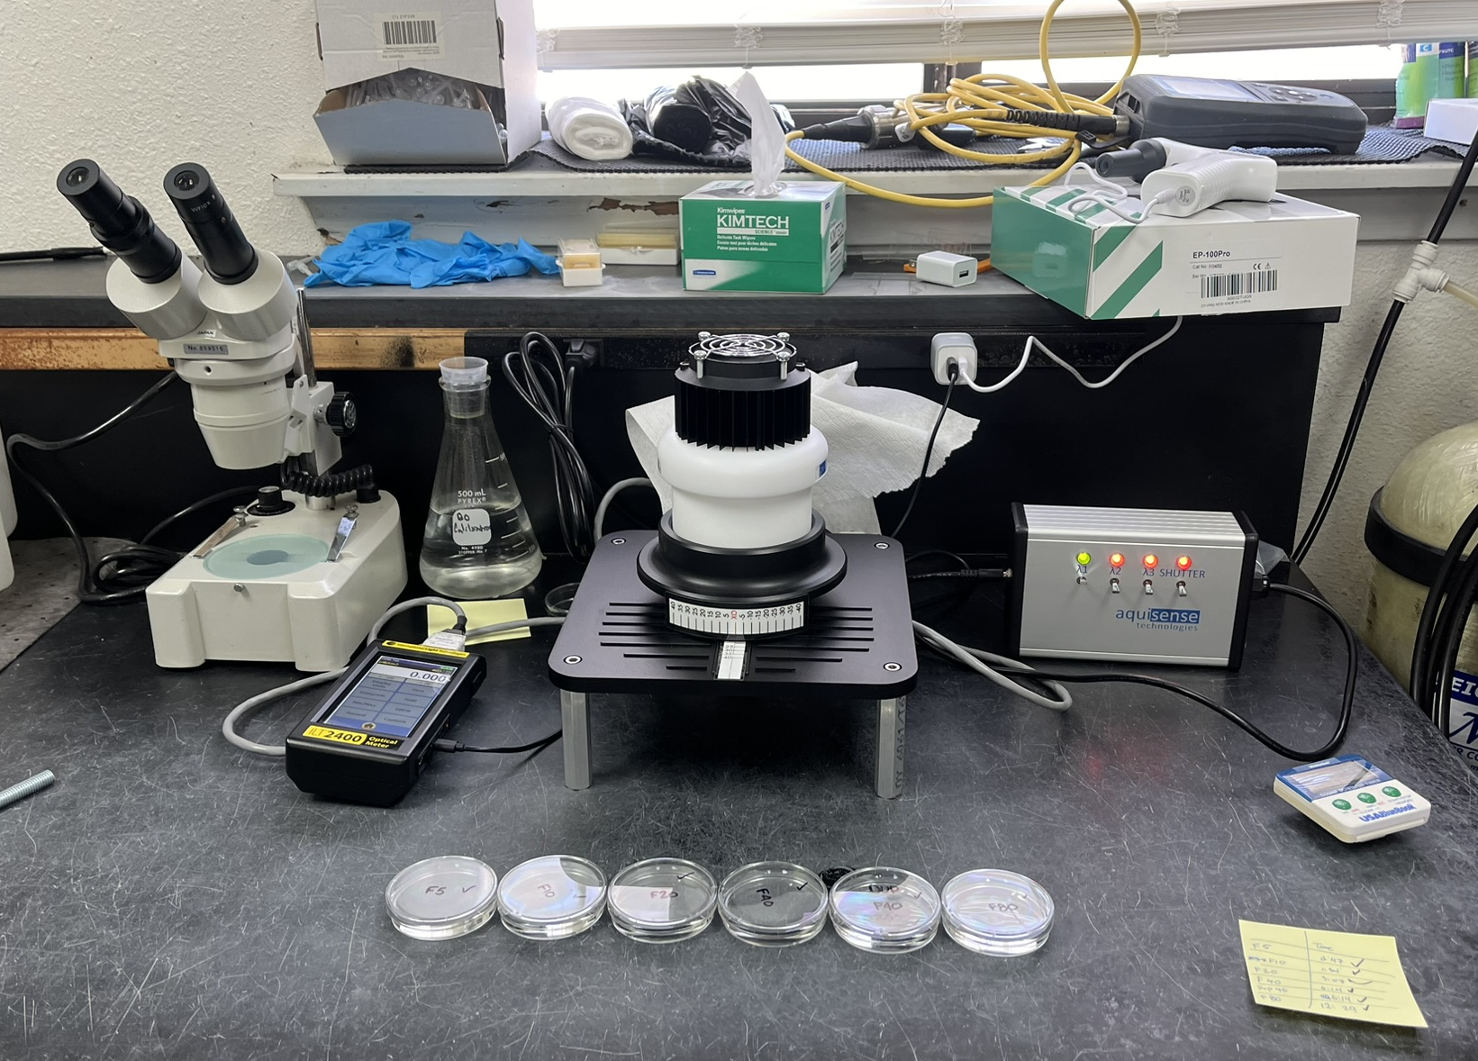
Notes:
It’s always site-specific. This particular client had a lot of data and were very risk averse.
Can change seasonally: UVT, TSS, undisinfected bacteria counts

Slide 6
Notes:
Collimated beam is like a UV response testing
When get to 10% increase in UVT, you can approx. cut the lamps in half!

Slide 7
Proper Sizing

Slide 8
Tailoring the System to Your Needs
Determine required Enterococcus or E. Coli log inactivation
1
2
Plot Collimated Beam Results
3
Determine UV dose and organism sensitivity
Notes:
It’s always site-specific. This particular client had a lot of data and were very risk averse.
Can change seasonally: UVT, TSS, undisinfected bacteria counts

Slide 9
Procurement

Slide 10

Pre-selection versus Hard Bid
Opportunity to account for non-cost impacts
Designing around a single manufacturer can reduce construction costs
SDs get reviewed during design
Minimizes coordination changes during construction

Slide 11

Pre-selection Process
RFP development
Technical requirements and scope
UV system testing options (hydraulics, harmonic, elevated TSS testing, etc)
Delegated design
Compensation for submittal development
Approach to spare parts and bid price escalation
RFP
RFP evaluation – NPV and non-cost weights
Notice of Award/Letter of Intent to selected UV manufacturer
Contract is still between the Contractor and the UV manufacturer

Slide 12
Procurement Lessons Learned
Discuss and agree on start-up and testing requirements.
Vet out approved vendors.
Engage operational staff for their input!
Redundancy

Slide 13
Design Considerations

Slide 14
UV System Design Considerations
Headloss
TCEQ Requirements
Spare part storage
Redundancy
Channel drainage
Controls: Automatic flow and water quality paced PLC control system
Alarms
Flow control: finger weir versus modulating weirs
Flow split and flow measurement
Environmental controls for panels
Sampling points
Cable routing and lengths
Channel Covers
Future expansion
Notes:
Environmental controls

Slide 15
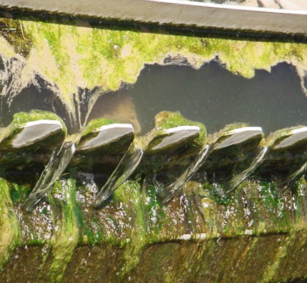
Design – Other Considerations
Secondary clarifier launder covers to reduce algae formation
Installing launder covers under on-going projects.
Use of ferric for upstream processes
Additional headloss from future upstream processes
Impact of process upsets
Power

Slide 16
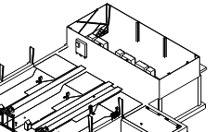
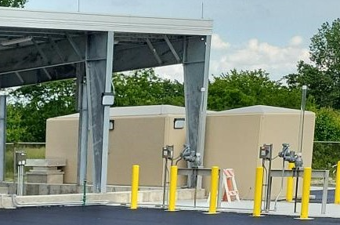
UV Facility – Value Engineering (VE)
Building
Pre-Engineered Metal Building
An enclosed electrical room and designed to allow for the full enclosure of the entire structure in the future
Canopy over the UV disinfection facility as bid alternate
Electrical Building
PDCs inside electrical building vs outside
FRP Prefabricated building
Flowmeter Locations
Moved from yard valve vault vs in Channel
Large diameter piping materials
VE
VE
ELECTRICAL
EFF SAMPLE

Slide 17
Construction and Testing/Startup

Slide 18
Construction and MOPO Lessons Learned
Keep lines of communication open between all parties.
Have clear sequencing discussions.
Know the minimum equipment performance needed at the process, if bypass is not possible.
Establish and agreed upon a game plan before critical demolitions occur.
Notes:
1- what needs to be in operation at all times? How long can you shut the plant down? Do you have an EQ Basin? Where is power coming from if you are transferring from existing power?

Slide 19
Testing and Startup Lessons Learned
Identify agencies to notify in advance before any sampling begins.
Closely review manufacturer’s performance testing plans and confirm responsibilities of all parties—especially when third parties are involved.
Understand the schedule and impacts from any burn-in requirements or potential undisinfected discharging.
Establish a clear chain of custody for sampling and lab testing.

Slide 20
Questions

Slide 21
Thank You!
Acknowledgements
My Contact Information
Kaitlin Allen
Brian Hilts
CDM Smith Project Team
Andrea Tom
tomam@cdmsmith.com

