Slide 1
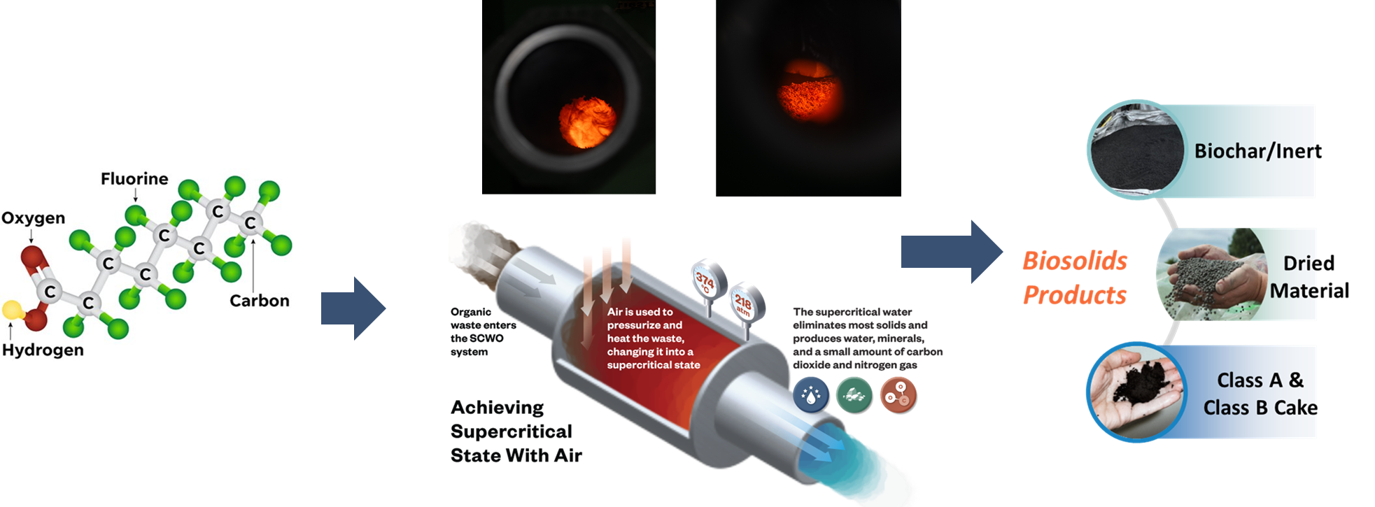
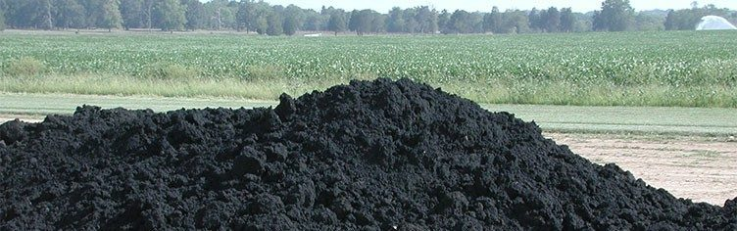
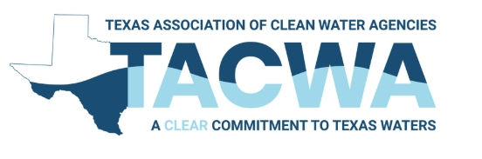
Advanced Thermal Processes of Biosolids
TEXAS ASSOCIATION OF CLEAN WATER AGENCIES
MARCH 27, 2026

Slide 2
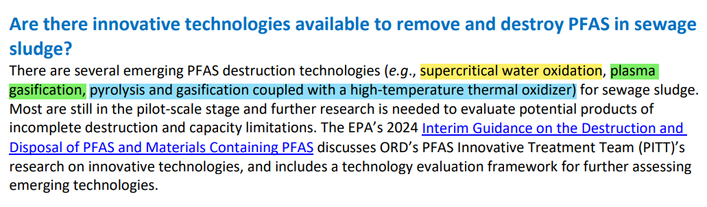
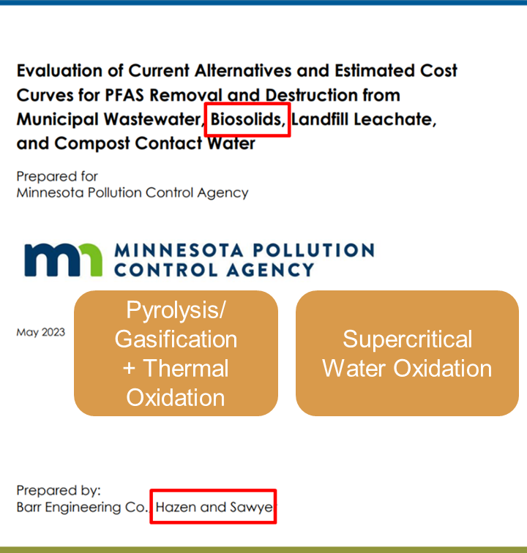
EPA agrees with our published research findings
Notes:
Published research findings are a project we did Minnesota pollution control agency aligns with

Slide 3
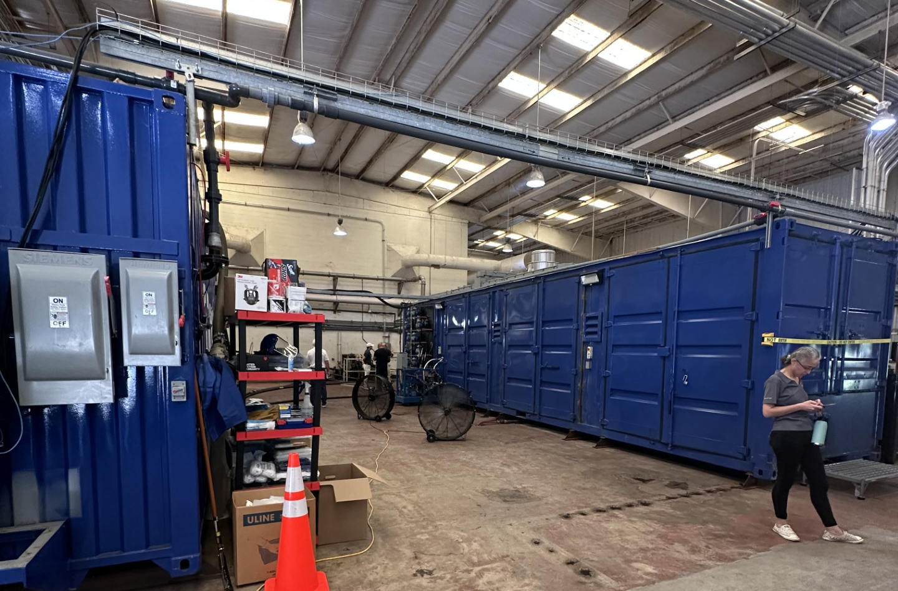
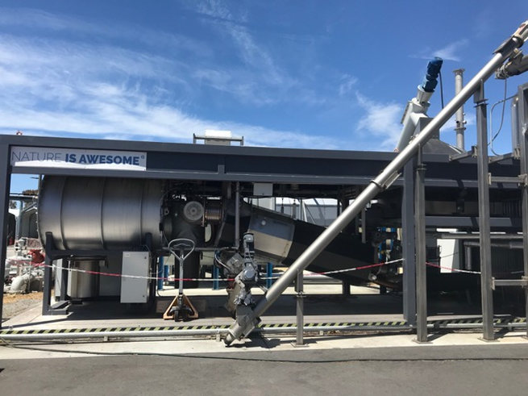
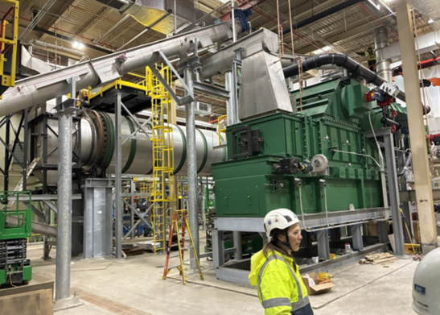
Agenda
SCWO Technology Update
Gasification Technology Update
Pyrolysis Technology Update
Full Scale Capacity Comparison

Slide 4
Supercritical Water Oxidation

Slide 5
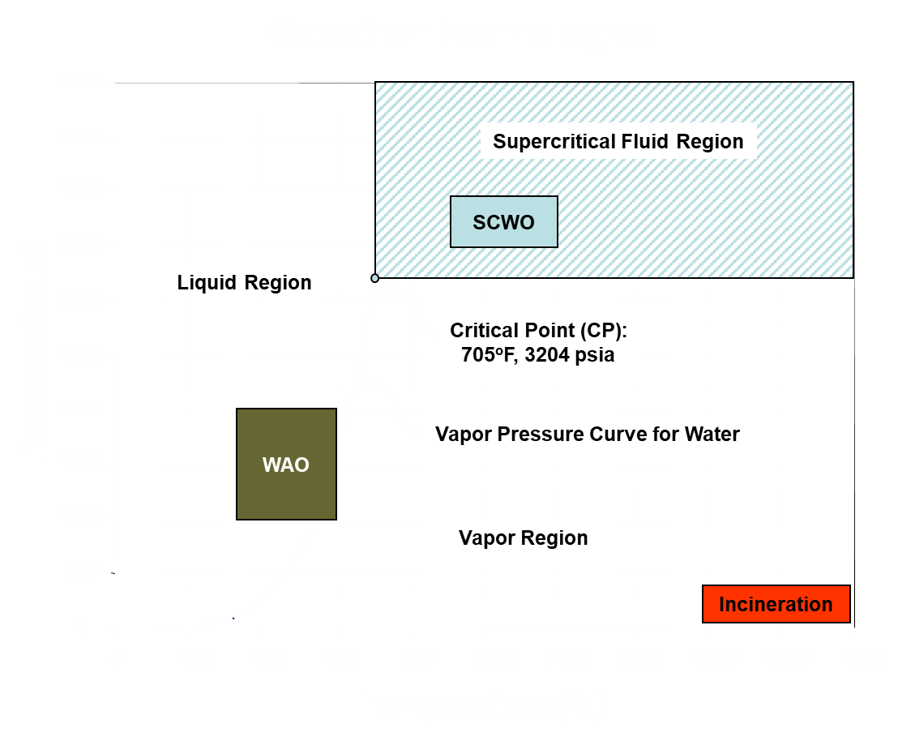
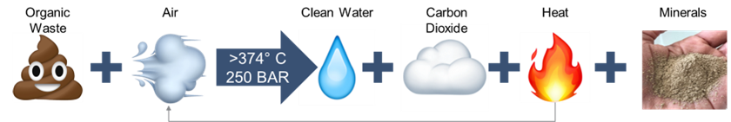
Supercritical Water Oxidation
Technology Overview
As pressure increase, water temp increases beyond the boiling point
Beyond critical point, organic matter rapidly dissolve and becomes simple molecules
With air/O₂, organics are fully oxidized
Peak temp in SCWO is not hot enough to produce NOx or SOx
Not a combustion technology by EPA

Slide 6
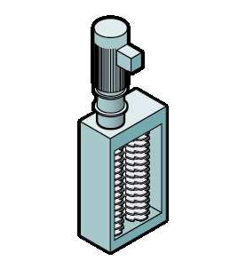
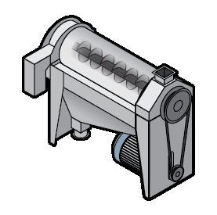
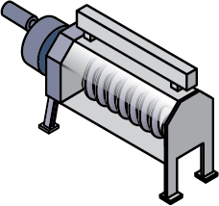
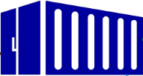
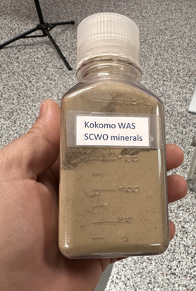
Technology overview/PFD
Sludge Pre-Treatment
Energy
Air
CO2/Air
Polymer
10-15%
Slurry
Liquid
Biosolids
Water
Sludge Grinder
Strain Press
Screw Press
Minerals
Co-Fuel
Screenings
Filtrate
Energy

Slide 7
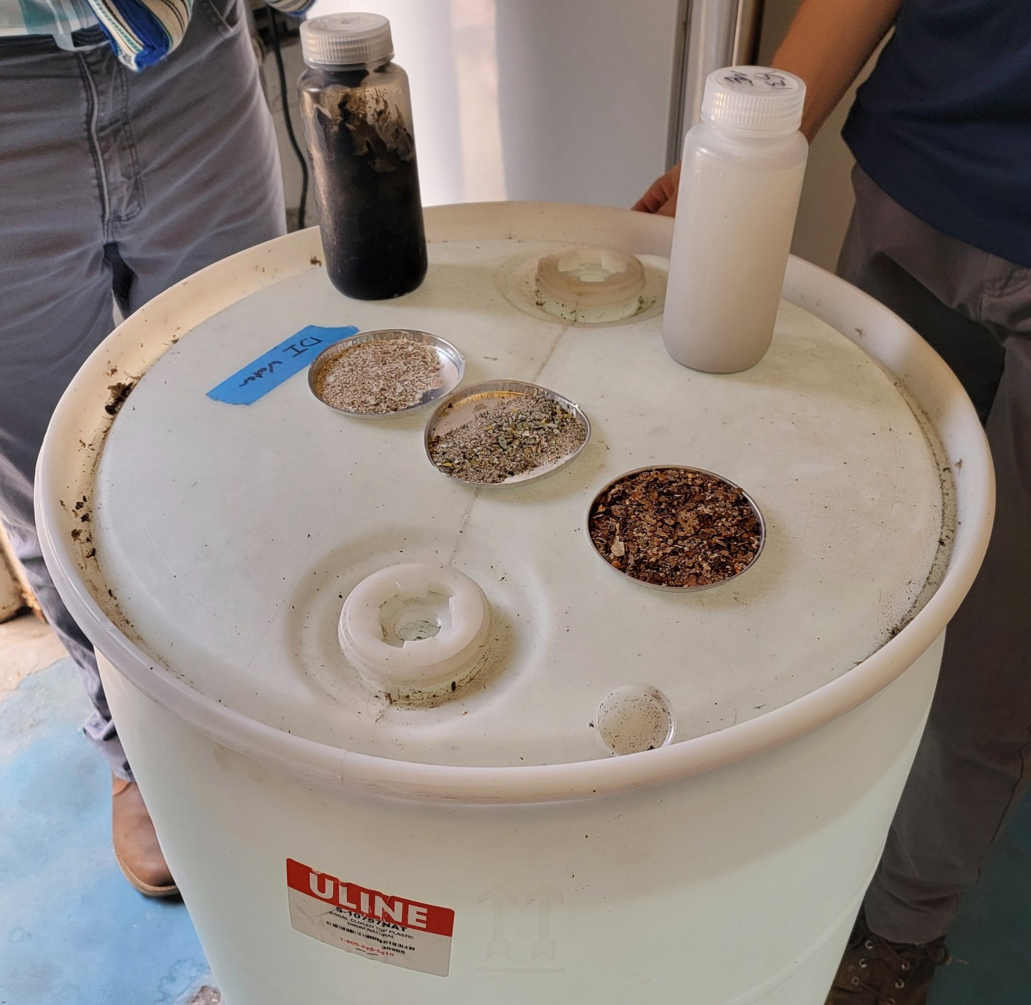
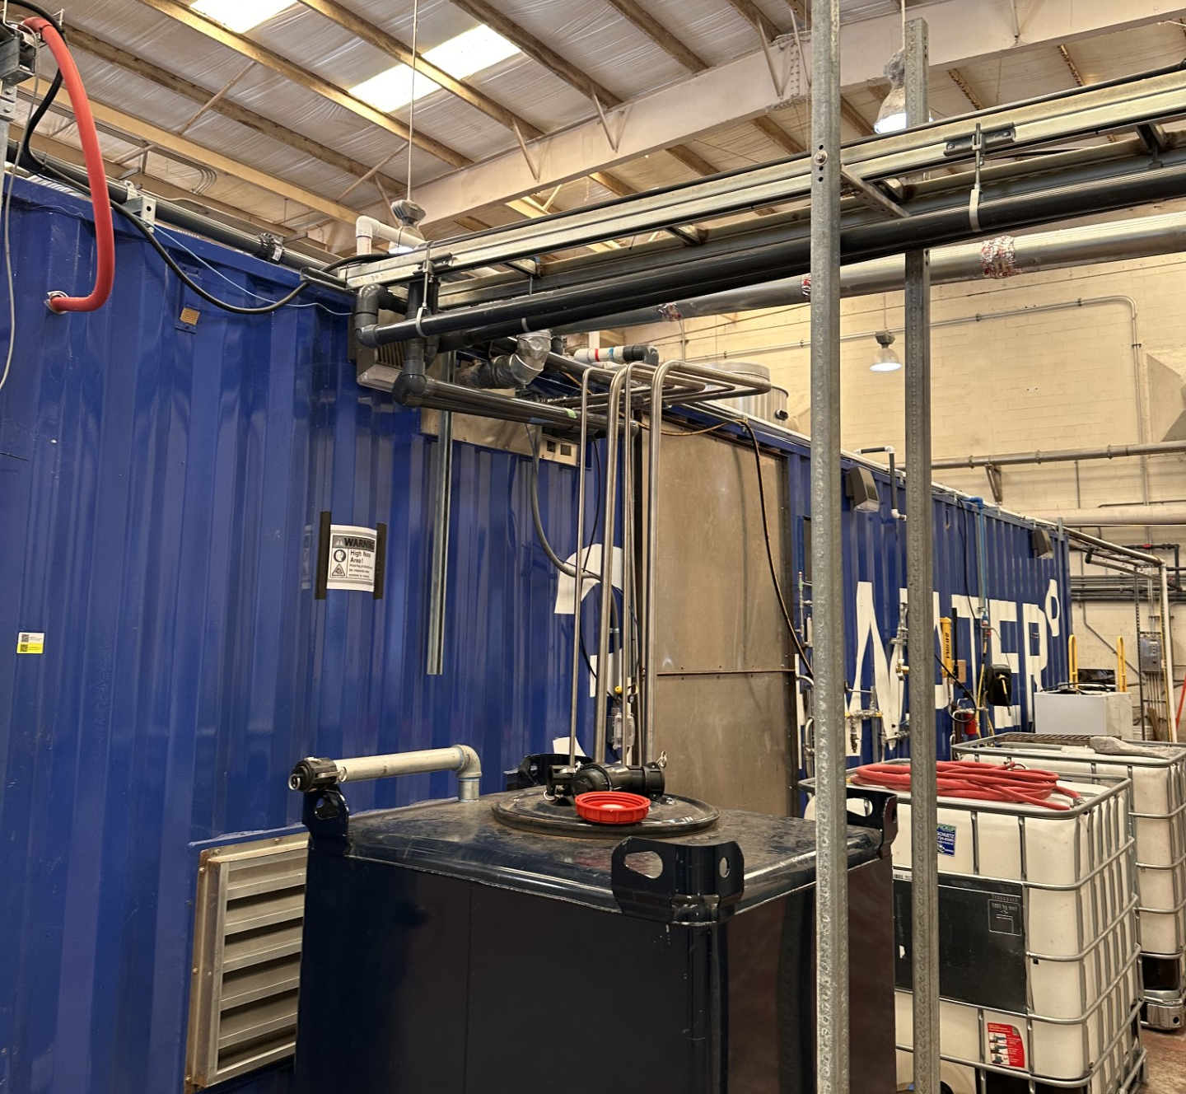
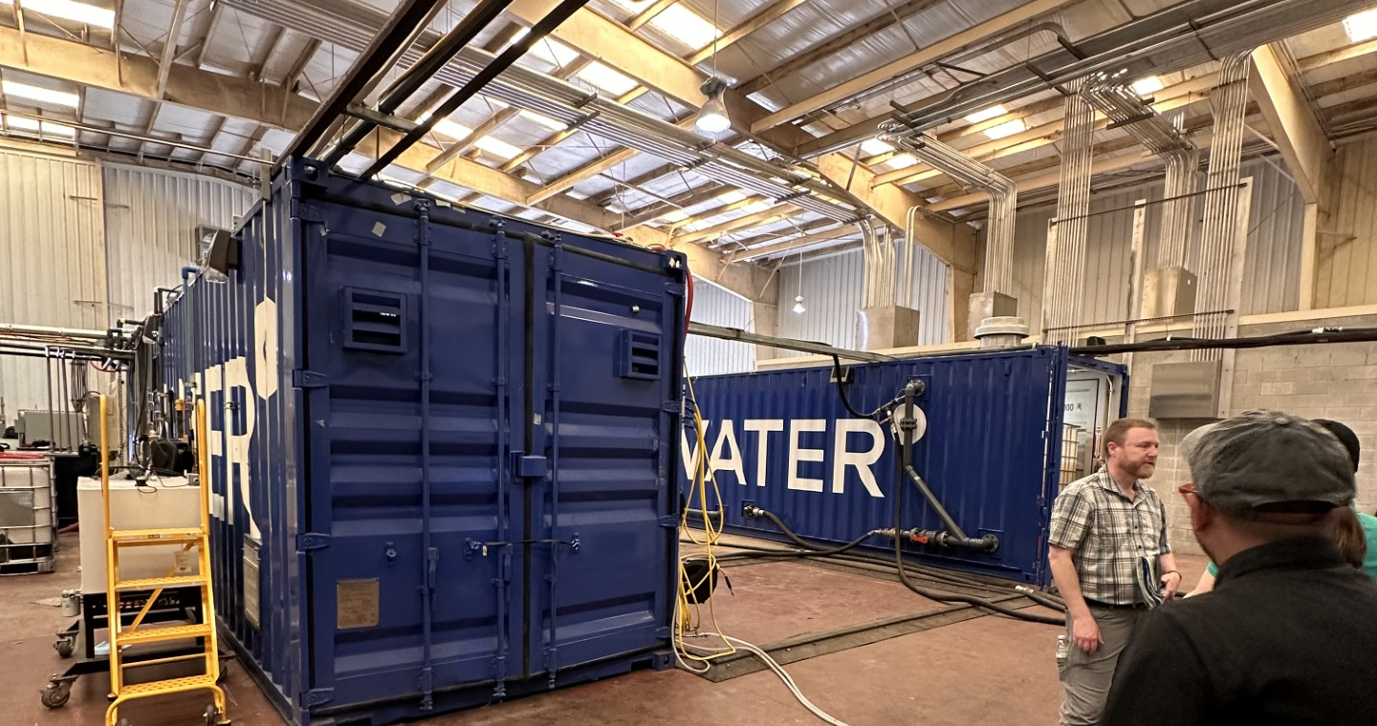
374Water Status
No installations yet, all piloting/demonstration
Location | Equipment | Size (wtpd) | Year Demonstrated
City of Orlando, FL | AirSCWO 6 | 4.5 | March – June 2025
Orange County Sanitation District, CA | AirSCWO 6 (Hazen) | 6 | 2026
City of Olathe, KS | AirSCWO 6 (Hazen) | 4.92 | 2027

Slide 8
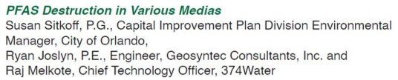
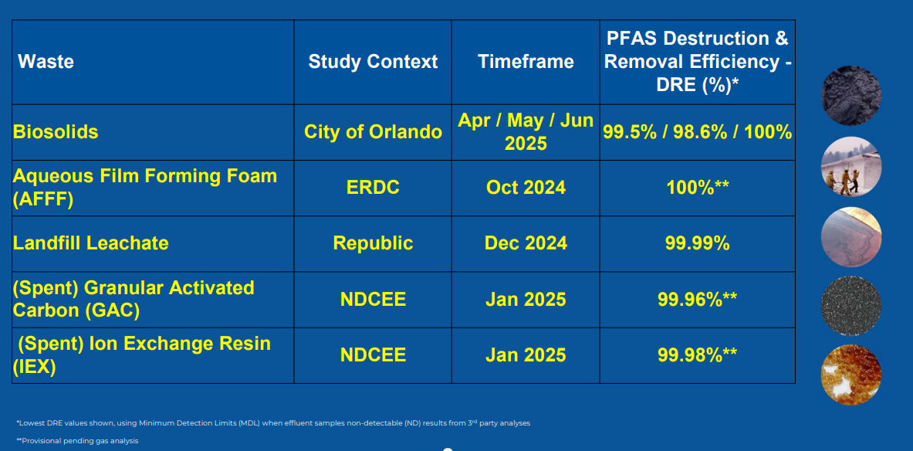
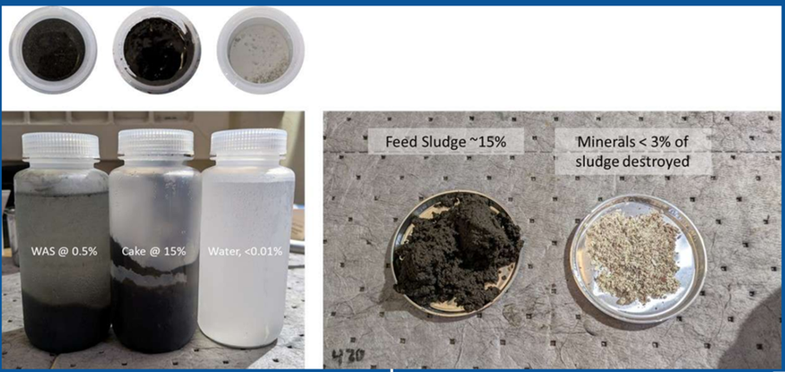
Pilot Testing Results
Results from 374Water Presentation at Florida Remediation Conference Nov 4, 2025

Slide 9


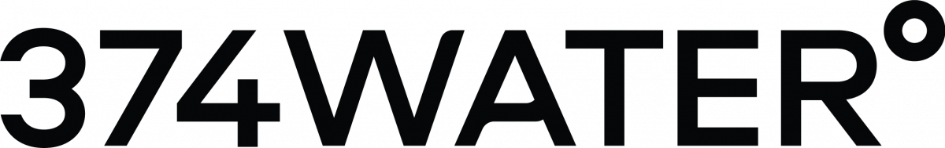

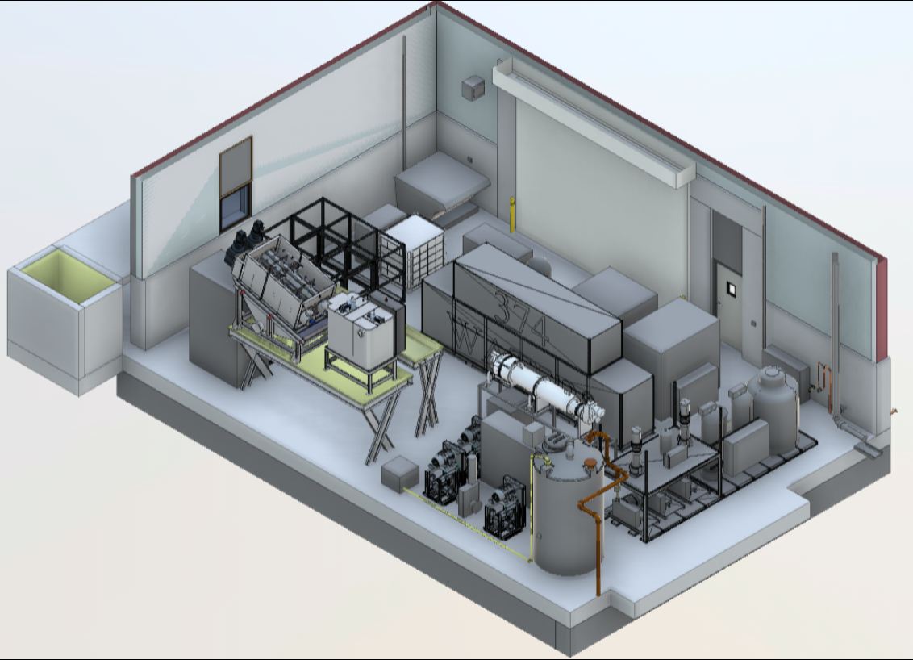
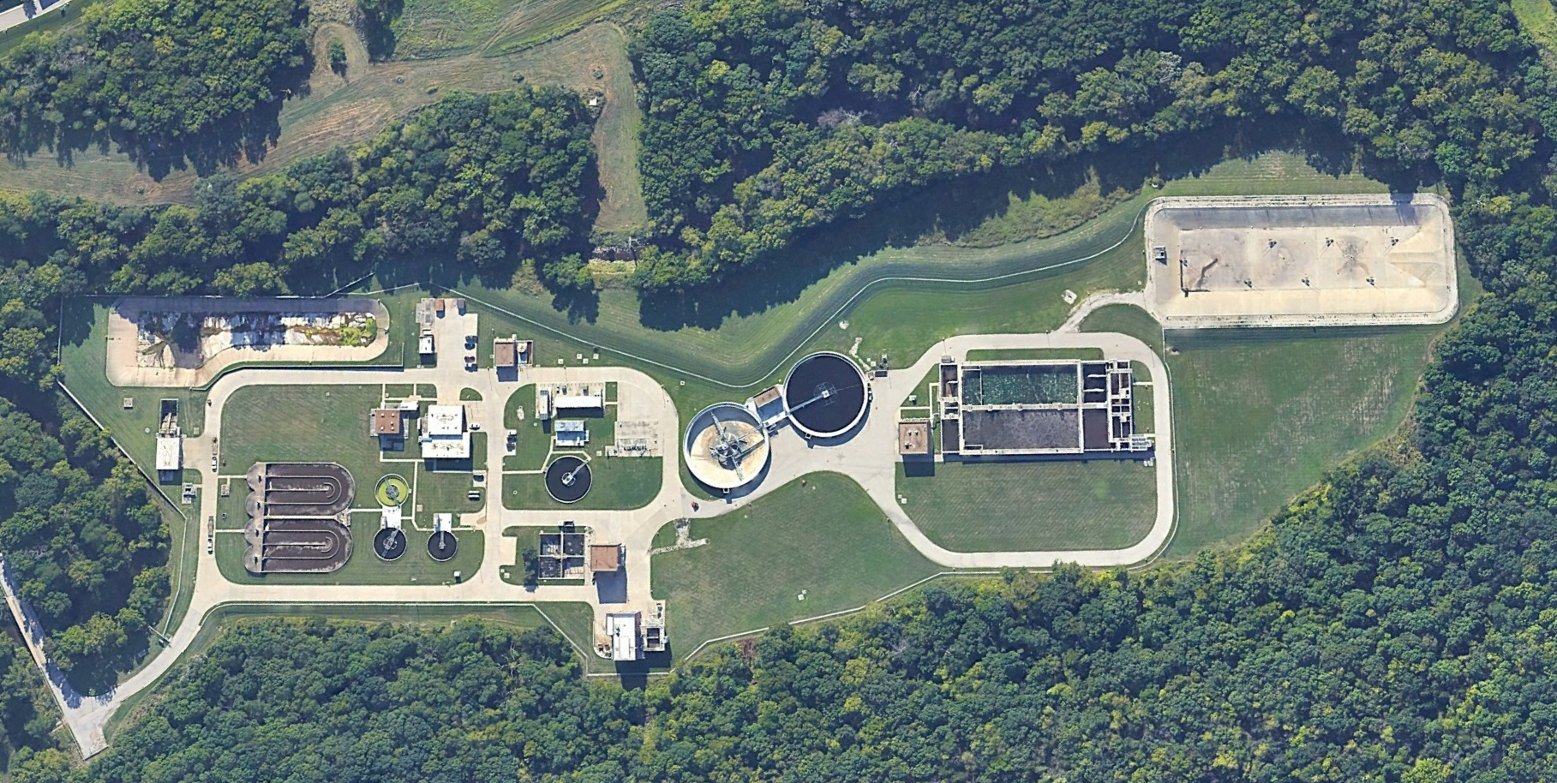
City of Olathe, KS – SCWO Pilot
Developed system since 2013 at Duke University​
Bill and Melinda Gates Foundation Funding​
AirSCWO 6 Unit currently operational in Michigan​
Leader in the market for SCWO treatment of biosolids​
Cedar Creek WWTP – 12.5 mgd after current expansion
Landfill disposal of biosolids going away​
$113M to transition to Class B land application(2024 Cedar Creek WWTP Expansion Plan)​
$5.8M KDHE Emerging Contaminate Grant Funding ​

Slide 10
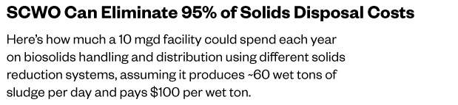
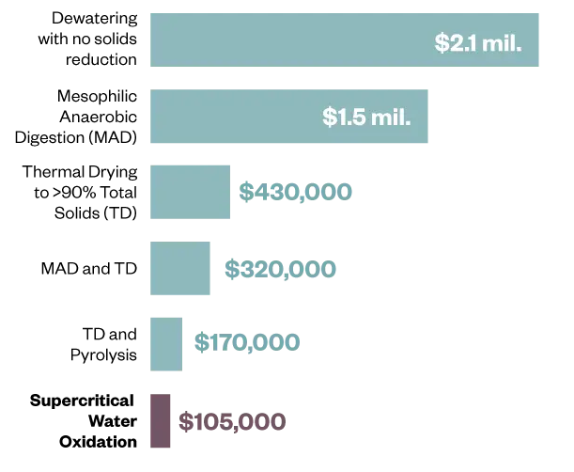
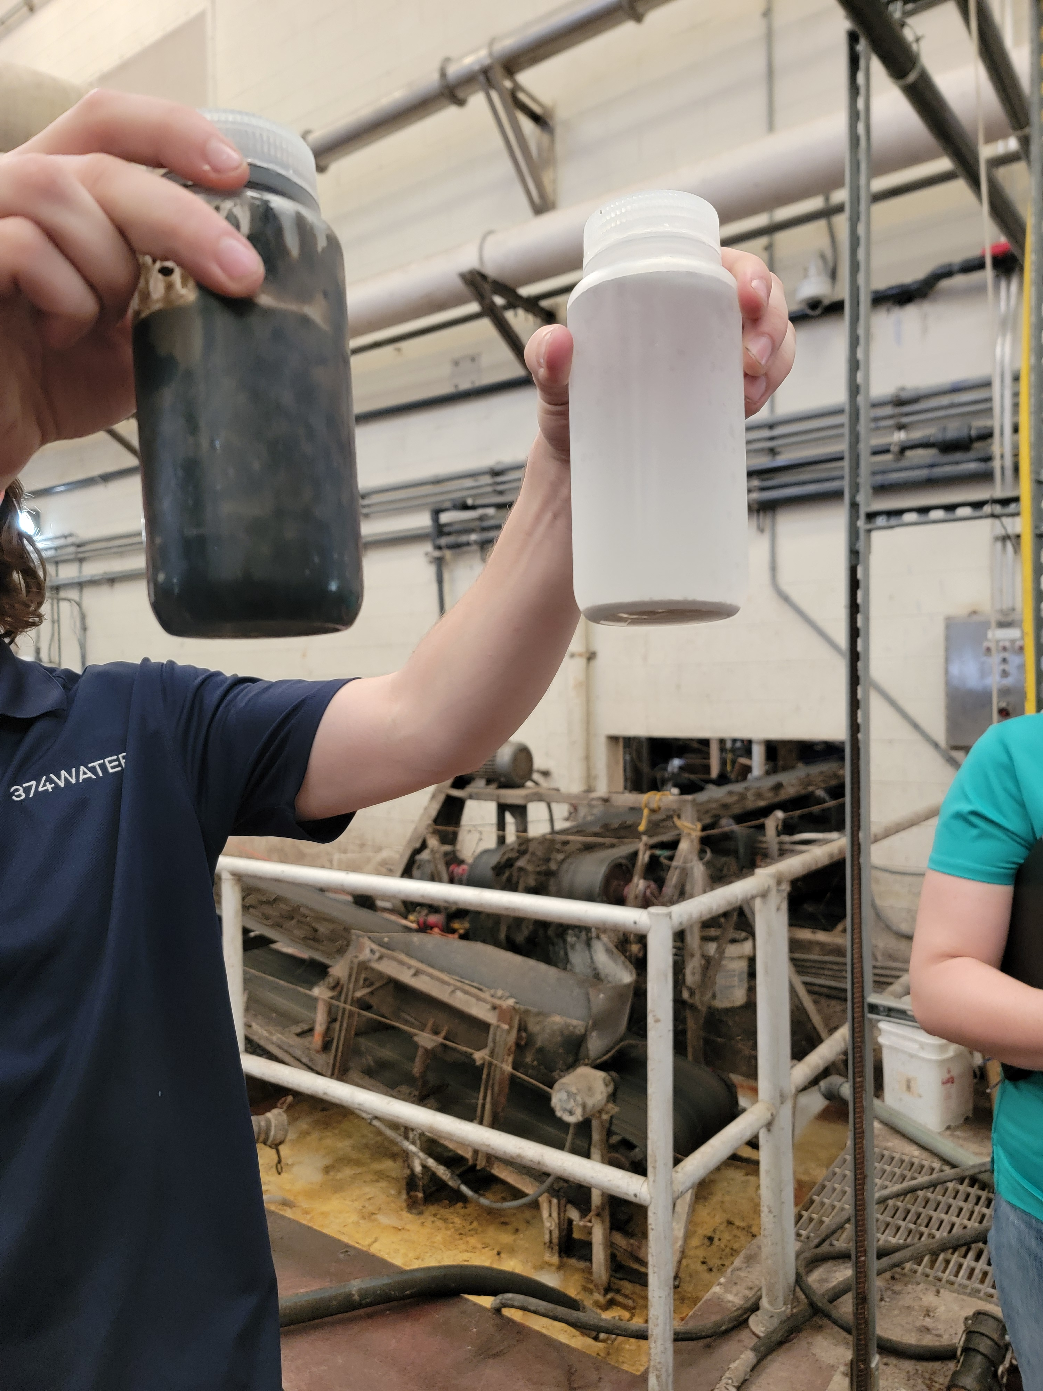
Olathe SCWO

Slide 11
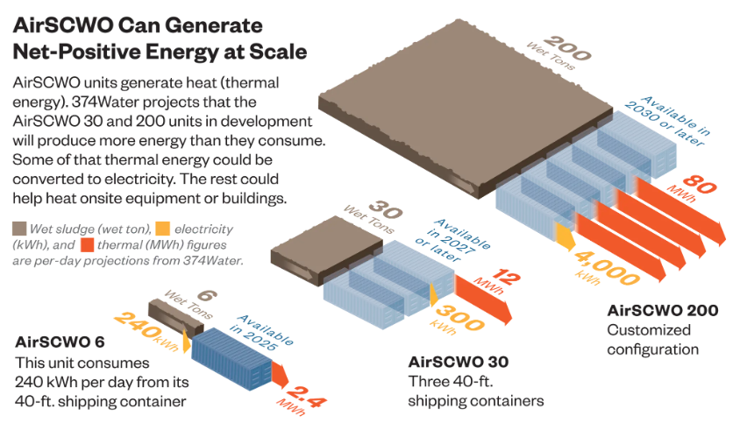
“Future” of SCWO – Full Scale and Piloting
Only the 1 wtpd unit will be available for piloting moving forward

Slide 12
Gasification and Pyrolysis

Slide 13
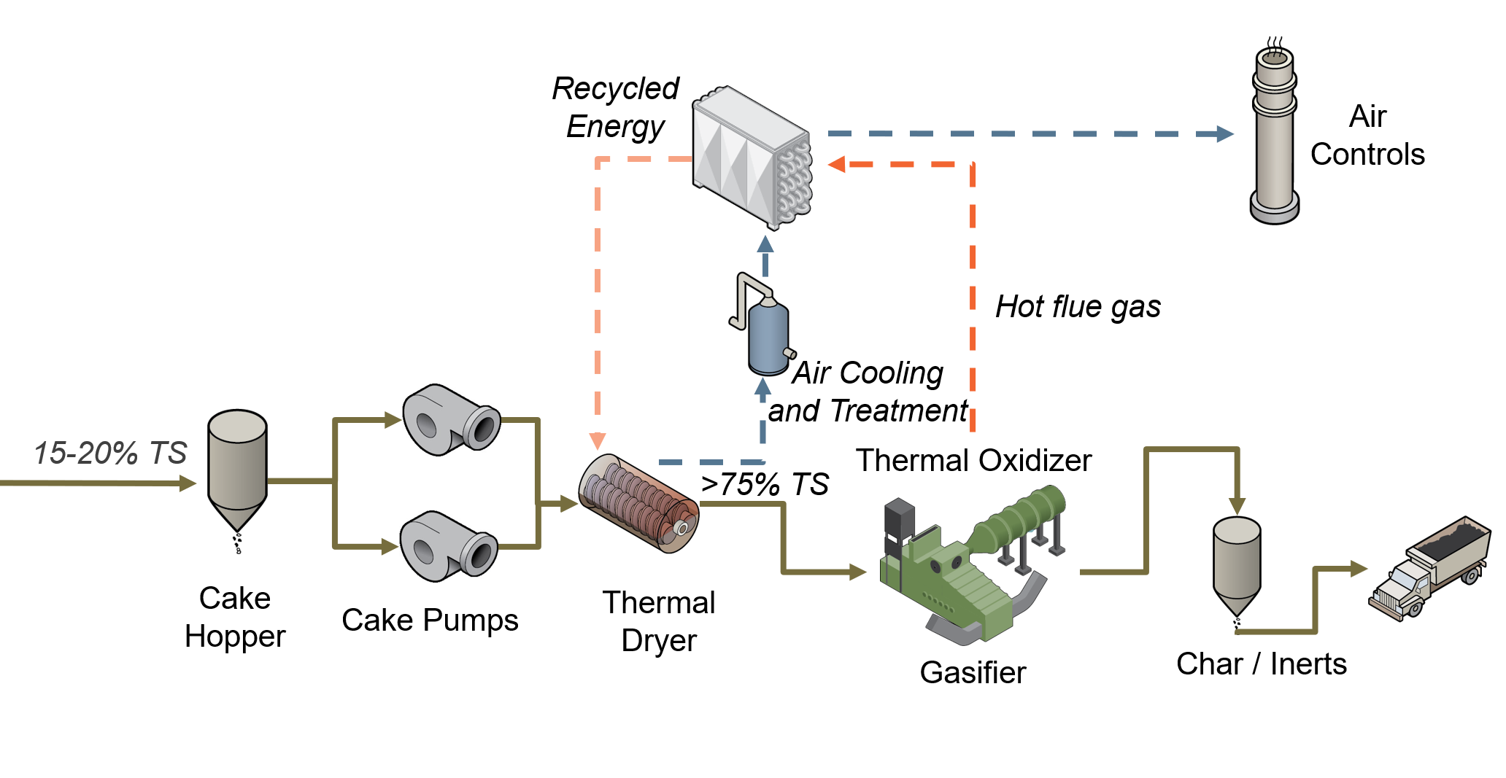
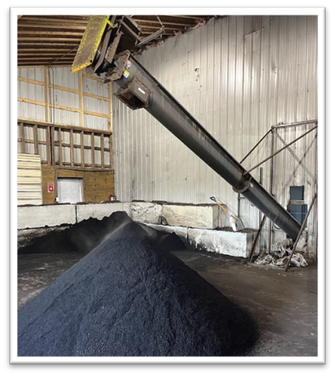
Gasification/Pyrolysis followed by Thermal Oxidation
Destruction Technology
Not an incineration process
Gasification/Pyrolysis is a thermochemical process use intense heat to decompose organic materials.
Parameter | Incineration | Gasification | Pyrolysis
Temperature (ºF) | 1,650-2,000 | 1,100-1,800 | 390-1,100
O₂ Supply | > Stoichiometric (Excess Air) | > Stoichiometric (Limited Air) | None
By-products | Flue Gas (CO₂, H₂O) and Ash | Syngas (H₂, CO) and Ash | Pyrolysis Gas, Oil, Tars, and Char
Combustion | Complete combustion of organics | No combustion due to limited or no oxygen

Slide 14
Gasification
Ecoremedy
Earthcare
Pyrocal

Slide 15
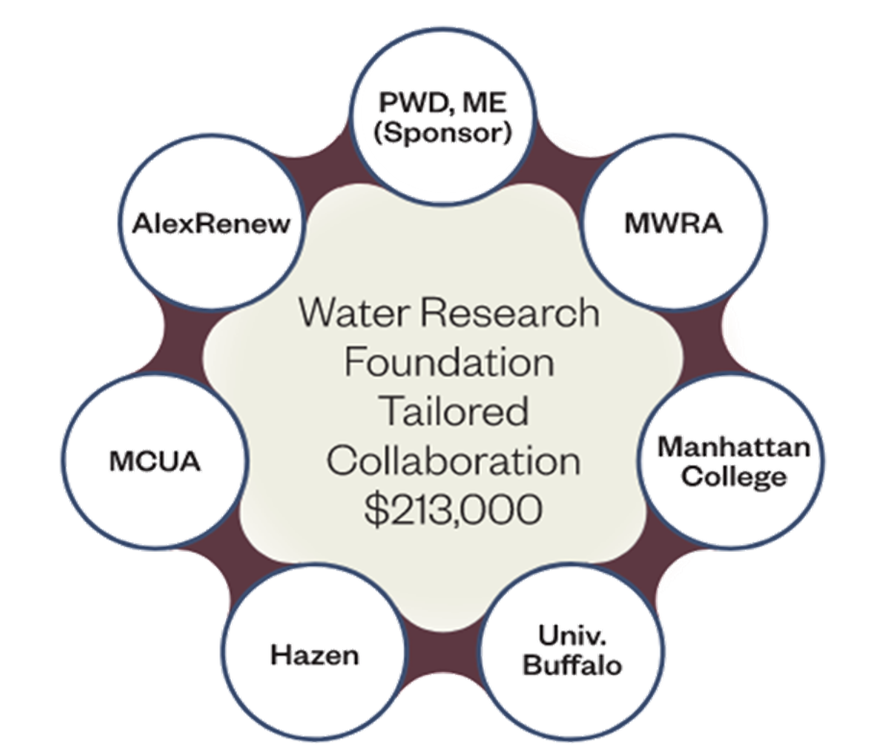

State of knowledge regarding PFAS fate before WRF #5107
PFAS?
Air In
Air Out
Drying
+
Gasification/Pyrolysis
+
Thermal Oxidation
Sludge/
Biosolids In
Biochar/
Inert
PFAS
PFAS
Three data points show N/D,
All Vendors:
Ecoremedy
Bioforcetech
Chartech
Water In
Water Out
PFAS, yes

Slide 16
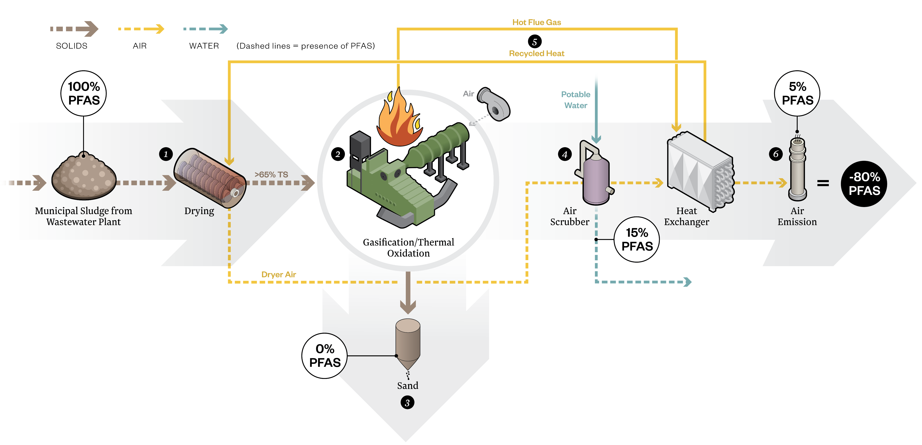
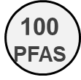
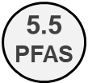
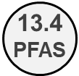
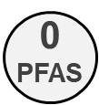
PFAS Fate in Edmonds Gasification Facility

Slide 17
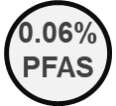
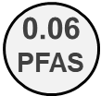
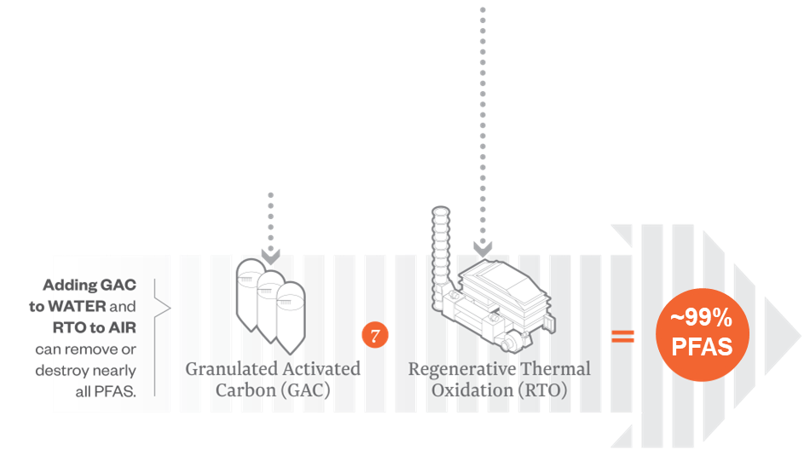
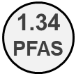
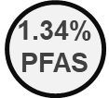
PFAS fate in Edmonds Gasification Facility with GAC and RTO

Slide 18
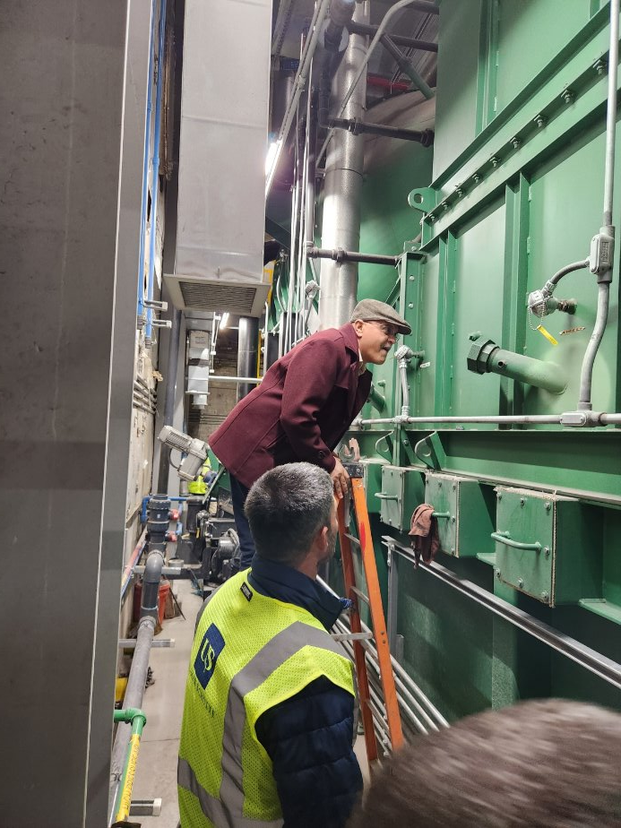
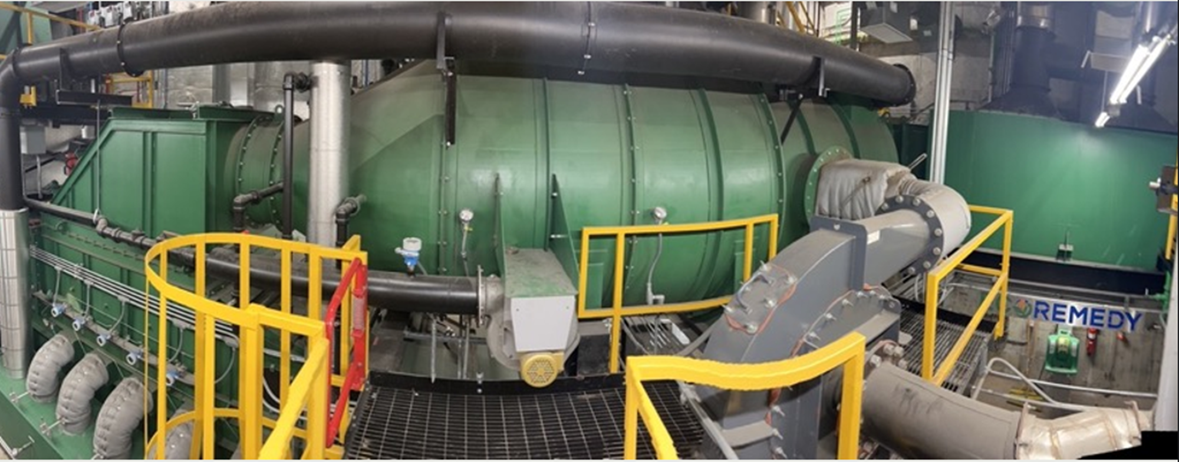

Ecoremedy
Installations
Location | Equipment | Size (dtpd) | Year Built | Operational Status
Edmond, WA | ECR-542 | 11.0 | 2023 | Operational
Derry Township, PA | ECR-742 | 14.0 | 2025 | Commissioning Q1 2026
Edmond, WA
Derry Township, PA

Slide 19
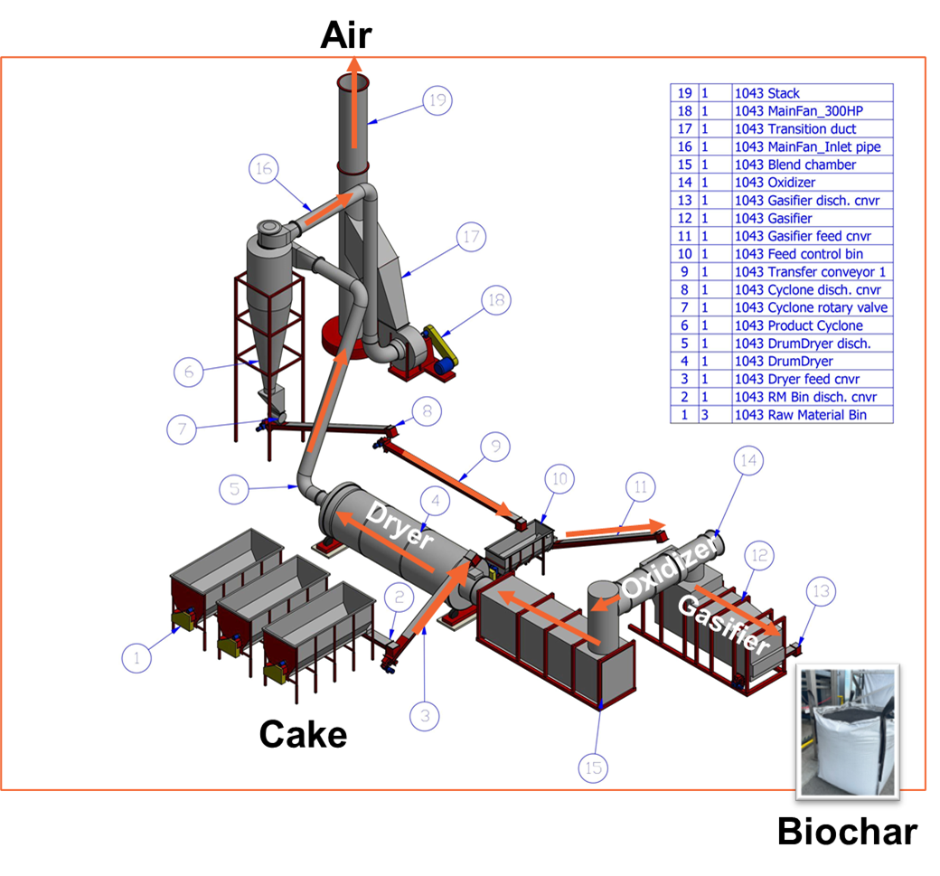
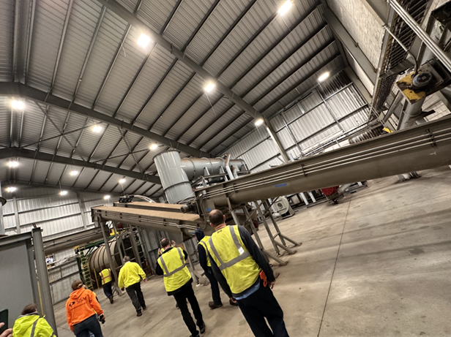
Earthcare
Gasification
System Information
Tripple Pass drying system, gasifier system coupled with thermal oxidizer
One train size is 40 dtpd
Have facilities in the Midwest for cow manure

Slide 20
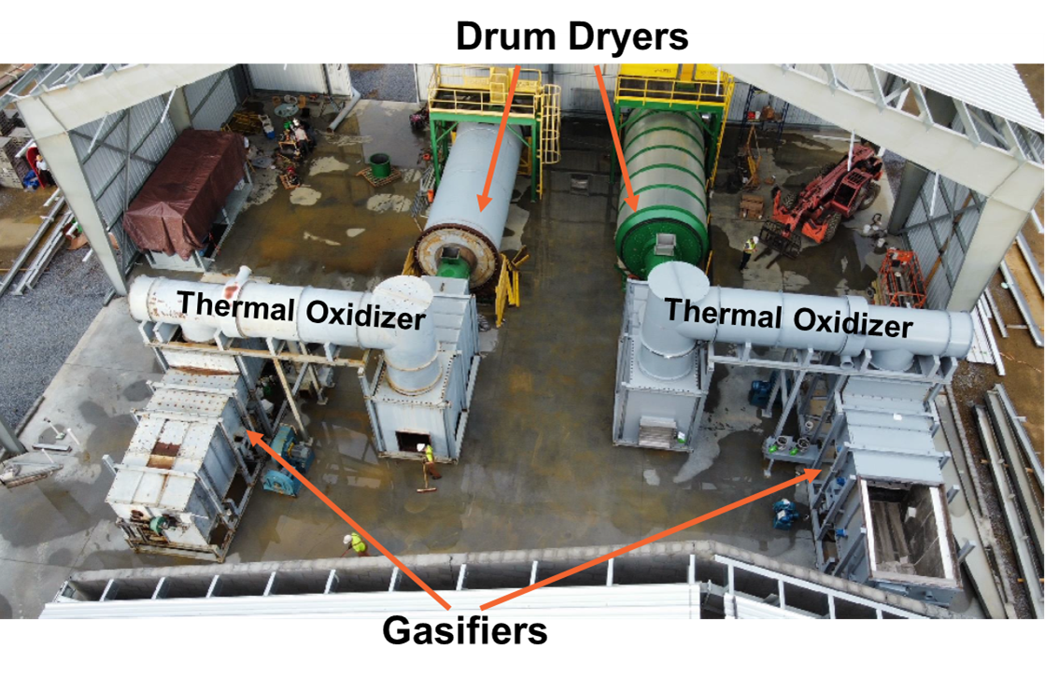
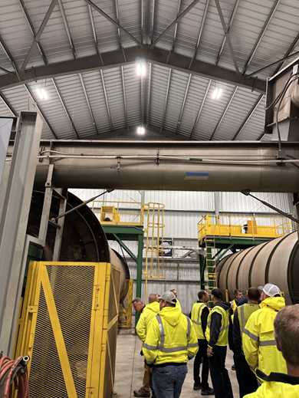
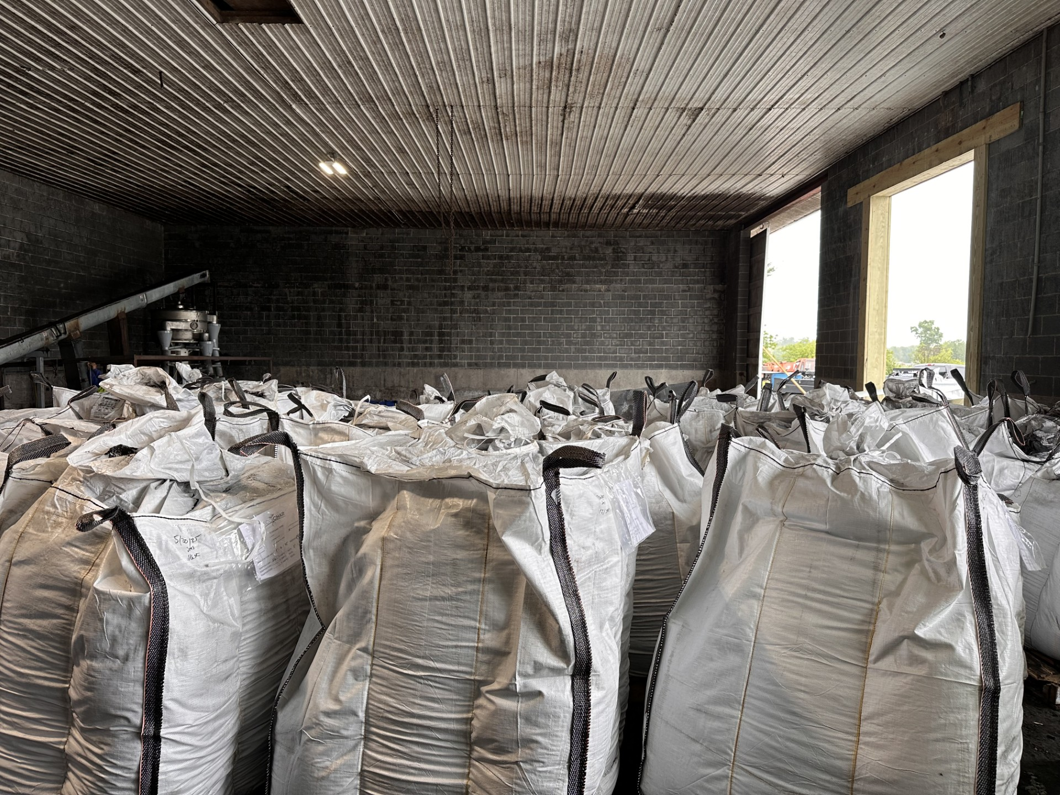
Earthcare
Installations
Location | Equipment | Size (dtpd) | Year Built | Operational Status
Bethel, PA Merchant facility | 50% sludge/biosolids 50% Chicken litter and other material | Two trains @ 80 dtpd total | 2024 | Operational
Earthcare has other facilities under construction

Slide 21
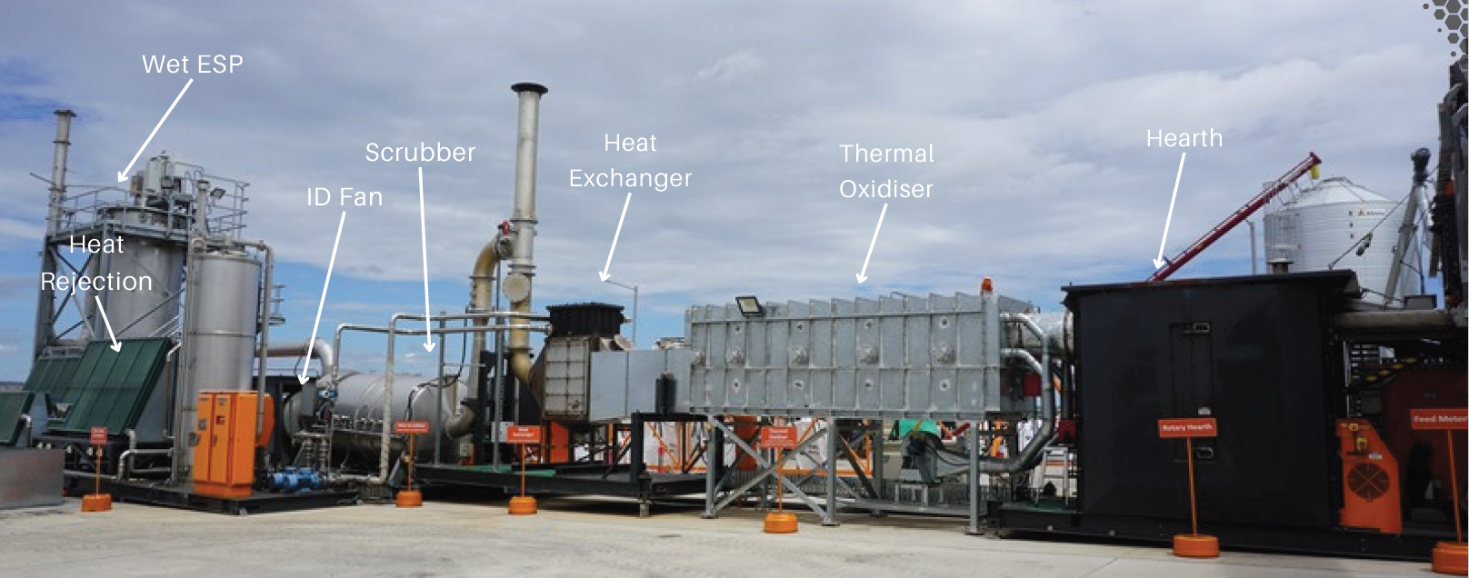
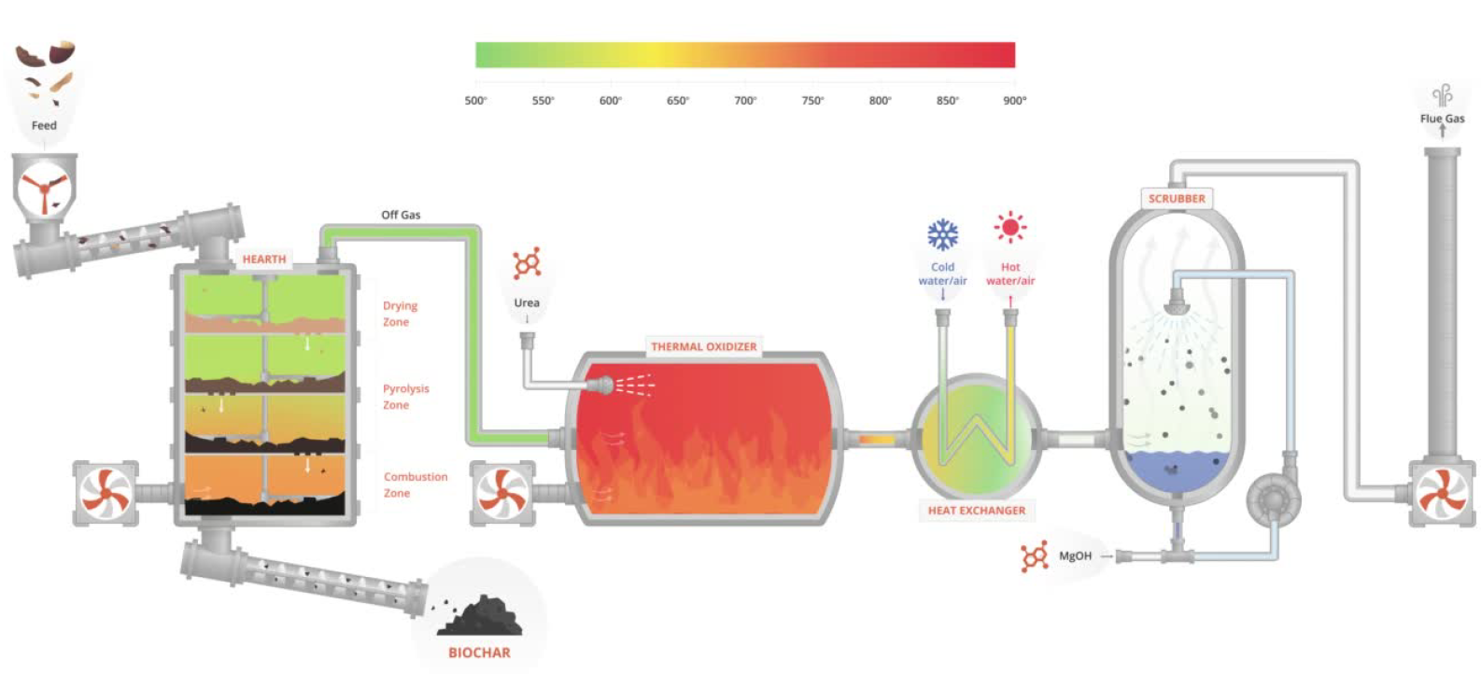
Pyrocal
Gasification
Australia-Based
Drying and pyrolysis system coupled with thermal oxidation
Started in 2016
First installation is Logan Water (Australia) in 2022 with new generation in 2023
Pyrocal offers two (2) difference size
  CCT-12 (Up to ~1,300 dry tons/year)
  CCT-20 (Up to ~3,800 dry tons/year)

Slide 22



Pyrocal (Gasification)
System Information and Installations
Location | Equipment | Size (dtpd) | Year Built | Operational Status
Loganholme, Australia | 2xCCT20 | ~32.0 | 2019 – Stable in 2022 | Operational
Victoria, Canada | CCT20 | ~16.0 | 2026/2027 | Under Construction
Pyrocal has eight (8) more installations operational since 2014 and later, treating rice hull, walnuts etc.

Slide 23
Pyrolysis
Pyreg
AquaGreen

Slide 24


Pyreg (Pyrolysis)
Pyrolysis coupled with thermal oxidizer
German company: opened offices in Maine
Pyreg system can be configured with different dryers, but recently coupled with belt dryer (Stella) and Berlie Falco as EPC from Quebec.
Pyrolyzer operates between 500 ^{º}F to 1,200 ^{º}F and residence time between 5 to 30 minutes
Two (2) sizes offering
  PX-500 (up to 1,000 dry tons annually) = 2.7 dtpd
  PX-1500 (up to 3,000 dry tons annually) = 8.2 dtpd
Energy recovery as hot water at 205 ºF
PFAS and other contaminants of concerns (CECs) removal
Automated system control for Pyrolysis system
Zero production of tars or bio-oil

Slide 25
Pyreg System installations
Location | Equipment | Size (dtpd) | Year Built | Operational Status
Ephrata, PA | PX-500 | 2.8 | 2025 | Under Commissioning
Silicon Valley Water Commission, CA | PX-500 | 1.0 | 2017-2022 | Replaced
Tabor, Czech Republic | PX-1500 | ~5 | Q4 2025 | Under Commissioning
Sydney, Australia | 2 PX-1500 | ~11.5 | Q1 2026 | Under Construction
Kleve, Germany | PX-750 |  | 2022 | Commissioned
Lorsbach, Germany | PX-750 |  | 2021 | Commissioned
Trutnov, Czech Republic | PX-500 | ~ 3 | 2020 | Commissioned
Hammenhog, Sweden | PX-500 | ~ 3 | 2019 | Commissioned
Homburg, Germany | PX-500 | ~3 | 2016 | Commissioned
Unkel, Germany | PX-500 | ~3 | 2015 | Commissioned
PX-750 is no longer in the equipment list provided by Pyreg

Slide 26




Pyreg Installations
Lorsbach, Germany
Kleve, Germany
Silicon Valley, CA

Slide 27


Aquagreen (Pyrolysis)
Danish/Denmark based company – Represented by Alfa Laval in the USA
Steam drying and pyrolysis coupled with thermal oxidation
Started 2016, offering commercial systems since 2020
Superheated steam drying (248-392 ºF) for 2 hours
Pyrolysis at 1,200 ºF for 20 minutes
Two system (HECLA) sizes available for pyrolysis
  Series 1000 → ~2.6 dtpd
  Series 1500 → ~4 dtpd.
Recover thermal energy as hot water (~160 ºF)
Potential to be Autogenous
Eliminate PFAS, Pharmaceuticals, microplastics and PAHs
Natural gas or liquid petroleum gas (LPG) is required for start-up

Slide 28


HECLA Configuration/Operation
1: You feed biosolids – digested or not, 18+% dry matter into the dryer
2: You dry biosolids with super-heated steam at 120 - 200ºC/ 250 - 400ºF for 2 hours
3: You condense excess steam
4: You pyrolyze at 650ºC / 1,200ºF for 10 minutes
5: You combust the pyrolysis gas at 900ºC/ 1650ºF
6: Your end-product is biosolids biochar
7: You treat the flue gas in the wet scrubber

Slide 29


Aquagreen
Location | Equipment | Size (dtpd) | Year Built | Operational Status
Odsherred Forsyning (Denmark) | HECLA 1000 | 2.6 | 2022 | Operational
Vandcenter SYD (Denmark) | HECLA 1000 | 2.6 | 2023 | Operational
Lemvig Vand (Denmark) | HECLA 1000 | 2.6 | 2025 | Operational
Tarnby Forsyning (Denmark) | HECLA 1500 | 4.0 | 2025 | Operational
VASYD (Sweden) | HECLA 300 | 1.0 | 2024 | Operational
Roslagsvatten (Sweden) | HECLA 1500 | 4.0 | Q1 2026 | Under Commissioning

Slide 30
Technology Capacity Comparison
SCWO
Gasification
Pyrolysis

Slide 31
Solids Production based on Annual Average Influent Flow
Influent Characteristics:
250 mg/L BOD
250 mg/L TSS
10 day Aerobic SRT

Slide 32
Current Capacity of PFAS Removal Technologies from Biosolids
Gasification
Pyrolysis
SCWO

Slide 33
Current Capacity of PFAS Removal Technologies from Biosolids
Gasification
SCWO
Pyrolysis

Slide 34
Current Capacity of PFAS Removal Technologies from Biosolids
Gasification
Pyrolysis
SCWO
80 to 120 mgd
5.5 to 80 dtpd
Largest available capacity units
Overall 80% to 99% PFAS removal
Complete PFAS destruction/ removal from residual solids
Needs dewatering and drying
Multiple complicated systems similar to rotary drum dryer
10 to 20 mgd
1 to 11.5 dtpd
Smaller capacity units
Overall 80% to 99% PFAS removal
Complete PFAS destruction/ removal from residual solids
Needs dewatering and drying (belt dryer/stream or paddle dryer)
<5 mgd (up to 20 mgd planned)
0.5 dtpd (up to 11 dtpd planned)
Thickening / Dewatering to 8 -12%
One unit process
  Air compressor, sludge pumps and piping
  No separate dryer system, steam, burner, ductwork and material transfer conveyors
Undetectable PFAS in minerals and exhaust
Lowest estimated disposal costs
Scale up ability not yet proven

