Slide 1
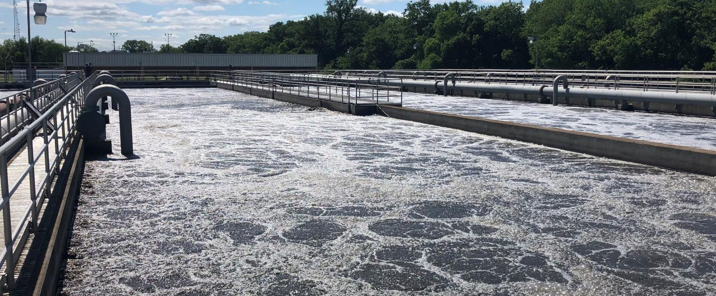
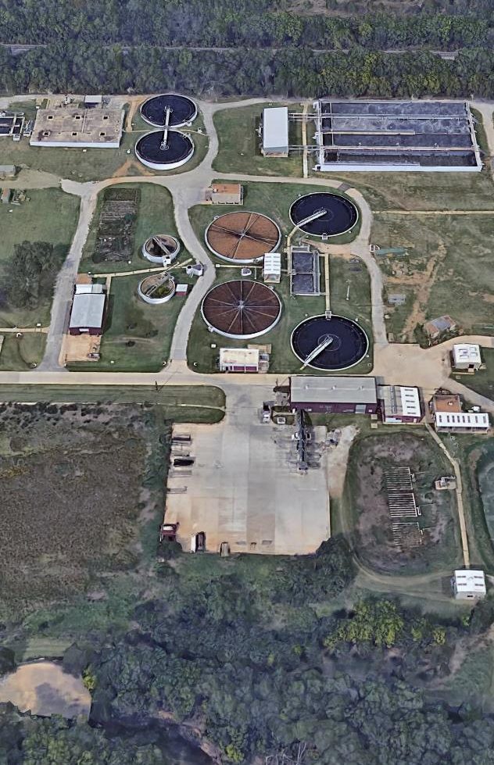

Addition by Subtraction – Expanding and Simplifying Lewisville’s Aged Secondary Treatment Process
Katelyn Hearon, City of Lewisville
Joel Cantwell, HDR
November 14, 2025

Slide 2
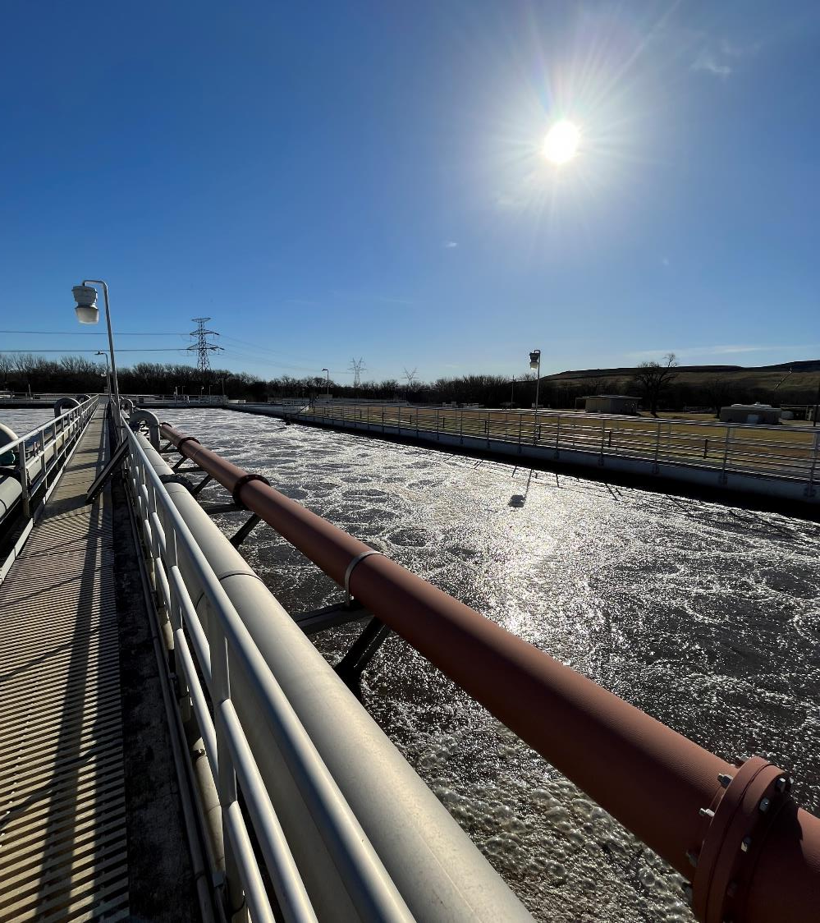
1
Existing Facilities Overview
2
Master Plan (2020)
3
Secondary Treatment Expansion Project (Current)
4
Questions

Slide 3
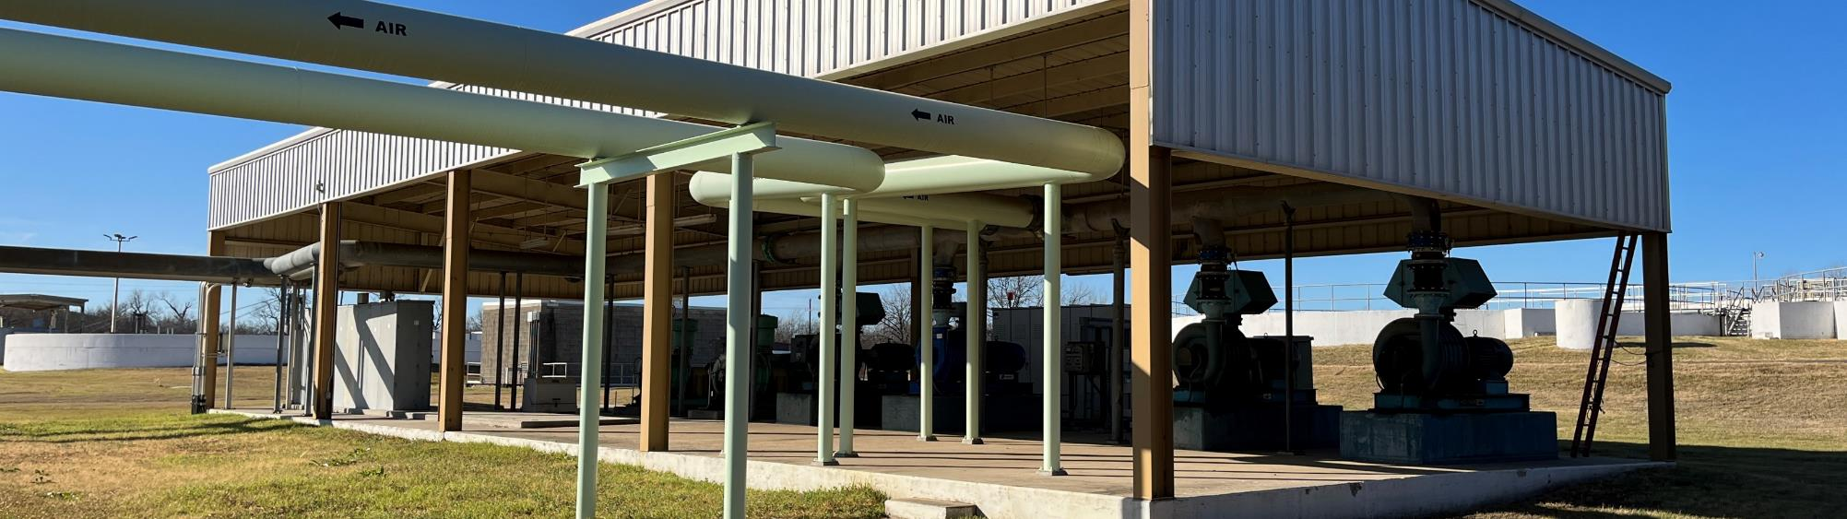
1
Existing Facilities Overview

Slide 4
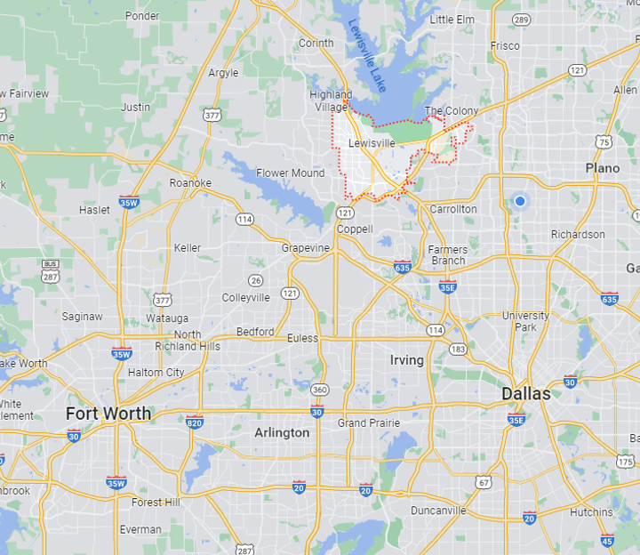
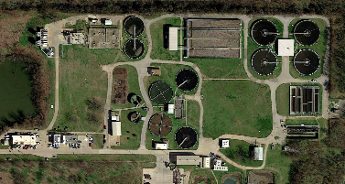
City of Lewisville
Population of 137,000
Growing at approx. 1.5% annually
Treat our own water and wastewater
Prairie Creek WWTP
Original 1950 (1.75 mgd)
Various expansions (1974, 1987, 1995, 2004, 2013)
Current permit for 12 mgd AADF / 30 mgd P2H
Prairie Creek WWTP

Slide 5
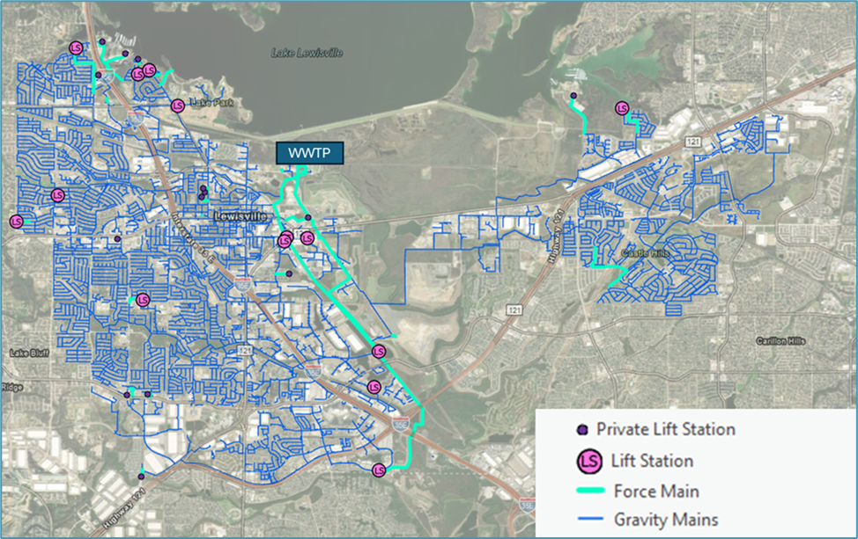
City of Lewisville Collection System
(18)
(17 miles)
(380 miles)

Slide 6
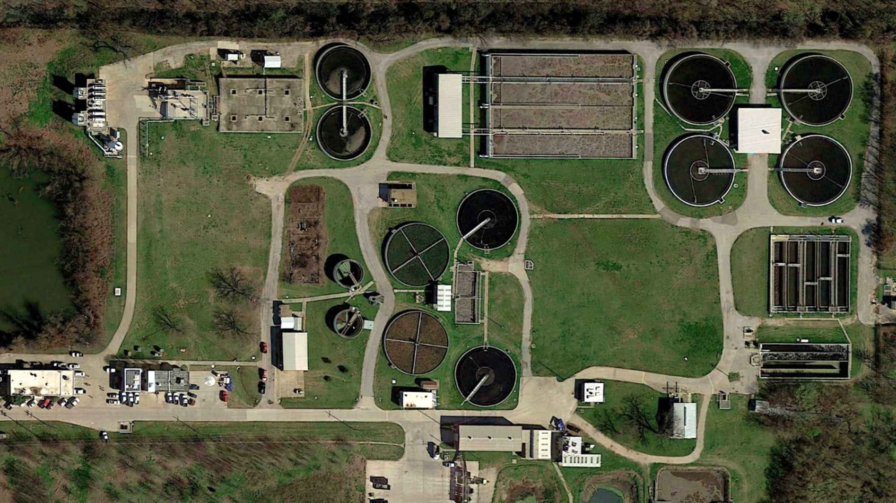
Screening
Grit Removal
Plant I
Plant II
Filters
Admin/Lab
Influent PS
Plant III
Chlorine Contact

Slide 7
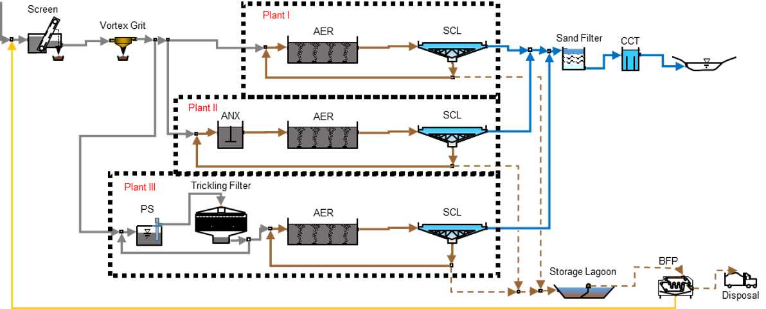
The Prairie Creek WWTP process includes 3 parallel secondary treatment plants
TPDES Permit Limits
Parameter | Value
AADF | 12 mgd
BOD | 10 mg/L
TSS | 15 mg/L

Slide 8
Capacity and process challenges are on the horizon
Capacity expansion needed by 2027
Potential ammonia limits this decade
Potential future phosphorus limits
Desire to address operational complexity of 3 plants

Slide 9
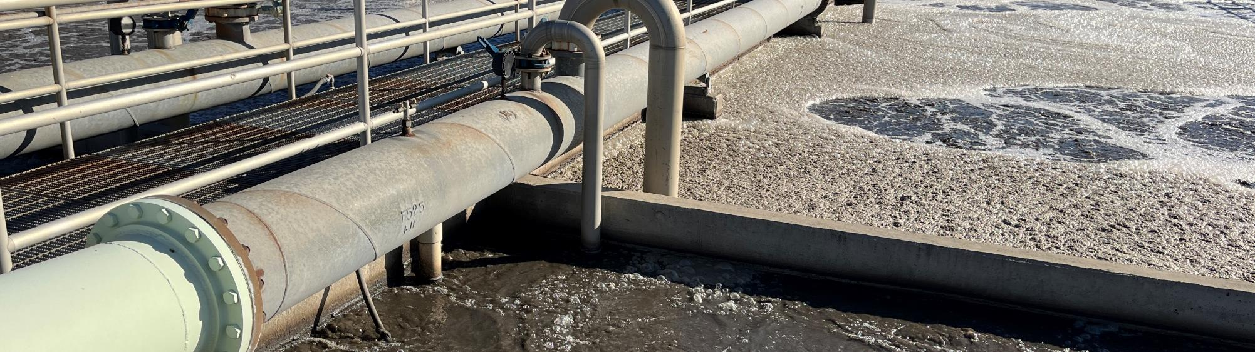
2
Master Plan

Slide 10
Master Plan Elements
Build-out planning criteria
Condition, process, and hydraulic assessments
Overall treatment process strategy
Improvements for each unit process
Short- and long-term CIP
Plant III near end of useful life
All aeration basins are shallow (12’ SWD)
Total capacity with full nitrification <11 mgd
Alternatives:
Conventional activated sludge (3-stage BNR)
Membrane bioreactors (MBR)
Aerobic granular sludge (AGS)

Slide 11
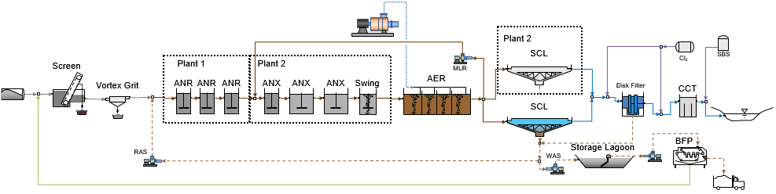
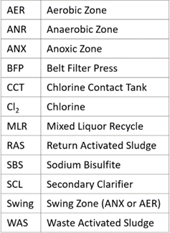
3-Stage BNR Conventional Activated Sludge

Slide 12
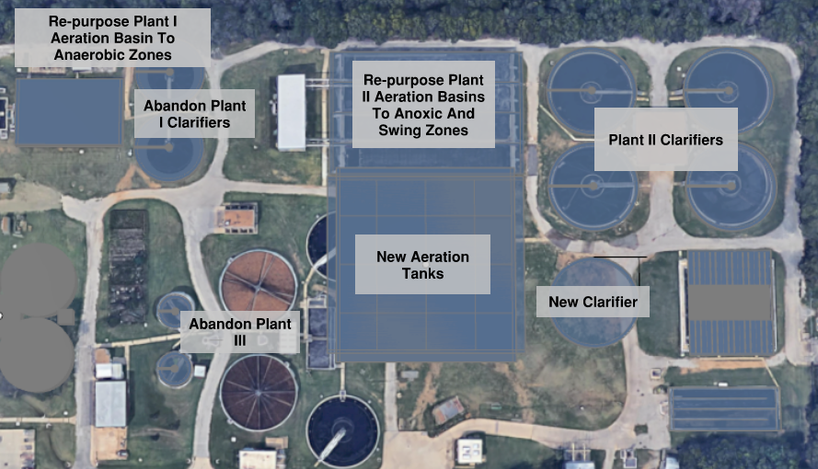

Slide 13
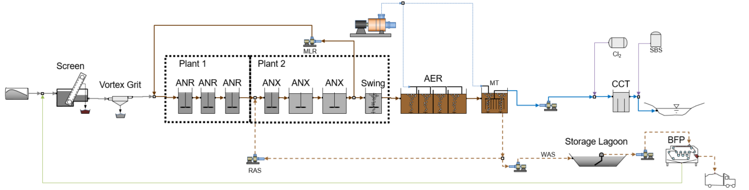
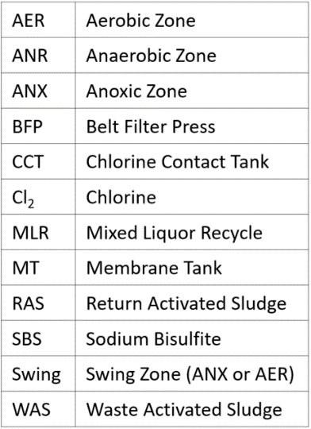
Membrane Bioreactor

Slide 14
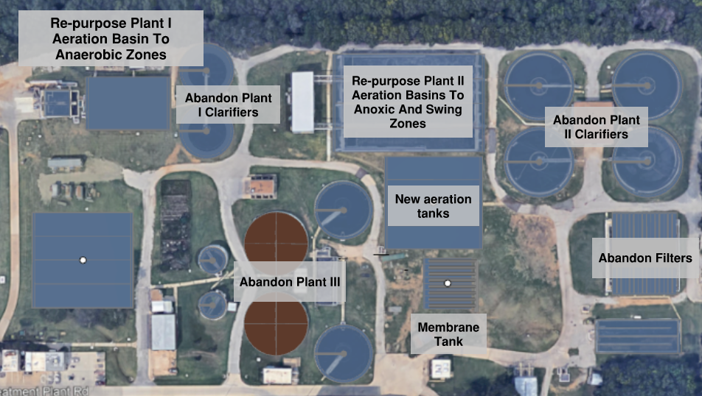

Slide 15
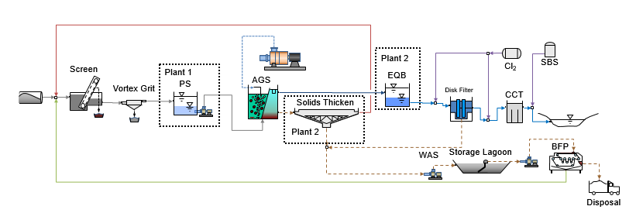
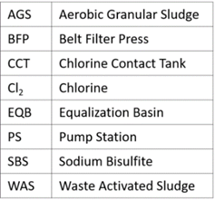
Aerobic Granular Sludge (AquaNereda®)

Slide 16
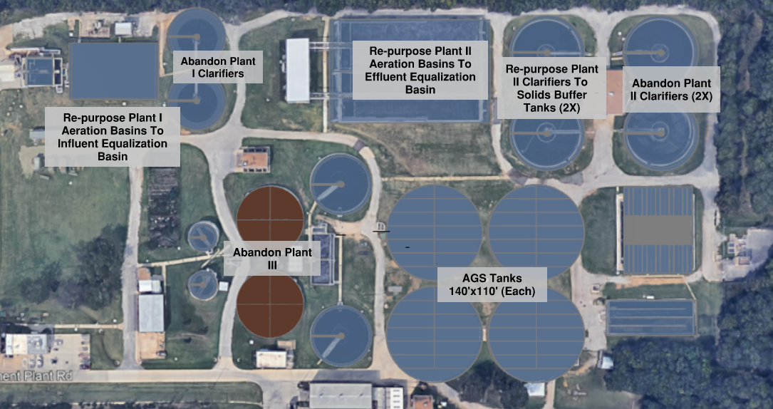

Slide 17
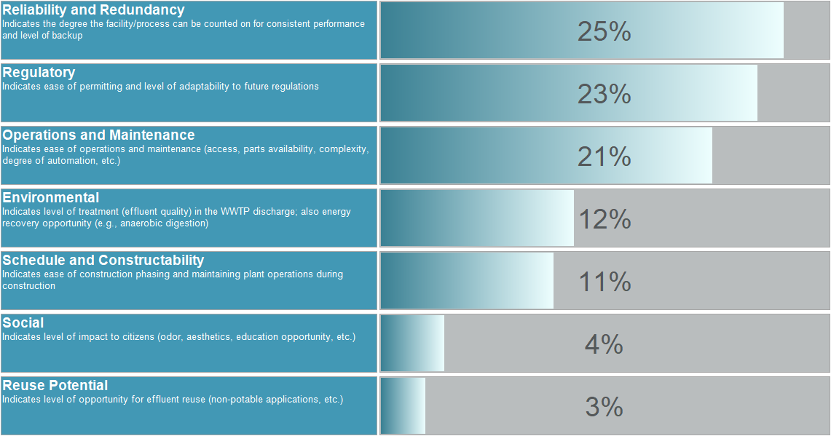
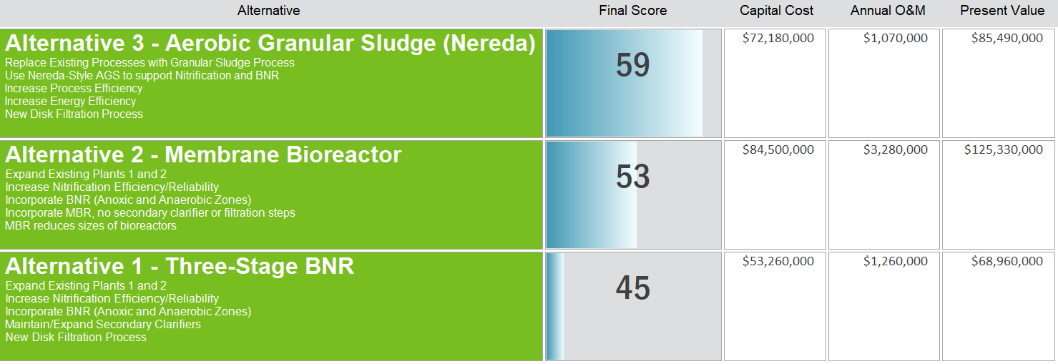
Decision modeling helped the City select the preferred approach

Slide 18
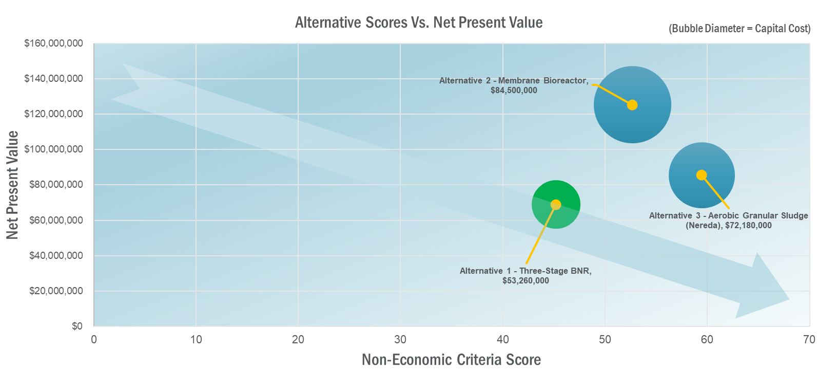
Conventional 3-stage BNR was selected

Slide 19
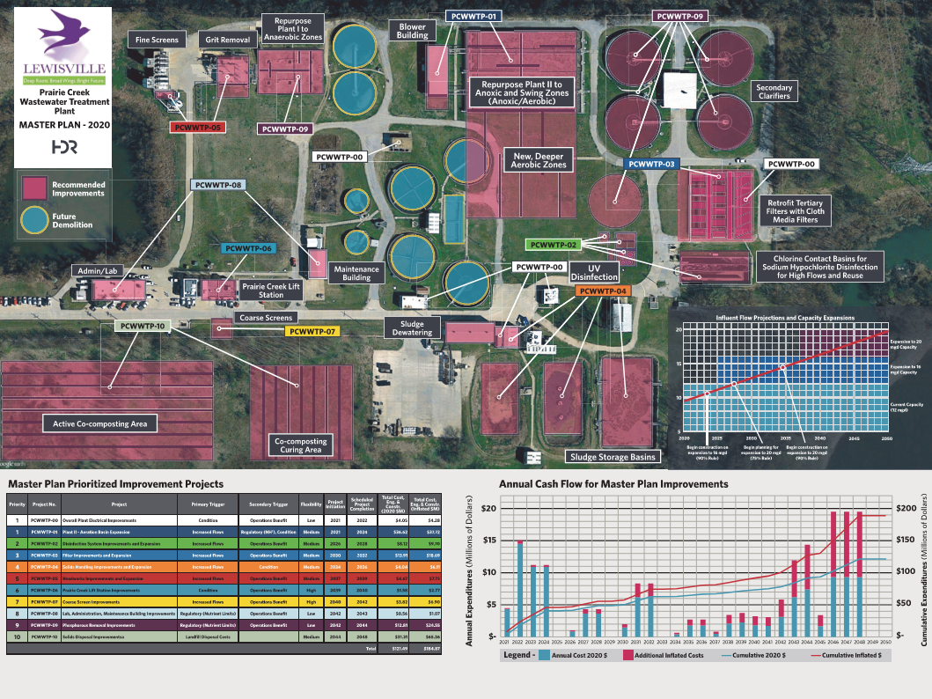
Master Plan was finalized in 2020
The first major project was aeration basin expansion

Slide 20
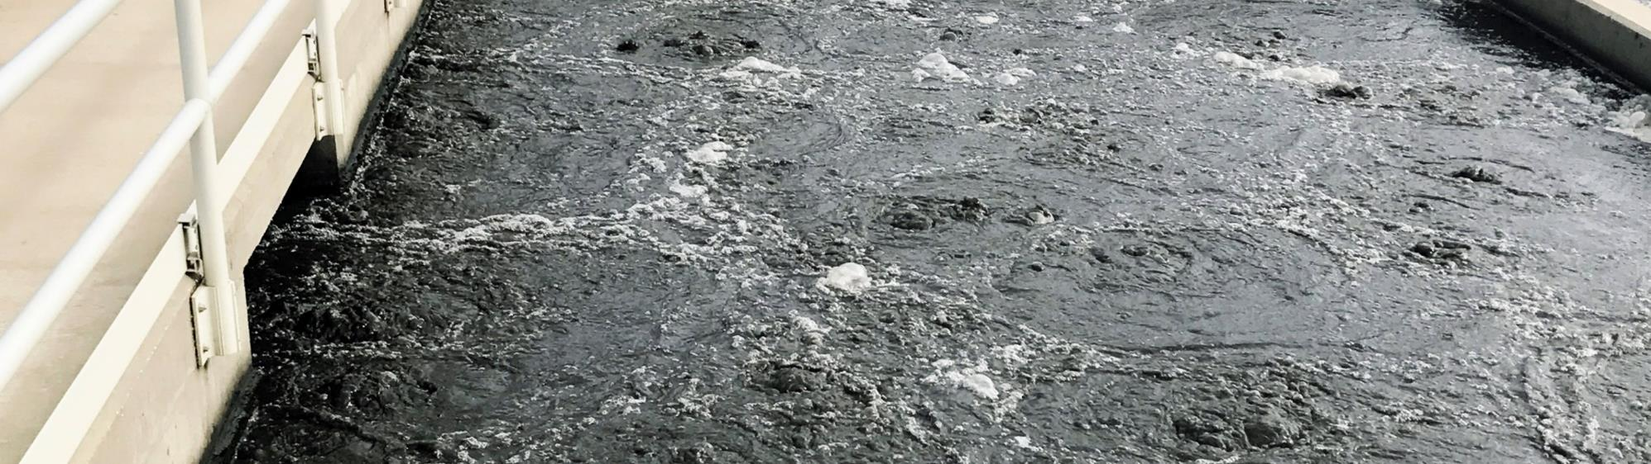
3
Aeration Basin Expansion Project

Slide 21
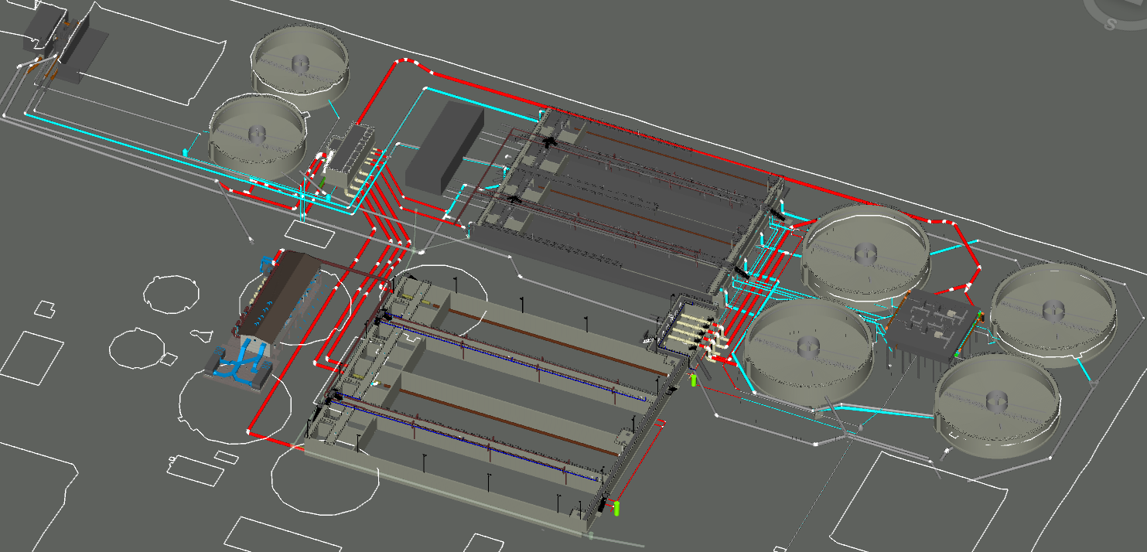
The Project Modernizes the Plant’s Secondary Treatment
Future Rehab Basins No. 1-4 (derate to 4-mgd)
Secondary Clarifier Splitter Structure
RAS Pump Station Rehab
Aeration Basin Splitter Structure
Aeration Basins No. 5-8 (16-mgd)
Blower Building

Slide 22
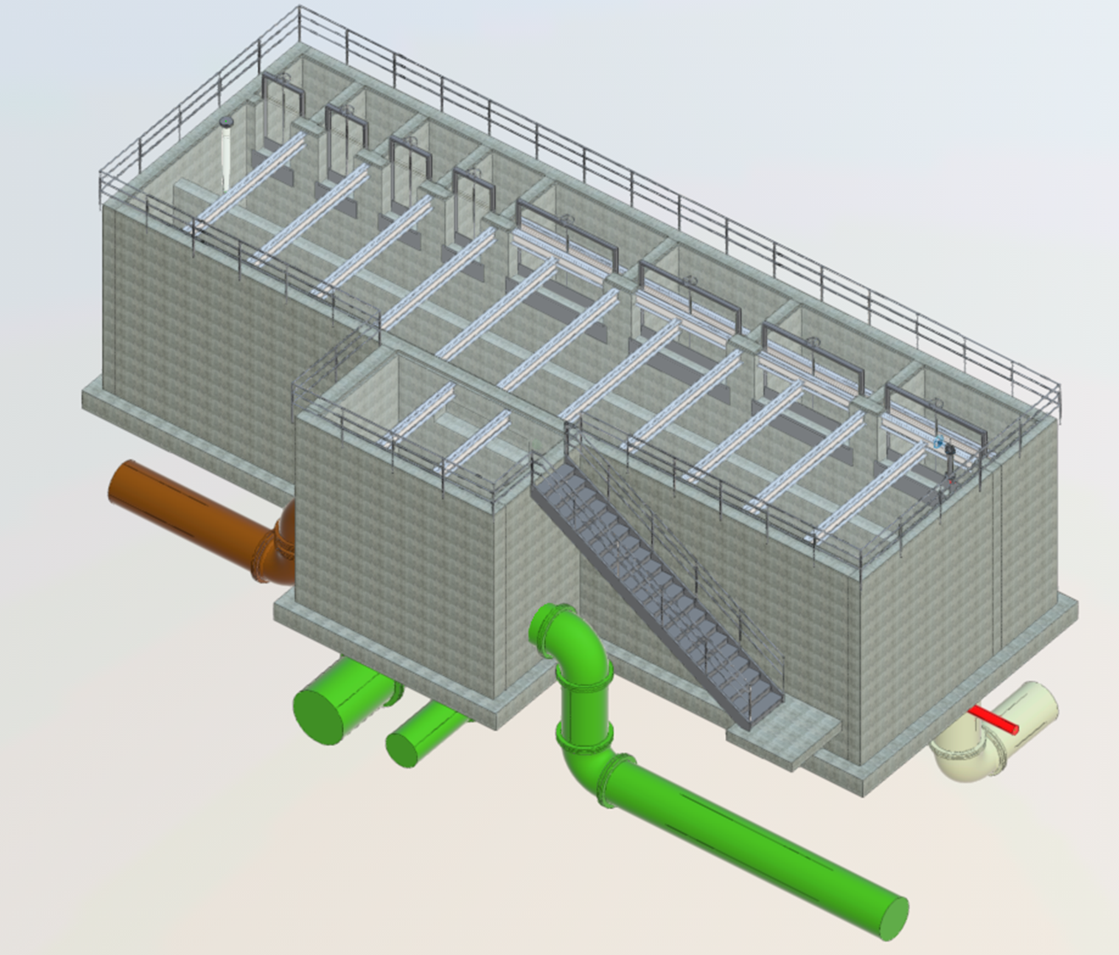
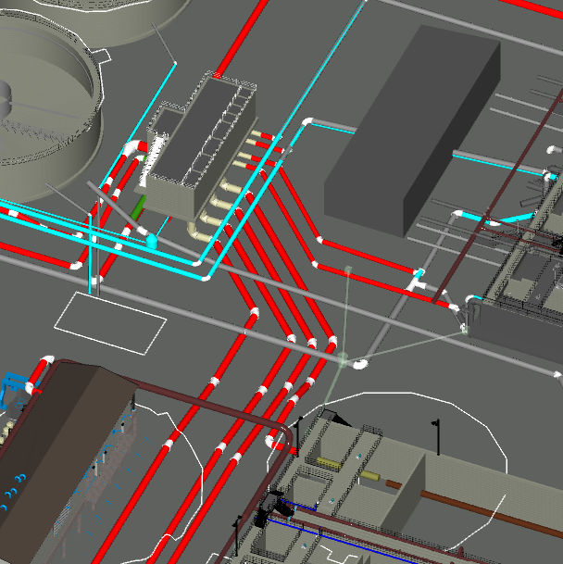
Aeration Basin Splitter Structure (8-way flow split)
RAS
Influent from Headworks

Slide 23
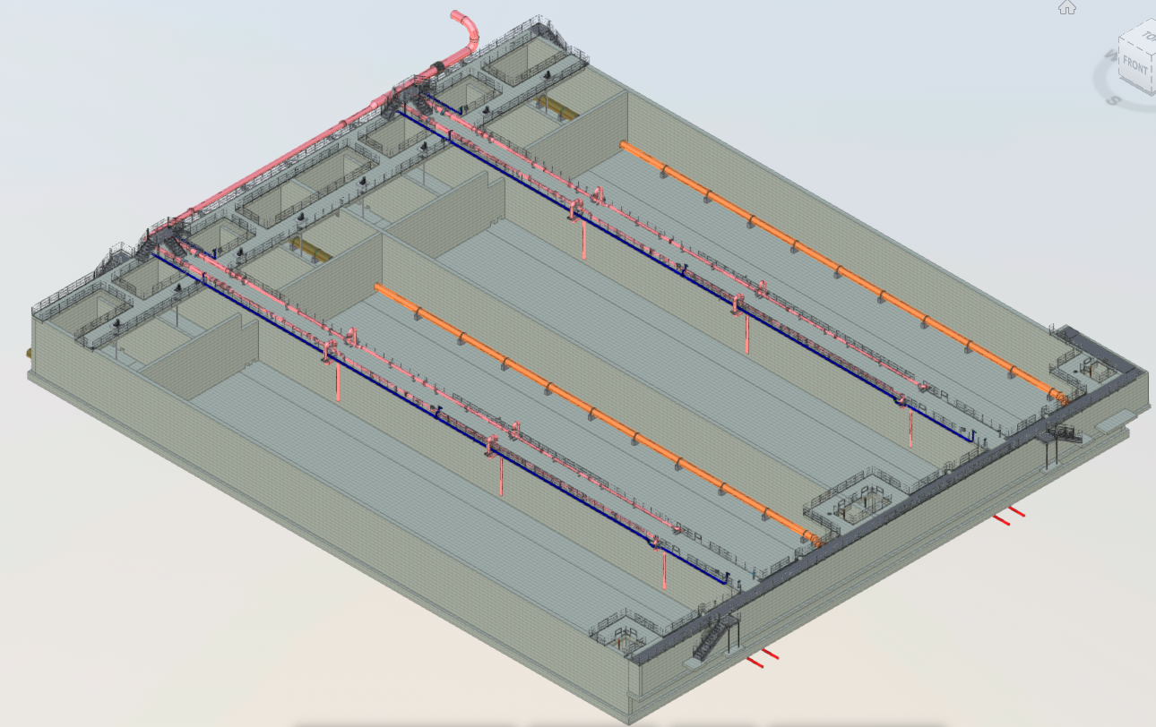
Aeration Basins No. 5-8
Anoxic Zones
Aerobic Zones (tapered)

Slide 24
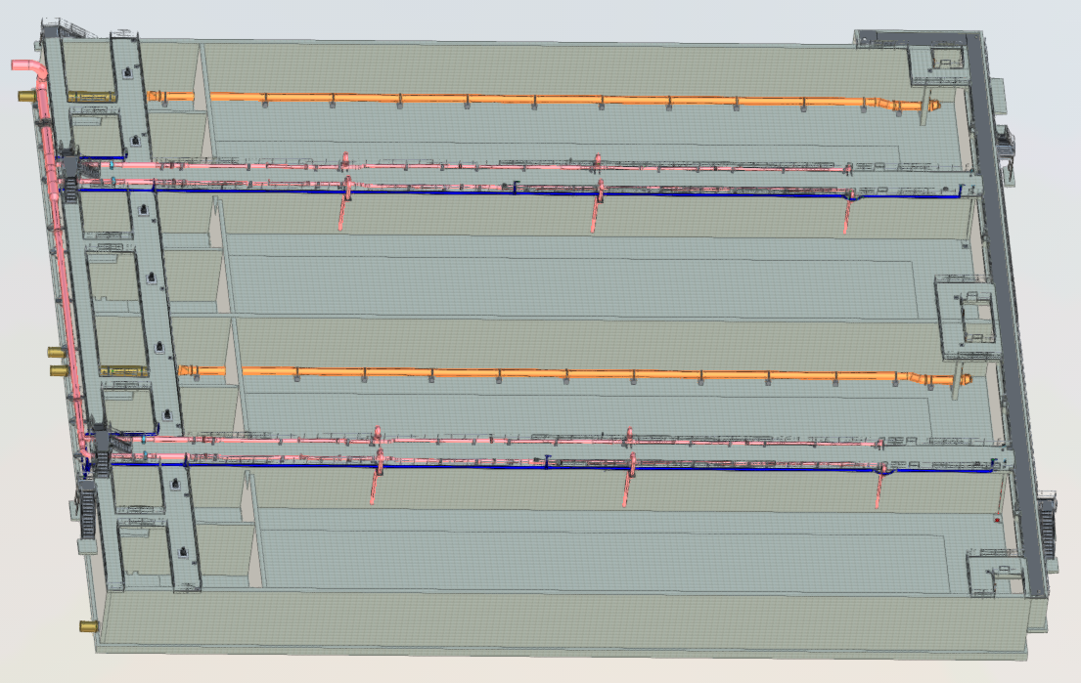
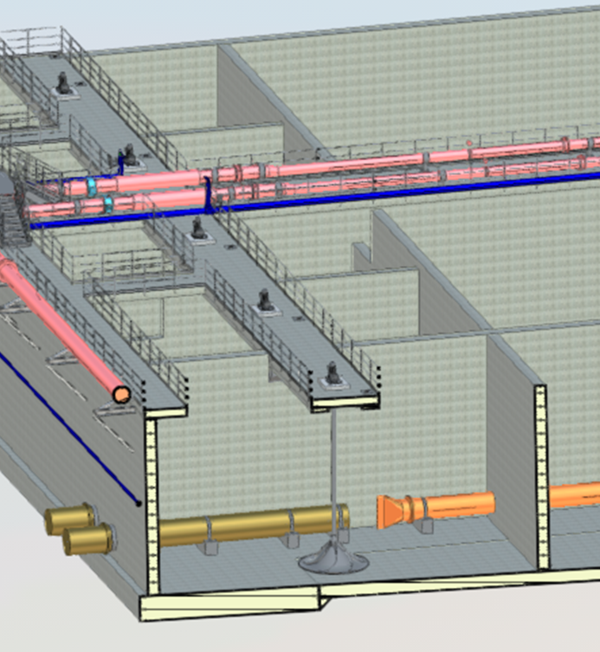
Aeration Basins No. 5-8
Mixed Liquor Return
Anoxic Zones

Slide 25
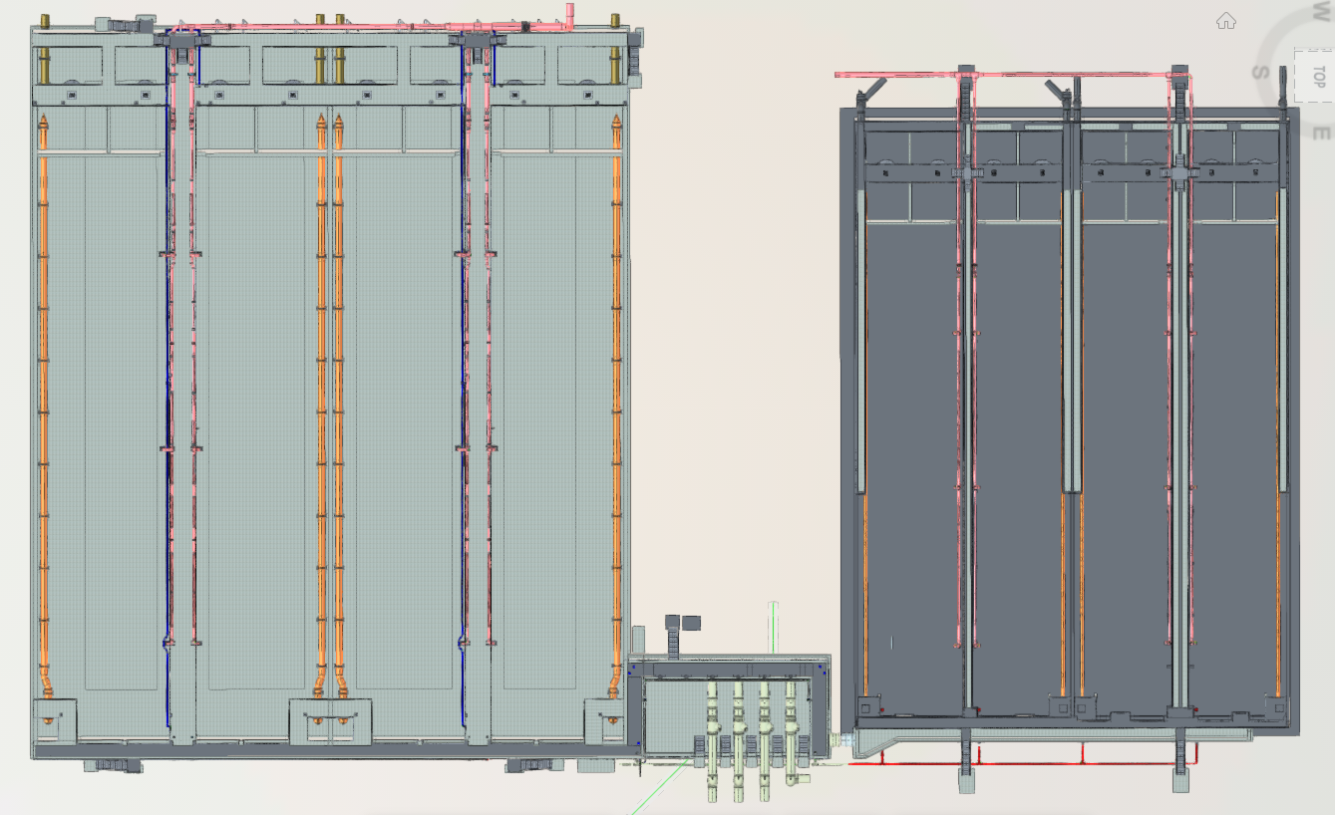
Aeration Basins 1-4 (Future Rehab)
Aeration Basins 5-8
Secondary Clarifier Splitter Structure

Slide 26
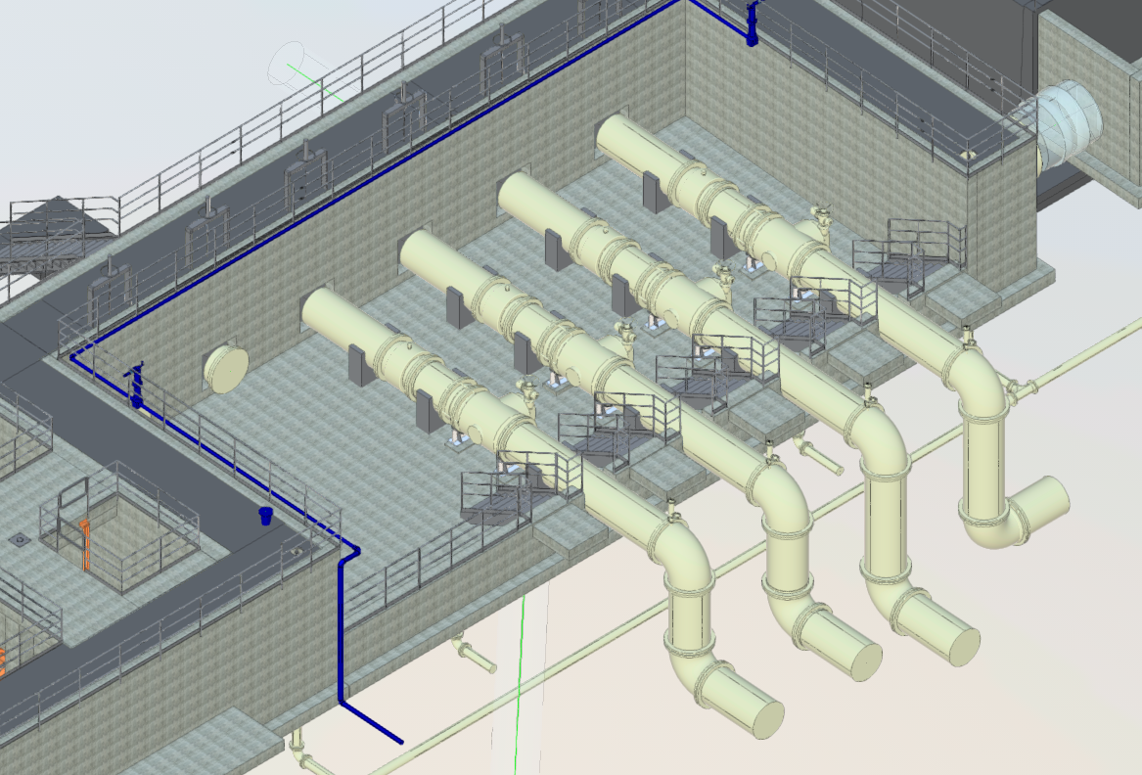
Secondary Clarifier Splitter Structure
36” Mag Meter
36” Motorized Plug Valve

Slide 27
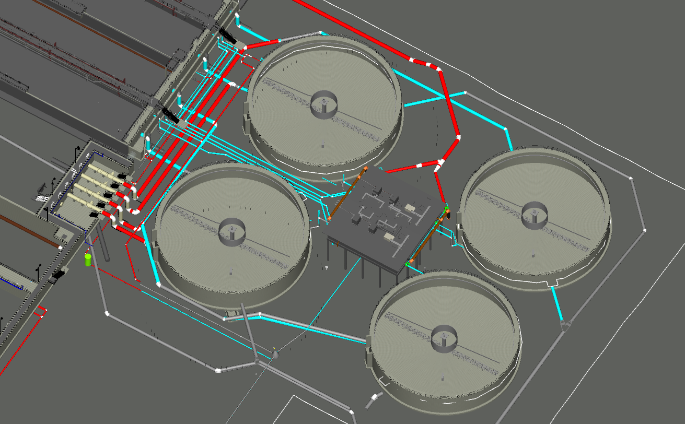
RAS Pump Station
No. 2
No. 1
No. 3
No. 4
Secondary Clarifier Splitter Structure

Slide 28
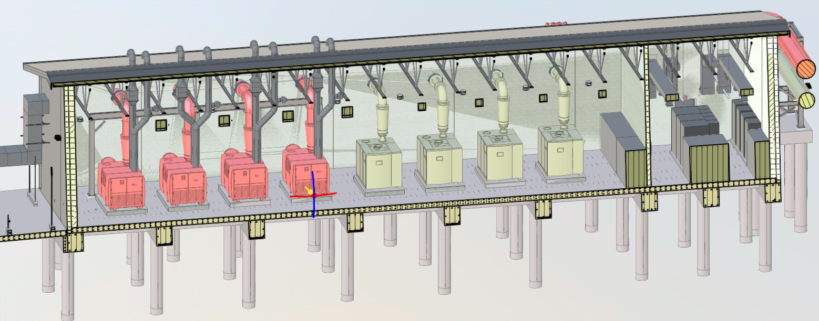
Blower Building
Blowers No. 5-8 (Future)
Blowers No. 1-4

Slide 29
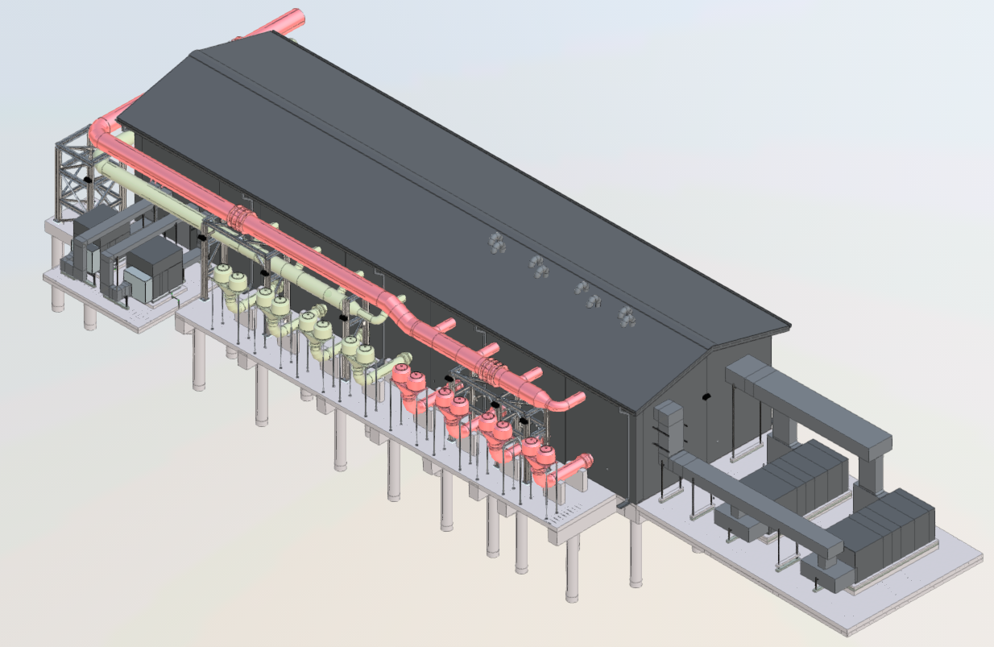
Blower Building
36” Air Header
Inlet Filter/Silencer

Slide 30
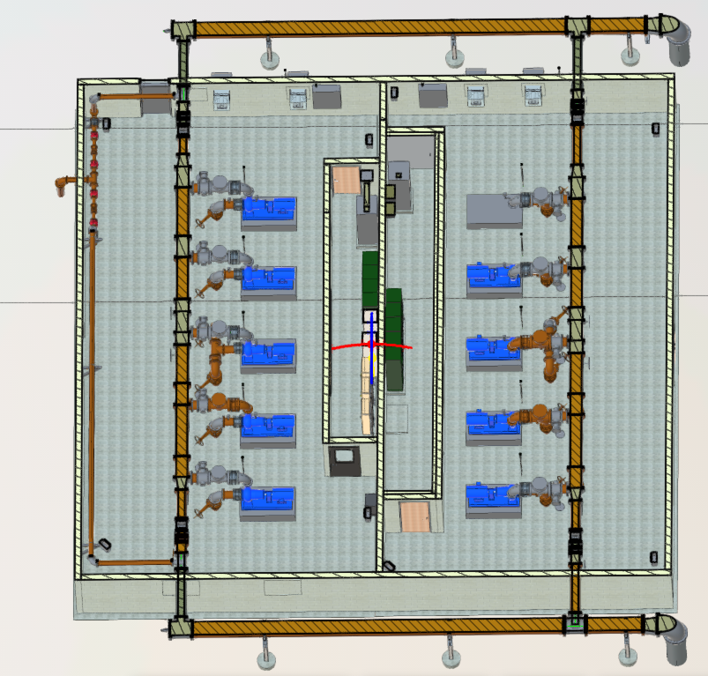
RAS Pump Station
Replace all pumps, valves, and piping
Replace electrical and add VFDs
Add automated valves and meters for wasting sludge

Slide 31
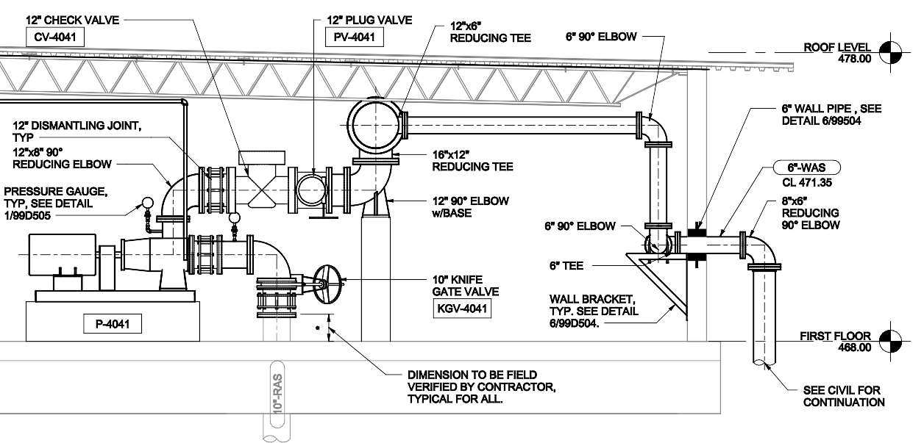
RAS Pump Station – minimum clearance prevented costly building renovations
7’

Slide 32
Key takeaways
Strive to simplify operations while increasing reliability
Reuse existing infrastructure where possible
Evaluate innovative technologies but conventional approaches may win out (use decision modeling)
Consider how to maintain treatment capacity during construction

Slide 33
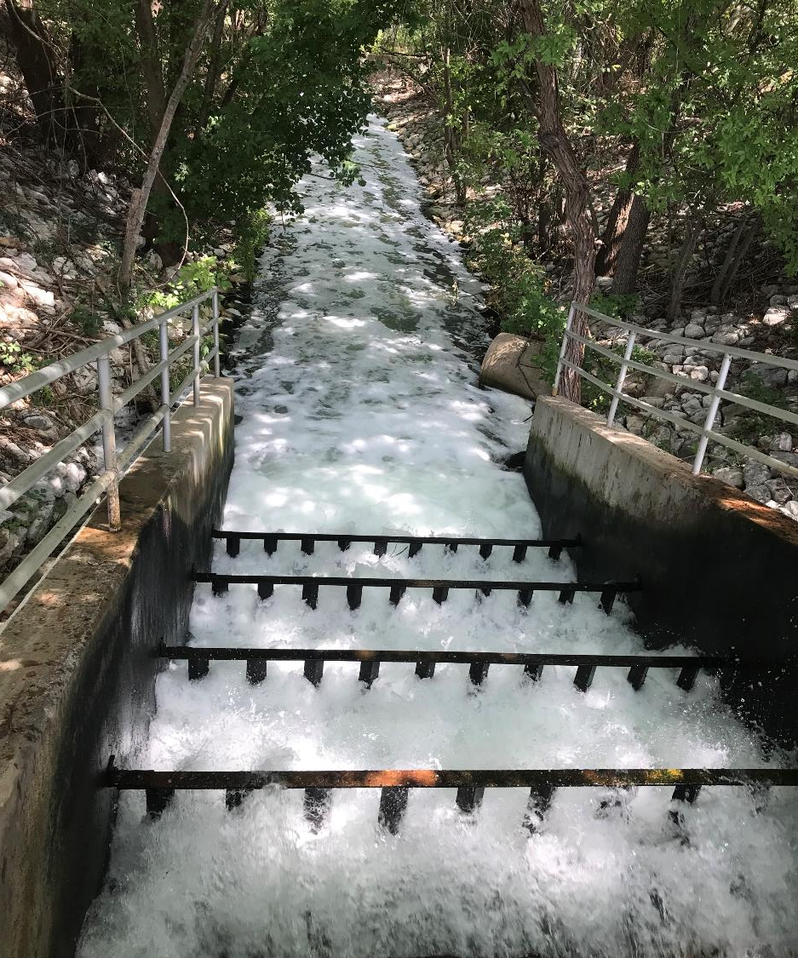
Questions?
Katelyn Hearon
Assistant Director, Public Services
City of Lewisville
khearon@cityoflewisville.com
972-219-3509
Joel Cantwell, PE
Vice President
HDR
joel.cantwell@hdrinc.com
972-960-4440

