Slide 1
Clear Waters Ahead – North Texas Municipal Water District’s Operator Training and Competency Programs
November 14, 2025
Hunter Stephens

Slide 2
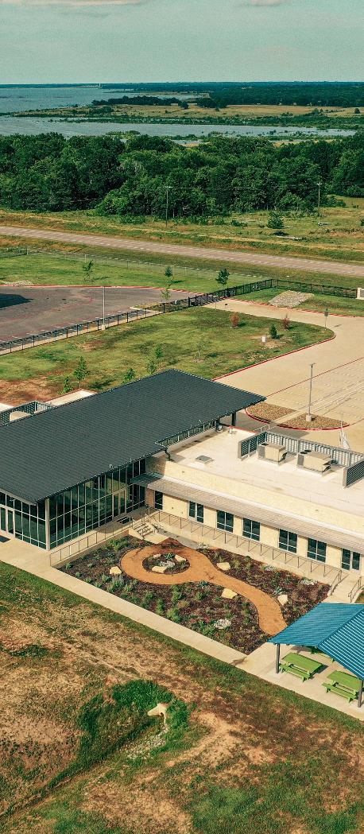

LEGACY OF SERVICE
“We decided we were all in this together. We couldn’t do it separately.” ~ from Gift of Water, Legacy of Service: A History of North Texas Municipal Water District
13 MEMBER CITIES
Allen | Farmersville | Forney | Frisco | Garland | McKinney | Mesquite
Plano | Princeton | Richardson | Rockwall | Royse City | Wylie
1951 Created by Texas Legislature to Provide Water Service
1956 Began Providing Treated WATER to Member Cities 1970s Expanded to WASTEWATER Services
1980s Expanded to SOLID WASTE Service

Slide 3
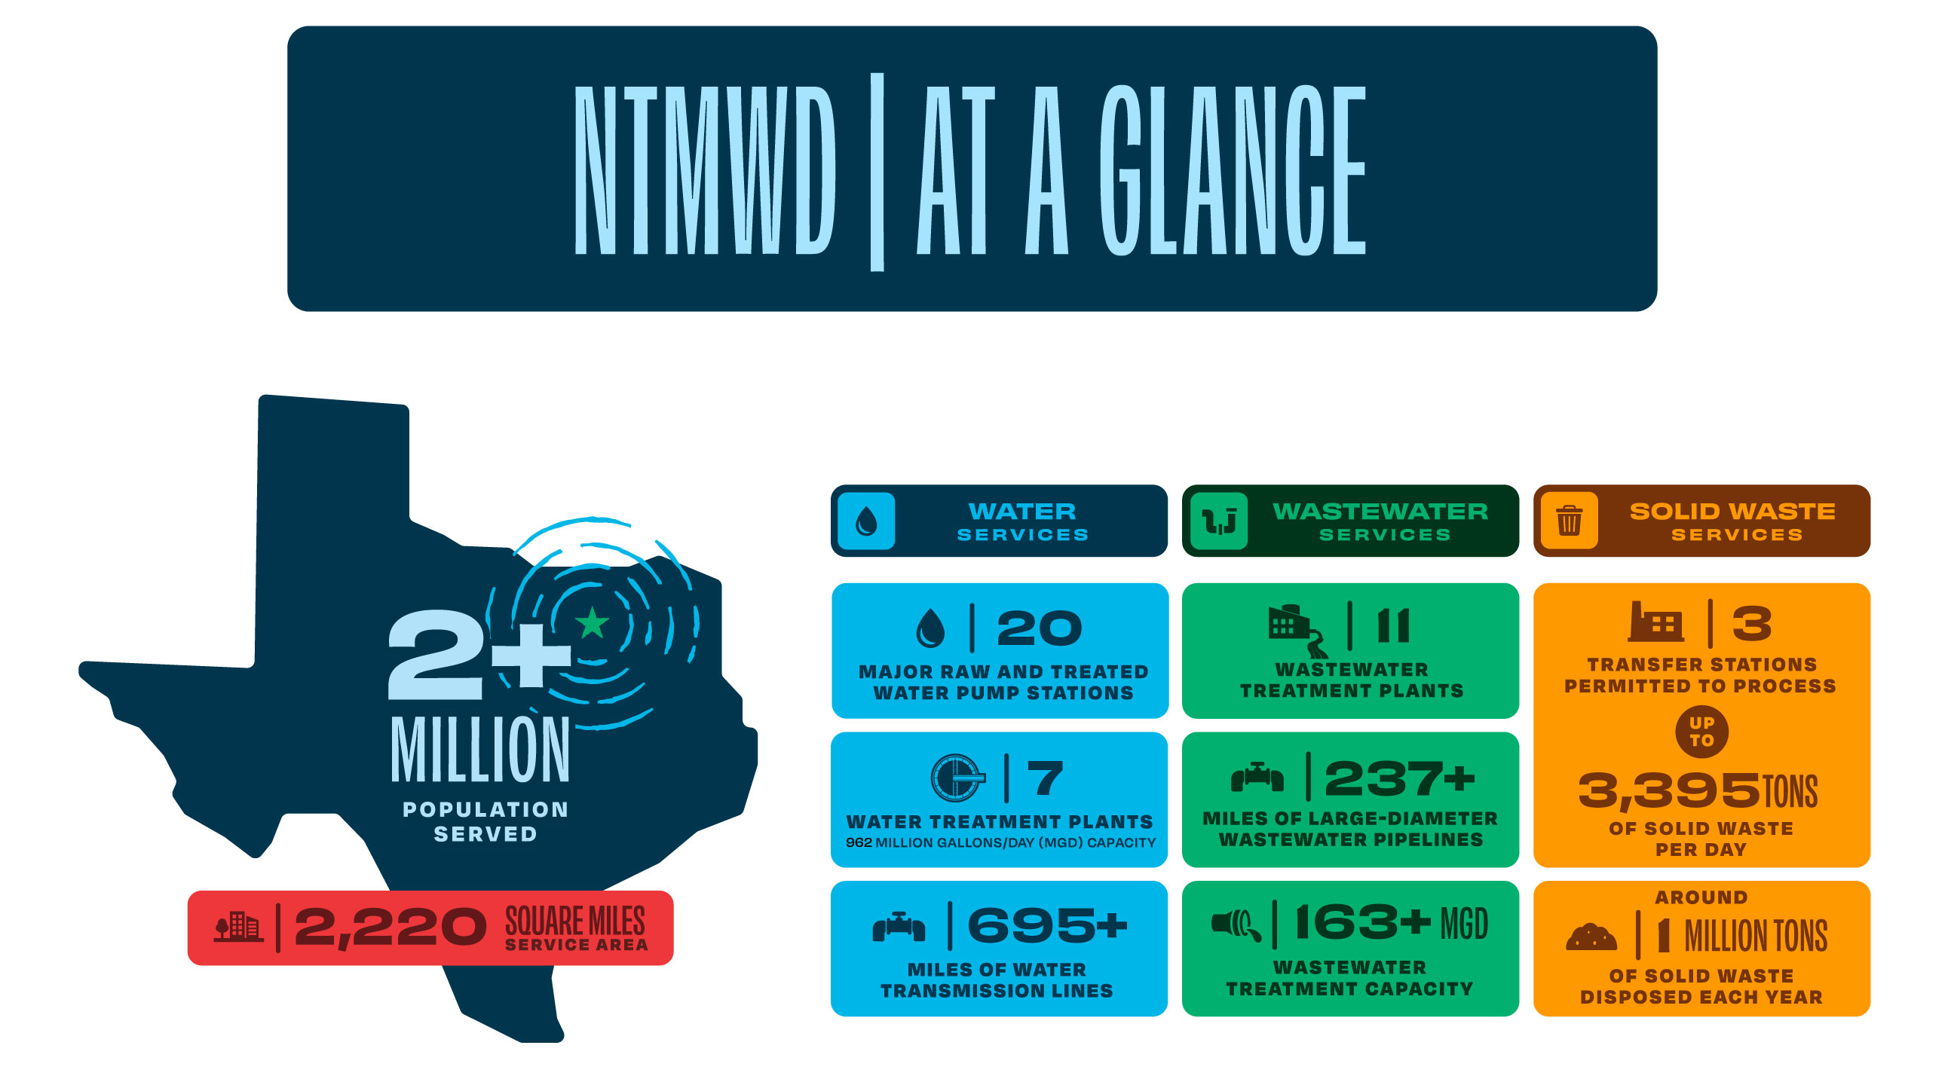

Slide 4
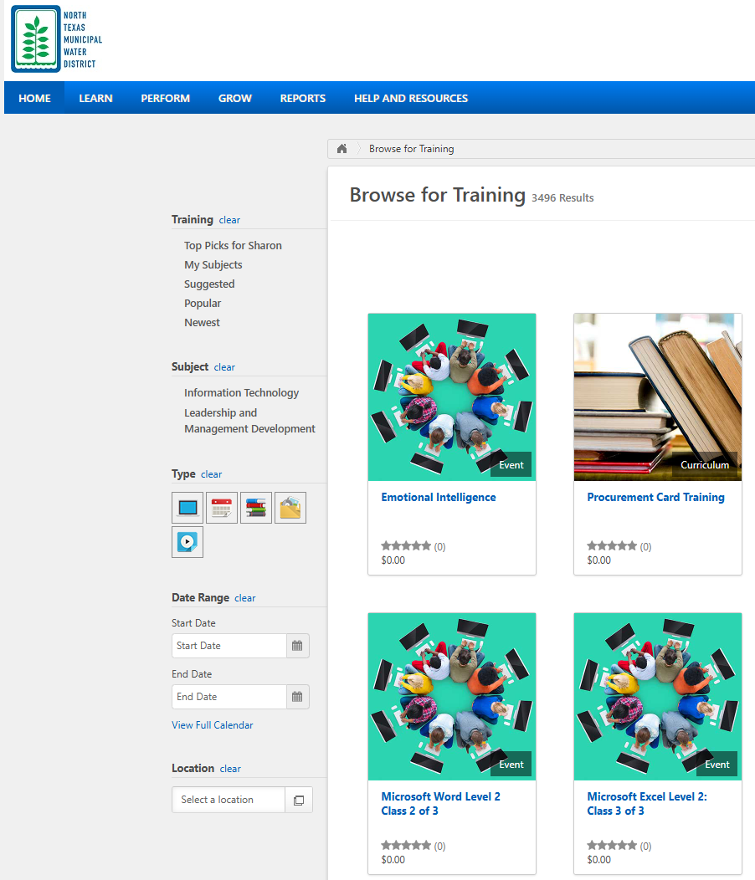
NTMWD Training and Professional Development Team
Developed and manages our Learning Management System (LMS)
Sign-up for in-person classes and access to online learning
Topics include:
Water/WW Operator Licensing/CEU classes
Safety Courses (Confined Space, HazComm, First Aid/CPR)
Leadership Courses (Emotional IQ, Self-Review, Difficult Conversations)
Technology Courses (Word, Excel, Outlook, etc)
Future: Advanced Training Modules
Notes:
One stop shop to put all the training we just showed you in one place

Slide 5
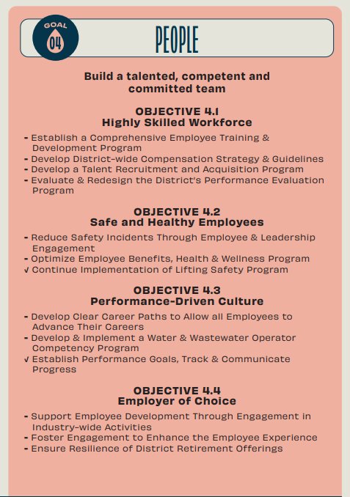
In-House Classes for Operator Licensing
Wastewater
Dual Credit
Advanced Technical Training
Online Learning Modules
Competency Program
Knowledge, Skills, and Abilities
Career Progression
Field Demonstrations
Site Specific Training
Water
Notes:
Deliver 26 In-House Operator Continuing Education Credit Hours/Calendar Year
Highlight that the survey results from the prior slide are included in the Strategic Plan.
Segway to Training Program
Majority of our workforce in the WW dept are the frontline workers. Typically, HS diploma and years of experience though some do have associates or bachelor’s degree. NTMWD requires all Lead Treatment Operators to have a Class B license, Lead Conveyance Operators to have a Class III Collections license, Wastewater Plant Supervisors to have an A license and Wastewater Conveyance Supervisors to have a Class III Collections license. All that requires training to:
- meet or exceed job requirements
- be prepared for promotional opportunities
- satisfy continuing education requirements
- be an active participant in continuous improvement (can’t improve what you don’t understand)

Slide 6


Our Competency Program – An Overview
Our “Why”
Ensure every operator is skilled to deliver reliable water services.
Our “Need”
Structured and consistent development
Mentorship and knowledge transfer
Safety, compliance, quality
Continuous improvement mindset
Our “How”
Define clear competency standards
Evaluate proficiency
Provide career progression readiness
Foster long-term professional growth
Notes:
Requested by employees (survey) to develop a path of progression and advancement – included as a Strategic Initiative
Sets minimum standards for each operator and mechanic level
Aids in employee’s career progression and readiness
Assesses workforce with impartiality
Provides more impactful mentoring to employee

Slide 7

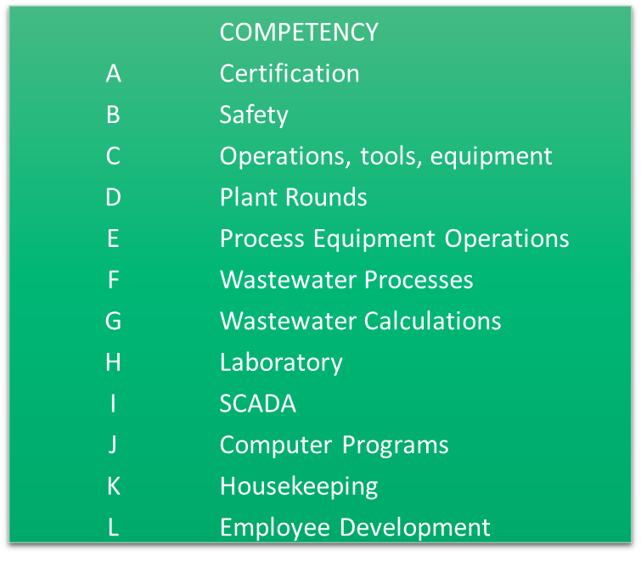
Competency Program Approach
Comprehensive roadmap to train and develop workforce.
Is position-specific and establishes common and core levels of knowledge, skills and abilities (KSAs)
Training based on:
Standard Operating Procedures
Best Management Practices
On the Job Training
Operations and Maintenance Manuals
TCEQ Approved Classes
NTMWD Policies and Procedures
Other sources as required
Training provided by designated staff (Leads, OPIIIs) and evaluations conducted by supervisory staff.
Notes:
Competency areas developed by Plant Supervisor as all plants are not created equal (i.e. not all plants have BNR, bench sheets/rounds could be different, etc).

Slide 8
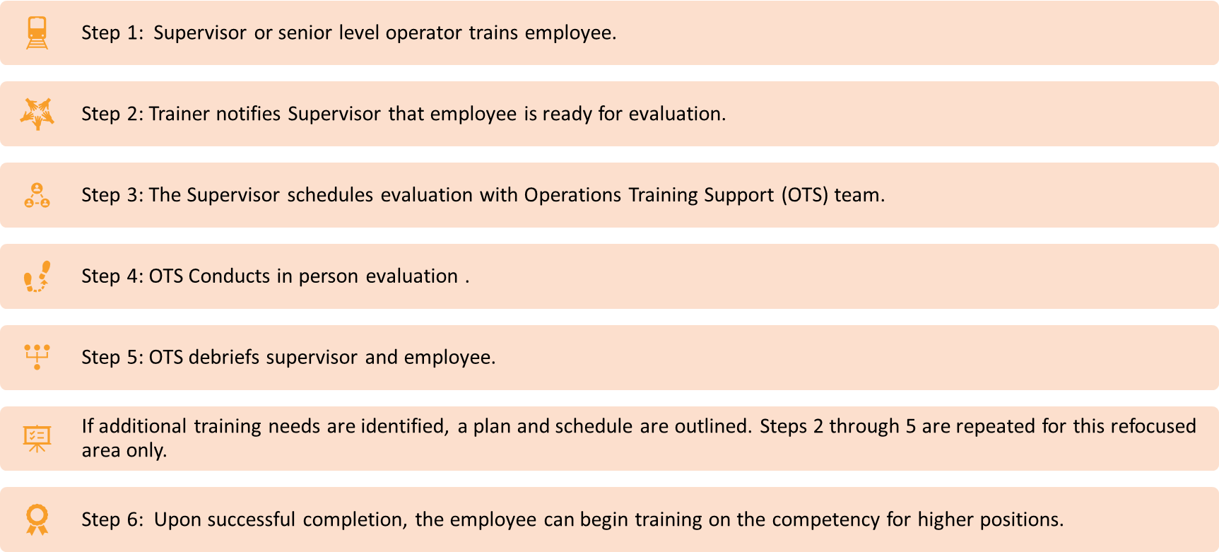
Employee Evaluation
Notes:
Plant Supervisor had input to the site specific KSAs for the competency areas – not all plants are created equal (i.e. may not have BNR)
Training based on:
Standard Operating Procedures
Best Management Practices
On the Job Training
Operations and Maintenance Manuals
TCEQ Approved Classes
NTMWD Policies and Procedures
Other sources as required

Slide 9

Early Wins, Challenges, and Next Steps
Early Wins
Requirements documentation
Identified strong change advocates
Challenges
Change Management – new process for NTMWD
Time and Personnel Investment for Evaluation Phase
Next Steps
Increase Momentum
Identify and Train Additional Evaluators
Implement Program for Water Operations
Develop Advanced Technical Training Program
Learning Retention
Notes:
Early Wins Examples: 1. Justified need for team dedicated to the program 2. Helped with knowledge transfer for upcoming retirees

Slide 10

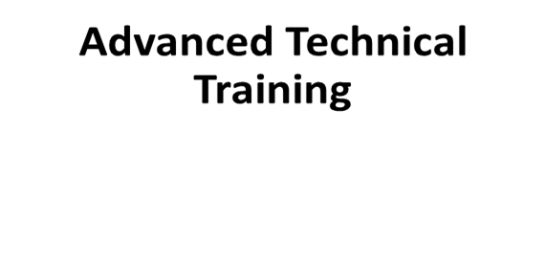
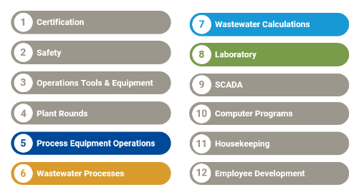
Advanced Technical Training Program
Consultant reviewed the Competency Program Manual, the completed Evaluation Forms and based on input from NTMWD; this program scope focuses on 4 areas of competencies

Slide 11
Advanced Technical Training Objectives
Increase staff understanding and retainage
Develop clear definitions, consistency across facilities, and identify metrics for performance measurement for each KSA and competency.
By focusing on the Wastewater Processes competency area, the program can:
Address subject matter that is applicable to all facilities
Standardization of KSAs across facilities
Focus on treatment elements that have significant impact to permit compliance
Build a foundation of knowledge that will expand into Process Equipment Operations, Wastewater Calculations and Laboratory
Notes:
Rowlett Creek, Sabine Creek, Stewart Creek and Wilson Creek

Slide 12
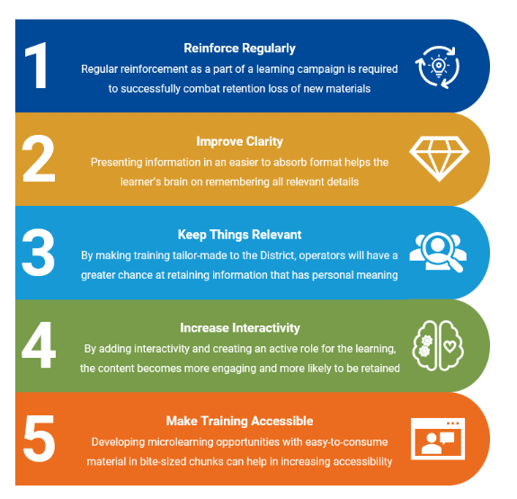
Learning Retention – Easy as 1, 2,…5?
Deliverables
In-Person Training Session
On-Demand Microlearning Videos
Equation Reference Sheet, Example Problems and Practice Problems
Notes:
Rowlett Creek, Sabine Creek, Stewart Creek and Wilson Creek
Staff Assessments with the goal of the results informing prioritization of education topics within the KSAs for in-person
Develop training content in powerpoint format
Provide on-demand videos in “bite-size chunks”
Develop leave behind materials
Conduct In-Person Training
Post-Evaluation

Slide 13
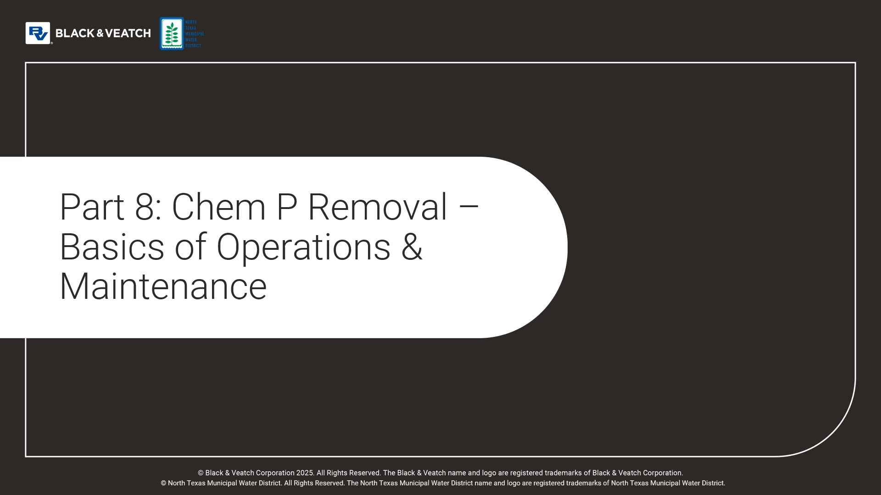
On-Demand Video Example

Slide 14
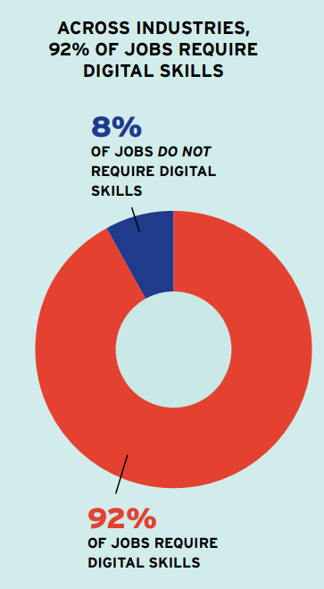
DIGITAL SKILL BUILDING
A rapidly changing workplace requires ongoing digital skill building
Digital skills are no longer optional; they are the foundation of nearly every job.
92% of jobs require digital skills, yet one-third of U.S. workers haven’t had the opportunity to build even foundational digital skills (the essential abilities required to effectively use digital technologies in the workplace) — despite their readiness to learn and contribute.
The fast-changing nature of digital tools means workers aren’t just playing catch-up; they’re in a constant race to stay employable.
Notes:
Approach aligns with how many adults prefer to learn, while also meeting businesses’ real-time workforce needs.
Critical for industries not traditionally seen as tech heavy where tasks that once required little or no digital interaction are evolving to rely more heavily on digital tools and skills to learn and contribute.
From the report: 8 Reasons Why Skills Training is Key to Economic Prosperity, The Empirical Cast for Investments in Workforce Development, National Skills Coalition, May 2025.
The statistics above are cited as follows in the report:
Amanda Bergson-Shilcock and Roderick Taylor with Nye Hodge, “Closing the Digital Skills Divide: The Payoff for Workers, Business, and the Economy” (National Skills Coalition, 2023)
https:// nationalskillscoalition.org/wp-content/uploads/2023/02/NSCDigitalDivide_report_Feb2023.pdf 12 https://nationalskillscoalition.org/blog/news/todays-tech-jobs-arehiding-in-plain-sight-and-theyre-not-where-you-think/

Slide 15
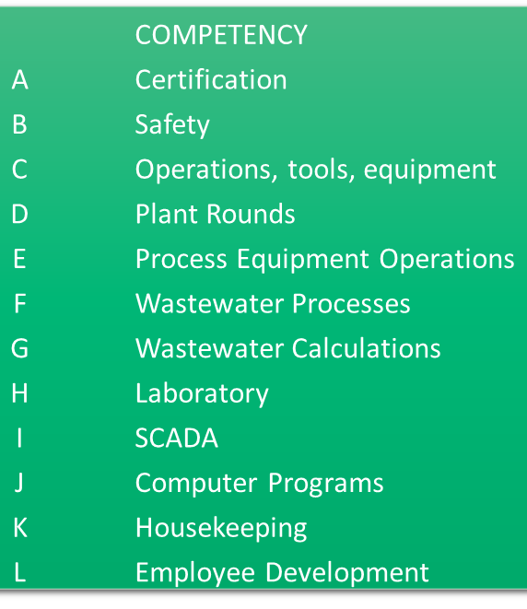
Why are Digital Skills Needed?
NTMWD O&M Staff
HR System I (Time, Hiring, Benefit Elections)
Finance System (Orders, Budget)
Maintenance Management System (Work Order, Asset Mgmt, Inventory, Planning and Scheduling)
SCADA (Alarms, Monitoring, Operation)
Operations Data and Reporting Systems (LIMS, HachWIMS)
HR System II (LMS – Performance Review, Training Sign-Ups, Online Learning)
Email (Send and Receive Communication
Power BI Dashboards, Required Training Completion
Laserfische Forms (LOTO, Confined Space, Change in Operation, Incident Reporting)
MS Office (Excel, Word and Powerpoint)

Slide 16

Training and Development For Today and our Future
Better Trained Employees
Increased Employee Engagement
Lower Turnover Rates
Develop Future Leadership
Improve Operational Reliability
Notes:
NTMWD has prioritized training and development of our employees with the objective to build a talented, competent and committed team. In the last three years, we:
Implemented a wastewater operator competency program to provide a career roadmap, level the KSAs of our workforce and ensure each person receives the training they need to be successful in their job
Implemented an advanced training program to further develop operator KSAs and performance metrics to aid in operator growth and development
Implemented a Learning Information System for ease of signing up for coursework, access to online content, tracking CEUs, ensuring completion of mandatory training requirements

