Slide 1
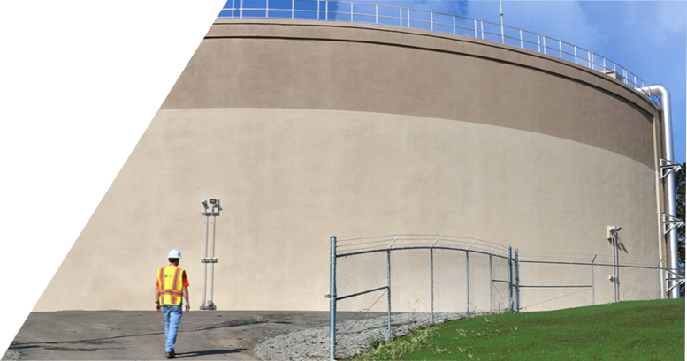
TACWA Presentation Mitigating Wet Weather Impacts on Collection Systems and Facilities
March 27, 2026

Slide 2

The Wet Weather Problem
Study and Planning Considerations
Technology Overview
Case Studies
Lessons Learned

Slide 3
Wet Weather Study and Planning

Slide 4


Slide 5
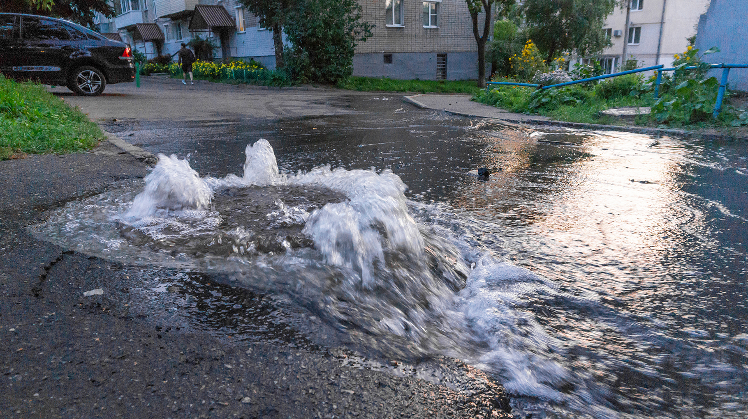
Aging Sewer Systems Can Be Impacted by Storms
Stormwater inflow and infiltration can overwhelm a sanitary sewer system and treatment plant
Capacity is impacted with surcharging and rising sewer levels
Excess wastewater can be released into streets and local waterways
SSOs are a national problem

Slide 6

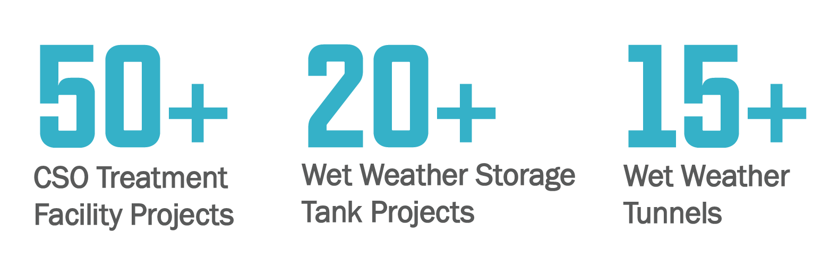
National Experience
Fort Worth, TX
City of Omaha
Great Lakes Water Authority
Northeast Ohio Regional Sewer District
Metropolitan Sewer District of Cincinnati
Allegheny County Sanitary Authority
Pittsburgh Water & Sewer Authority
Nashville Metro Water
New York City DEP
Metropolitan St. Louis Sewer District
City of Indianapolis
Pinellas
Wade Trim Wet Weather Experience

Slide 7
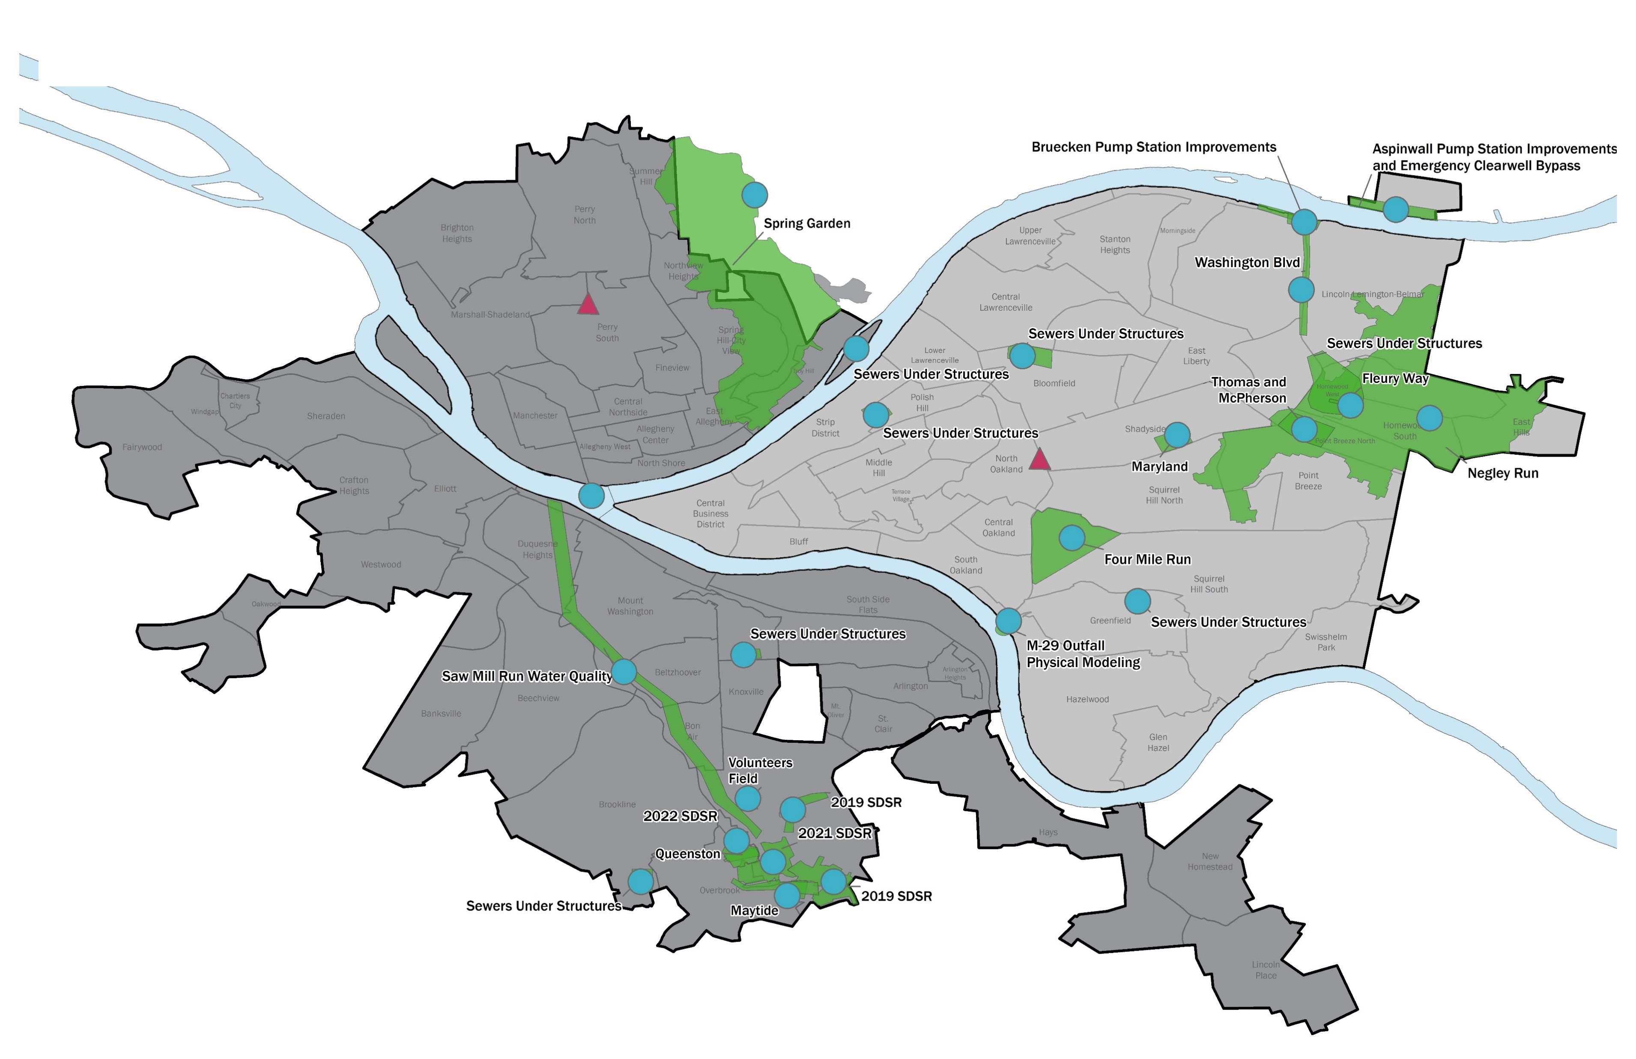
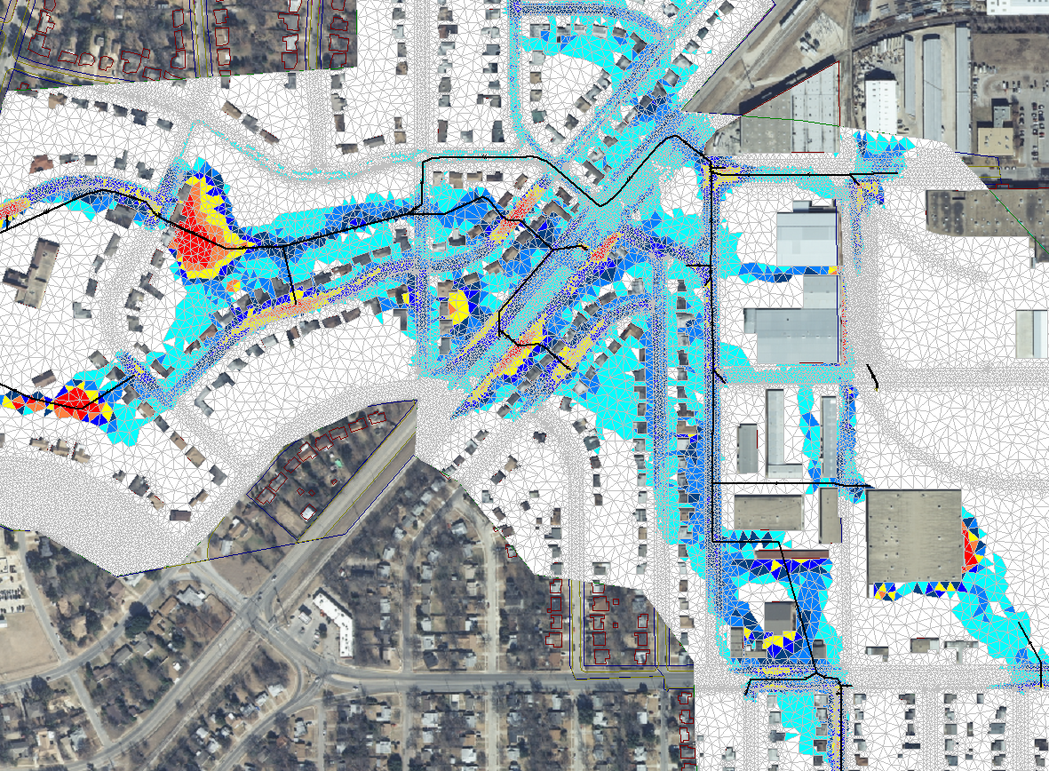
Study and Planning
System characterization
Flow Metering
Hydraulic model development
Alternative optimization
Digital twins

Slide 8
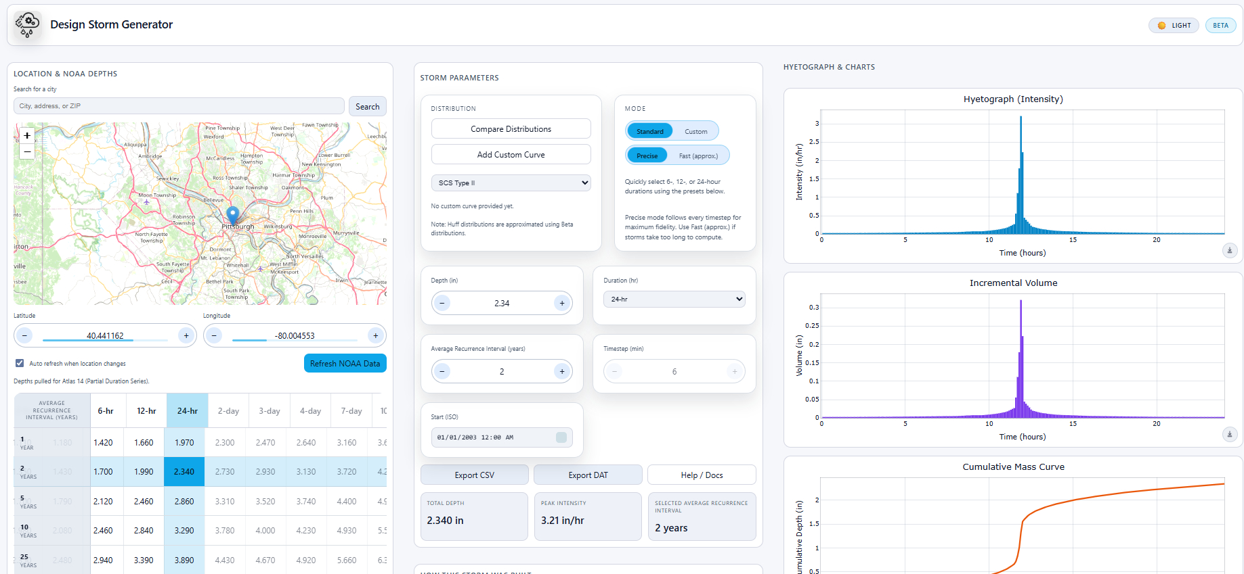
System Characterization

Slide 9
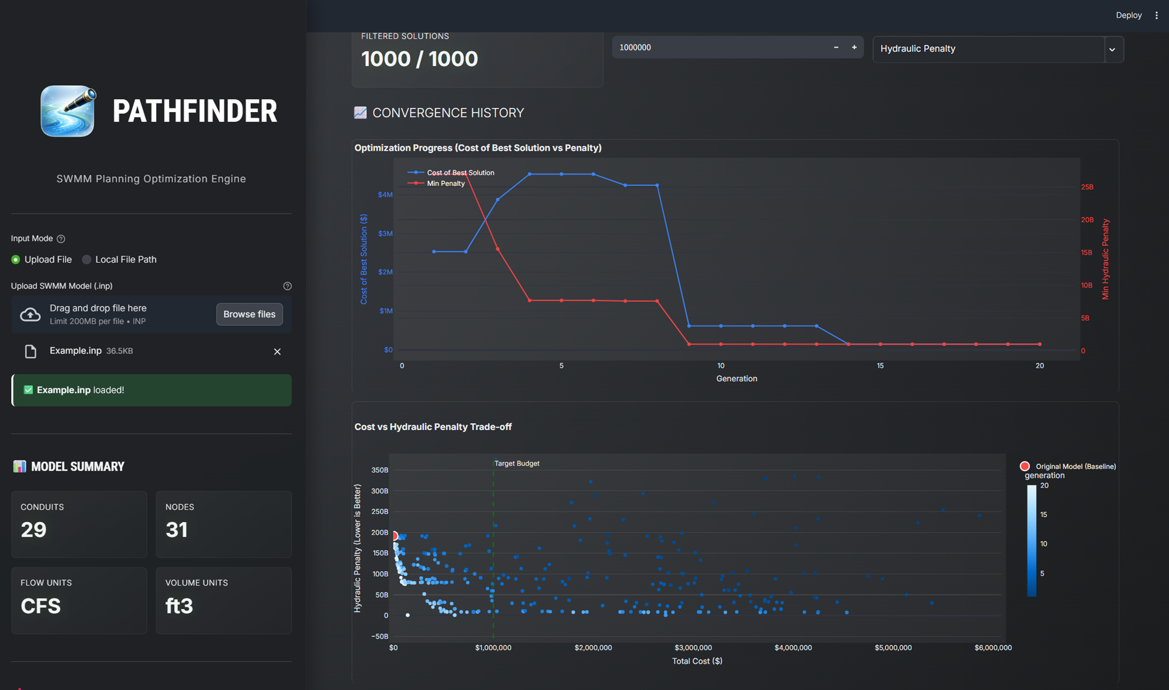
Alternative Optimization

Slide 10
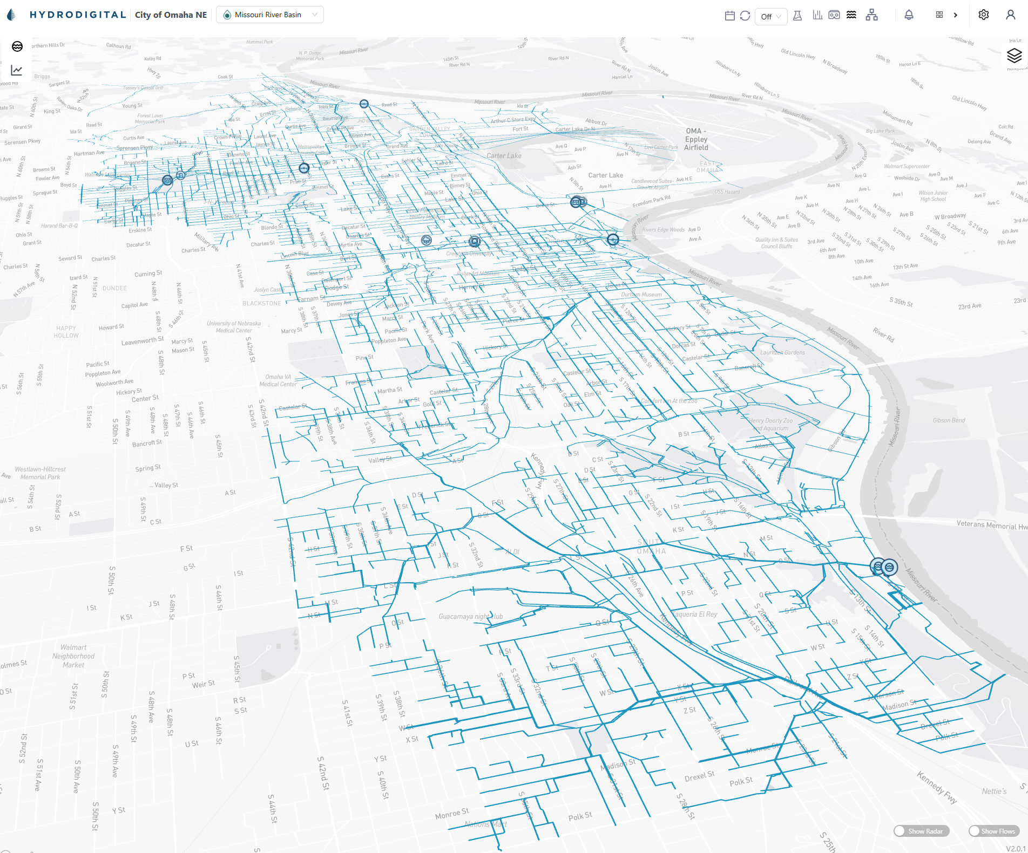
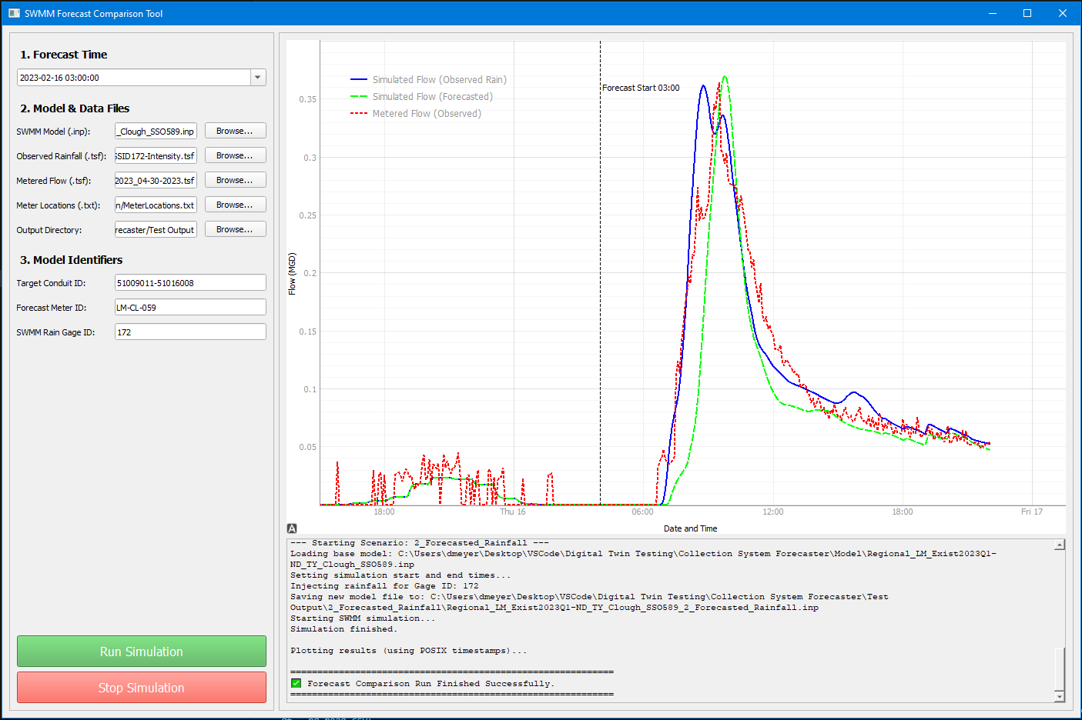

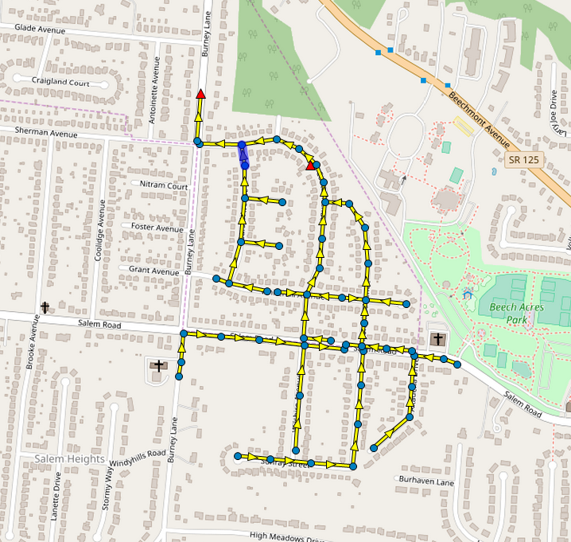
Digital Twins
Support key use cases
Connection to live system data
Forecasting capabilities
Operations advisories
Training and what if planning

Slide 11
Technology Overview

Slide 12
Wet Weather Control Strategies
Public and Private I&I control
Storage and conveyance solutions
Smart sewers
Expand capacity of the plant
Combination of the above

Slide 13
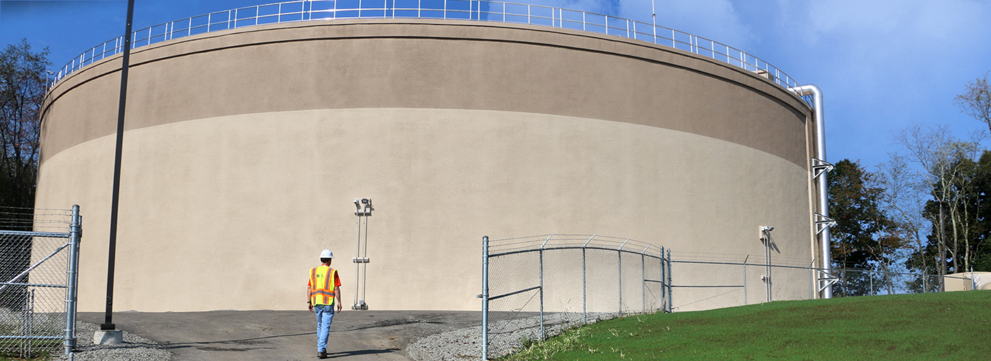
Storage
Notes:
Jeff

Slide 14
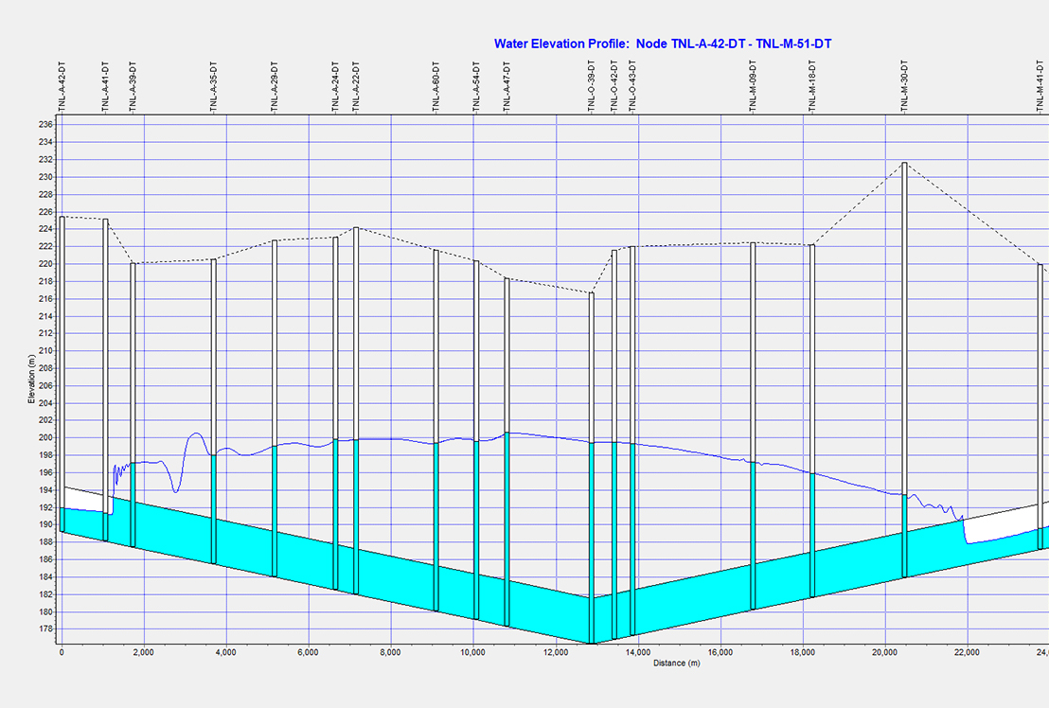
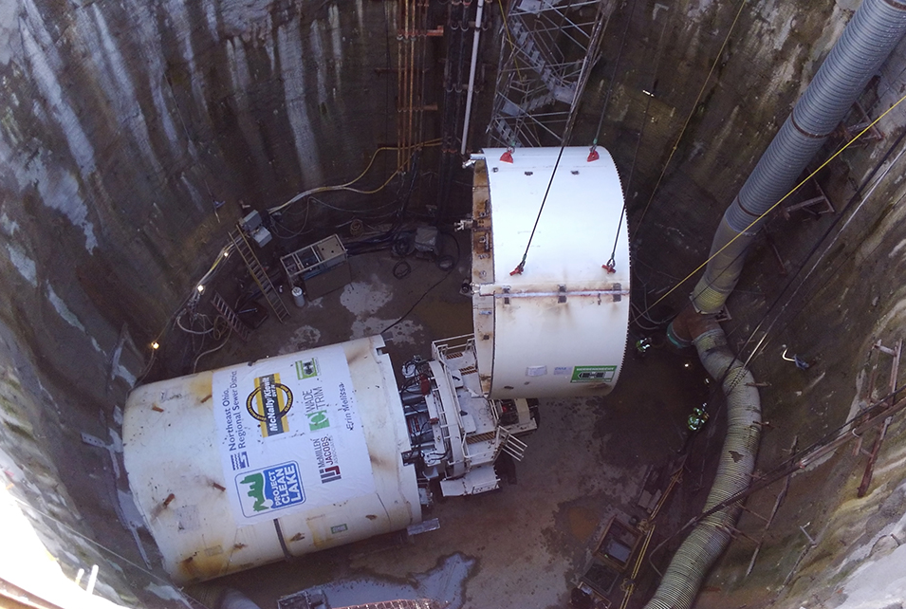
Large Sewer and Tunnels

Slide 15
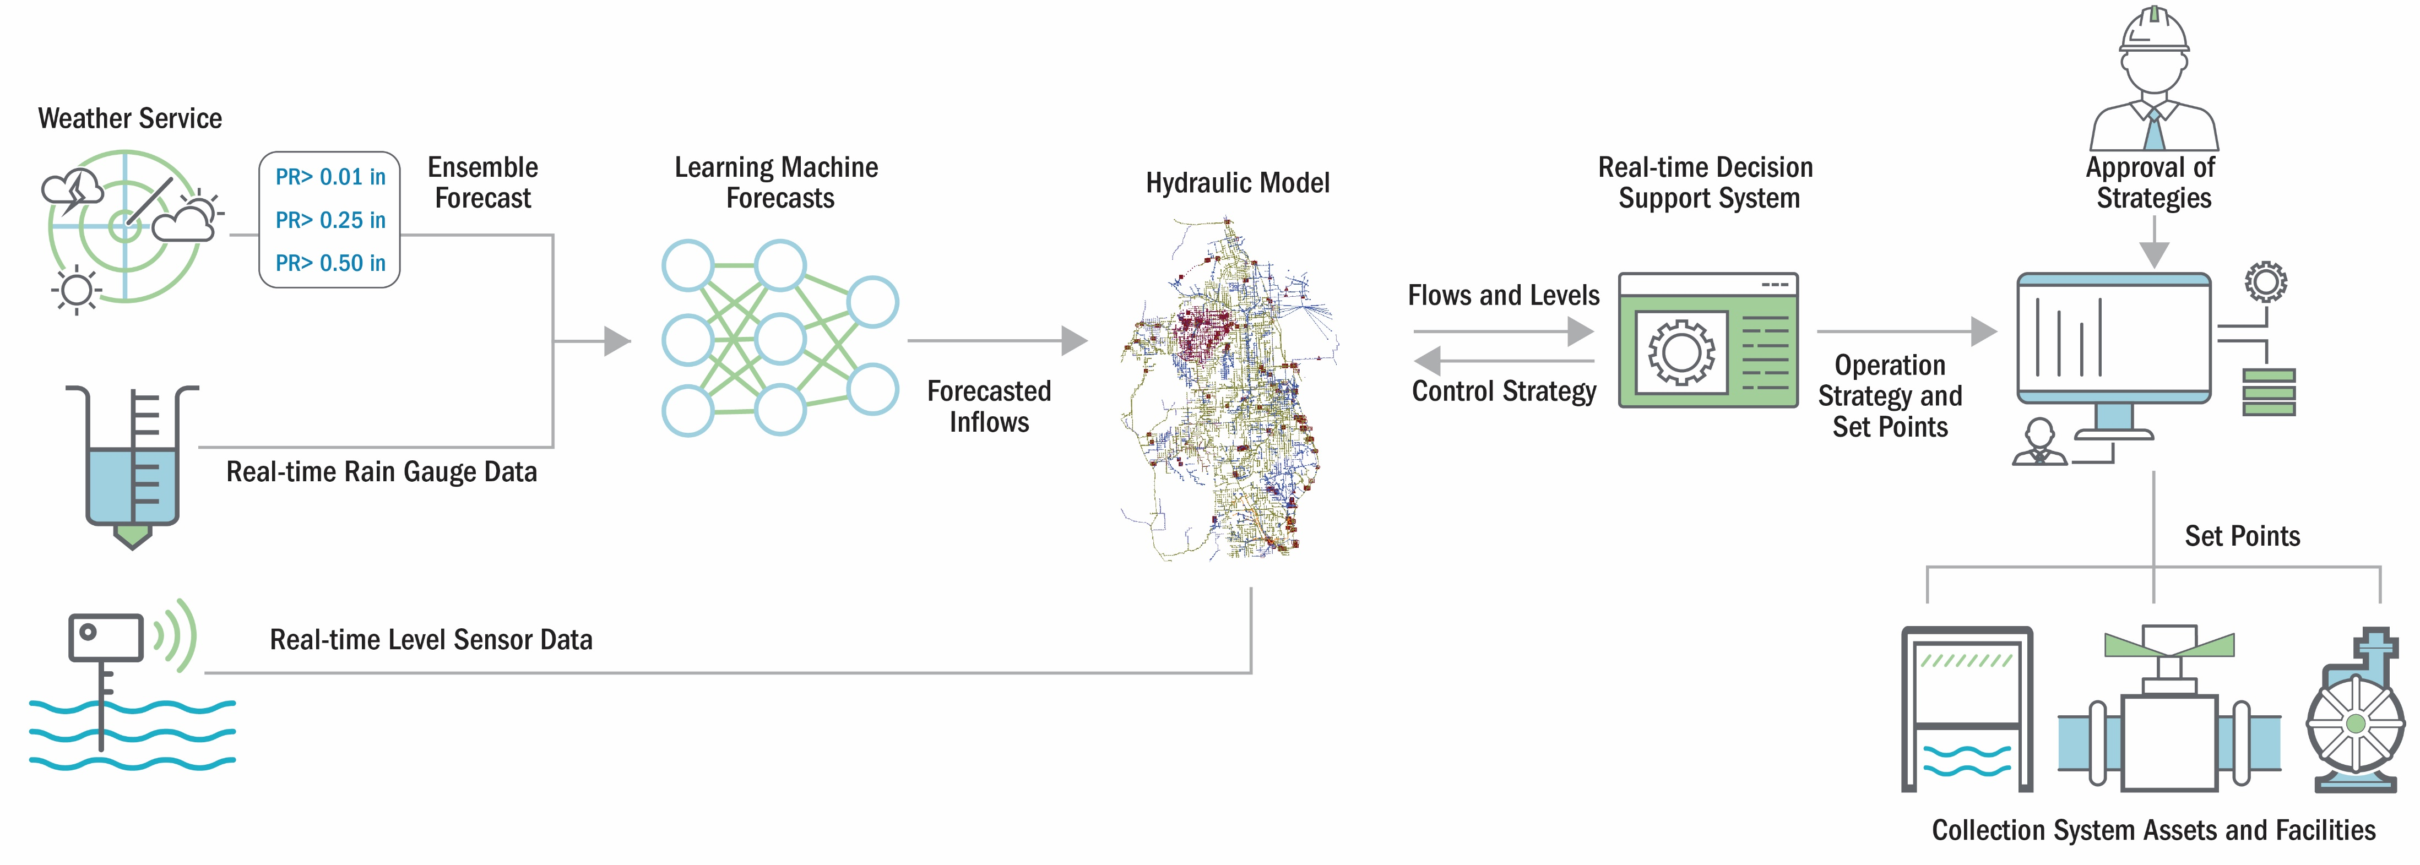
Smart Sewer Systems

Slide 16
Case Studies

Slide 17
Remote Storage Relief Sewer

Slide 18
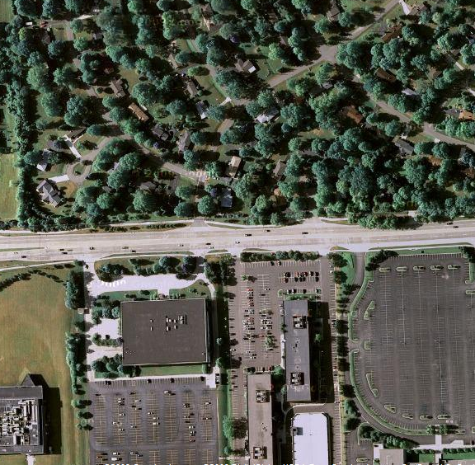
Kendalwood Relief
Small neighborhood area
Problems with SSOs and exceeding capacity limitations
Limited siting for storage facilities
Design storm was 25-yr, 24-hr

Slide 19
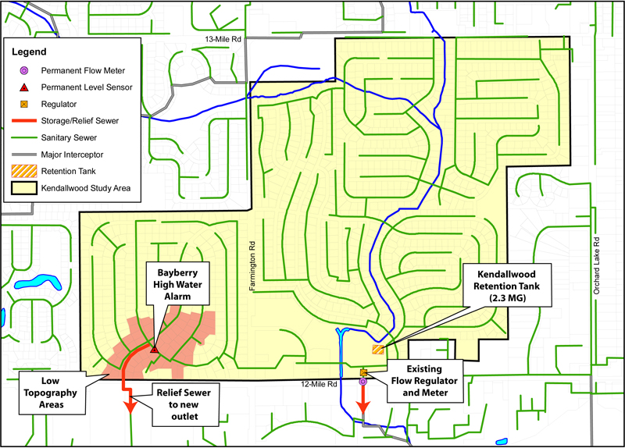
Storage/Relief Sewer Alternative

Slide 20
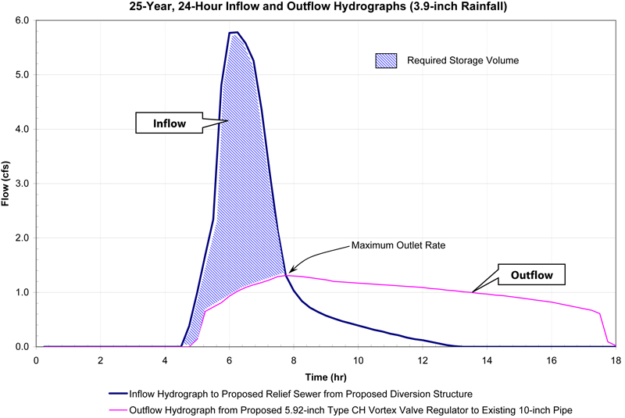
Peak Flow Management

Slide 21
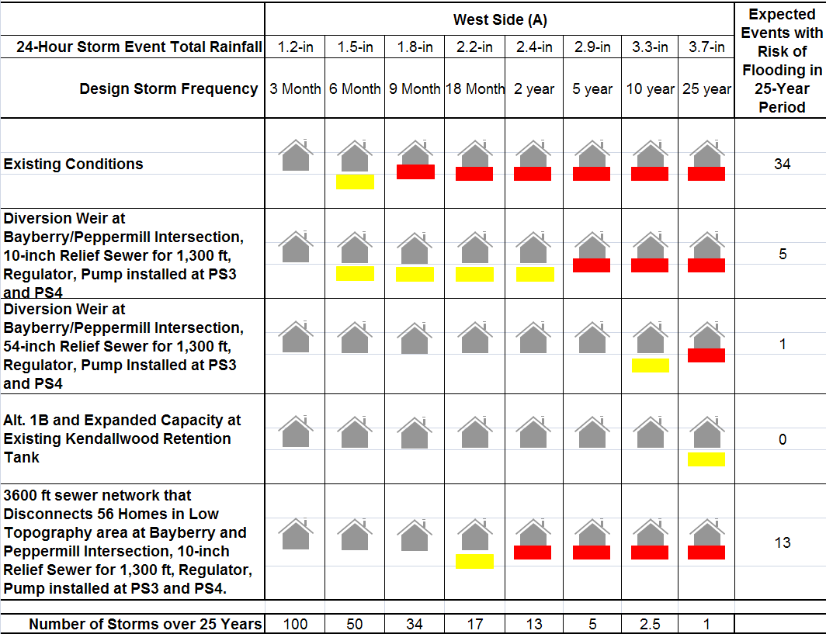
Alternatives and Level of Service

Slide 22
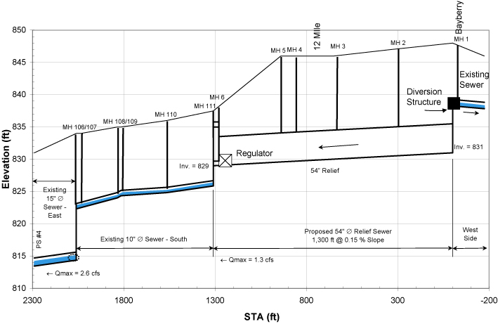
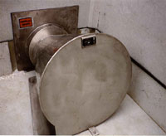
Storage Relief Sewer Profile Normal Conditions

Slide 23
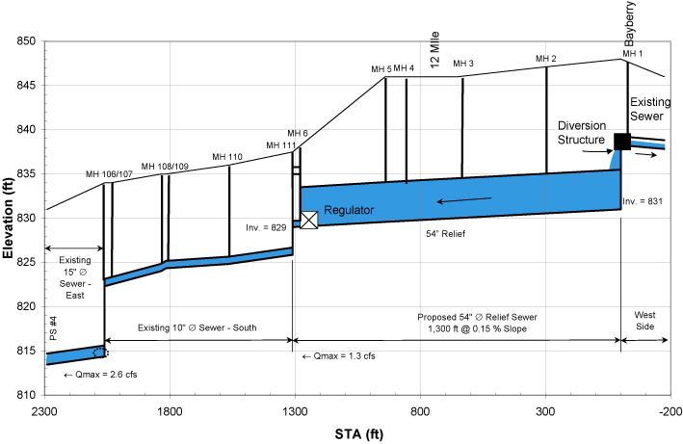
Storage Relief Sewer Profile Storm Conditions

Slide 24
Remote Large Tunnel Storage System

Slide 25
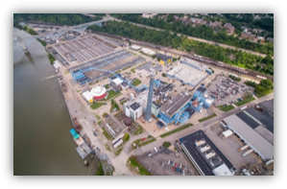
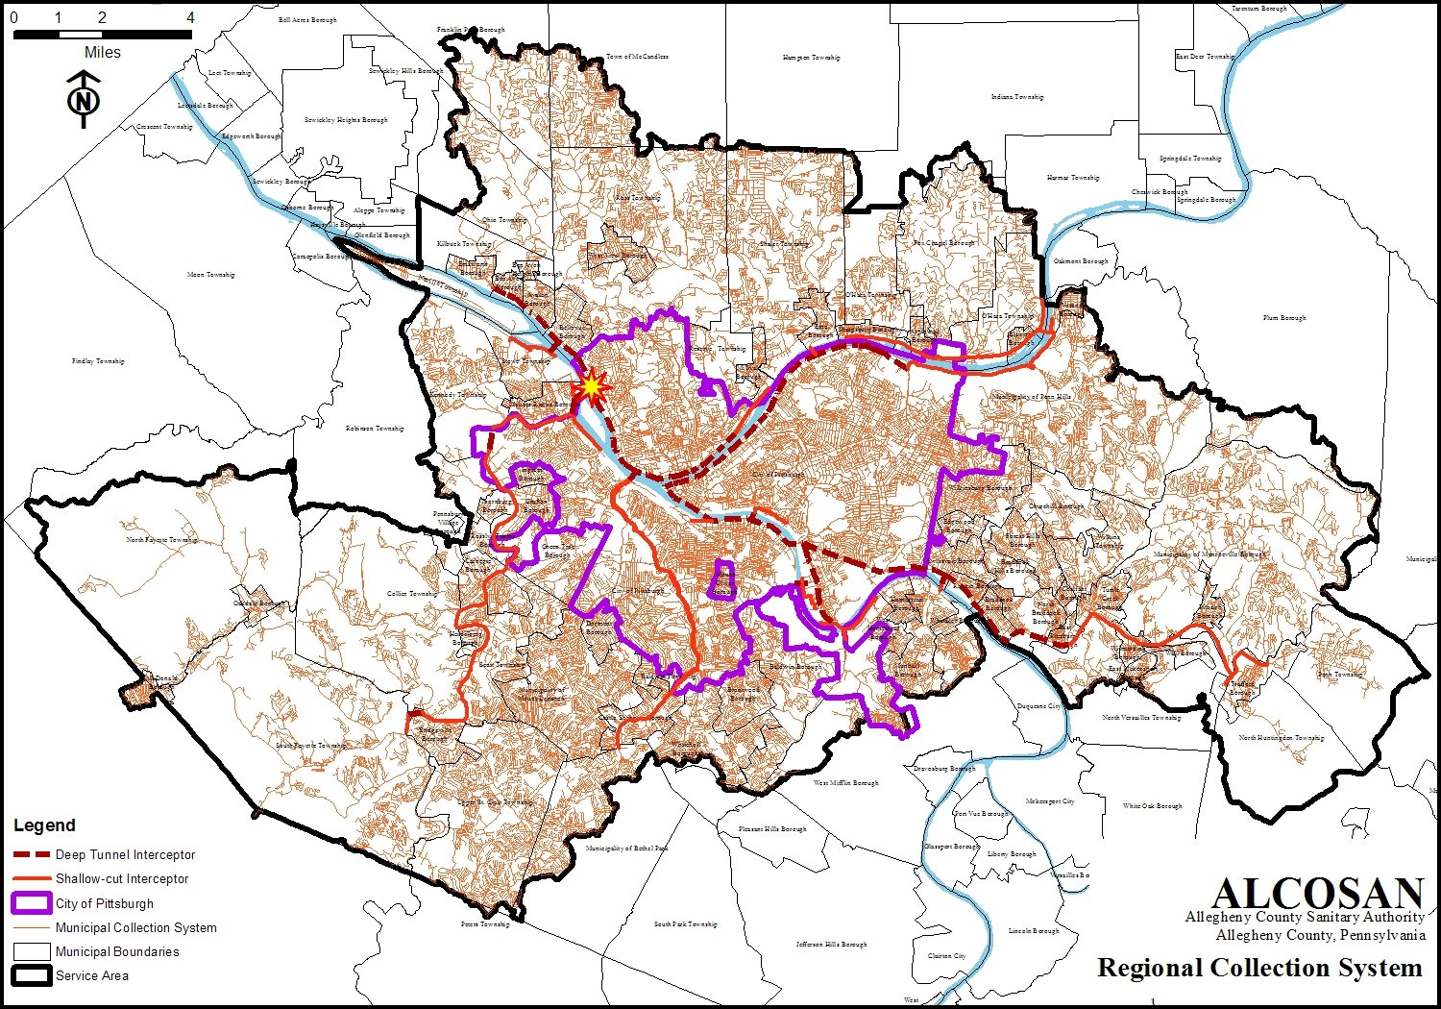
Allegheny County Sanitary Authority
Provides wastewater treatment services to 83 communities and the City of Pittsburgh
250 million gallons per day WWTP
Currently owns 90 miles of interceptors and 54 miles of trunk sewers.
Significant overflows requiring long term control plan to address

Slide 26
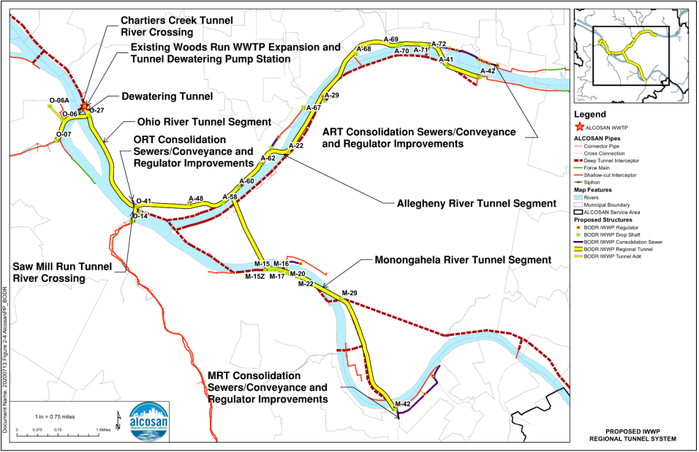
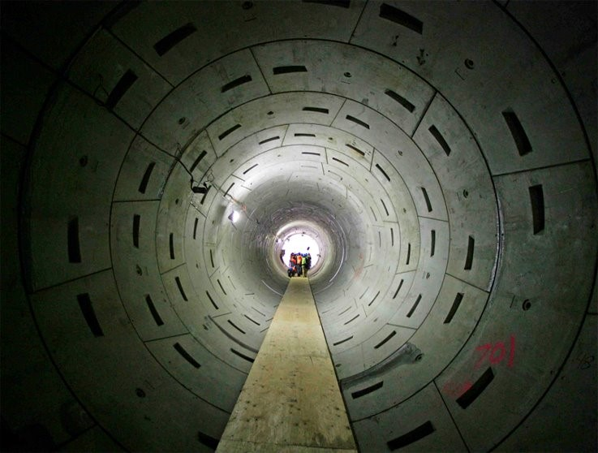
Tunnel Storage System

Slide 27
Remote Storage Tank

Slide 28
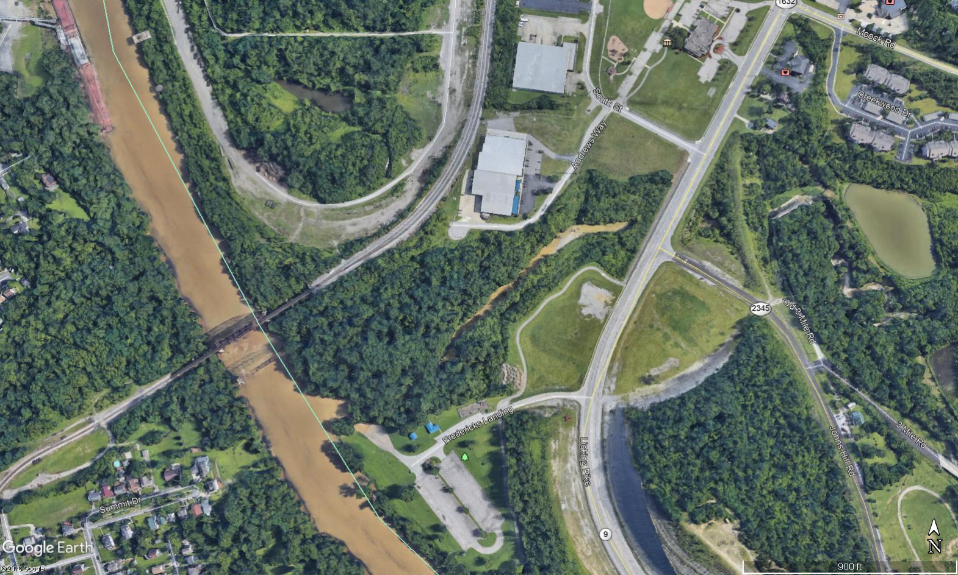
Licking River EQ Tank and Pump Stations
Reduce overflows
Size storage facilities to capture excess flow up to the 2-year, 6-hour design storm event
Pump flows from sewer into an above ground storage tank
Hold and release flow back into system when capacity is available
Licking River EQ

Slide 29
Equalization Tank Facility
Diversion Structure and Future Screen Chamber
Drain valve and meter pit
Pump Station
Storage Tank

Slide 30
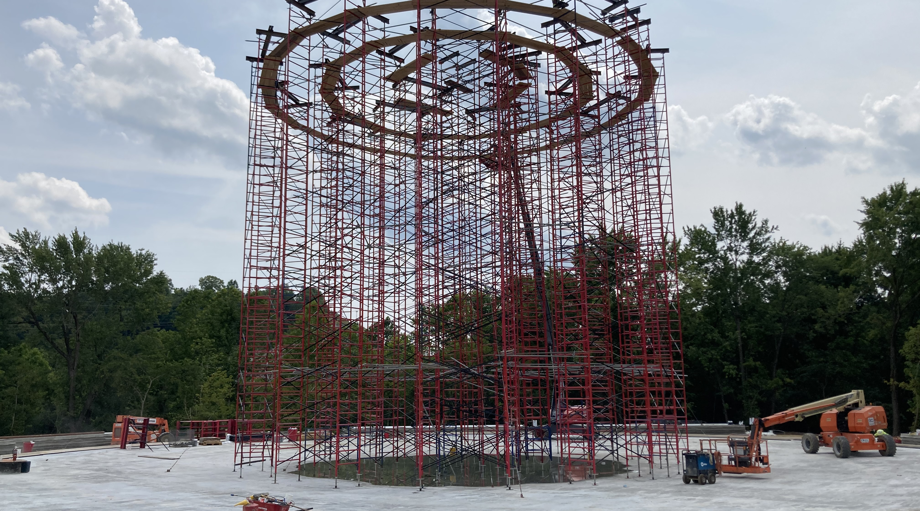

Slide 31
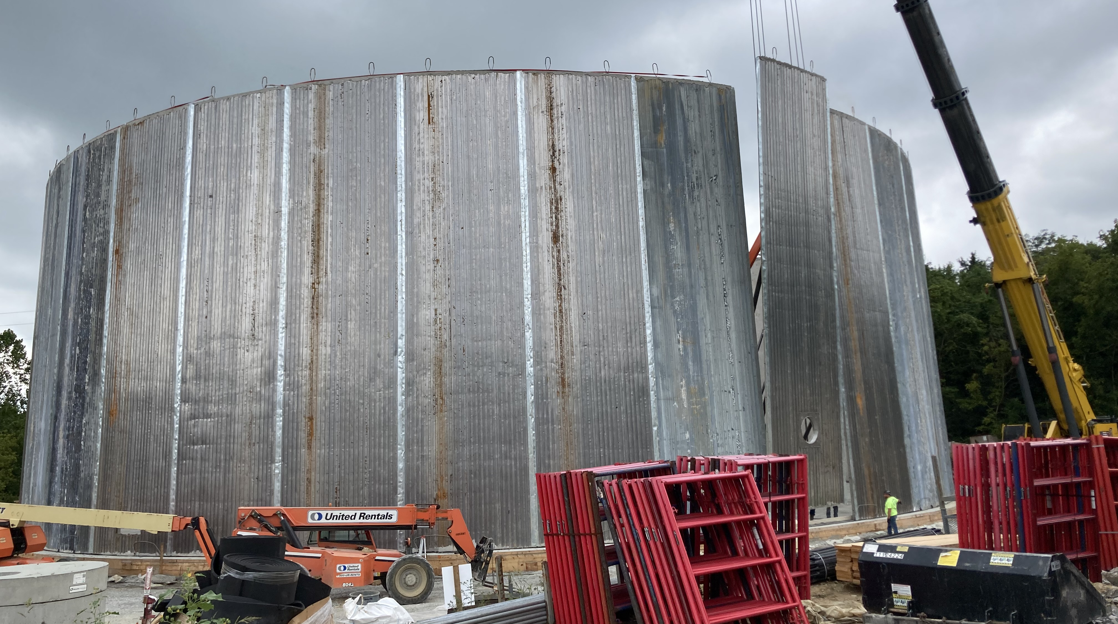

Slide 32
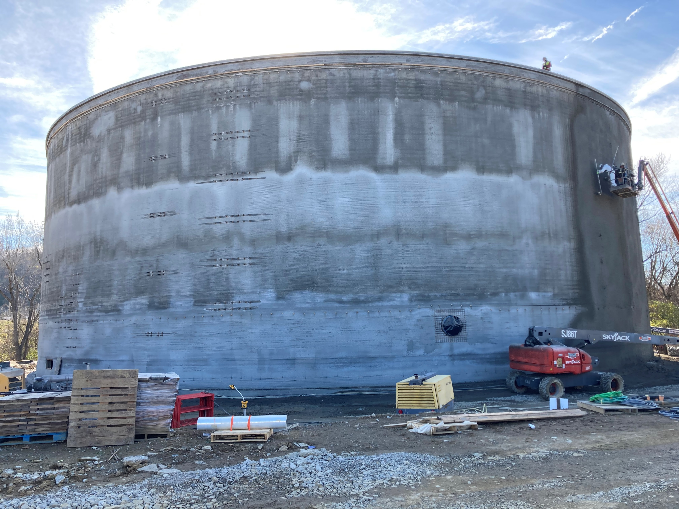

Slide 33

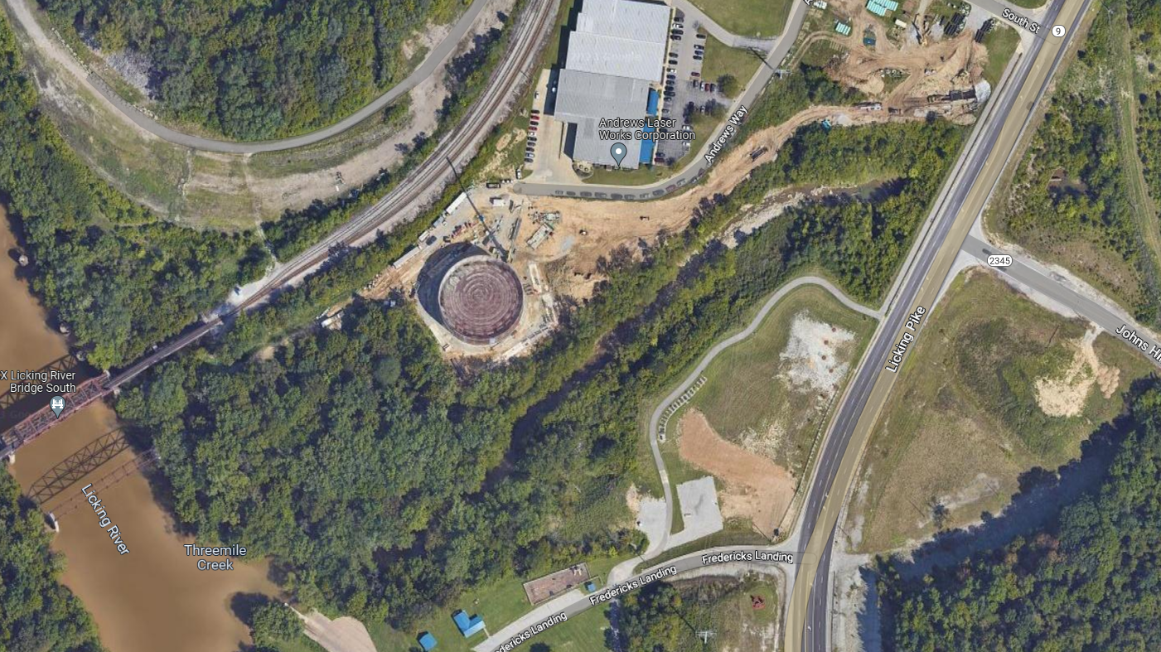

Slide 34
Storage and Pump Station Upgrade at WWTP

Slide 35
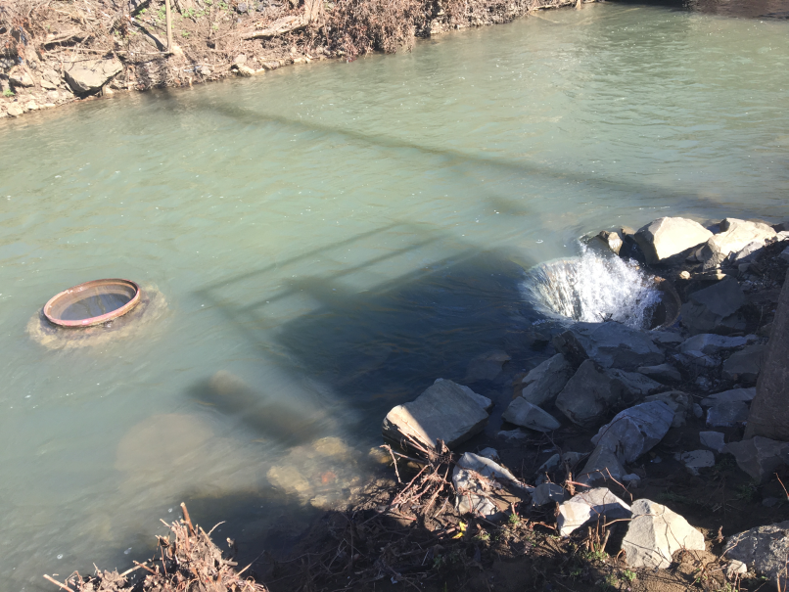
Brush Creek WWTP Upgrade Project
Western Westmoreland Municipal Authority
12,500 Acres
WWTP (4.4 MGD, 15 MGD Peak)
Interceptor sewer (~8 miles)
Diversion structures (4)
Originally built in 1977
Overflows and back ups

Slide 36
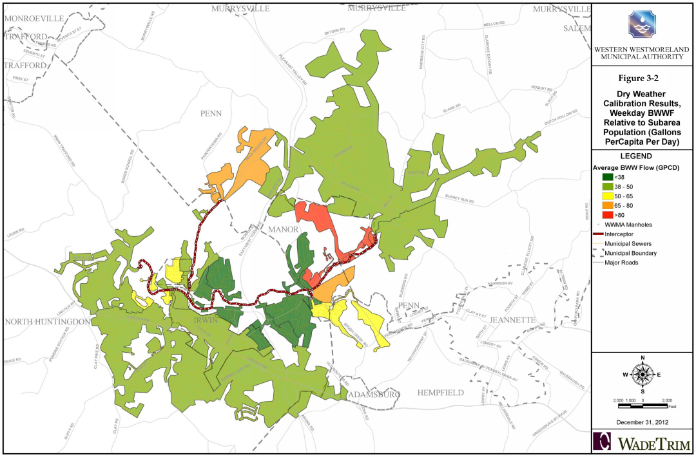
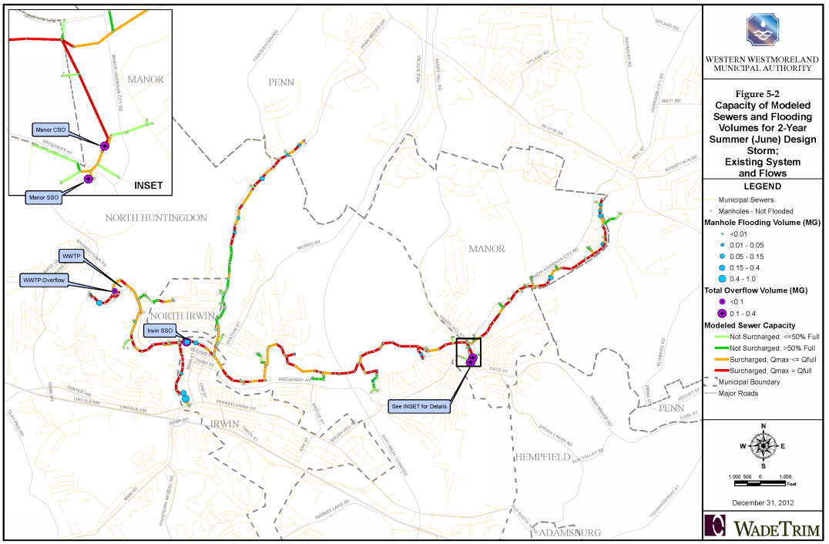
System Overview

Slide 37
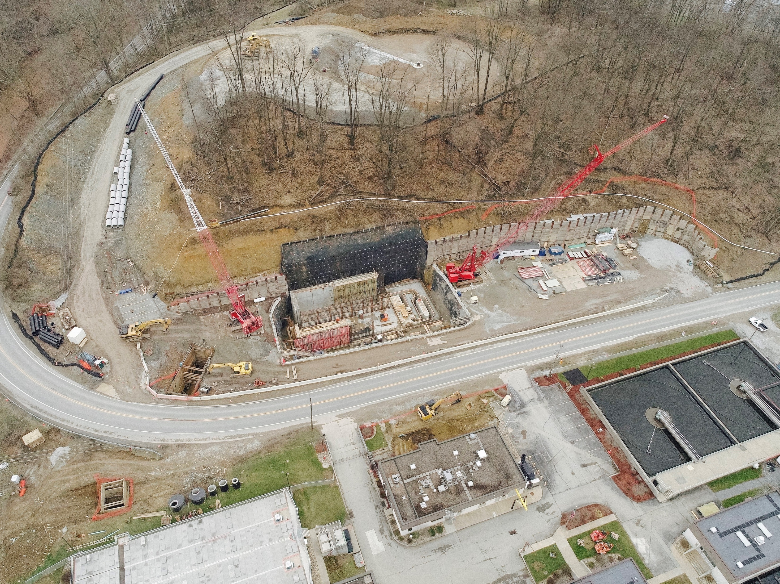
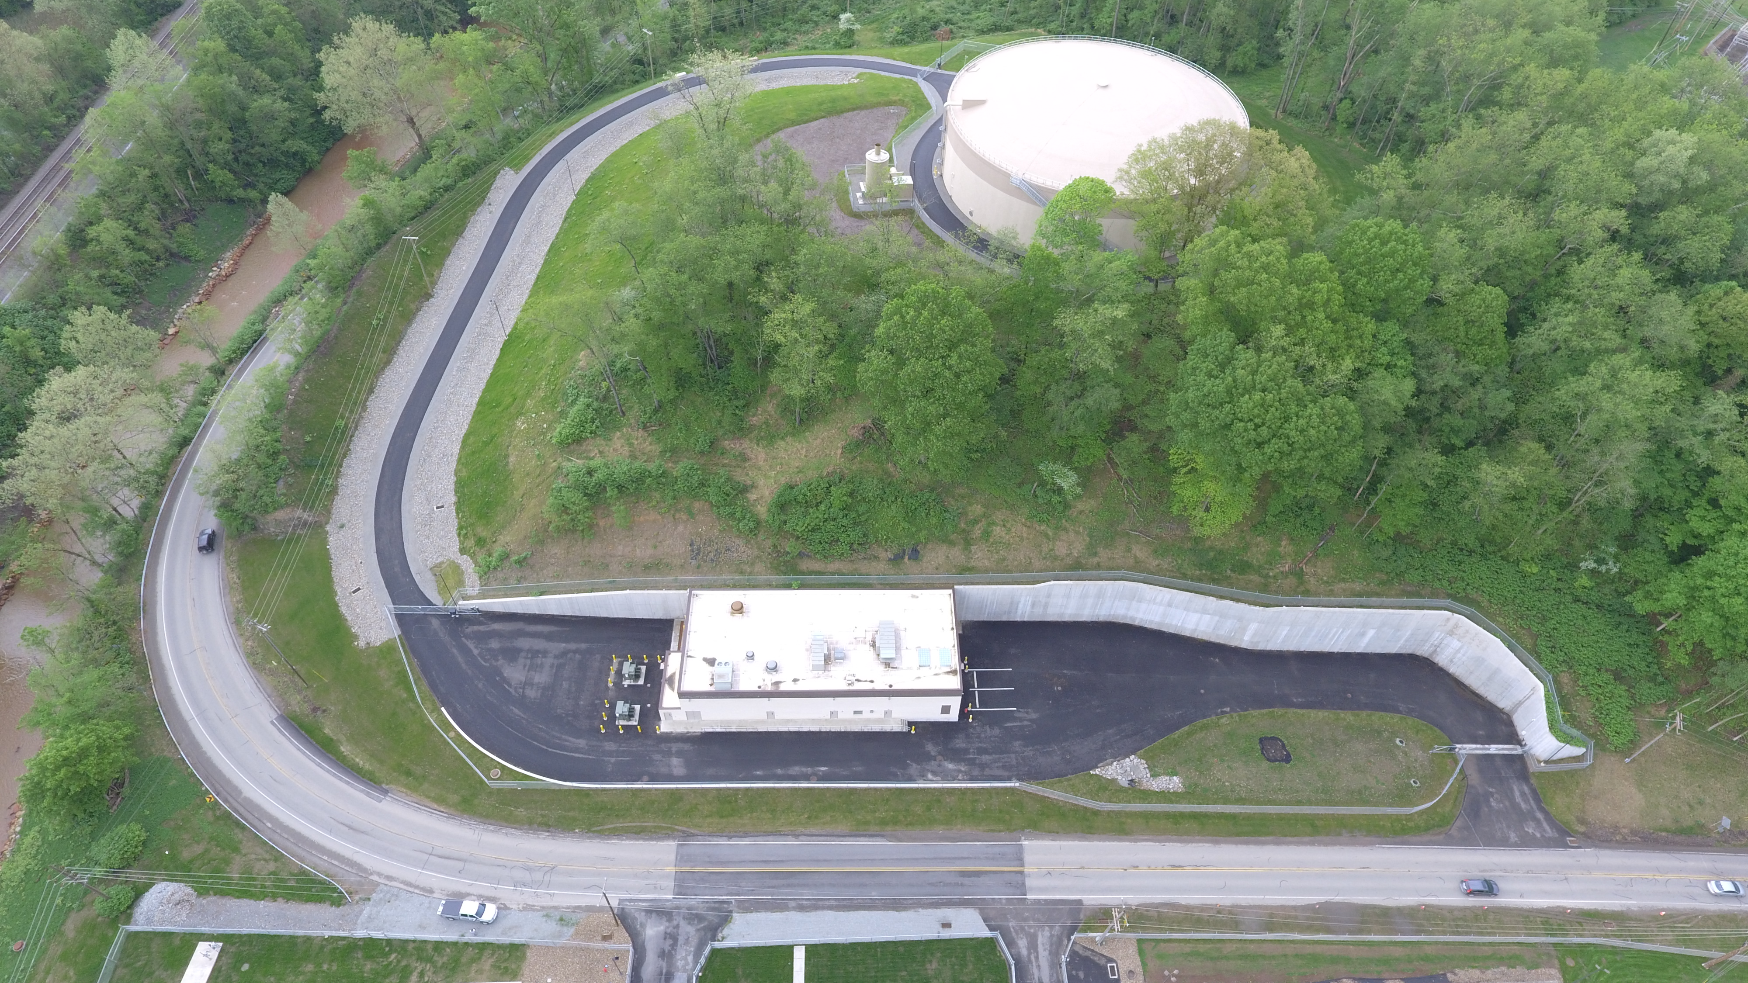
New Pump Station and EQ Tank at WWTP
45 MGD pump station with Mechanical screens, washer compactor, hopper
15 MGD to plant
30 MGD to 7 MG EQ tank

Slide 38
Lessons Learned
Invest in robust data & modeling: Accurate system characterization is essential for effective, right-sized solutions
Optimize existing infrastructure first: Prioritize operational improvements and capacity upgrades before committing to large capital projects.
Solutions are local: Find the right technology that fits with your conditions to be as simple as possible and cost effective while minimizing long term O&M
Plan collaboratively and adaptively: Engage regulators, municipalities, and the public early; use phased implementation to meet regulatory goals efficiently and affordably.

Slide 39


?
Dave White, Wet Weather Practice Lead dwhite@wadetrim.com

