Slide 1
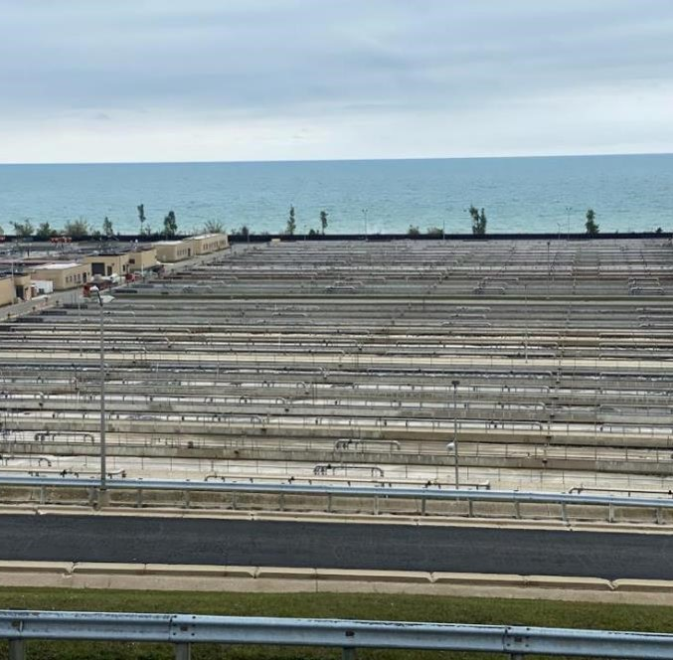
Alternative
Delivery
A collaborative approach to delivering the largest thickening and dewatering facilities in the US – a design-build journey.
Rudy E. Kilian
TACWA Meeting Houston, TX / August 18, 2025

Slide 2
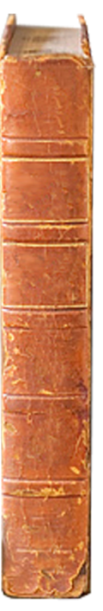
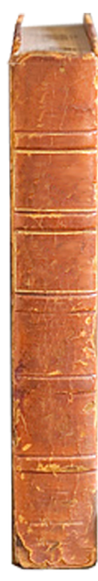
A spectrum of delivery methods is used in the W/WW market
Design-Bid-Build
Progressive
Design-Build
CMAR
Fixed Price
Design-Build
Range of Delivery Models
Shorter Schedule
More Design Control
Early Cost Certainty/Budget Control
Reduced Risk to Owner
Notes:
Talk through CSP as a variation of DBB.

Slide 3
Design-Bid-Build (DBB)
Key Characteristics and Considerations
  Traditional approach for the W/WW market.
  Appropriate when early delivery is not required.
  Low-bid selection without regard to contractor capabilities.
  Owner controls design development
  Complex projects can lead to higher risks for the owner.
  Can procure under Competitive Sealed Proposal (CSP) to select on a best-value basis.
Owner
Selection at beginning of design
Selection following design completion
Designer
Contractor
Legend
Working Relationship
Contractual Relationship

Slide 4
Construction Manager at-Risk (CMAR)
Owner
SJRA
Key Characteristics and Considerations
  Used frequently over the last 10+ years in the W/WW market.
  CMAR selection based on price +qualifications.
  Cost modeling leads to earlier cost certainty.
  GMP negotiated prior to construction; off-ramp available if agreement not reached.
  Can reduce the overall length of the project.
  Project costs are typically higher than DBB, but risks are lowered.
Selection at beginning of design
Selection at beginning of design
Selection at ~30% to ~ 60% design
Selection at ~30% to ~60% design
Designer
Contractor
Designer
Contractor
Arranged Relationship
Legend
Legend
Working Relationship
Working Relationship
Contractual Relationship
Contractual Relationship

Slide 5
Fixed Price Design Build (FPDB)
Progressive Design-Build (PDB)
Owner
Selection at ~1-5% design
Key Characteristics and Considerations
  Increasingly used in the U.S. W/WW market for complex projects.
  2-phase delivery with the ability for design collaboration. (PDB)
  GMP negotiated prior to construction; off-ramp available if agreement not reached. (PDB)
  Allows for earlier project completion.
  Can include a performance guarantee.
Designer/
Builder
Legend
Working Relationship
Contractual Relationship

Slide 6
Delivery method comparison
 | Design-Bid-Build | CMAR | Progressive Design-Build
Early Cost Certainty
Schedule Flexibility
Design Control
Risk Allocation
Project Quality
Relative Ranking Legend
Best meets criteria
Partially meets criteria
Least meets criteria

Slide 7
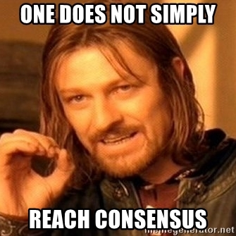
A tool for internal consensus decision-making
DBIA - Rocky Mountain Region
Notes:
Blake – BIM was also used to help obtain internal consensus.

Slide 8
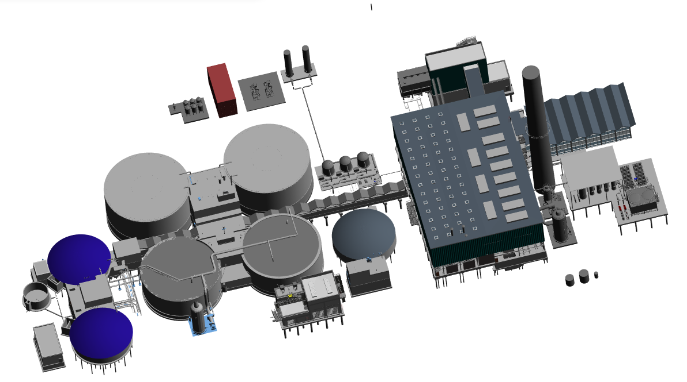
KCMO Solids Improvement Project Owner’s Advisor for fixed Price (turned into progressive) Design-Build

Slide 9
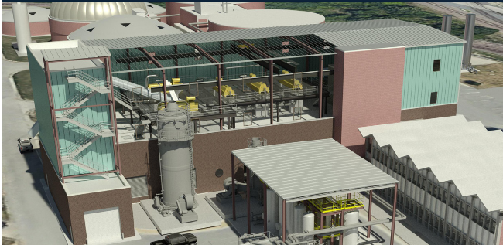
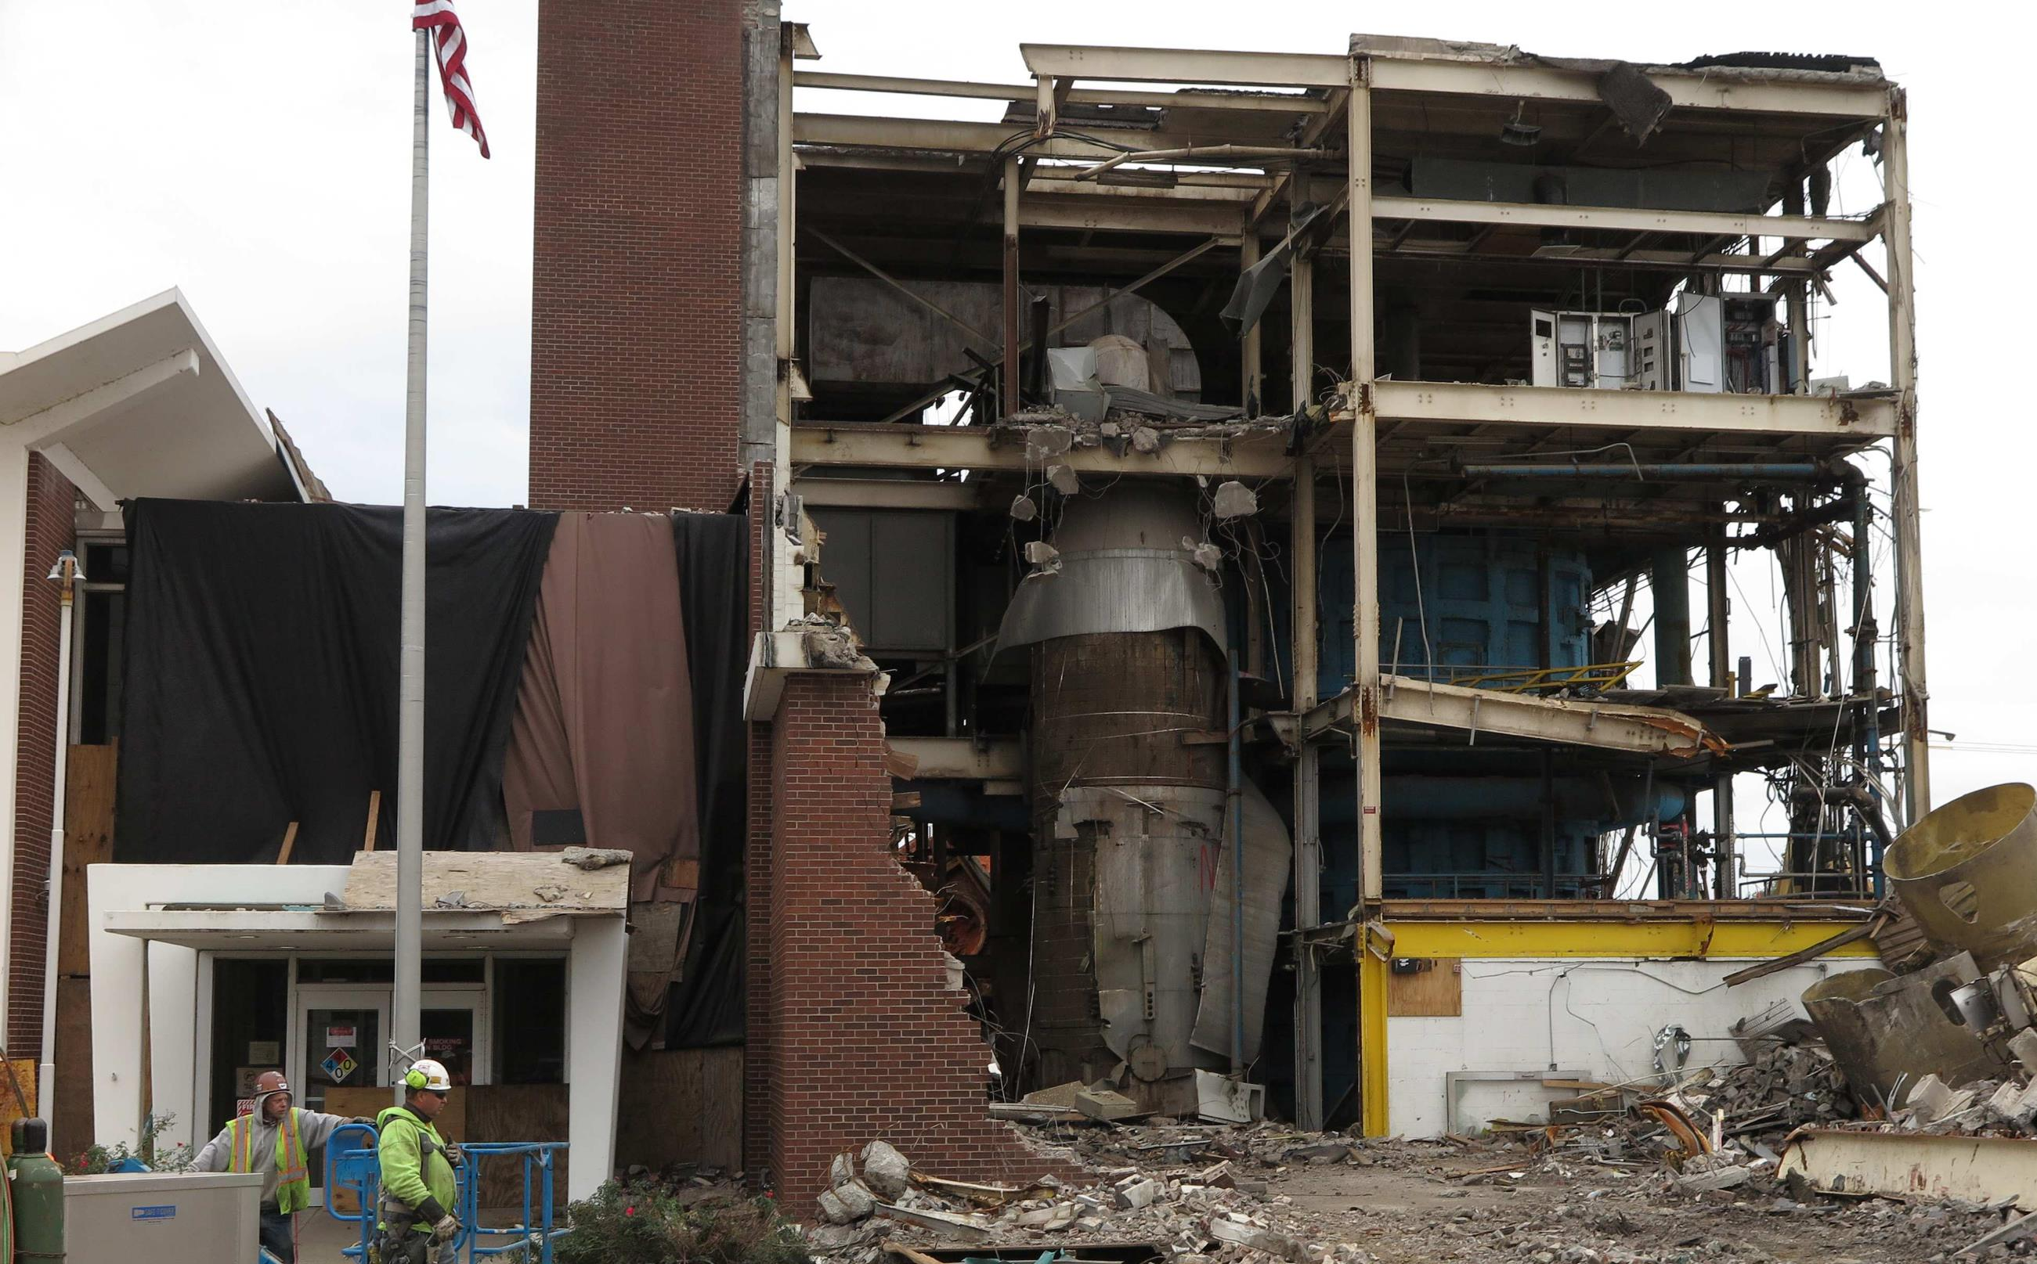
12 months of design decisions

Slide 10
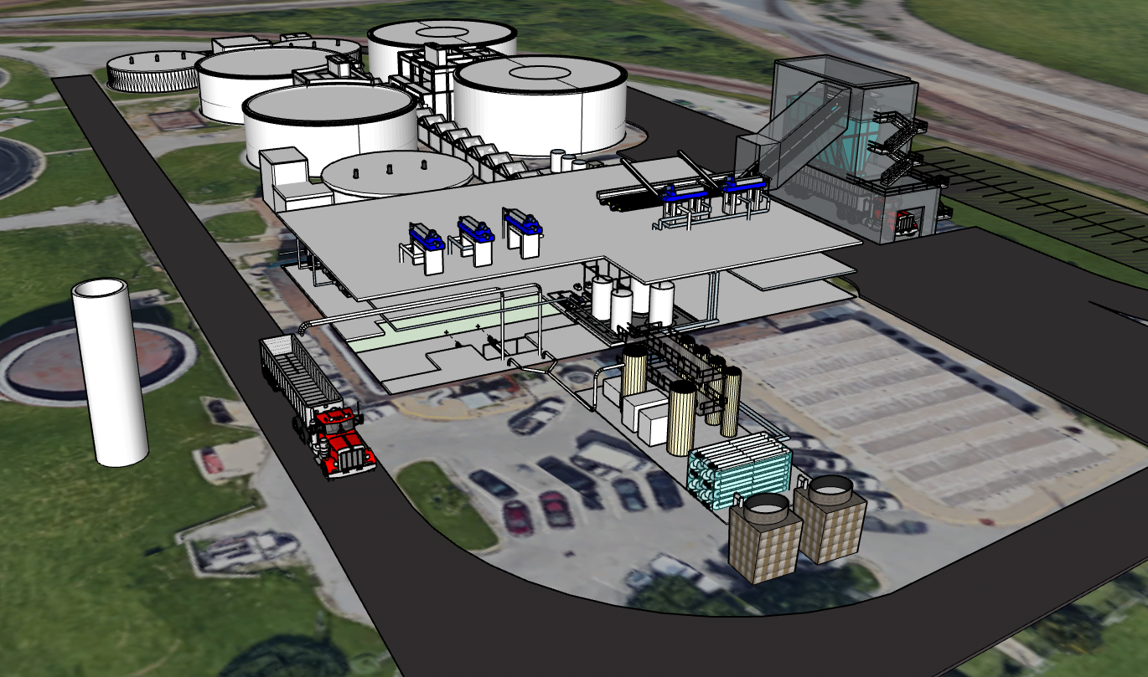
Blue River Wastewater Treatment Facility
Kansas City, MO
CLICK TO LEARN MORE
CAROLLO | 10

Slide 11
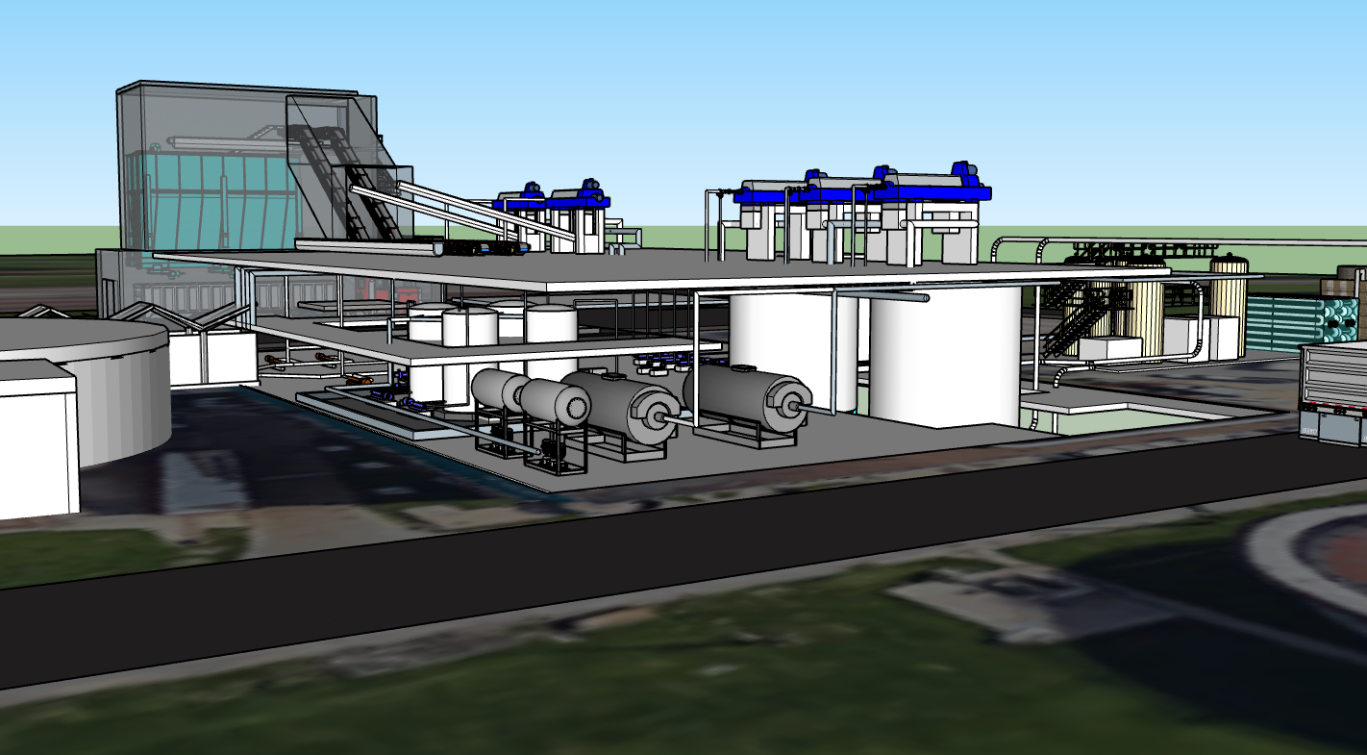

Slide 12
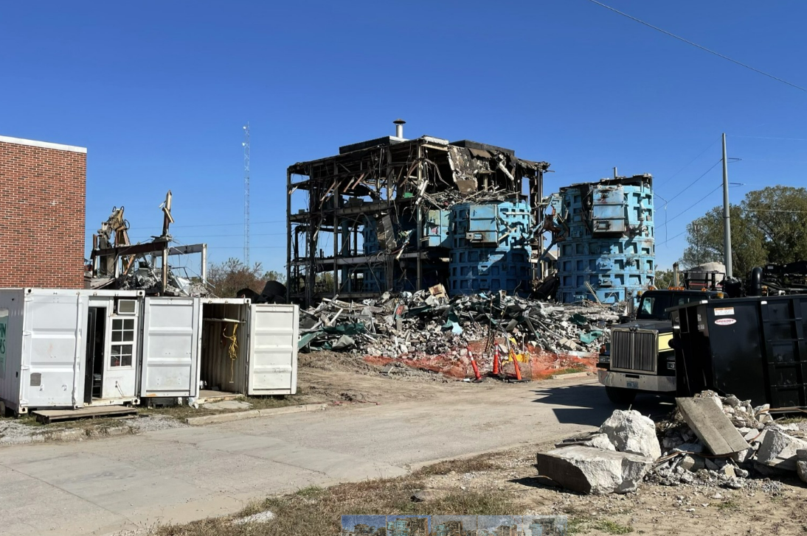
And then the DB Teams came in…

Slide 13
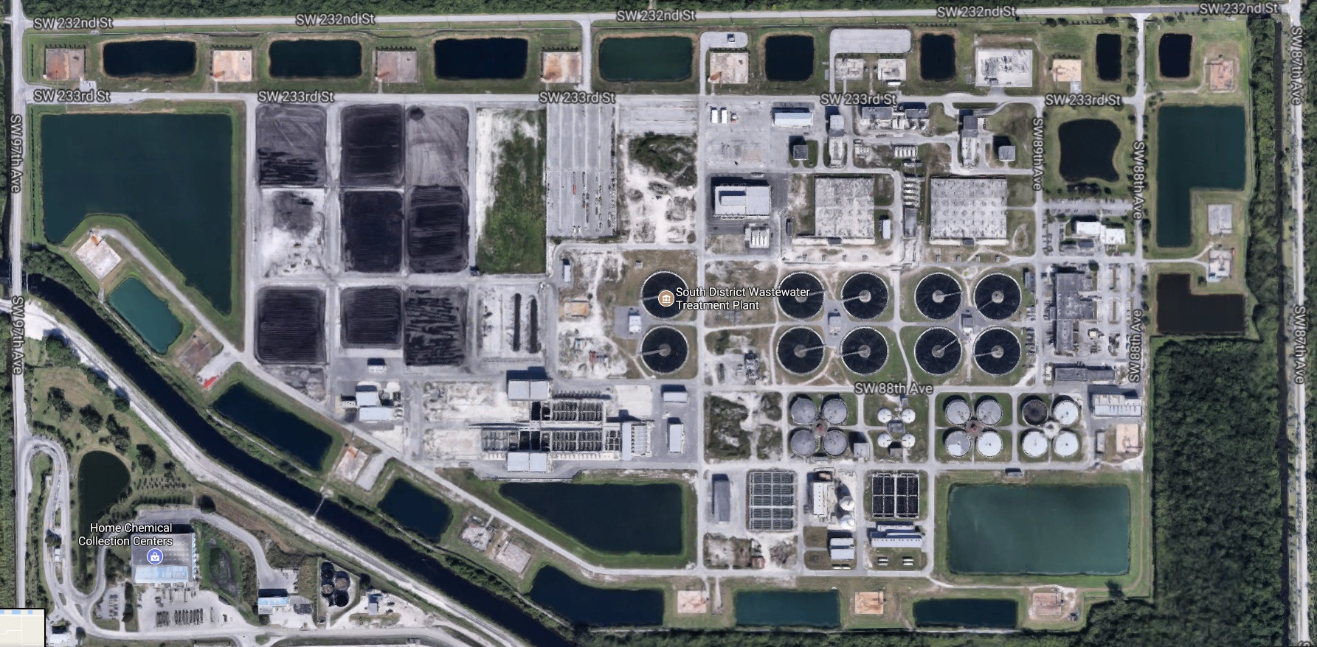
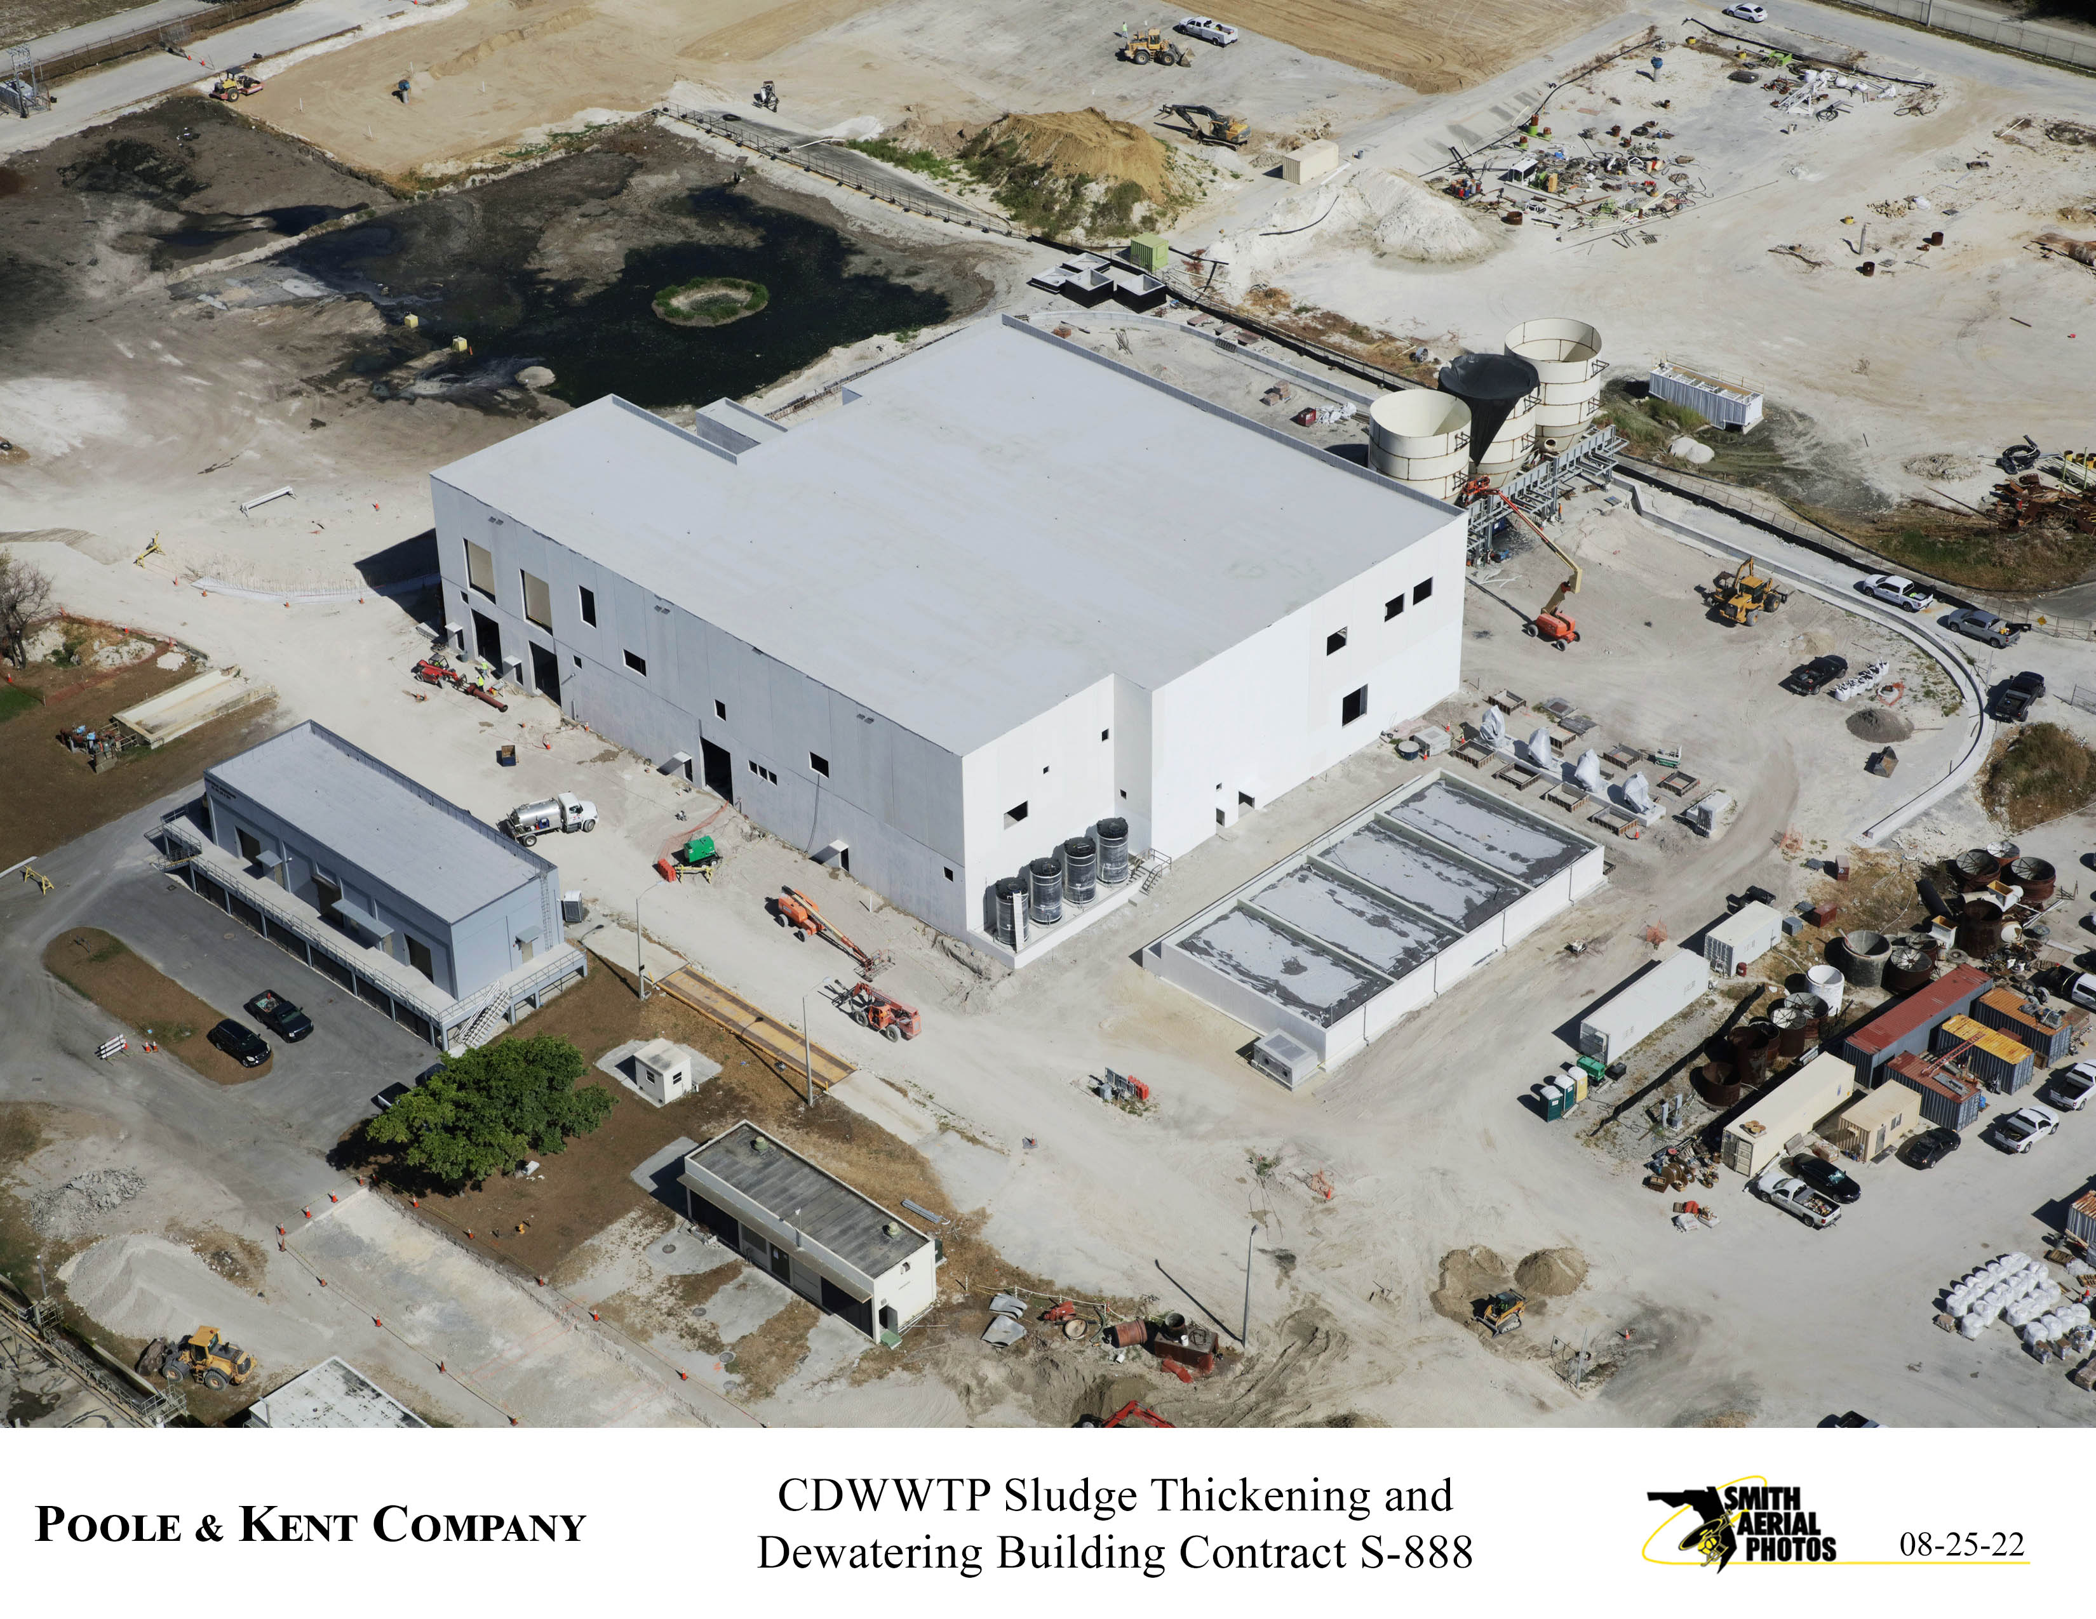
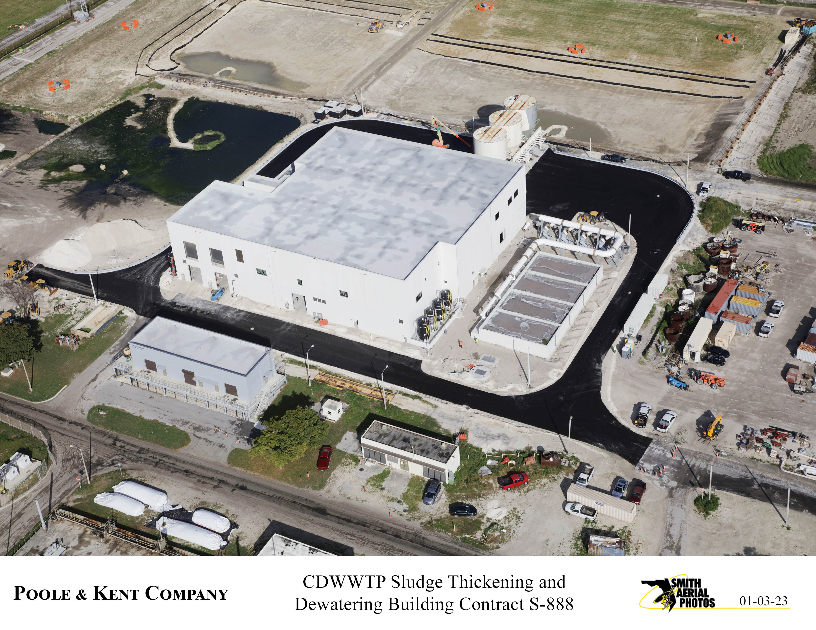
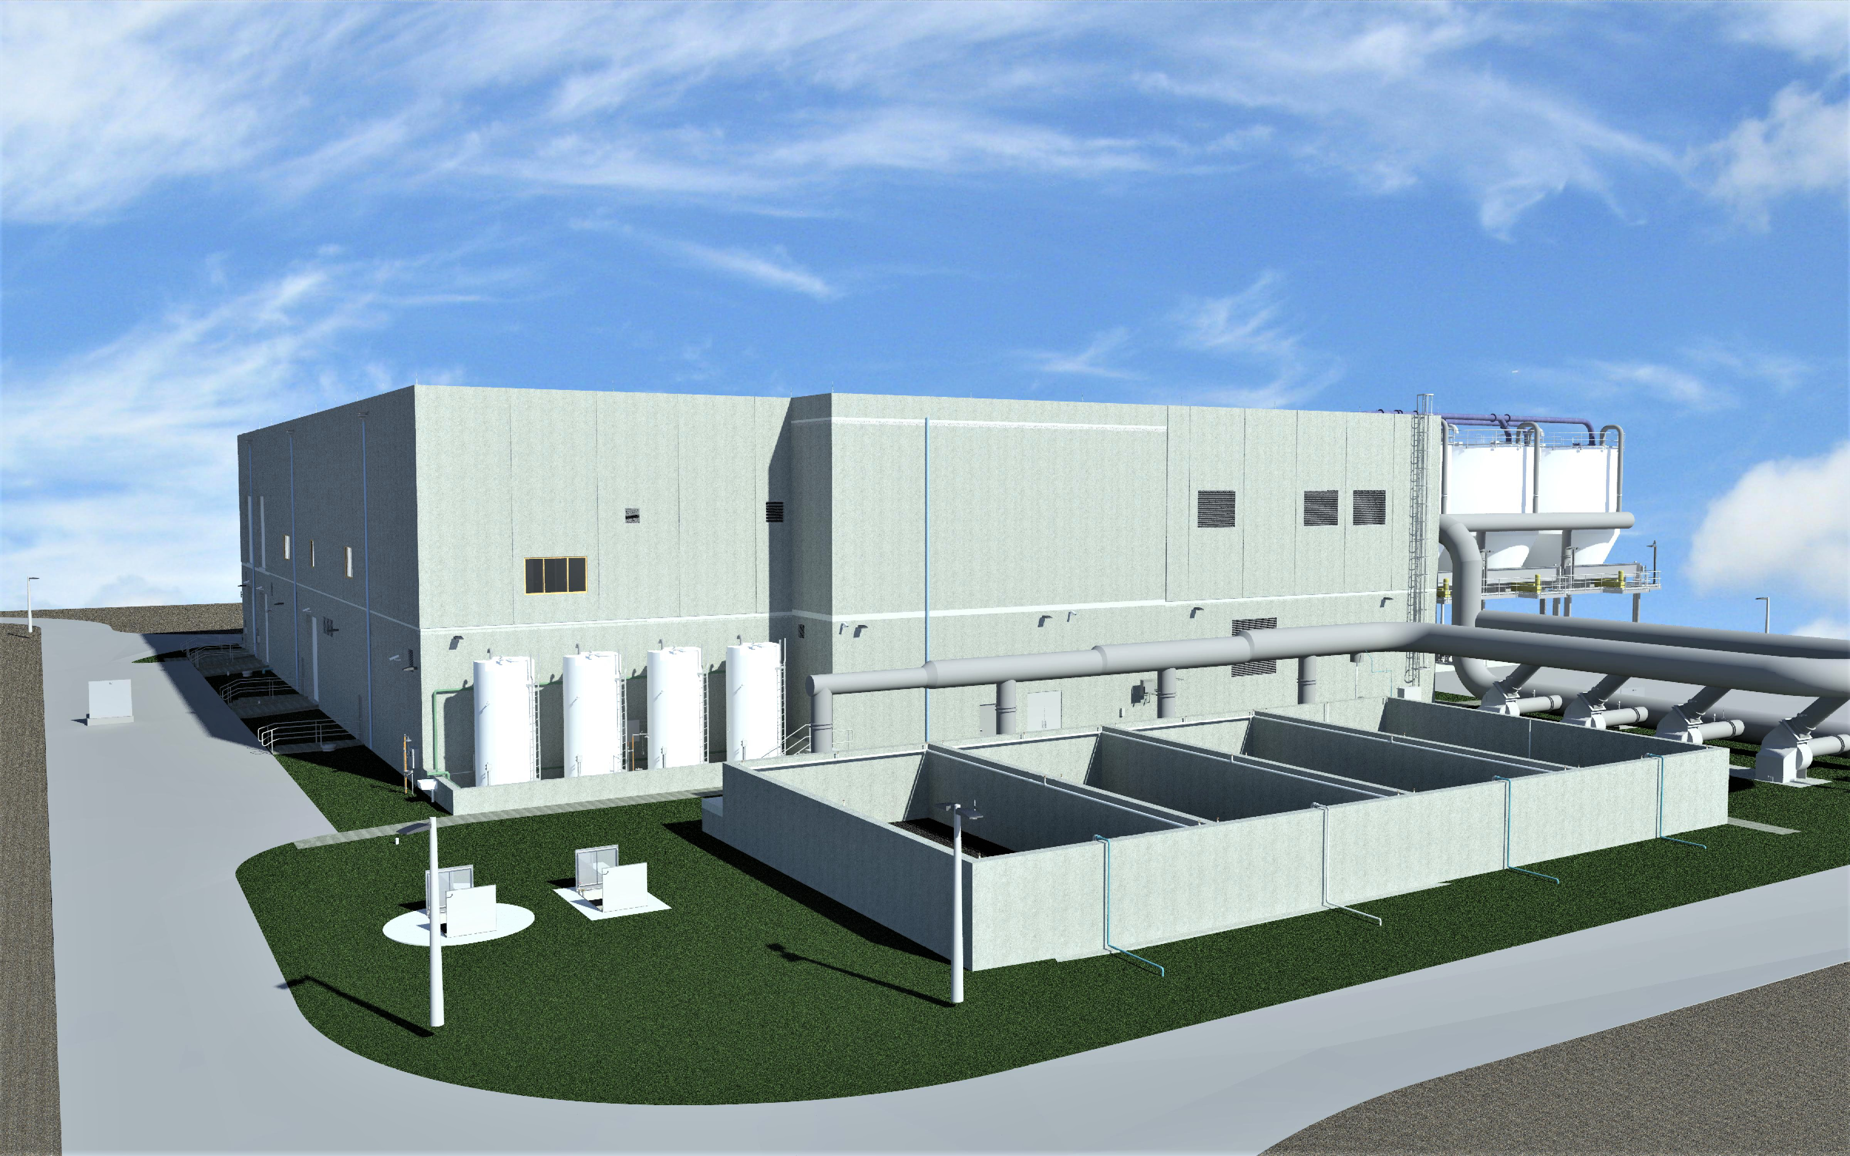
Central District Wastewater Treatment Plant (CDWWTP)
Thickening & Dewatering Project Model/Pictures

Slide 14
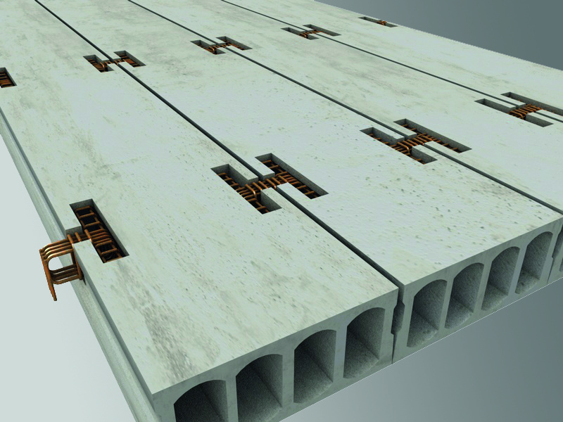
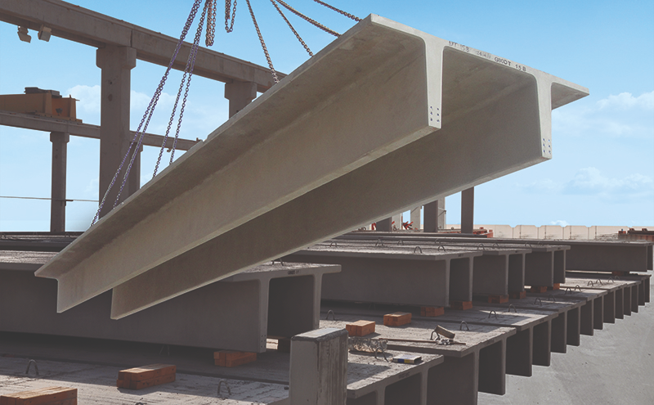
Building Design was optimized for Weight and Cost

Slide 15
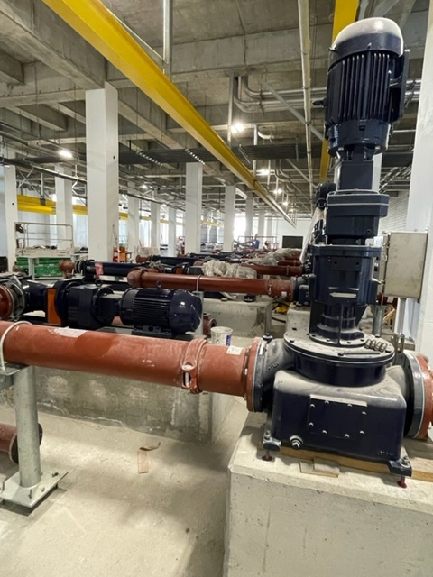
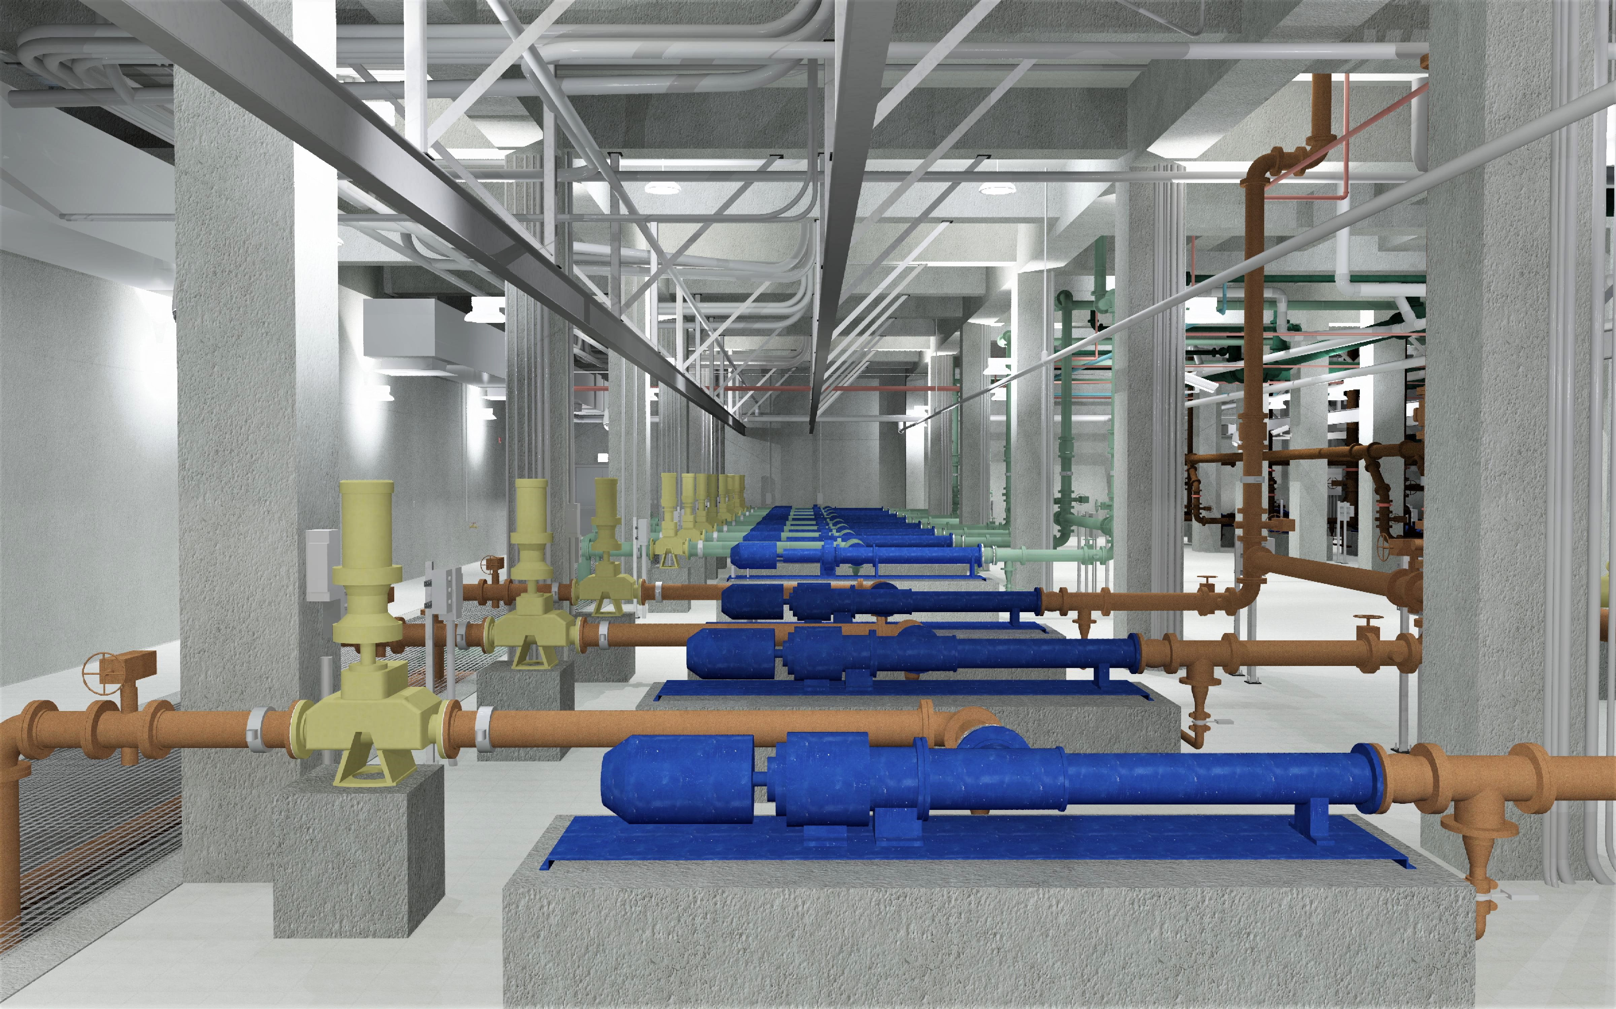
CDWWTP
Thickening & Dewatering Project Model/Pictures

Slide 16
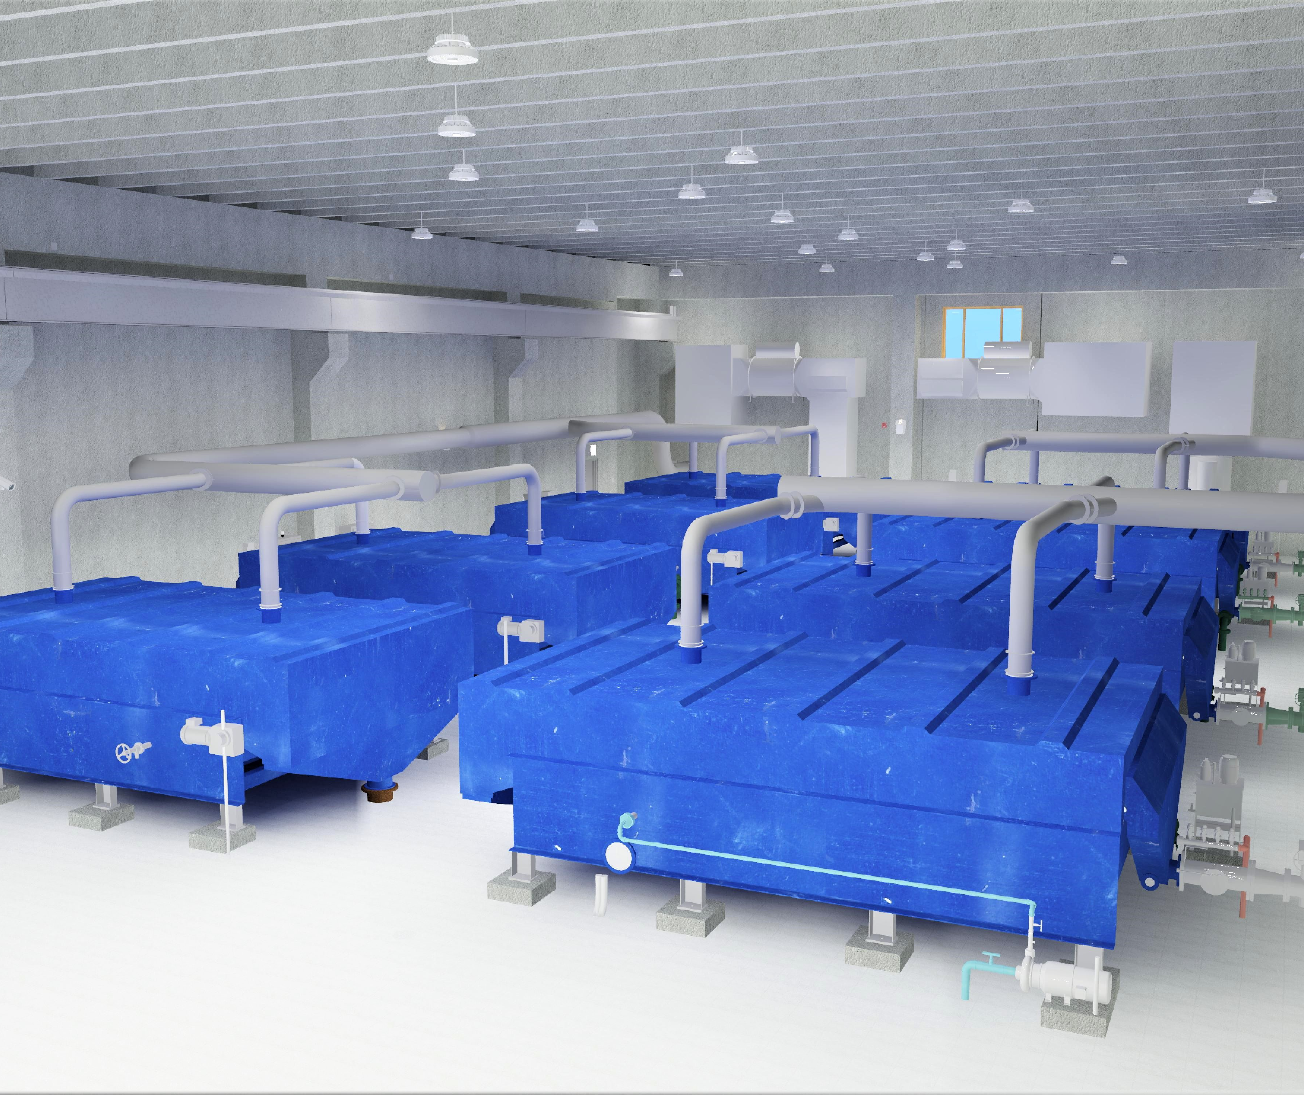
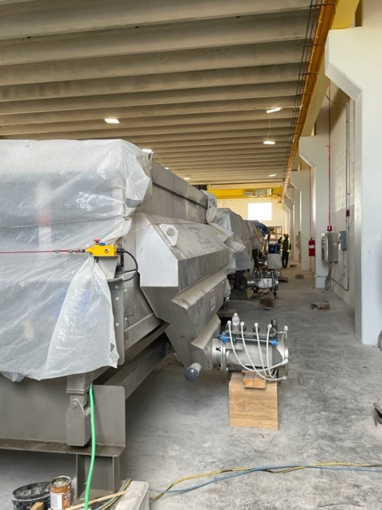
CDWWTP
Thickening & Dewatering Project Model/Pictures

Slide 17
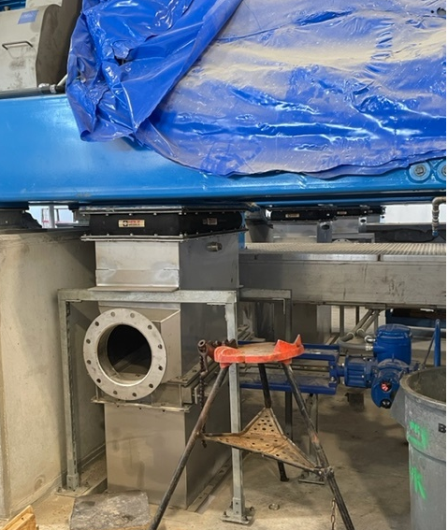
CDWWTP
Thickening & Dewatering Project

Slide 18
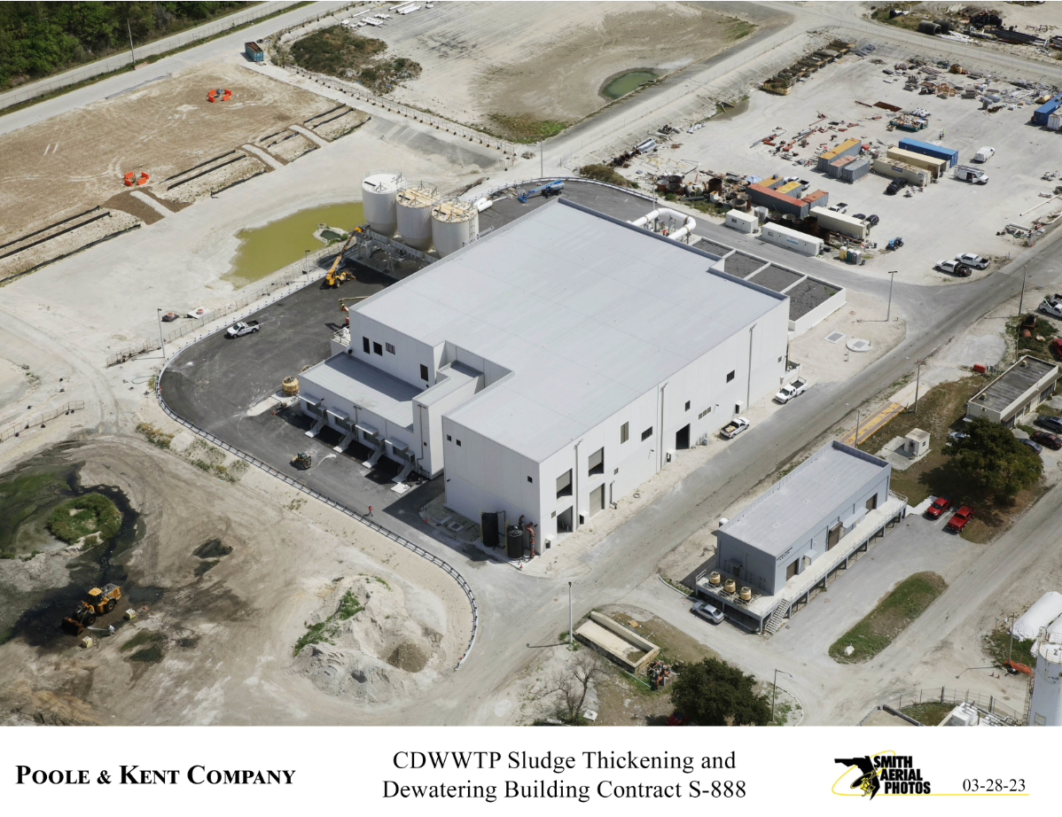
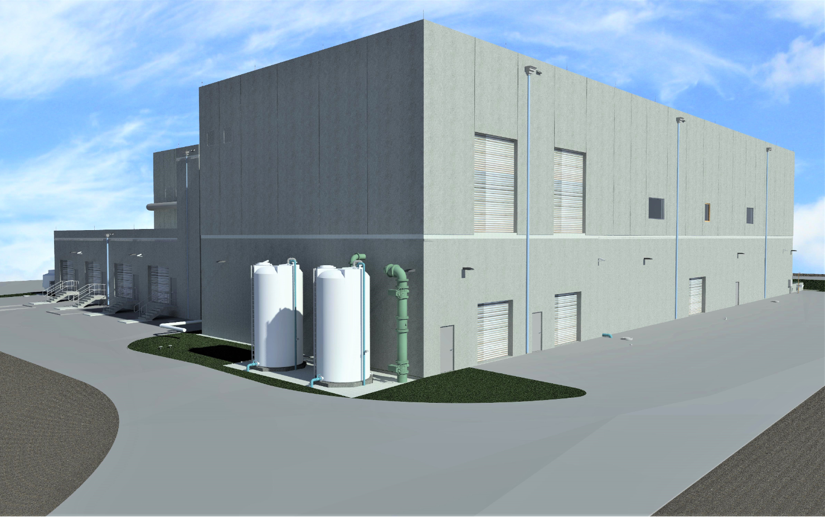
Central District Wastewater Treatment Plant
Thickening & Dewatering Building
Construction
Model - Water Booster Tanks & Influent Piping vs Similarly Installed

Slide 19
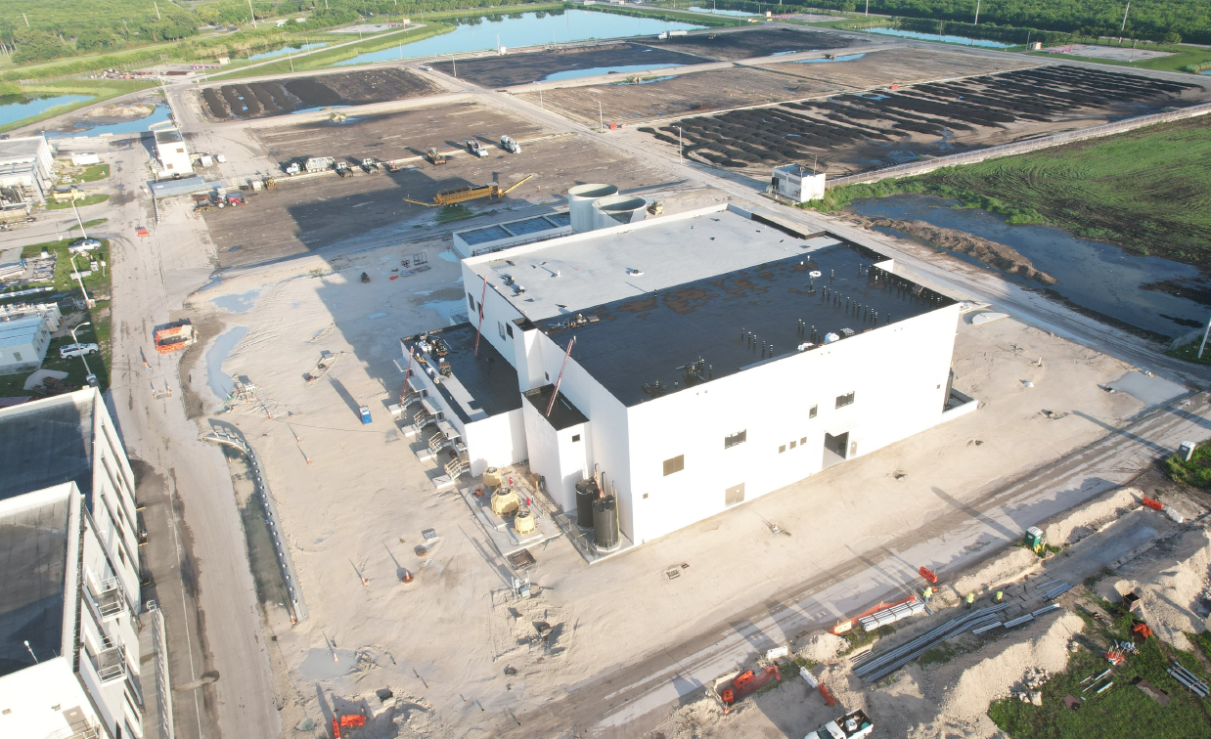
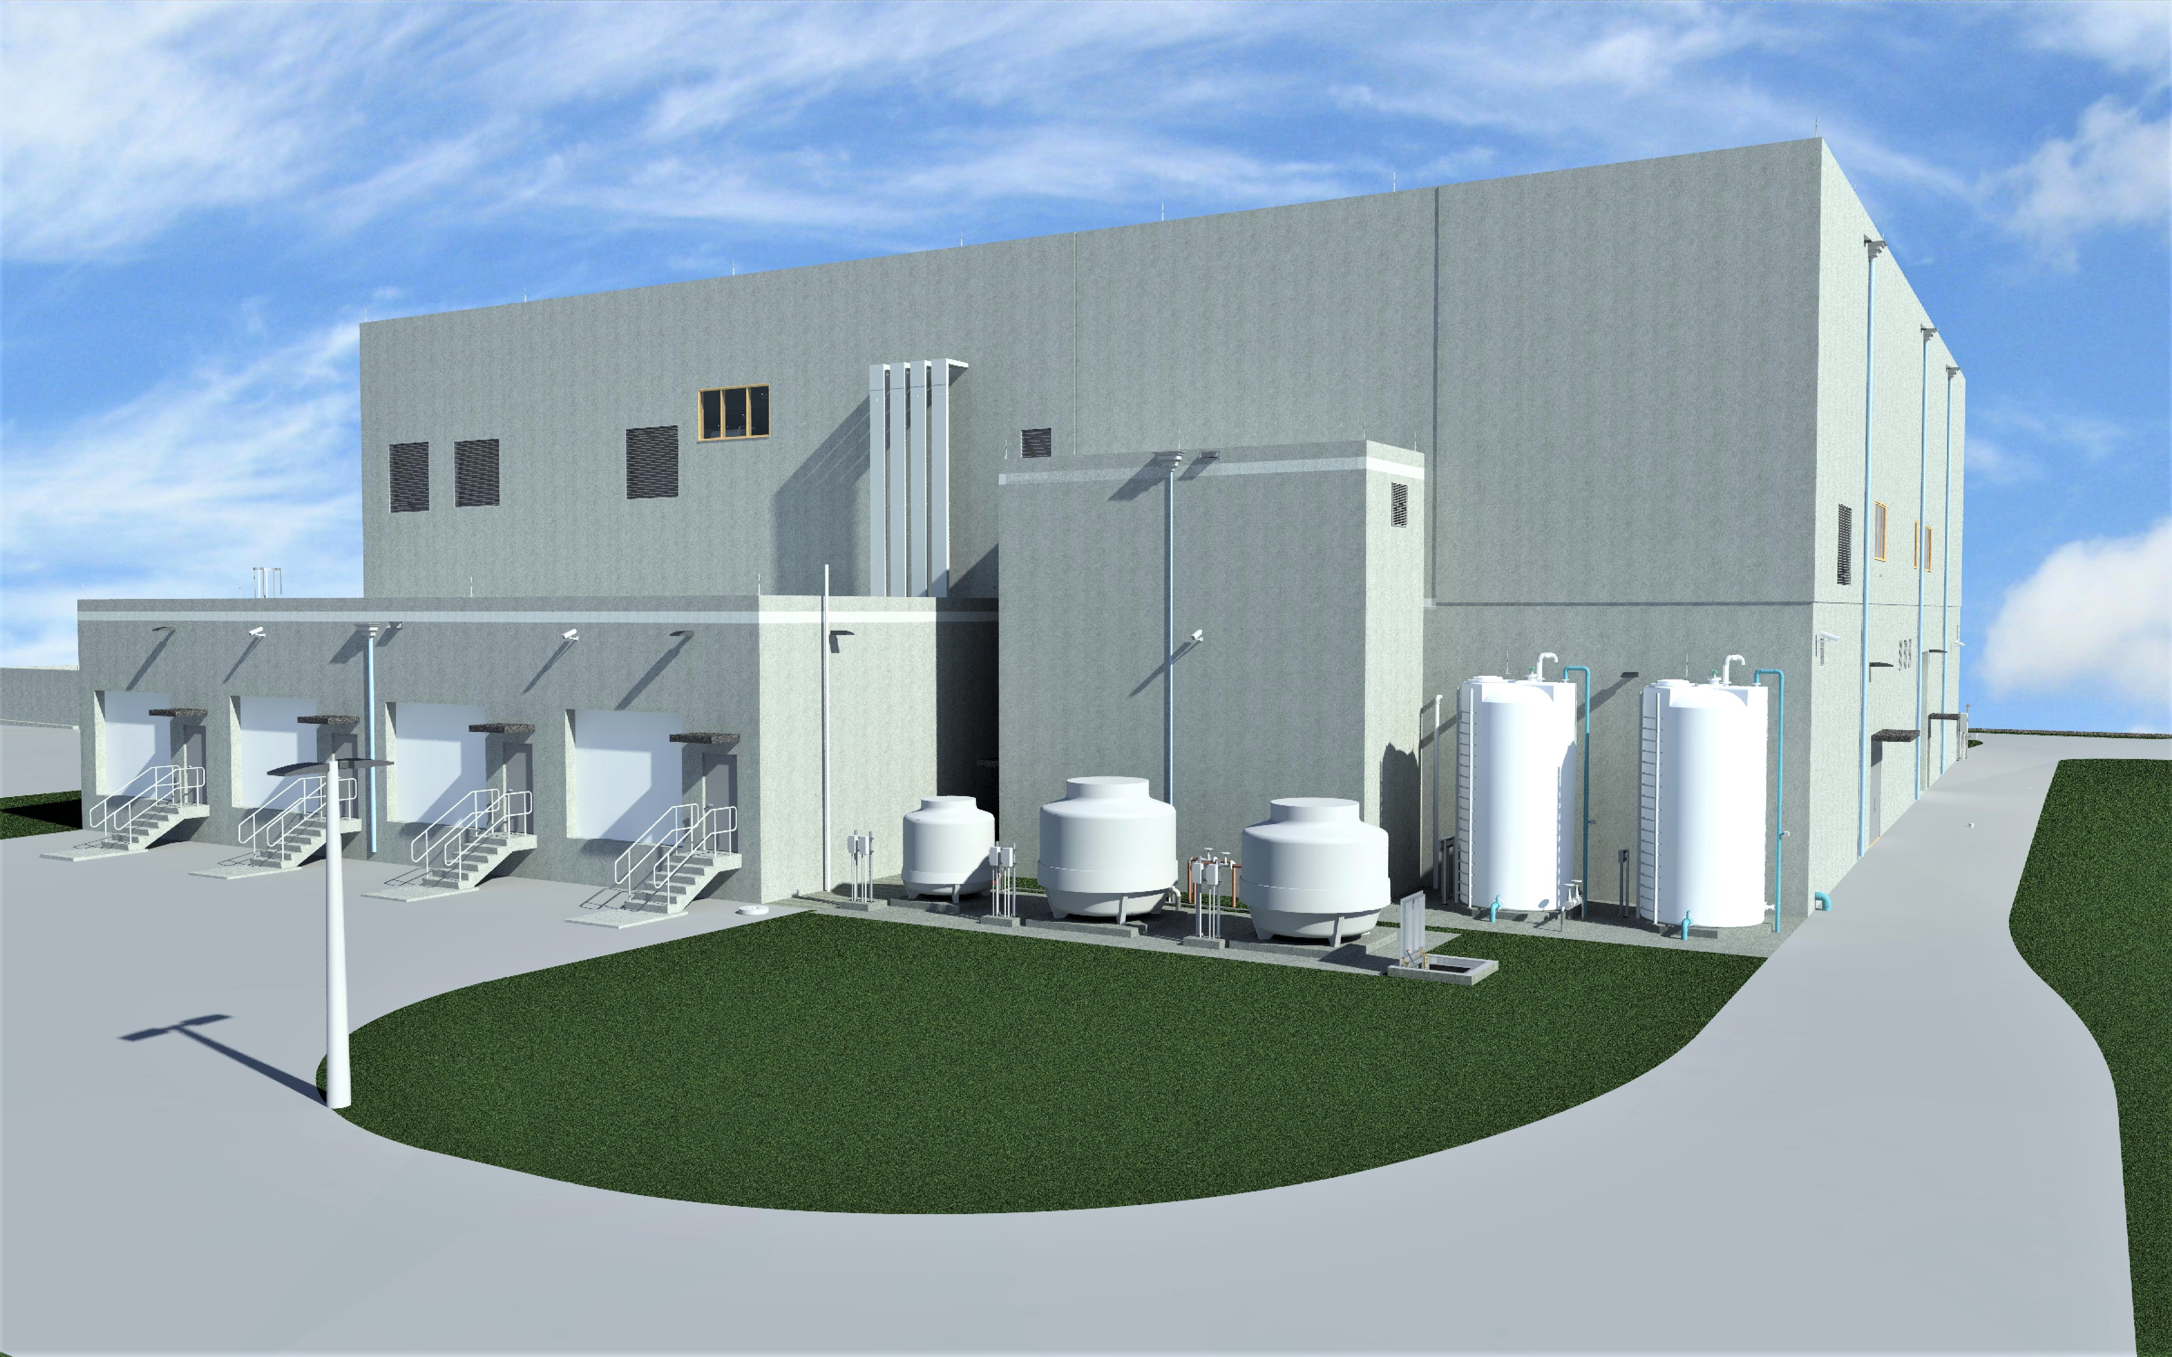
South District Wastewater Treatment Plant (SDWWTP)
Thickening & Dewatering Model/Pictures

Slide 20
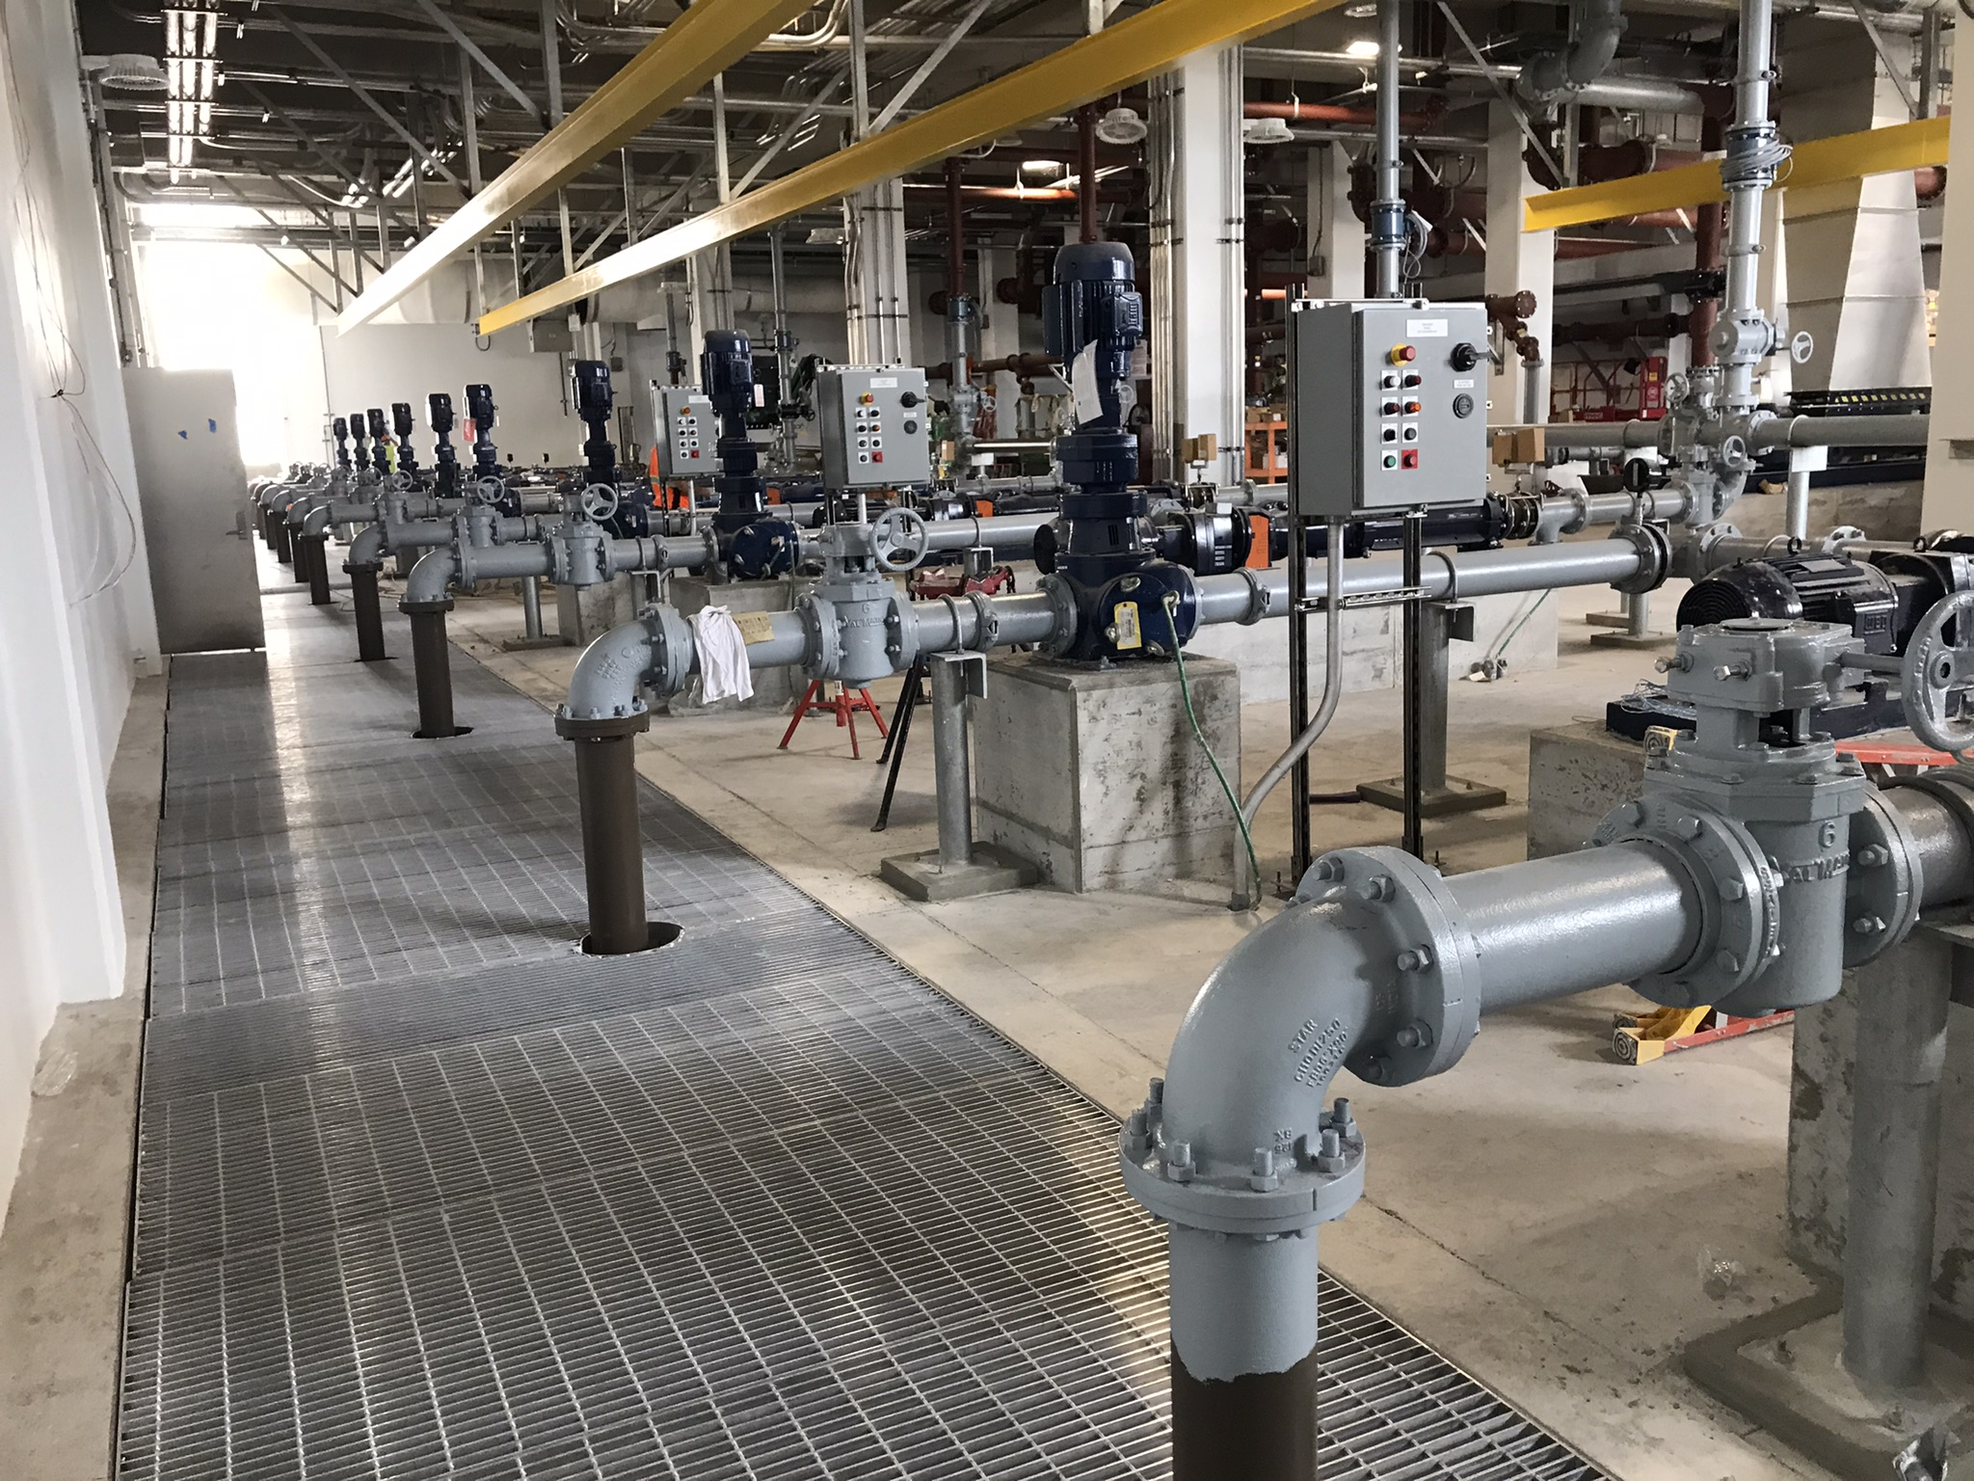
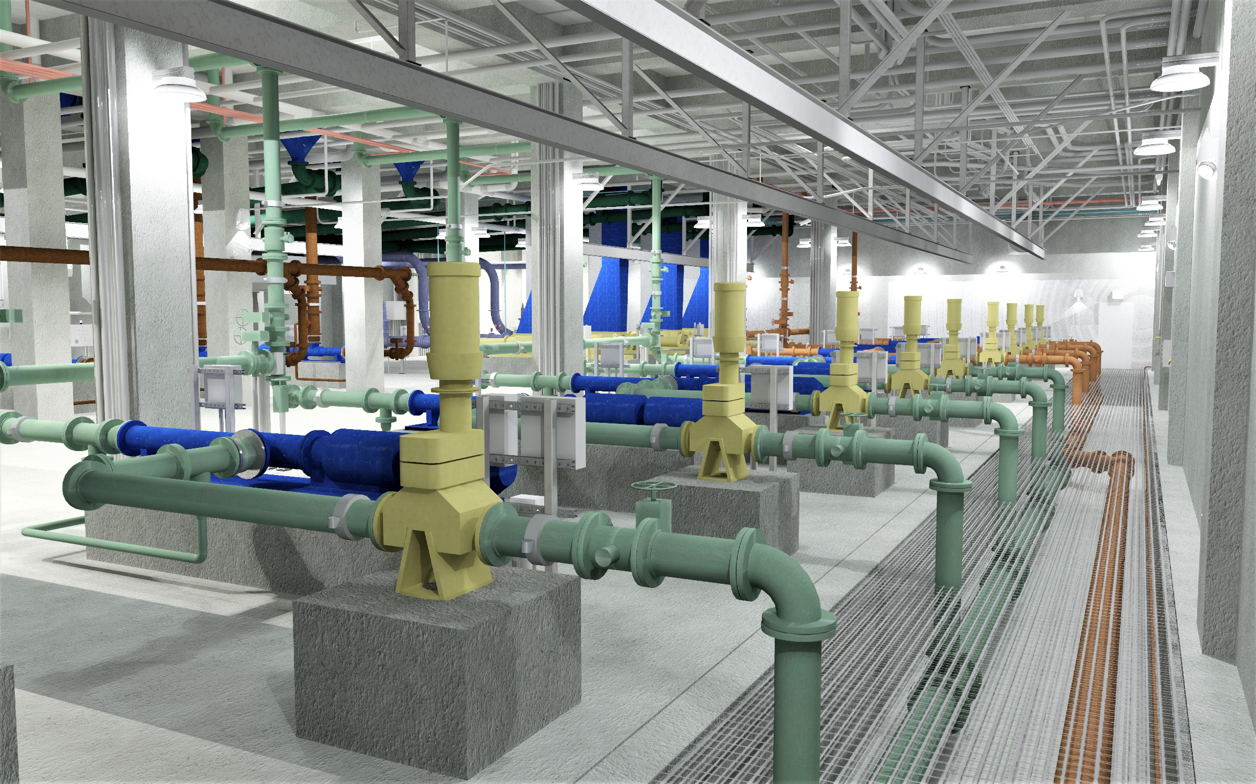
SDWWTP
Thickening & Dewatering Project Model/Pictures
Pump Room
Model vs PUMPS: WAS Grinder & WAS Feed - DSL Grinder & DSL Feed

Slide 21
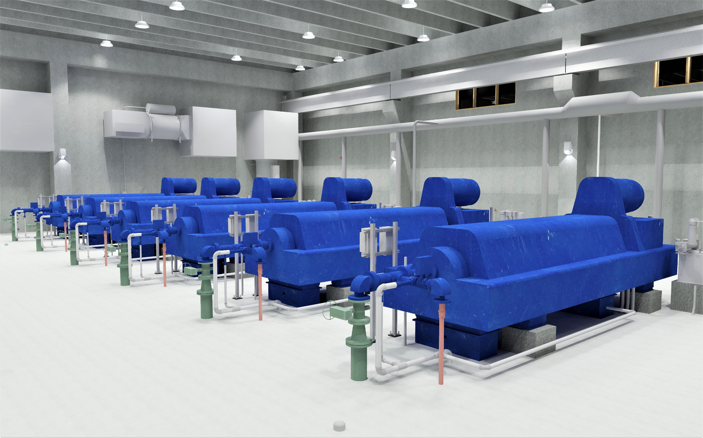
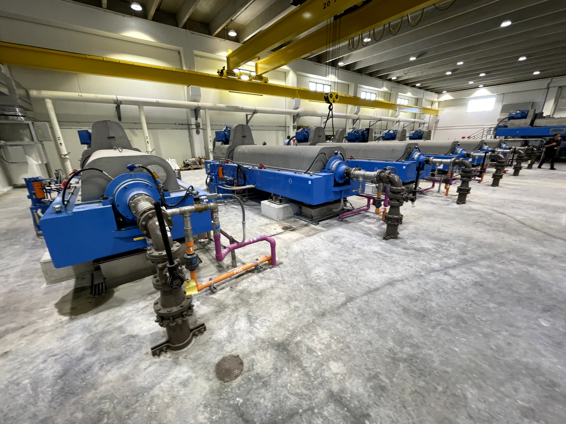
SDWWTP
Thickening & Dewatering Project Model/Pictures

Slide 22
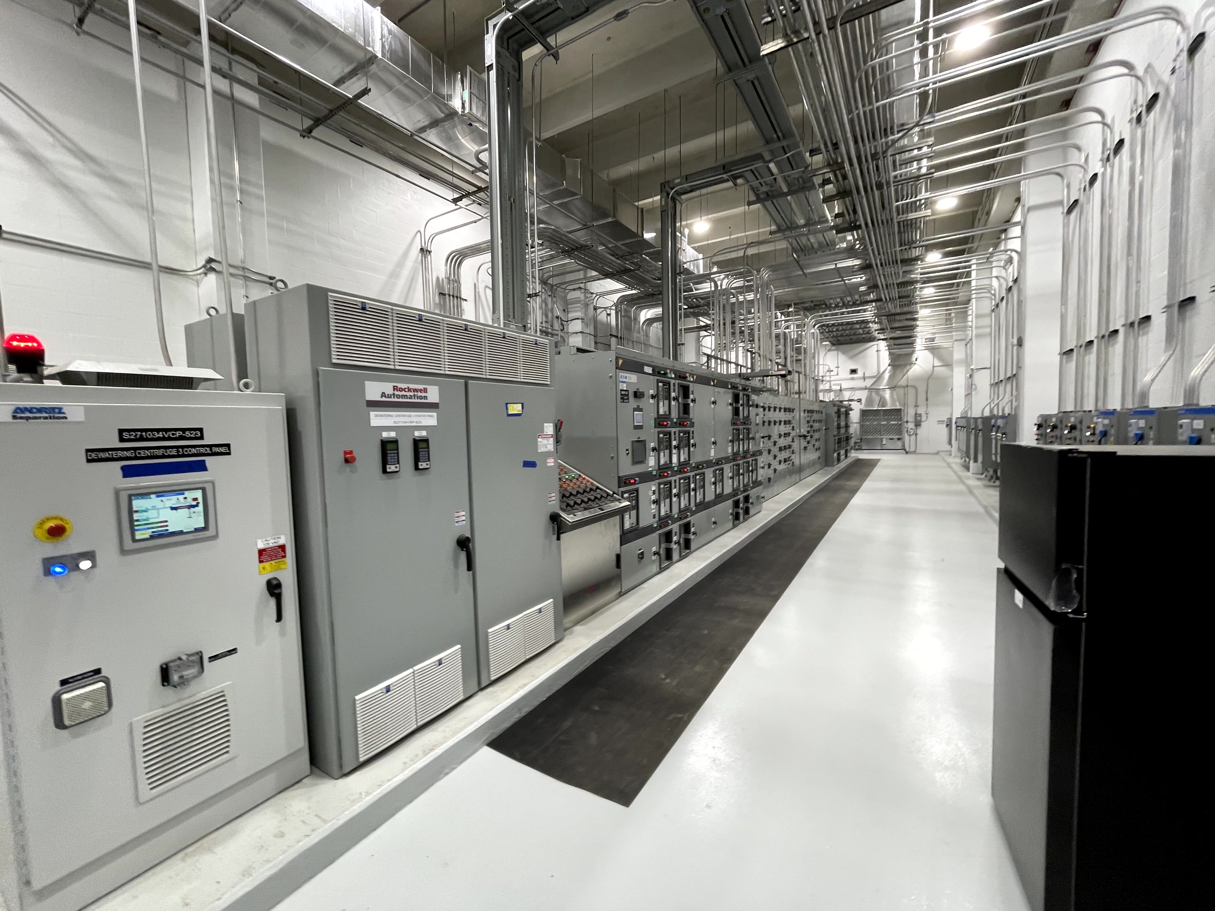
SDWWTP
Thickening & Dewatering Project Pictures

Slide 23
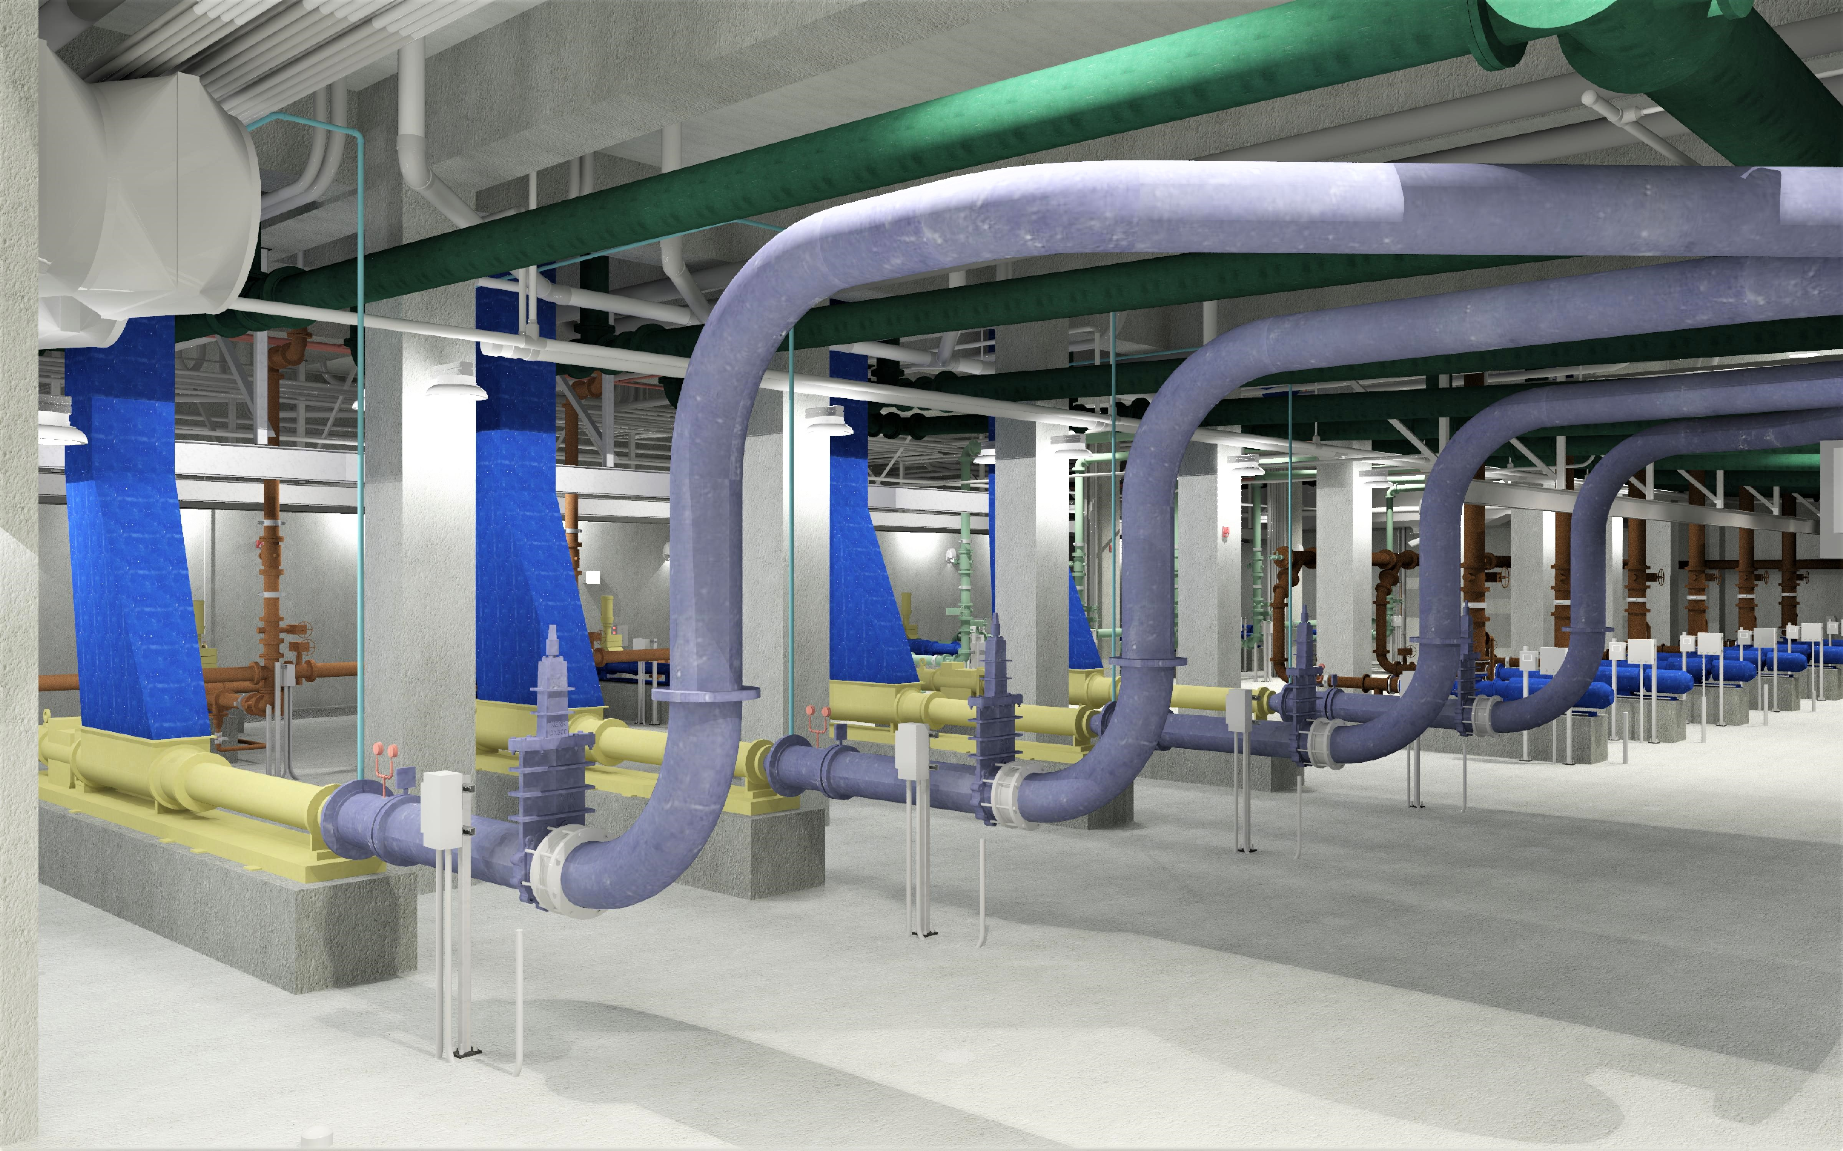
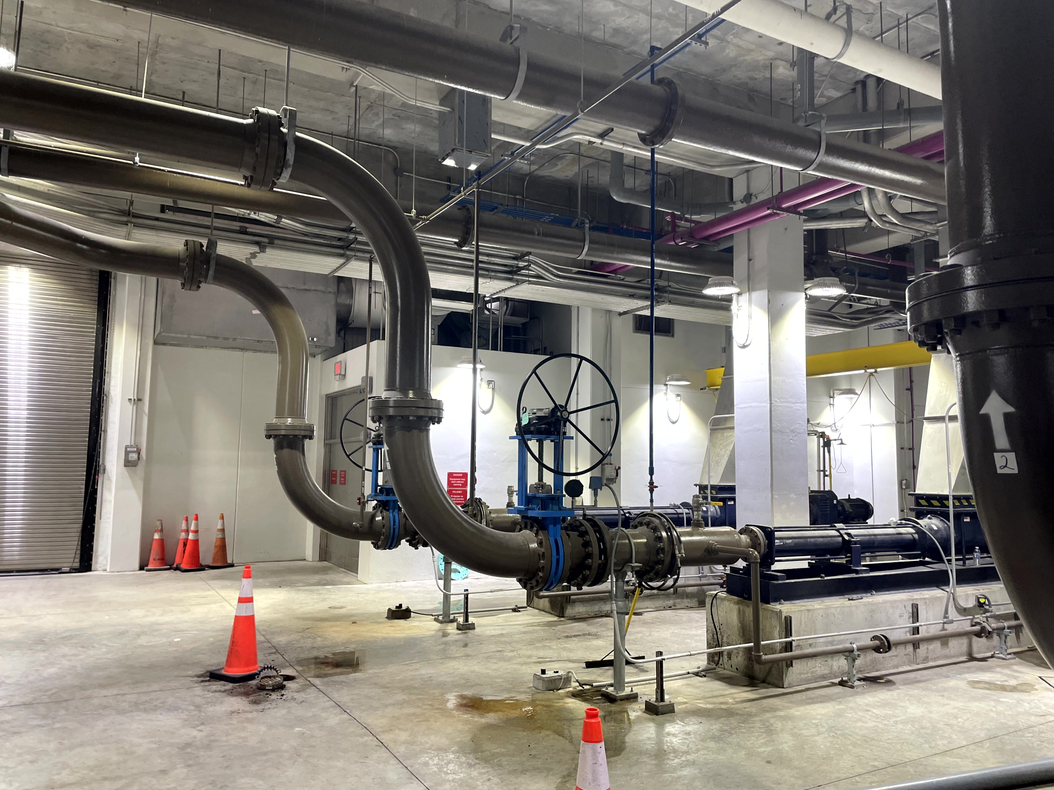
SDWWTP
Thickening & Dewatering Project Model/Pictures

Slide 24
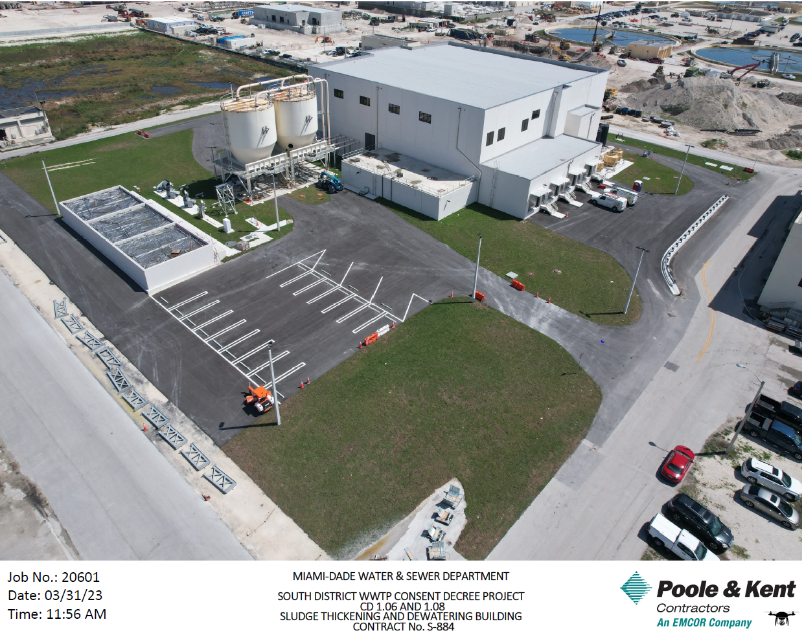
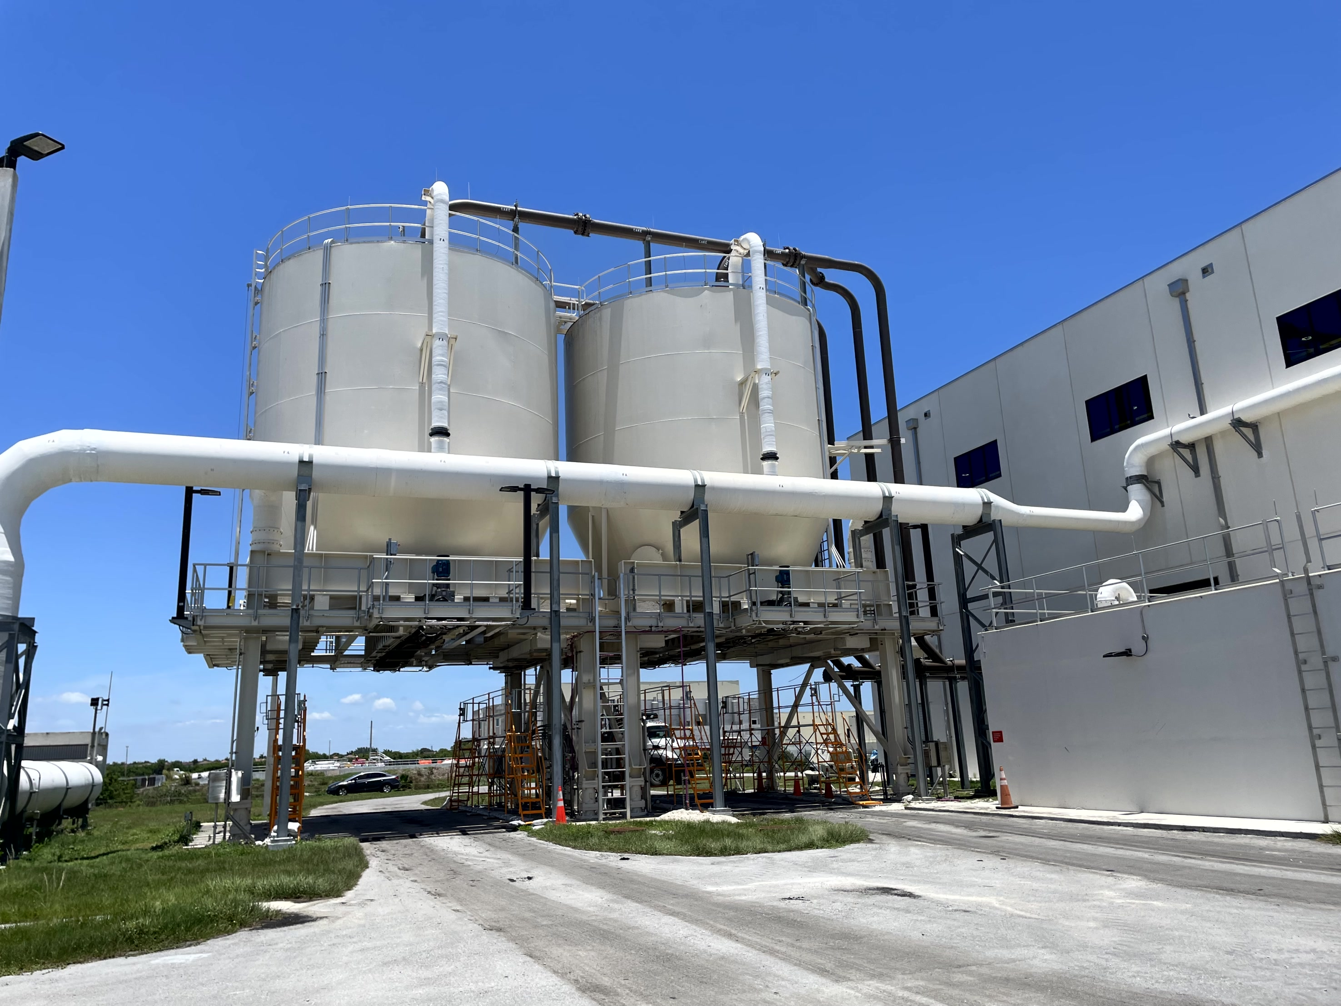
SDWWTP
Thickening & Dewatering Project Model/Pictures

Slide 25
Summary
Alternative Delivery can:
  Reduce the time to beneficial occupancy
  Provide early price certainty for owner
  Provide more optimized (size, cost) facility
Alternative Delivery (Fixed Price Design Build) can also:
  Reduce the input from staff and operations in the final product
  Provide materials or suppliers that may not be of common use by the Utility

