Slide 1

Creative operational strategies for rapid service area growth
A case study panel discussion
TACWA | March 27, 2026

Slide 2
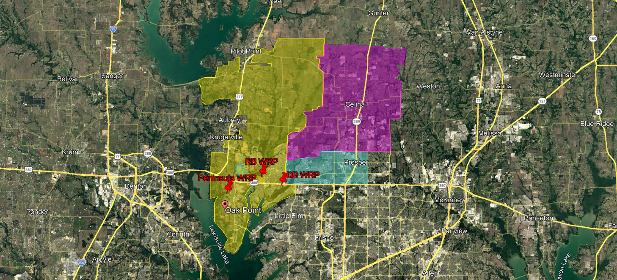
UTRWD Northeast Region
Riverbend WRP (4 mgd AADF Capacity)
1.47 mgd -> 3.54 mgd AADF
2003 -> 2026
Doe Branch WRP (4 mgd AADF Capacity)
2.05 mgd -> 5.69 mgd AADF
2016 -> 2026
Expansion to 12 mgd in construction

Slide 3
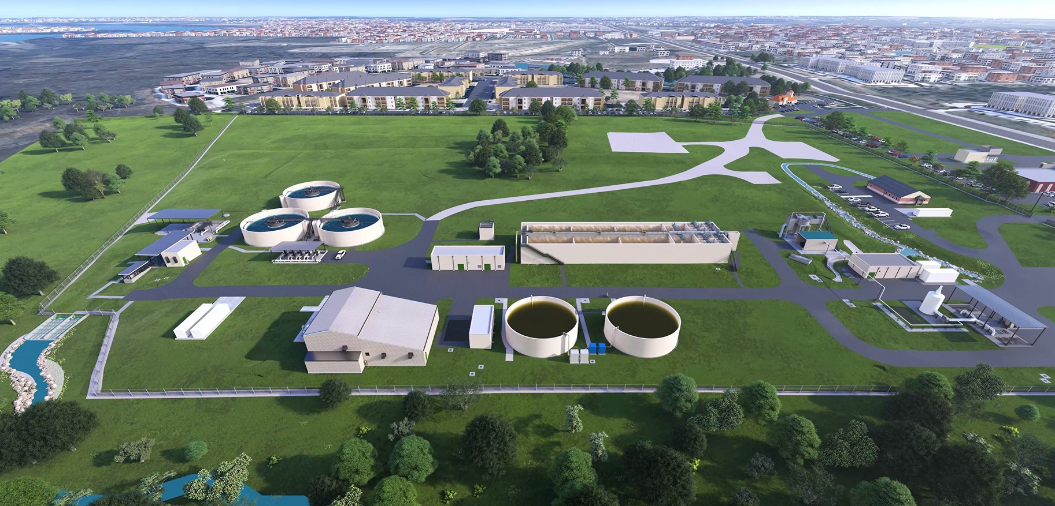
Doe Branch Expansion to 4 mgd completed in 2022
Influent lift station includes transfer pumps to RBWRP

Slide 4
What has the growth in the Northeast Region Looked like for UTRWD?
01
Jeff Mlak, Upper Trinity Regional Water District Operations Manager

Slide 5
UTRWD operations follows growth
 | ‘16 |  |  |  | ‘20 |  |  |  |  | ‘26 |  |  |  |  |  |  | ‘50
Population Growth
Treatment Capacity
Treatment Facility Projects
Model Build
NE Regional WR System Budget
35,236
119,928
439,000
4.94 mgd
10.0 mgd
30.3 mgd
PN
Ph 3
RB Ph 3
PN Ph 2
DB Ph 1
Design
DB
Ph 3
RB
Ph 4
DB
Ph 4
DB Ph 2
?
$4.2 M
8 People
0.84 BG
$8.3 M
13 People
2.0 BG
$20.0 M (+476% from 2016)
20 People (+250% from ‘16)
3.9 BG (+464% from ‘16)

Slide 6
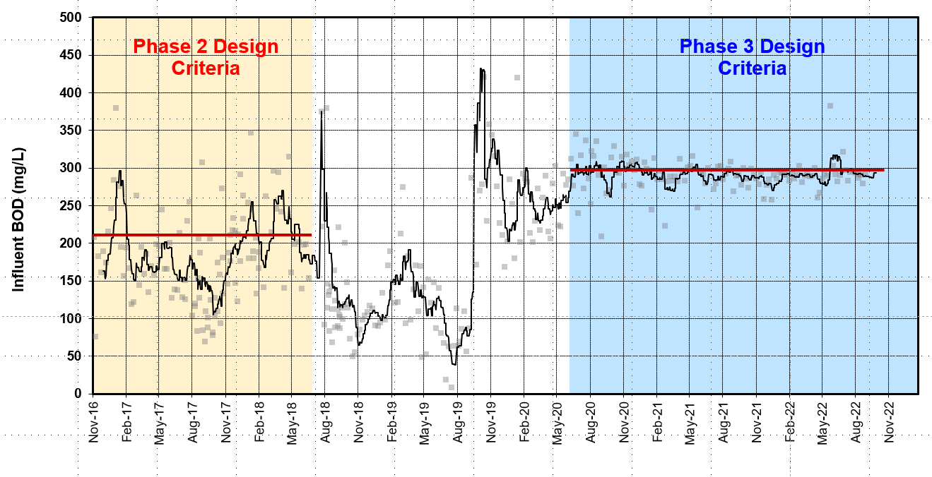
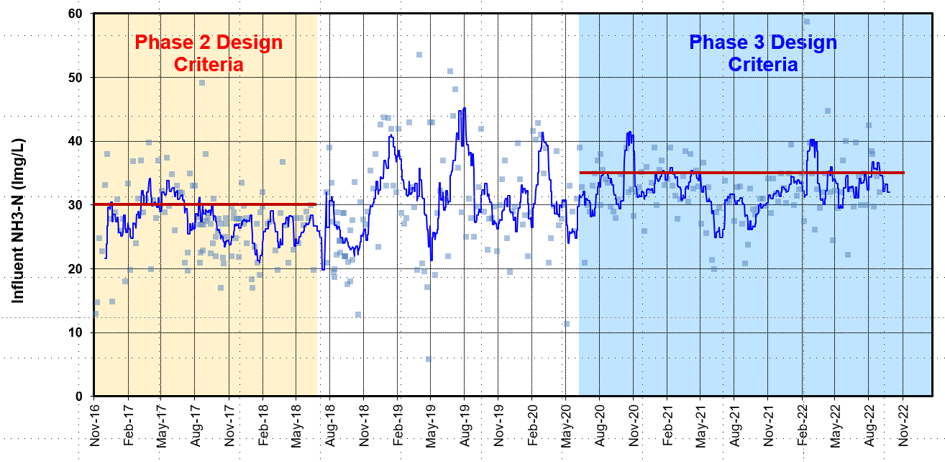
Actual waste load increased from phase 2
Ph 2 Construction
Ph 2 Construction
BOD Increased from ~220 mg/l to 300 mg/l
Influent Ammonia from ~30 mg/l to 35 mg/l

Slide 7
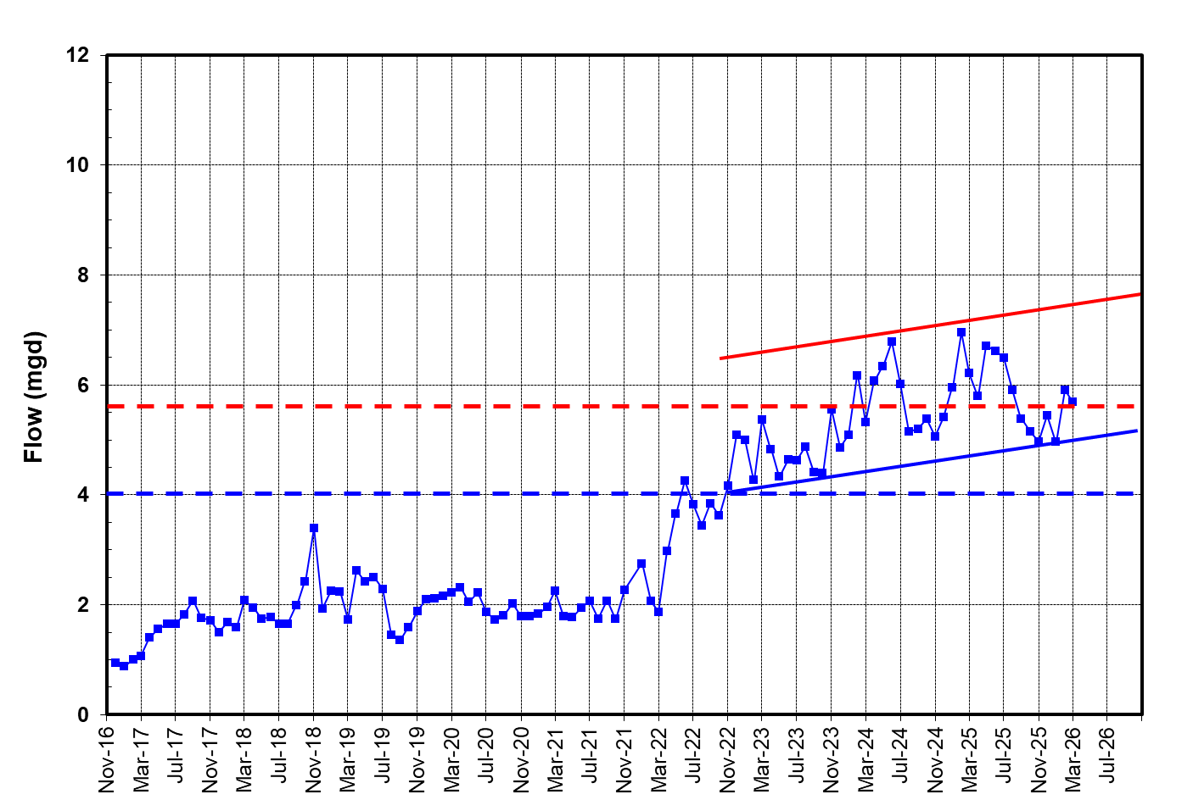
Doe Branch Flows (365-day average)
Transfer to RBWRP

Slide 8
High performance under stress
Parameter | Design | 2025 Actual | % of Design | Eff. Performance
Flow | 4.0 mgd | 5.97 mgd | 149% | N/A
CBOD | 6,005 lbs/day | 11,462 lbs/day | 191% | 2.44 mg/L
TSS | 5,595 lbs/day | 7,339 lbs/day | 76% | 2.5 mg/L
Ammonia | 1,001 lbs/day | 1,871 lbs/day | 187% | 0.29 mg/L
Phosphorus | 200 lbs/day | 248 lbs/day | 124% | 0.165 mg/L

Slide 9
How are you operating the plant to consistently maintain excellent treatment with the extreme changes in flow and load?
02
Joe Thompson, UTRWD Operations Supervisor

Slide 10
RAS conditioning has been effective

Slide 11
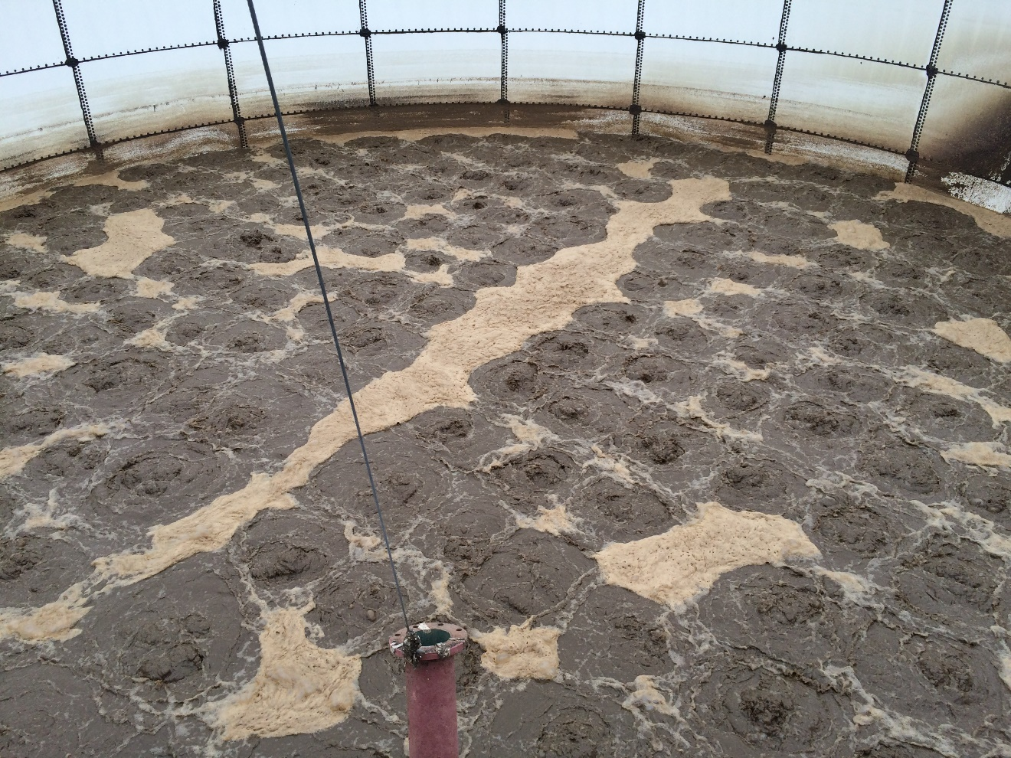
SBR Inspired operation lowers P and N, adds Alkalinity

Slide 12
What is happening? Why is this working so well?
03
Anton Dapcic, Carollo TX Wastewater Practice Lead

Slide 13
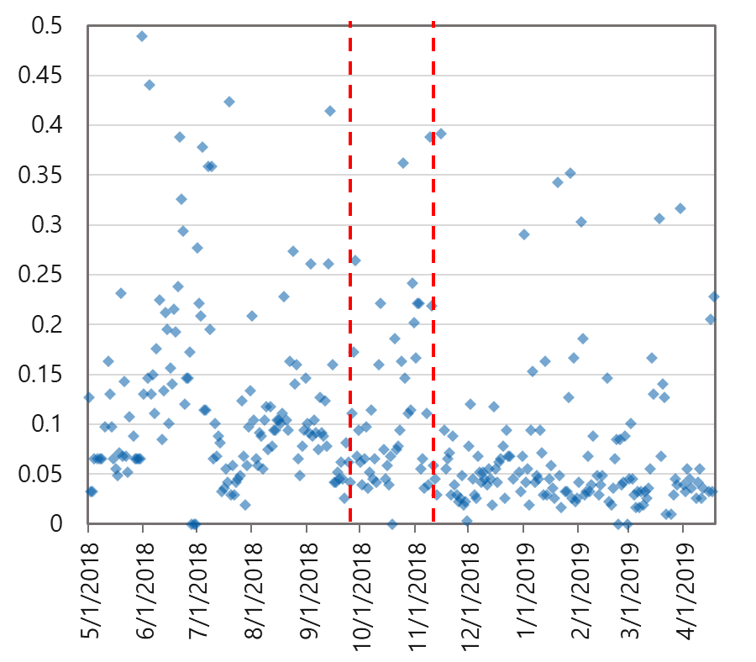
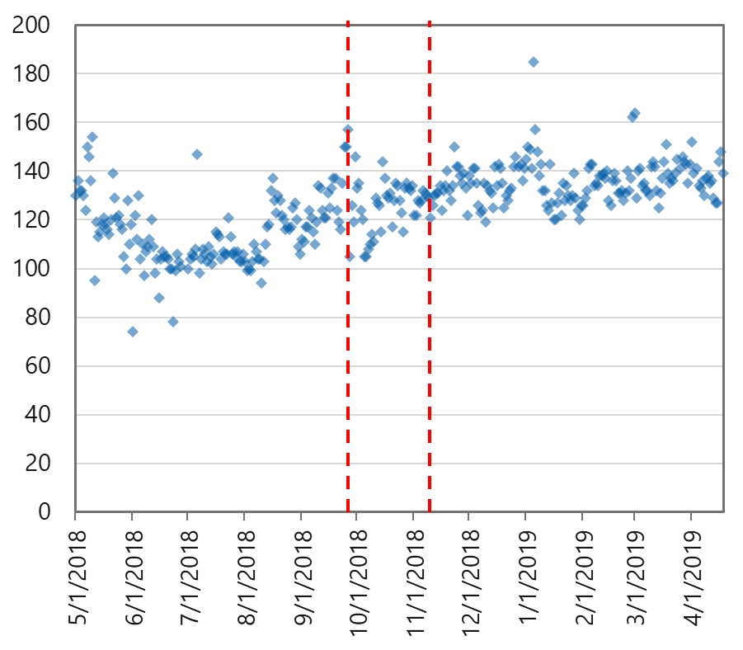
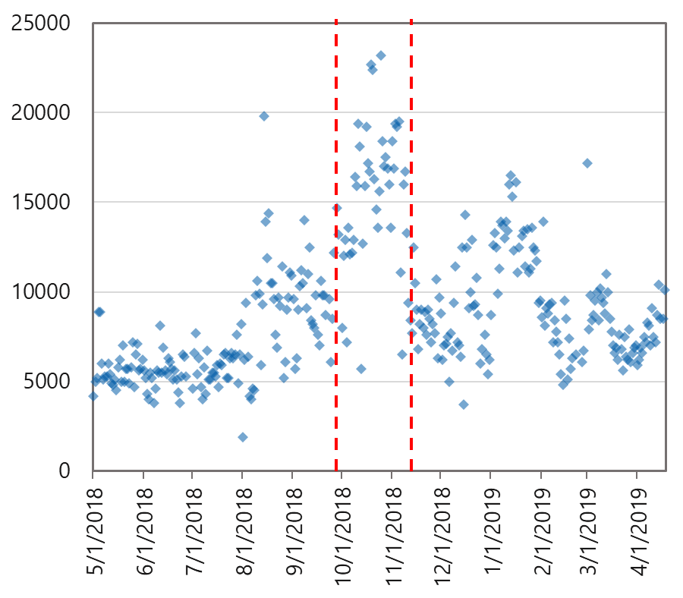
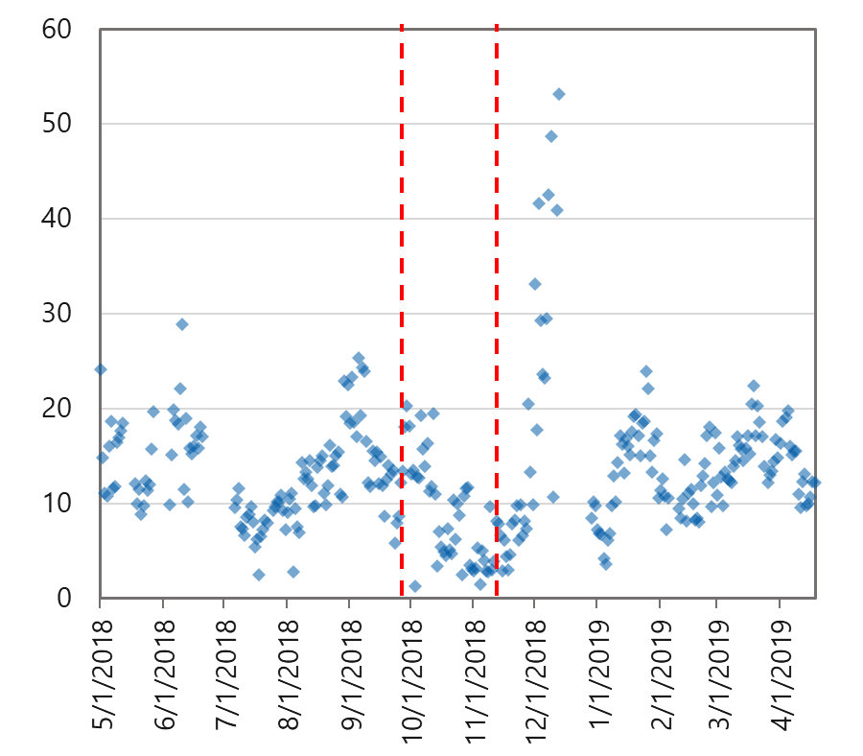
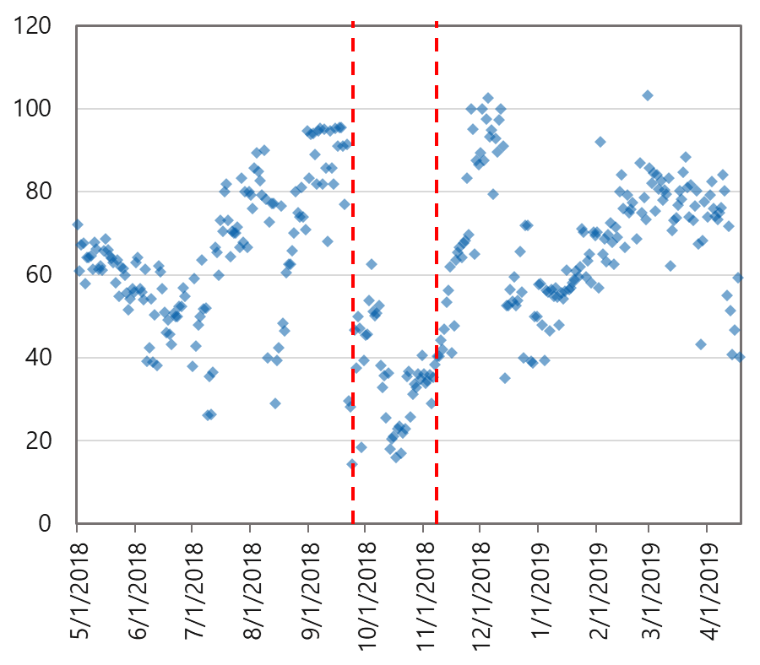
Effluent TP (mg/L)
Effluent Alkalinity (mg/L as CaCO₃)
RAS TSS (mg/L)
Sludge Volume Index (mL/g)
Effluent NO₃-N (mg/L)

Slide 14

The Phase 3 Expansion includes RAS fermentation
Doe Branch WRP Phase 3 (8 mgd AADF)
Wastewater
ANX
ANA
ANX
OXIC
MLR
WAS
RAS

Slide 15
Questions for the panel?

Slide 17
Are you operating in a similar way at Riverbend and Peninsula?
04
Joe / Jeff

Slide 18
Are there odor control or other benefits to this strategy?
05

Slide 19
Has dewatering quality and consistency improved or been challenged by operating this way?
06

