Slide 1
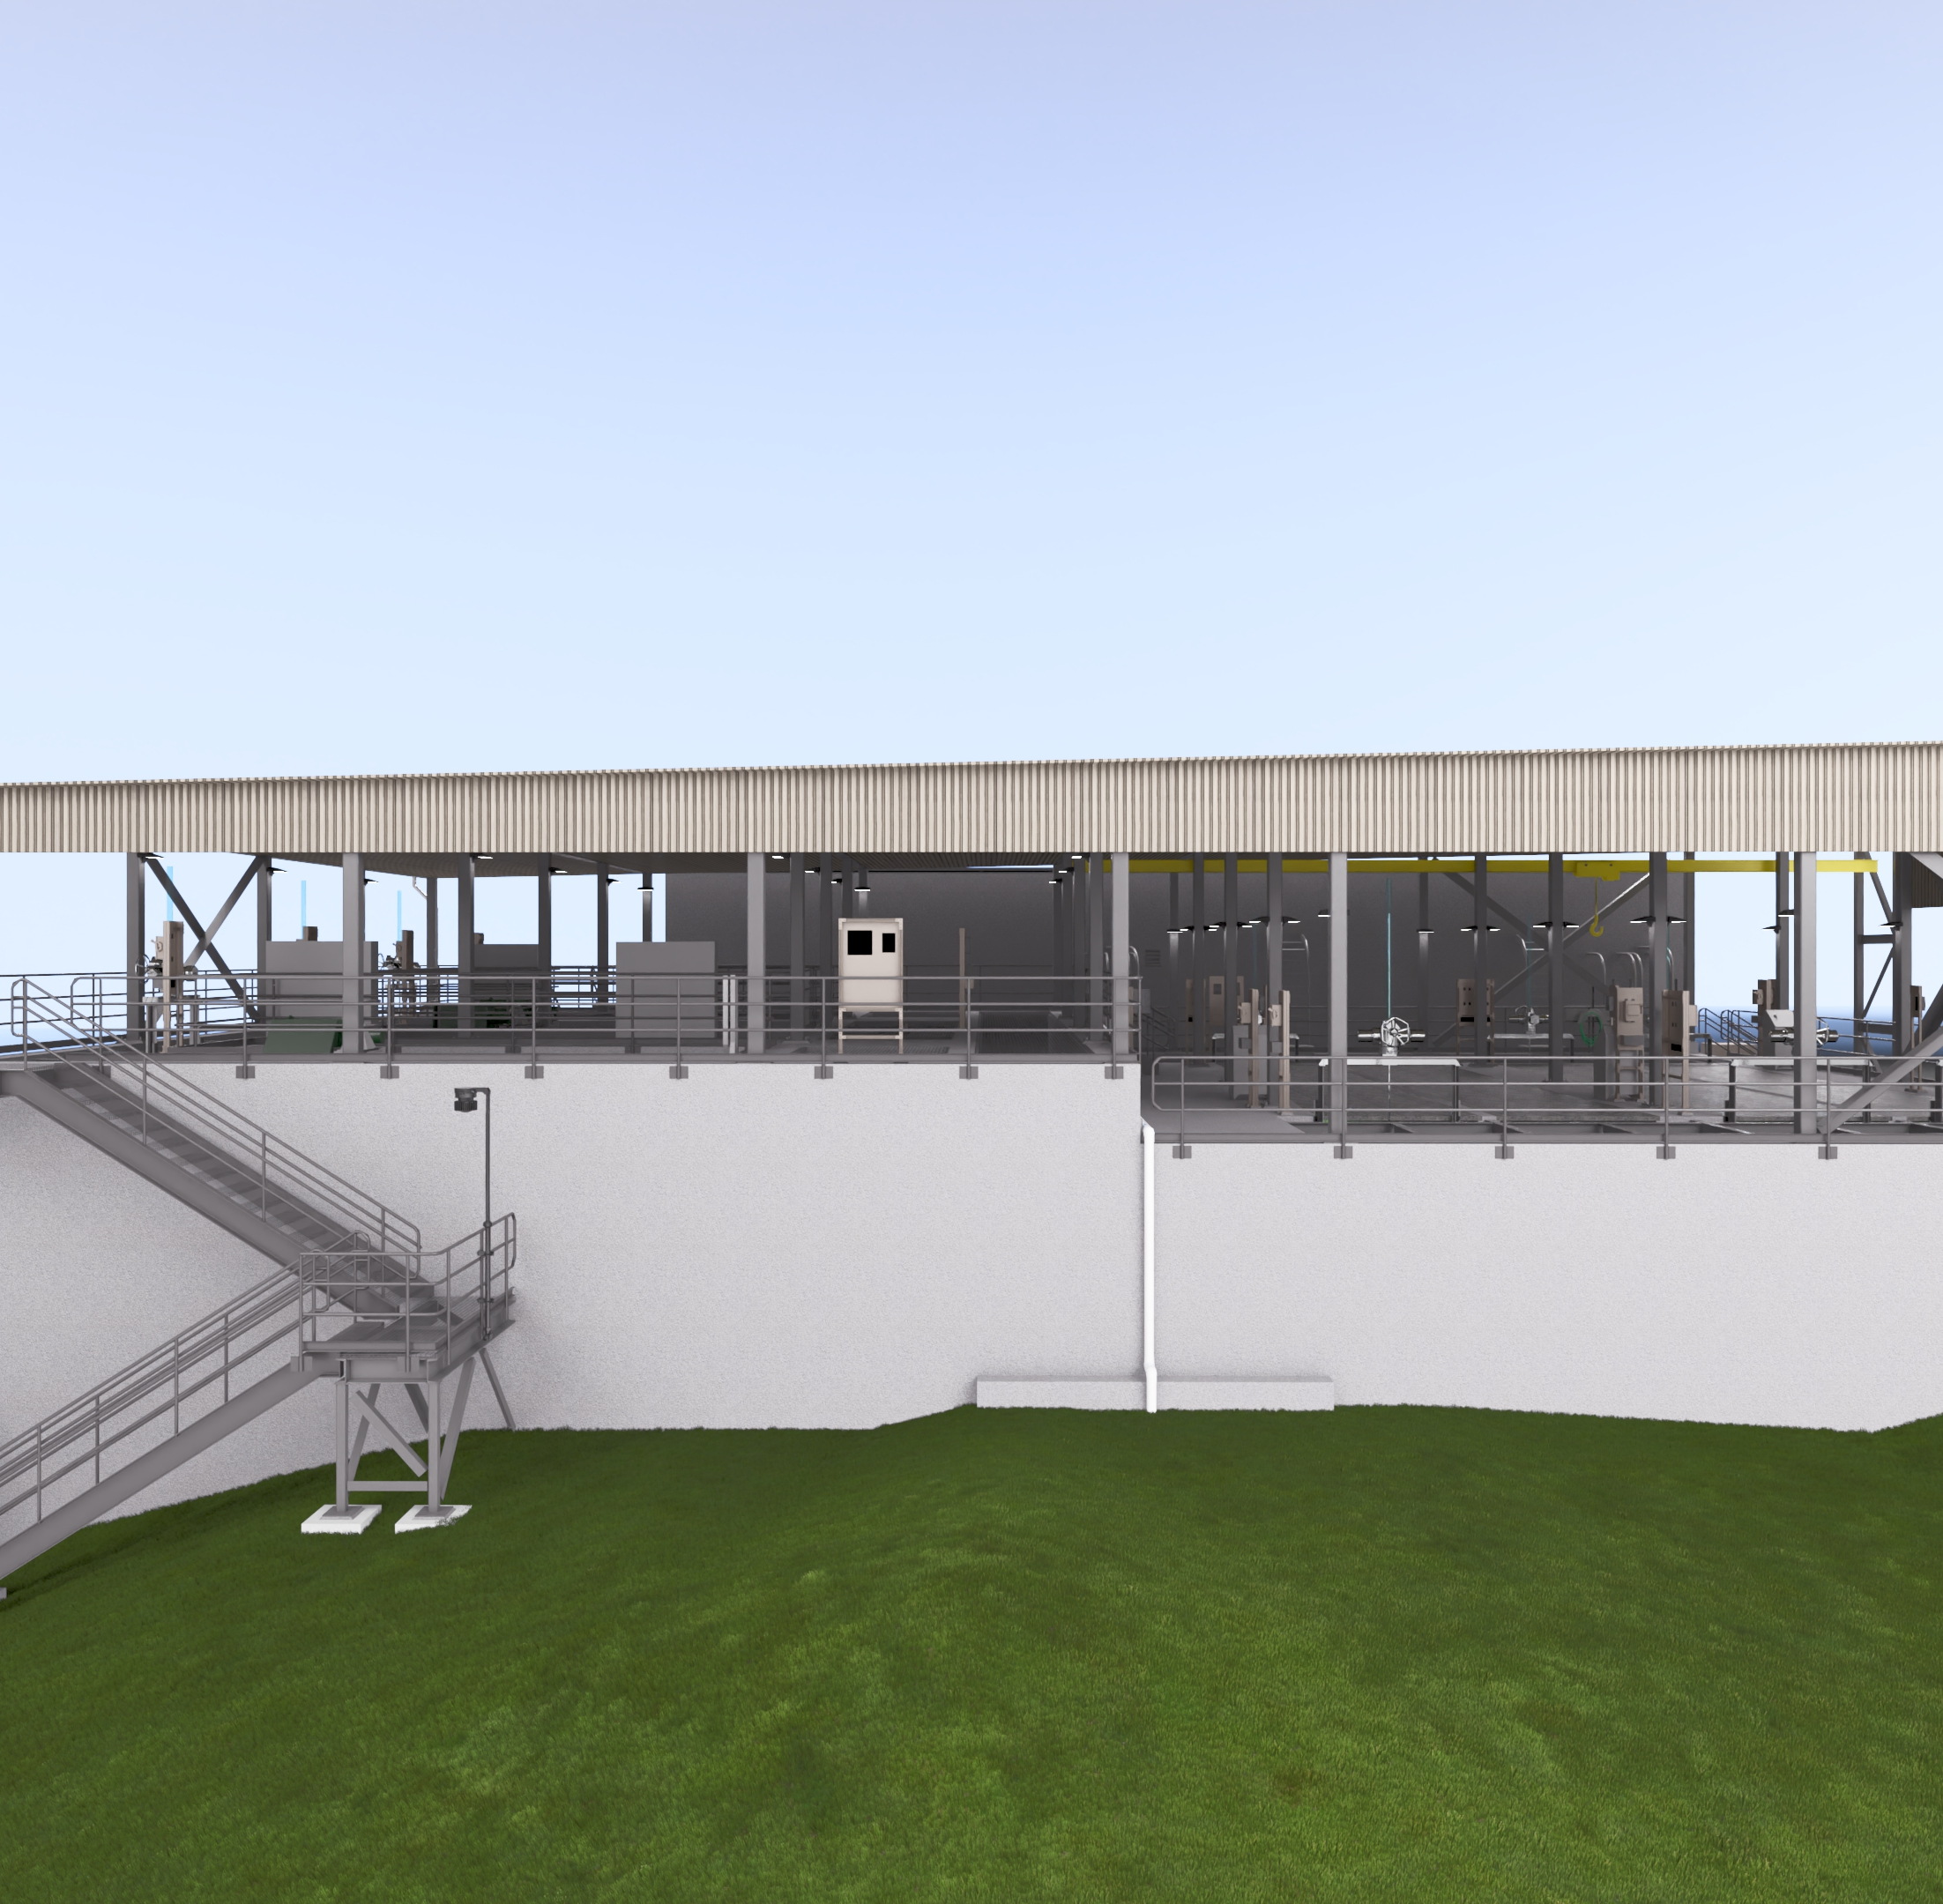

Duck Creek WWTP Filter Replacement And UV Disinfection
Sam Barraco – Carollo Engineers, Inc.
Brandon Little – Operations Manager
NOVEMBER 14, 2025

Slide 2



Agenda
Project Overview
Construction Update
Operations

Slide 3

Project Overview
01

Slide 4
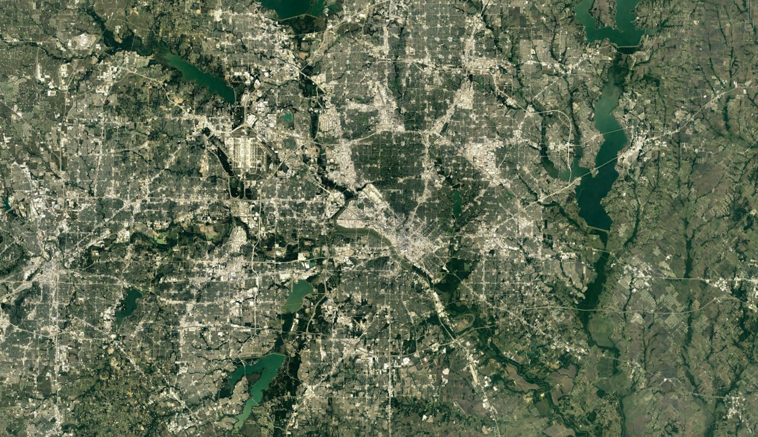
City of Garland WWTPs
ROWLETT CREEK WWTP
GARLAND
DALLAS
FORT WORTH
DUCK CREEK WWTP
Notes:
Garland has two WWTPs

Slide 5
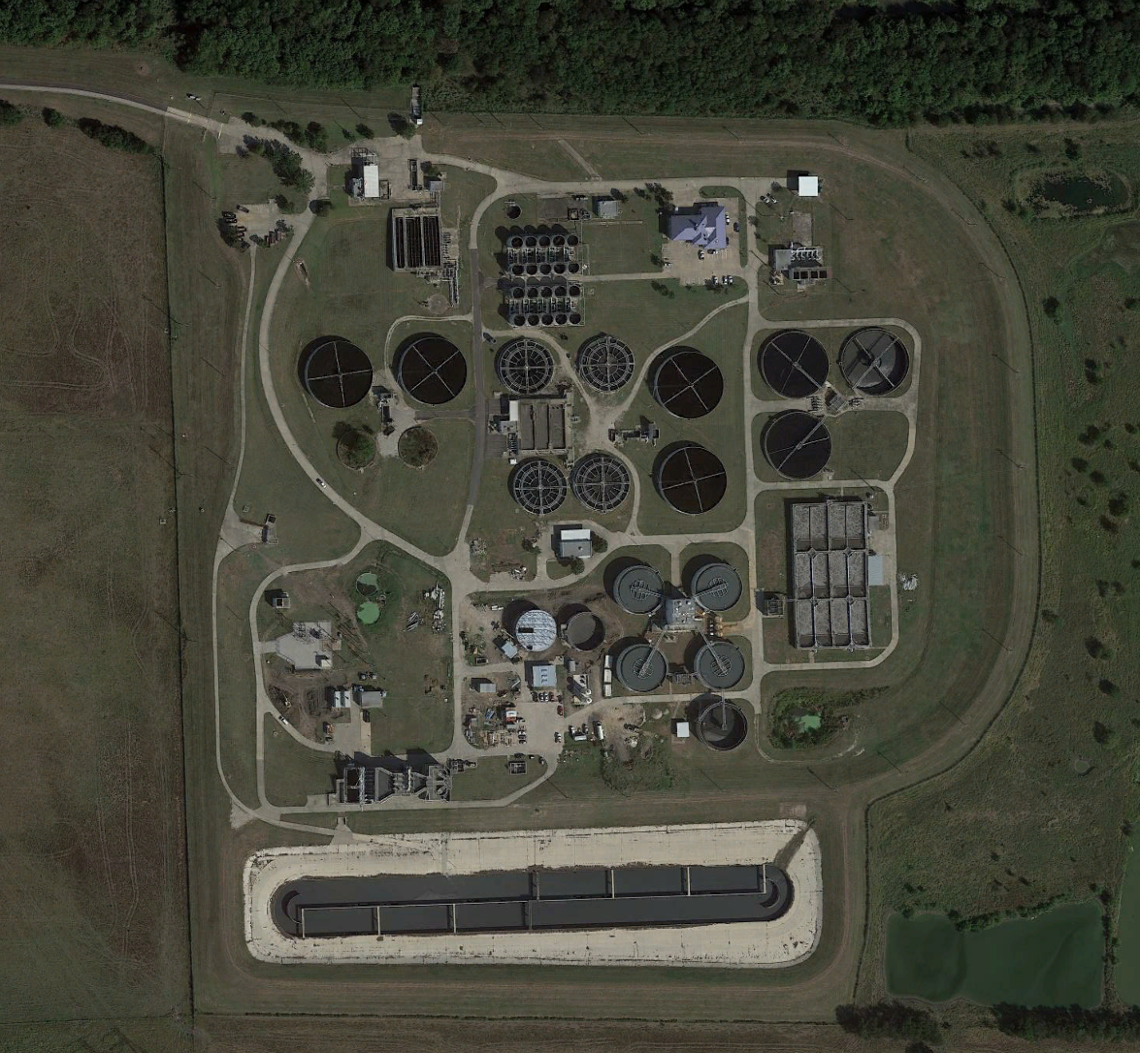
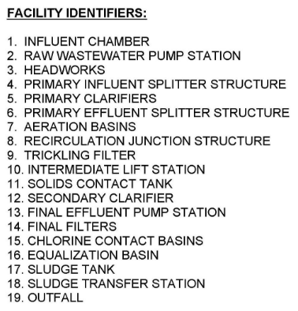
Duck Creek Wastewater Treatment Plant
19
15
14
13
9
12
8
8
10
11
9
12
12
6
7
17
5
ADF: 40 MGD
P2H: 72 MGD
18
4
5
3
1
2
16

Slide 6
Existing process flow diagram
SECONDARY TREATMENT
(TRICKLING FILTER TRAIN)
PRIMARY TREATMENT
PRIMARY EFFLUENT SPLITTER
FINAL PUMP STATION
SAND
FILTERS
CHLORINE DISINFECTION
SECONDARY TREATMENT
(AERATION BASIN TRAIN)
OUTFALL

Slide 7
Existing process flow diagram
SECONDARY TREATMENT
(TRICKLING FILTER TRAIN)
PROJECT SCOPE
PRIMARY TREATMENT
PRIMARY EFFLUENT SPLITTER
FINAL PUMP STATION
SAND
FILTERS
CHLORINE DISINFECTION
SECONDARY TREATMENT
(AERATION BASIN TRAIN)
OUTFALL

Slide 8
Proposed process flow diagram
SECONDARY TREATMENT
(TRICKLING FILTER TRAIN)
PRIMARY TREATMENT
PRIMARY EFFLUENT SPLITTER
FINAL PUMP STATION
DISK
FILTERS
UV DISINFECTION
SECONDARY TREATMENT
(AERATION BASIN TRAIN)
OUTFALL
Notes:
……Megadisk filters and UV disinfection……click for next

Slide 9
The project incorporated wet weather blending
SECONDARY TREATMENT
(TRICKLING FILTER TRAIN)
PRIMARY TREATMENT
PRIMARY EFFLUENT SPLITTER
FINAL PUMP STATION
STORM
FILTERS
UV DISINFECTION
SECONDARY TREATMENT
(AERATION BASIN TRAIN)
OUTFALL

Slide 10
What is wet weather blending?
Wet weather blending is routing a portion of wastewater flows during a wet weather peak flow event through a non-biological treatment process
and then recombining the flow with the biological treatment effluent before disinfection and final outfall.
BIOLOGICAL TREATMENT
PRIMARY TREATMENT
DISINFECTION
OUTFALL
NON -BIOLOGICAL TREATMENT

Slide 11
Storm filters are dual-purpose filters
Dual-purpose filters serve as tertiary filtration for the main process as well as non-biological treatment for redirected storm water flow.
BIOLOGICAL TREATMENT
PRIMARY TREATMENT
DISINFECTION
OUTFALL
NON -BIOLOGICAL TREATMENT

Slide 12
Storm filters are dual-purpose filters
Dual-purpose filters serve as tertiary treatment for the main process as well as non-biological treatment for redirected storm water flow.
BIOLOGICAL TREATMENT
PRIMARY TREATMENT
DISINFECTION
OUTFALL
DUAL-PURPOSE FILTERS

Slide 13
Does blending meet permit? (TSS)
Secondary Effluent (67%)
Stormwater Flow (33%)
TSS: 15 mg/L
TSS: 183 mg/L
Blended Filter Influent
TSS: 70 mg/L
Effluent Characteristics
Filters
PERMIT:
30 Day – 15 mg/l
7 Day – 25 mg/l
Daily Max – 40 mg/l
Single Grab – 60 mg/l
TSS: 20 mg/L

Slide 14
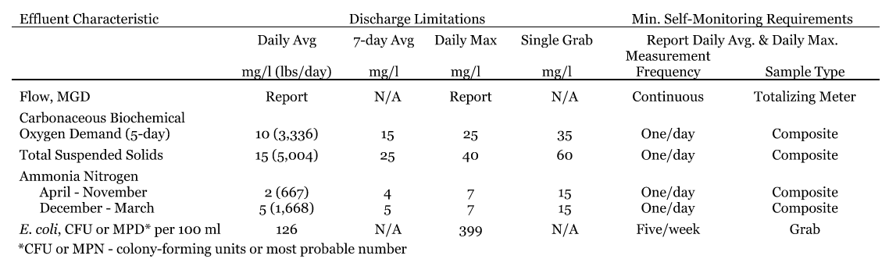
Yes, blending meets permit

Slide 15
Does blending meet permit? (Ammonia)
Sewer (25%)
Stormwater (75%)
NH3: 30 mg/L
NH3: 0 mg/L
Secondary Effluent (67%)
Stormwater Flow (33%)
NH3: 1 mg/L
NH3: 7.5 mg/L
PERMIT:
30 Day – 5 mg/l
7 Day – 5 mg/L
Daily Max – 7 mg/l
Single Grab – 15 mg/l
Blended Effluent
NH3: 3.1 mg/L
Notes:
Well below the permit:
7-day average is 25 mg/L TSS
Daily average is 40 mg/L TSS
Single grab sample: 60 mg/L TSS

Slide 16
Yes, blending meets permit
Notes:
Well below the permit:
7-day average is 25 mg/L TSS
Daily average is 40 mg/L TSS
Single grab sample: 60 mg/L TSS

Slide 17
Project objectives
CHLORINE CONTACT
SAND FILTERS
FILTERS/UV
FEPS
Replacing aging sand filters
Convert from chlorine to UV disinfection
New pumps on final effluent pump station for new head conditions
Provide ability for wet weather blending to reduce peak flows on secondary treatment
PRIMARY EFFLUENT
PRIMARY SPLITTER

Slide 18
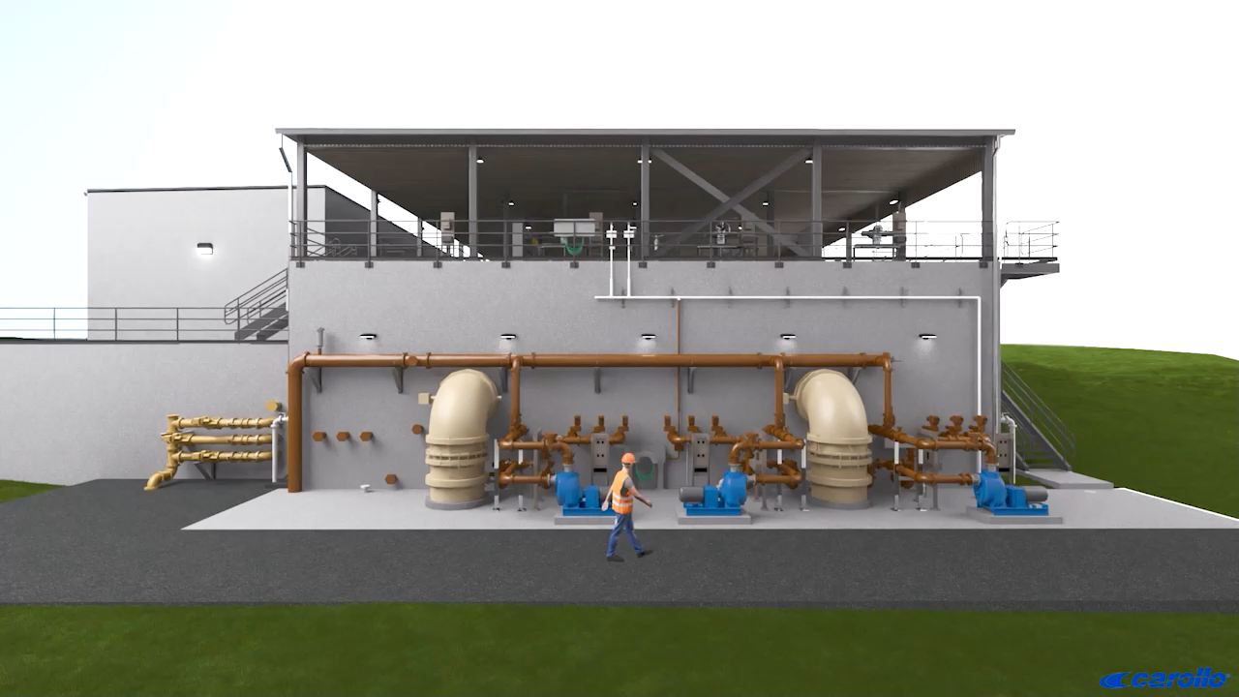
Look Ahead

Slide 19
Construction Update
02

Slide 20
Construction update
METRICS
Percent Complete
61% of Time
68% of Budget
Contingency Use
0.75% of Construction
Quality
Piers complete with no issues
Concrete complete with no issues
Bid Date
November 2023
Bid Amount
Crescent: $30M
Construction Start
June 2024
Construction Complete
August 2026
Notes:
Well below the permit:
7-day average is 25 mg/L TSS
Daily average is 40 mg/L TSS
Single grab sample: 60 mg/L TSS

Slide 21
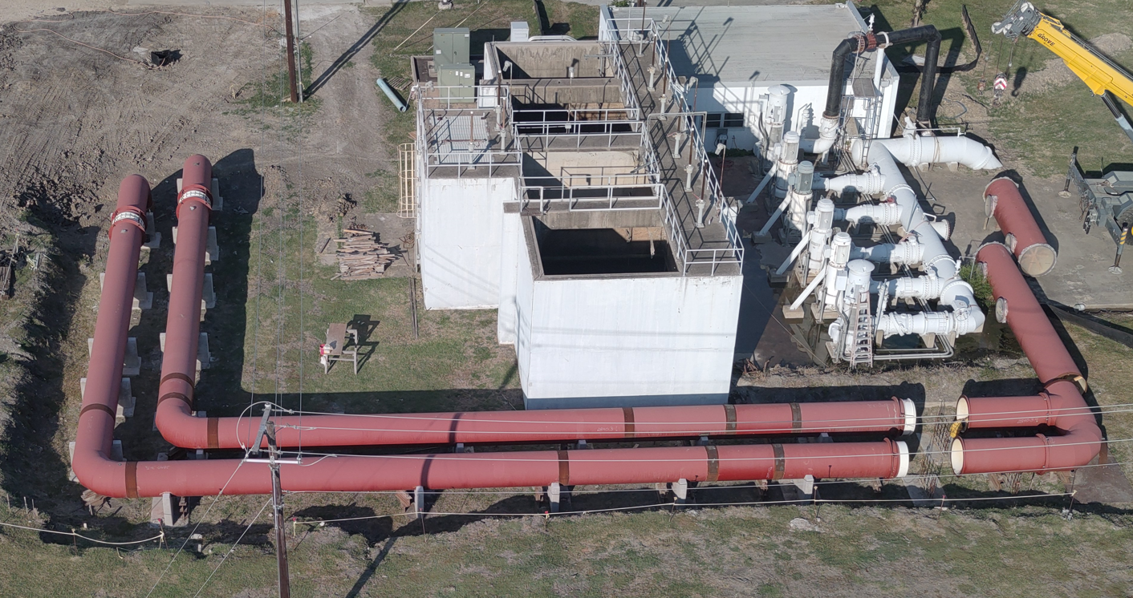
Construction update – Pump Station
Notes:
Well below the permit:
7-day average is 25 mg/L TSS
Daily average is 40 mg/L TSS
Single grab sample: 60 mg/L TSS

Slide 22
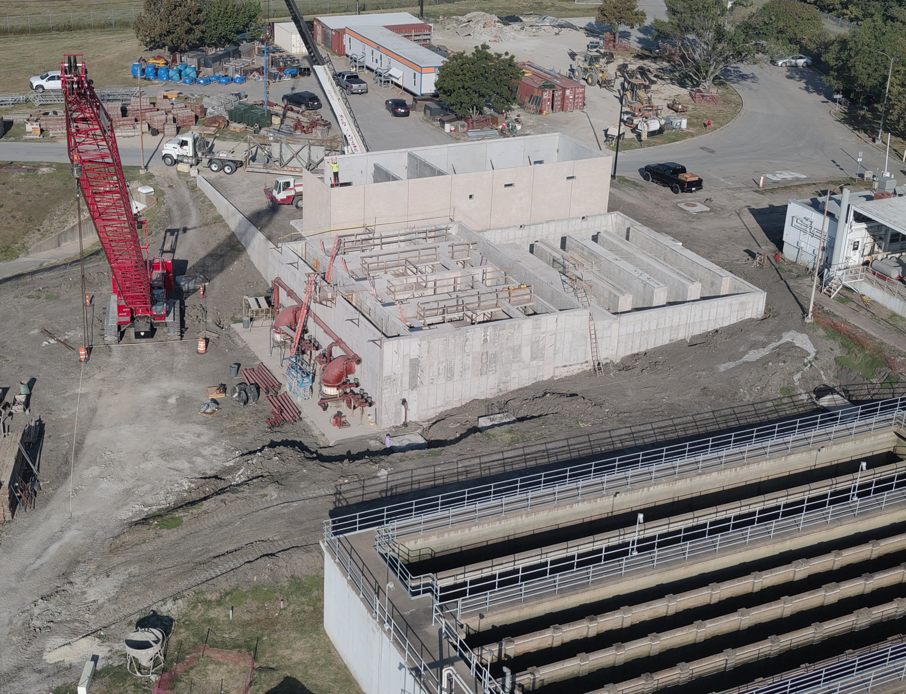
Construction update – Filter/UV
Notes:
Well below the permit:
7-day average is 25 mg/L TSS
Daily average is 40 mg/L TSS
Single grab sample: 60 mg/L TSS

Slide 23
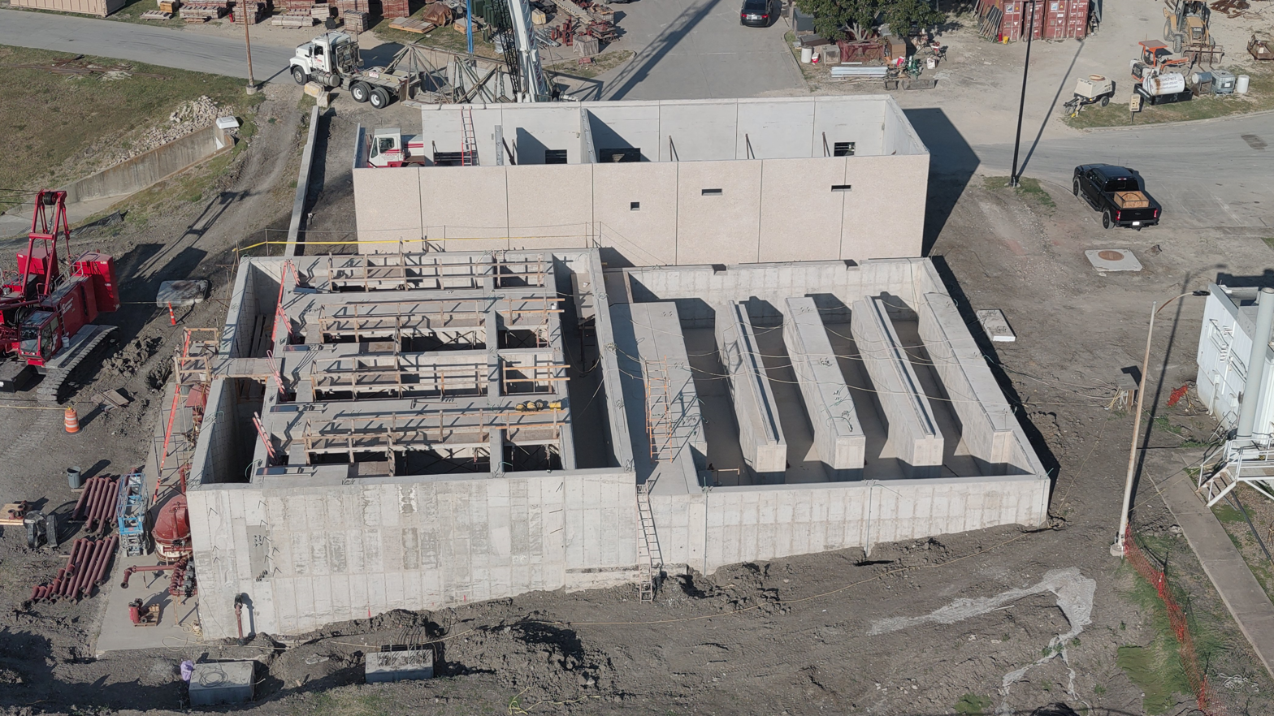
Construction update – Filter/UV
Notes:
Well below the permit:
7-day average is 25 mg/L TSS
Daily average is 40 mg/L TSS
Single grab sample: 60 mg/L TSS

Slide 24
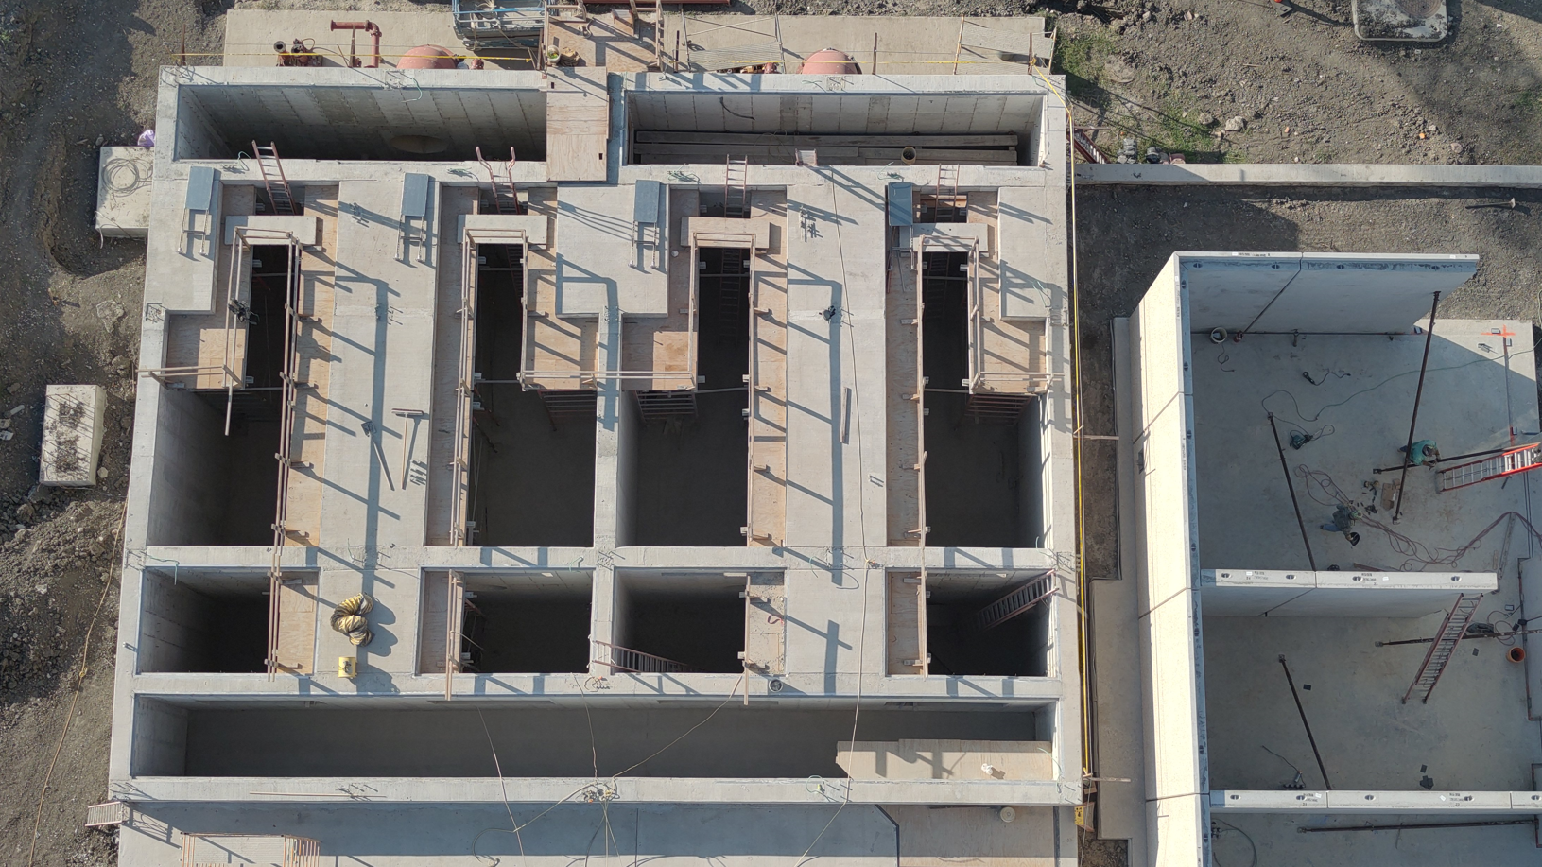
Construction update – Filter/UV
Notes:
Well below the permit:
7-day average is 25 mg/L TSS
Daily average is 40 mg/L TSS
Single grab sample: 60 mg/L TSS

Slide 25
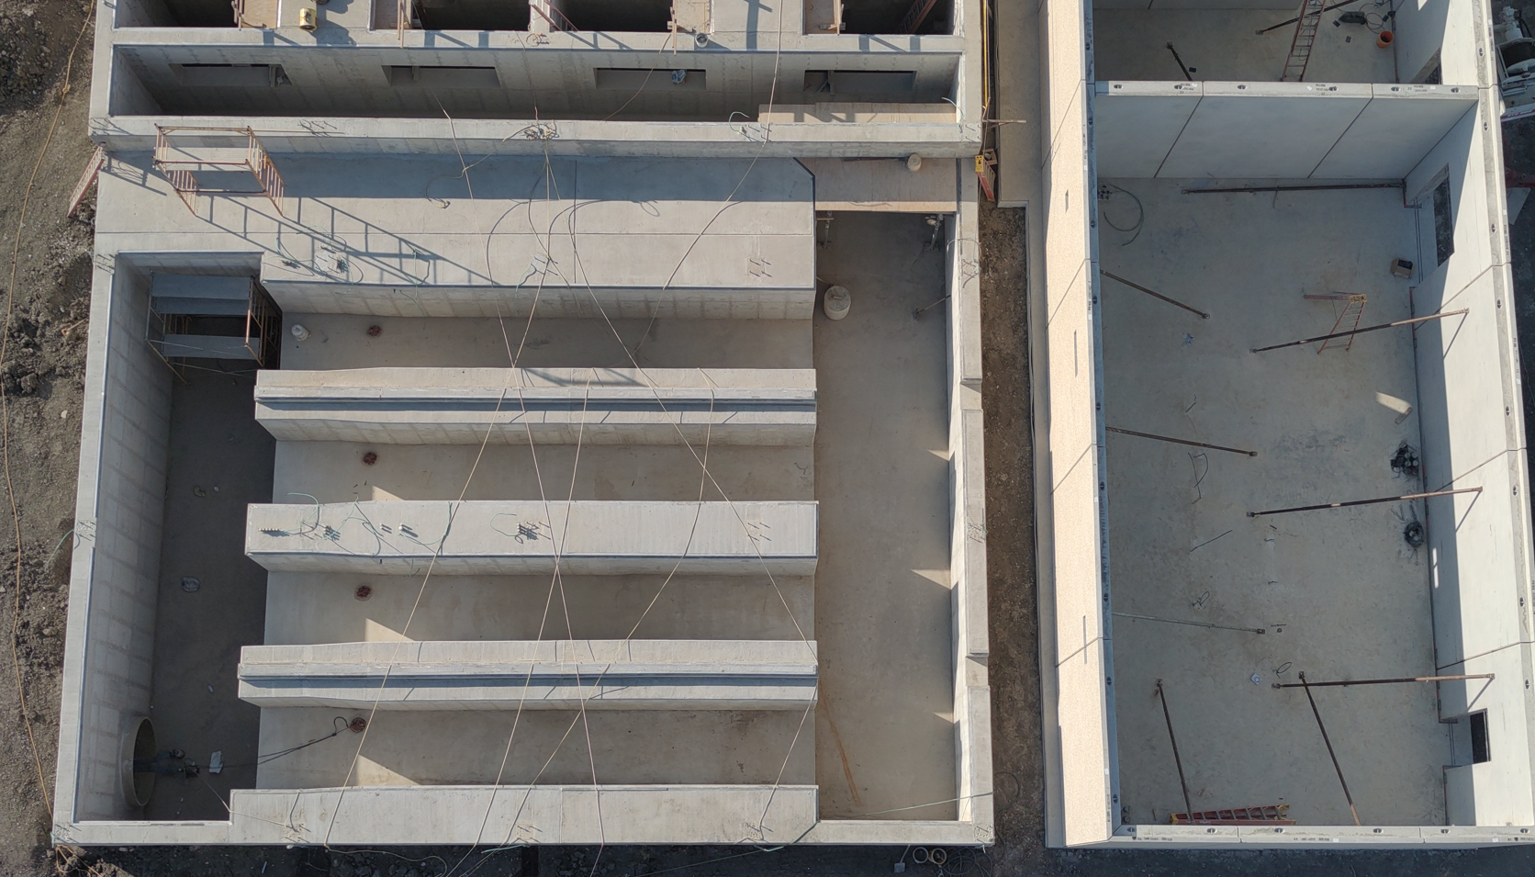
Construction update – Filter/UV
Notes:
Well below the permit:
7-day average is 25 mg/L TSS
Daily average is 40 mg/L TSS
Single grab sample: 60 mg/L TSS

Slide 26
Operations
03

Slide 27
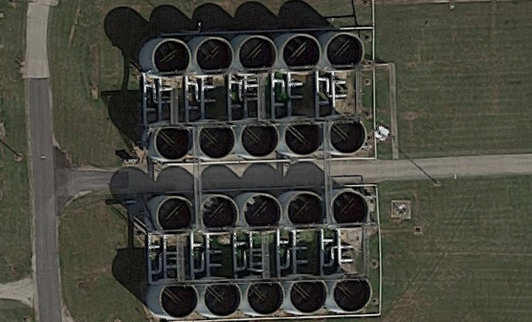
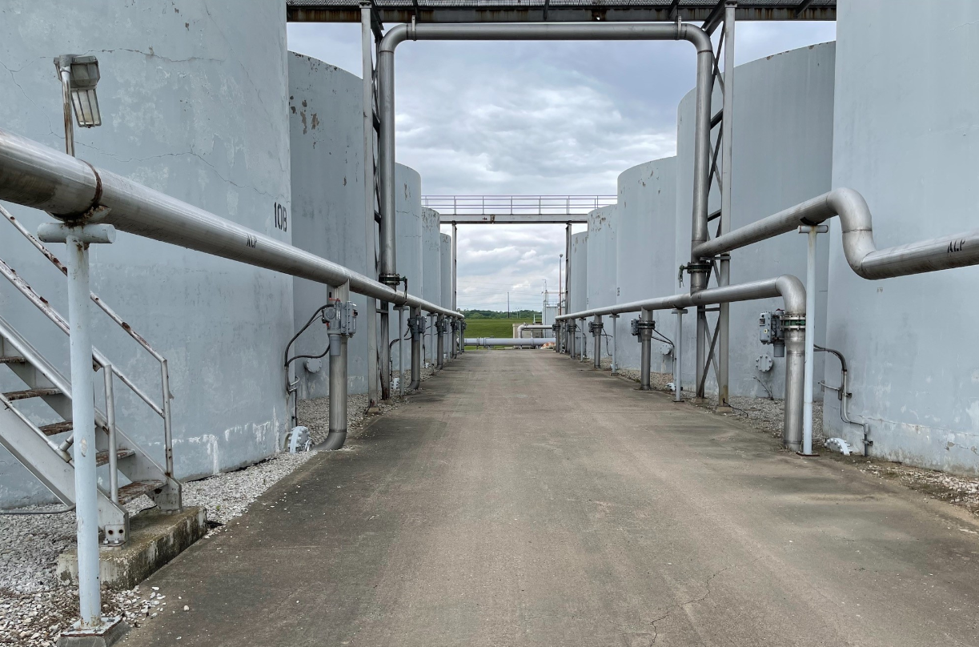
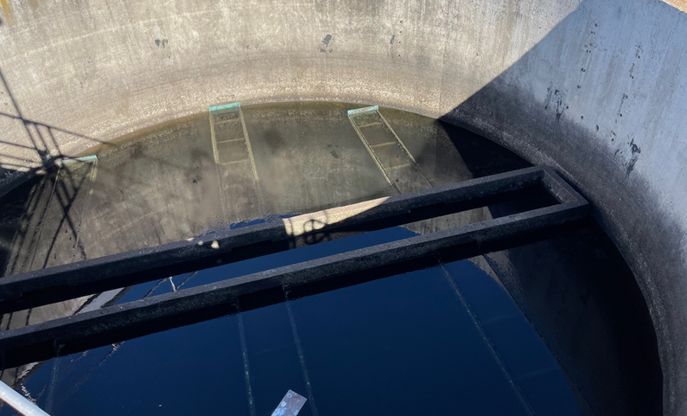
Current sand filter operations
Lack of capacity
Loss of media
Repair and replace valves
More frequent backwash

Slide 28
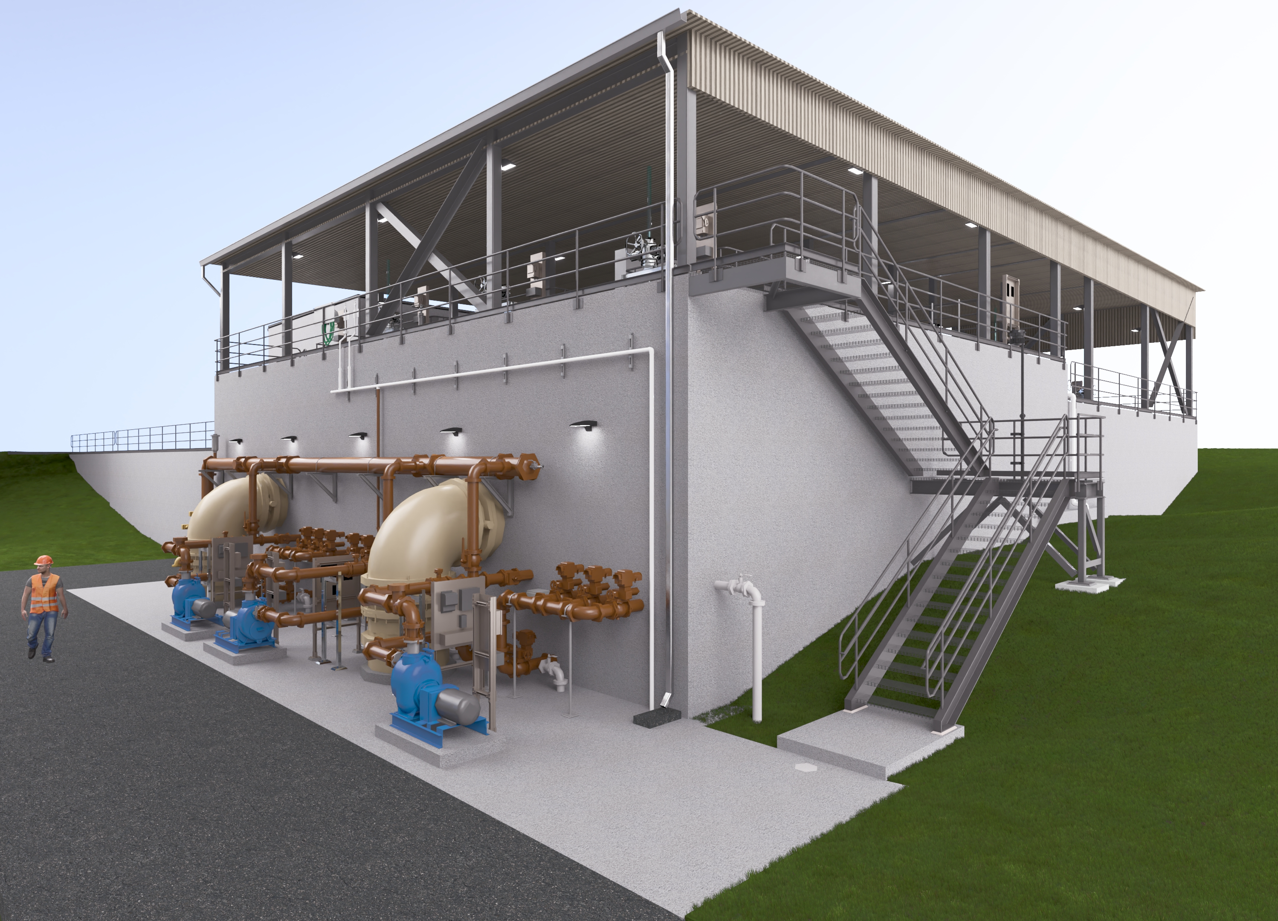
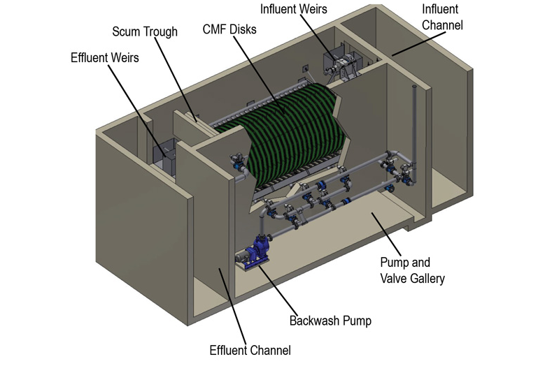
Planning for future disk filter operations
Number of basins in operation
Monitoring turbidity
Disk replacement
Cleaning
Storm Rated Disk Filter (AquaStorm™)
Image provided by Aqua-Aerobic

Slide 29
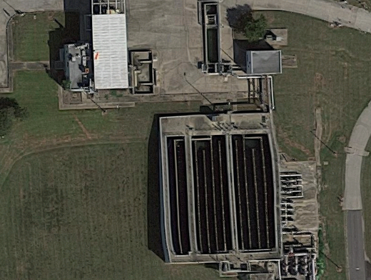
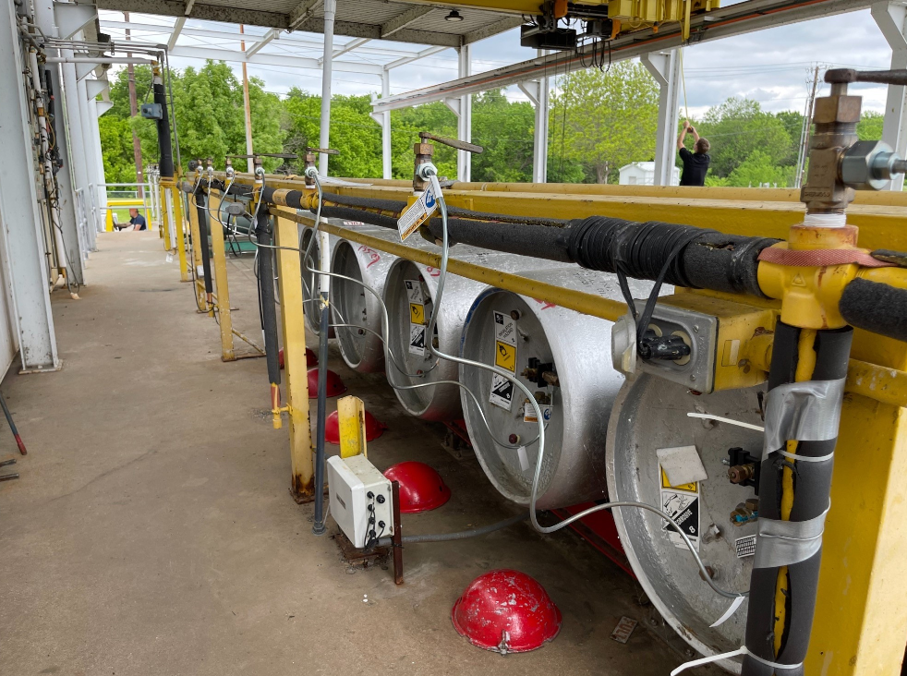
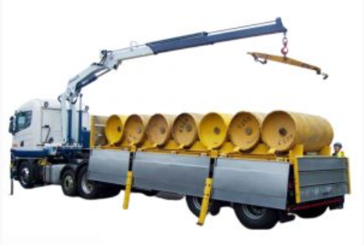
Current chlorine disinfection operations
Existing CCB and chemical storage
Safety concerns
8 - 1 ton chlorine cylinders on site
4 - 1 ton SO₂ cylinders on site
Changed over every other week
Supply concerns
Cost doubled in last 10 years
Market stresses
Delivery timing

Slide 30
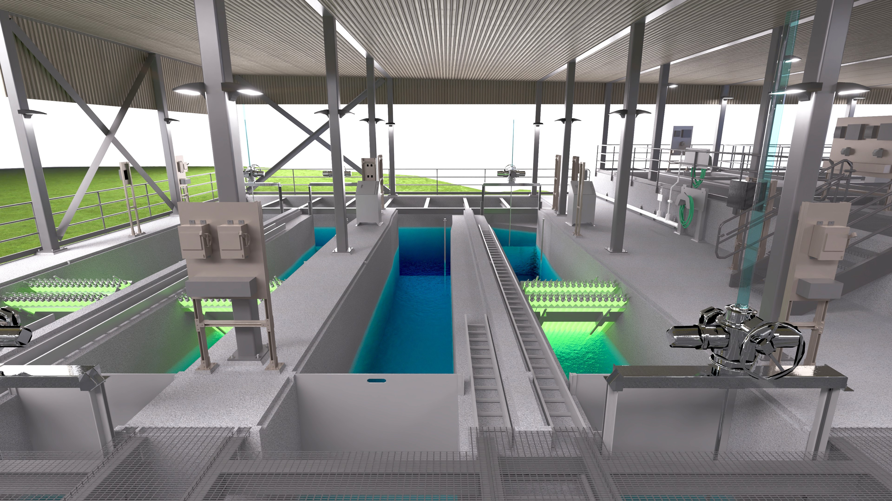
Planning for future UV disinfection
Regular maintenance, trip to 10 mile creek
There will be 144 Lamps and related parts requiring replacement:
50 Lamps / year
7 Ballasts / year
Sensors, sleeves, wipers, etc
New sample point and increased reporting
No chlorine in plant water

Slide 31
Wet weather blending
FILTERS/UV
FEPS
No one wants to bypass secondary treatment
But it provides a big cost savings for future expansions
Plan to monitor influent and effluent TSS and ammonia during wet weather
PRIMARY EFFLUENT
PRIMARY CLARIFIER

Slide 32
Look Ahead
Thank you!
Sam Barraco
SBarraco@carollo.com
Brandon Little
BLittle@garlandtx.gov

