Slide 1
Wired For Delay: Navigating Electrical Lead Time Hurdles
Presented by:
Marisa Palmer, P.E., PMP, Director – Plants & Major Projects, SAWS
Daniel Ghobrial, P.E., Project Manager, Gupta & Associates

Slide 2
How did we get here
Supply Chain Disruptions
Raw Material Shortages
Manufacturing Capacity
Expansion of Data Centers into Texas
Tariff hikes
COVID
Texas Winter Storm Uri in February 2021
Copper
Steel
Concrete
Never caught up with demands
Orders didn’t slow down while backlogs never cleared
Major growth
Placing large orders
Artificial Intelligence

Slide 3
Meanwhile… Advancement of Industries and Technology
Consumer Electronics - Smart phones, laptops, semiconductors
Automotive Industries - Electric Vehicles, electronic components, batteries
Renewable Energy - Solar and Wind, semiconductors, electronic components
Telecommunications - 5G networks, future 6G??, electronic components
Tesla, Apple, Samsung, Facebook, Amazon, Intel, Siemens

Slide 4
Water and Wastewater Industry We are the little guys
Them
Us
Companies invest hundreds of billions of $$$$$$
They are purchasing equipment by the thousands of gear
We invest in the tens of millions $$
We purchase less than 10 to 20 gear per project
VS.

Slide 5
Lead times can vary widely –
Different vendors
Different equipment configurations
Supply chain issues change quickly
Note that the lead times do not include shop drawing prep
Equipment Lead Times

Slide 6
Typical equipment lead times
Equipment | Supplier | Shop Drawing | Delivery
480V Switchgear | Vendor #1 | 12-14 weeks | 60-65 weeks
 | Vendor #2 | 6 weeks | 68-82 weeks
 | Vendor #3 | 15 weeks | 75 weeks
480V MCC | Vendor #1 | 10-12 weeks | 40-50 weeks
 | Vendor #2 | 6-8 weeks | 17-35 weeks
 | Vendor #3 | 16 weeks | 65-72 weeks

Slide 7
Typical equipment lead times
Equipment | Supplier | Shop Drawing | Delivery
Pad Mounted Transformer | Vendor #1 | 6-8 weeks | 120-135 weeks
 | Vendor #2 | 4 weeks | 70-75 weeks
 | Vendor #3 | 20-24 weeks | 40-50 weeks
15 kV Pad Mounted Switchgear | Vendor #1 | 90-117 weeks total
 | Vendor #2 | 70-75 weeks total
5 kV Metalclad Switchgear | Vendor #1 | 22-24 weeks | 65-70 weeks
 | Vendor #2 | 20 weeks | 60-65 weeks

Slide 8
Typical equipment lead times
Equipment | Supplier | Shop Drawing | Delivery
Generator, Diesel, 150 kW | Vendor #1 | 3-5 weeks | 34-36 weeks
 | Vendor #2 | 2-4 weeks | 12-16 weeks
 | Vendor #3 | 2-4 weeks | 22-24 weeks
Generator, Diesel, 1000 kW | Vendor #1 | 3-5 weeks | 56-60 weeks
 | Vendor #2 | 2-4 weeks | 60-64 weeks
 | Vendor #3 | 2-4 weeks | 82-84 weeks
Generator, Natural Gas, 500 kW | Vendor #1 | 3-5 weeks | 56-60 weeks
 | Vendor #2 | 2-4 weeks | 44-50 weeks
 | Vendor #3 | 2-4 weeks | 27-29 weeks

Slide 9
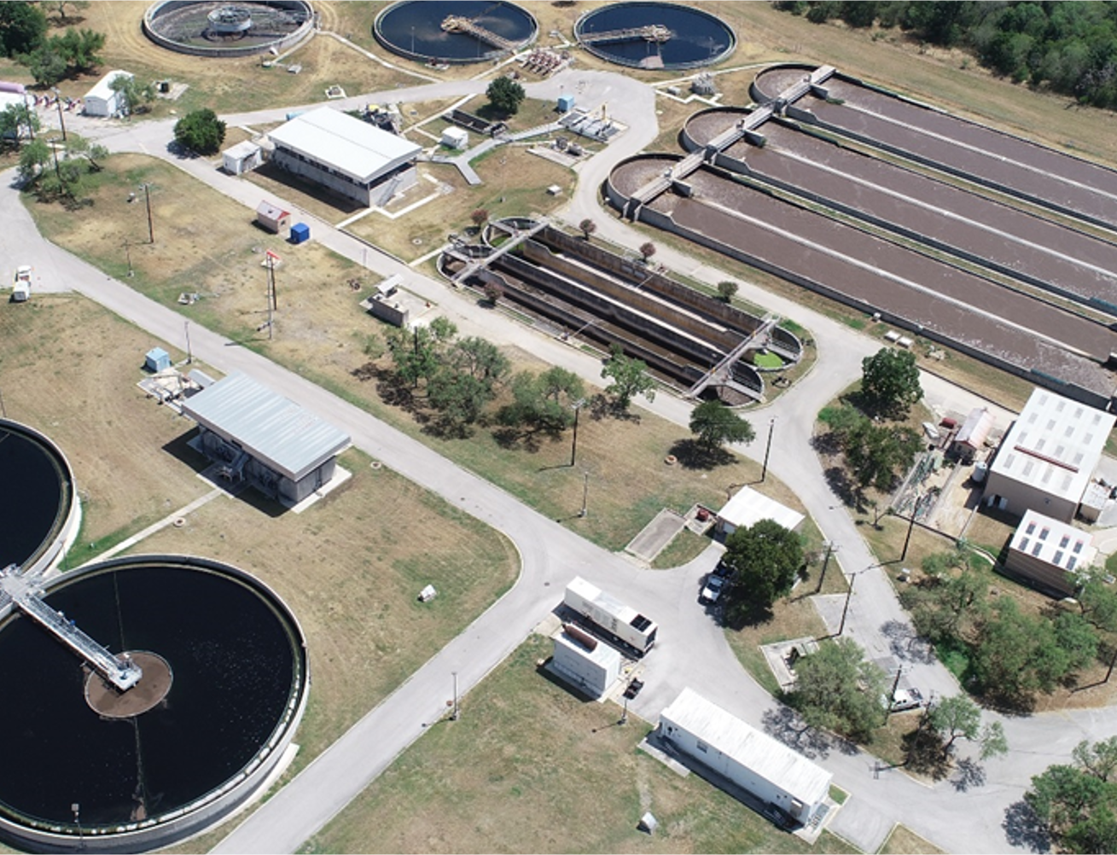
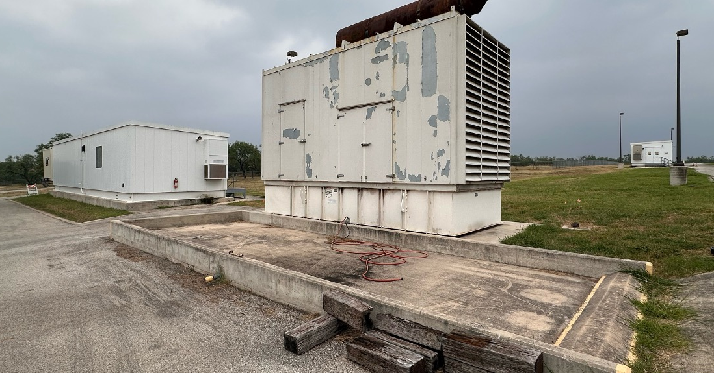
Case Study #1 – SAWS Medio Creek WRC Generators
Generators were long lead time equipment
Operations was renting generators at a premium, regulatory requirement
Intent was to pre-procure to gain 2-3 months, submittal process during construction
Evaluate bids based on schedule
SAWS learning curve on development of documents and working through Purchasing
Secured price and Consultant was able to finalize contract documents based on selected vendor (minimize issues during Construction)
Vendor outreach

Slide 10
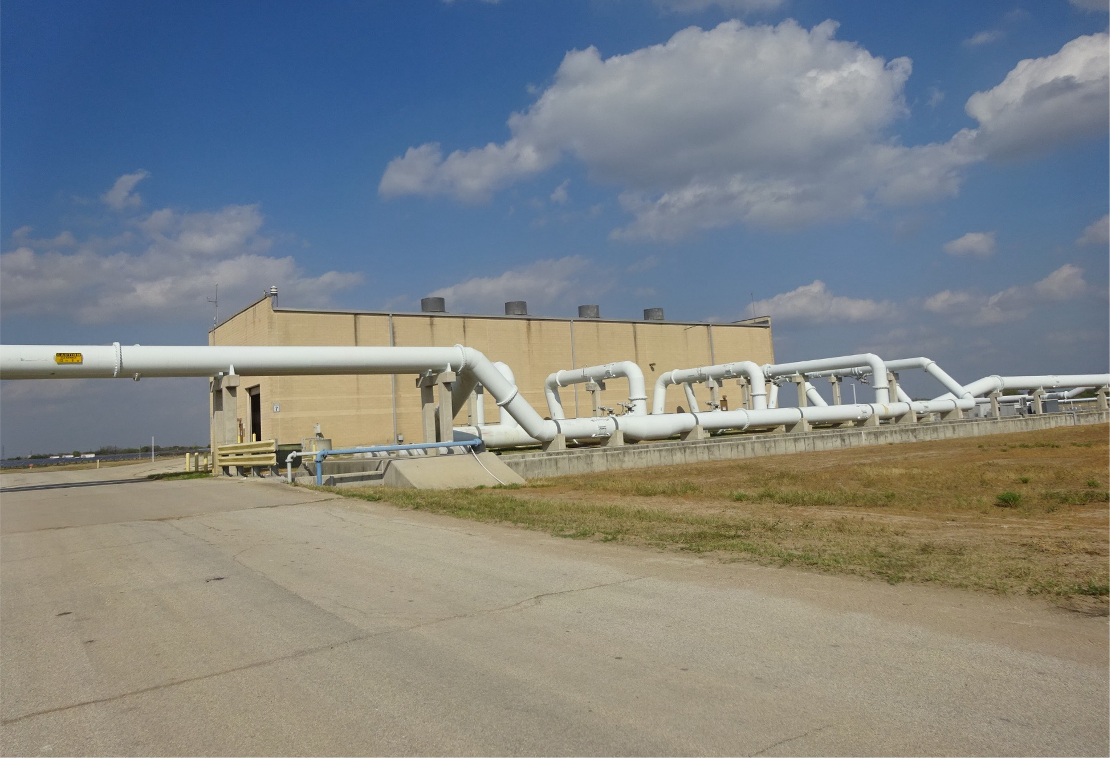
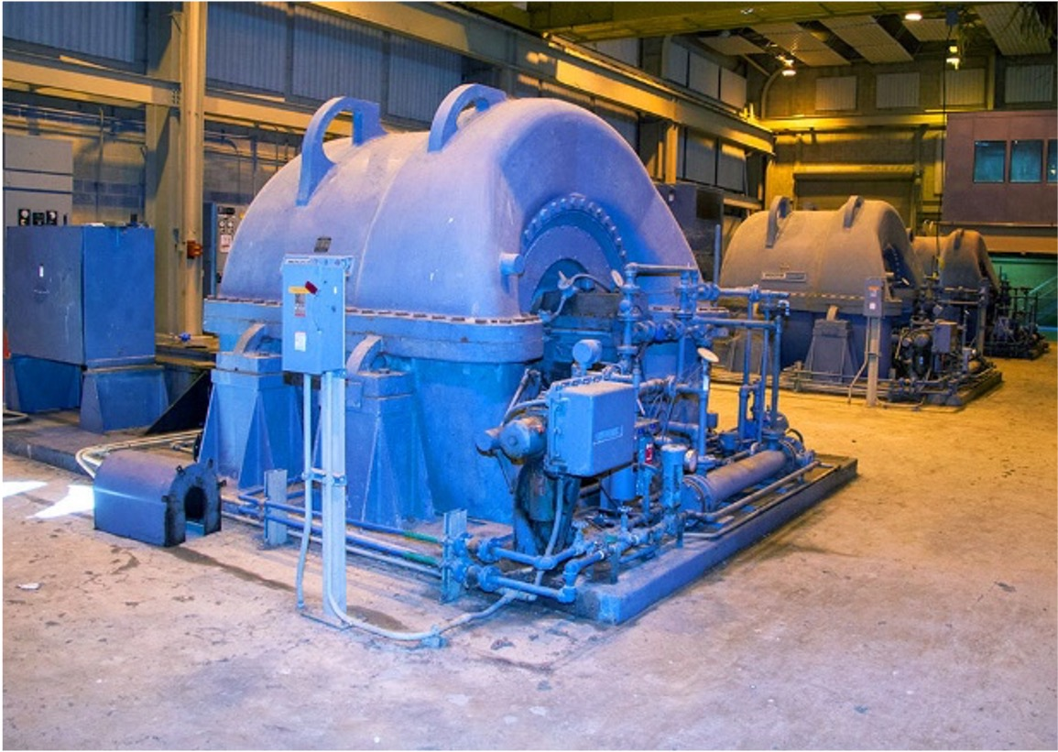
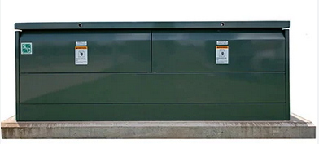
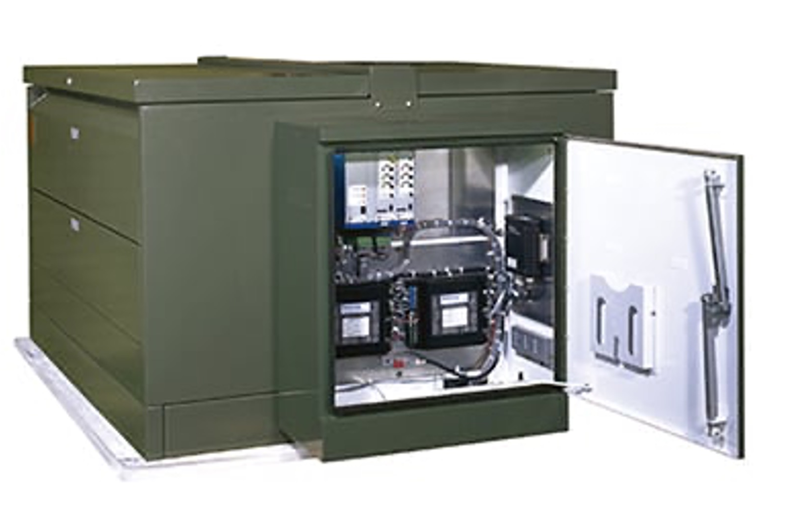
Case Study #2 – SAWS Steven M. Clouse Vista Gear
Goal for project to install and provide operational blowers by December 2026 (firm date)
Vista Gear was critical to allow for start up and commissioning of Blowers to meet firm date
Vista Gear had a long lead time and critical equipment
SAWS opted to pre-purchase the equipment
Used pre-procurement for Medio documents as a starting point
Sole Source the equipment – approval, risks, and outreach

Slide 11
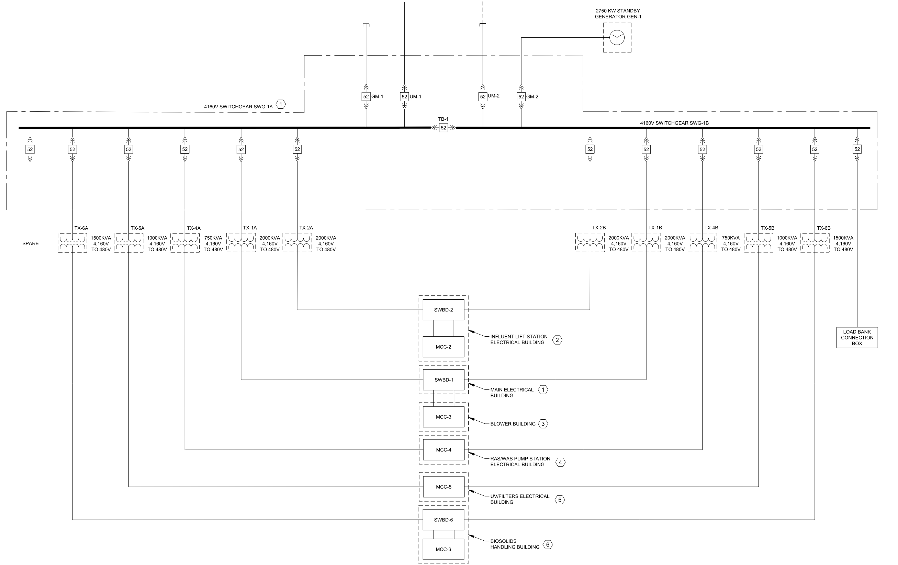
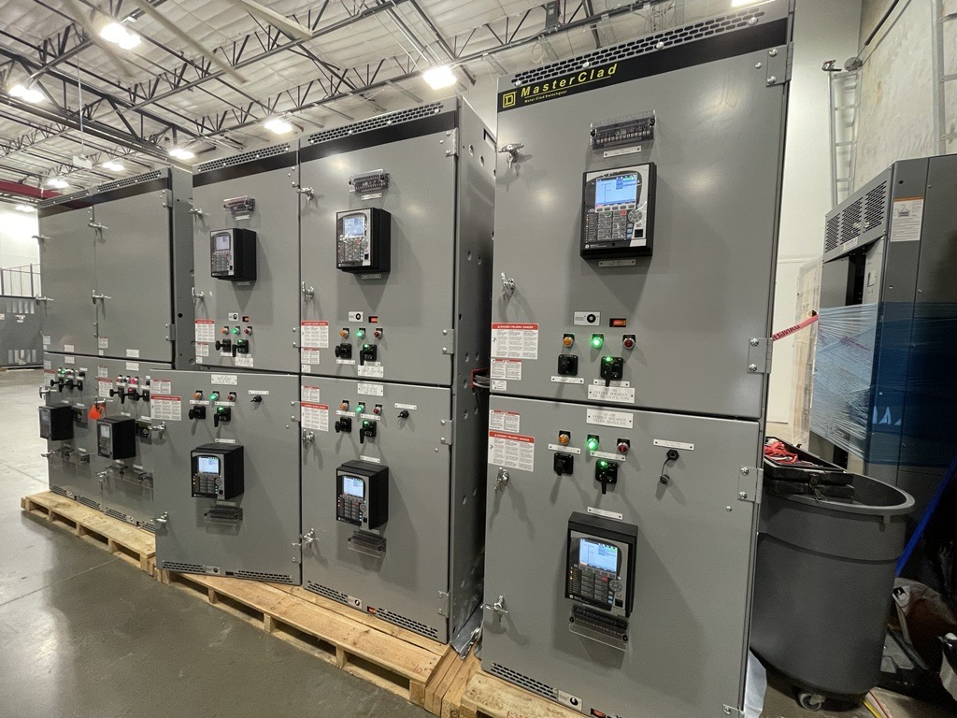
Case Study #3 - Pflugerville WCRWWTF
Pre-purchased Major Electrical Distribution Equipment.
Bid as a CSP, evaluated based on cost and schedule.
Three Electrical Supplier’s submitted bids based on the same manufacturer which had the shortest lead time.
Current Status: Substantially complete.
Notes:
1. Major Electrical Equipment were the 5kV Switchgear, 10 Pad-Mounted Transformers, three distribution switchboards, and five motor control centers. 2. The Generator was bid as a separate bid package
3. By Pre-purchasing, The city was able to limit the risk of construction delays due to electrical lead times
4. Equipment will be stored until the electrical buildings are constructed.

Slide 12
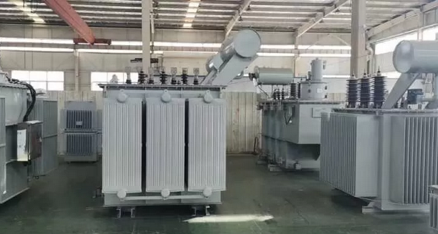
Case Study #4 – NTMWD South Mesquite Headworks
CMAR identified bid packages – decided on three packages based on overall budget and cost
Identified electrical equipment for various phases and compared it to construction timeline
Pre-purchased the following equipment:
- Four 5 MVA substation Transformer
- 4160V Switchgear for power distribution
- Generators and associated switchgear
- Pad mounted transformers various sizes

Slide 13
Adjust construction schedule to accommodate longer lead times
Pre-purchase equipment ahead of advertising
Pre-purchase shop drawings to “get in line” earlier
Consider alternative engineered solutions
Switchboards vs MCCs vs panelboard?
Can we eliminate “certain” vendors?
Can we use OEMs instead of the main 5 or 6 electrical gear vendors?
Consider alternate delivery methods
Takeaways/ Lessons Learned

Slide 14
What Do we do now?
- You have options and each has its benefits
- Do what works best for you and your clients
- Coordinate early to decide what is needed
- There is a learning curve

Slide 15
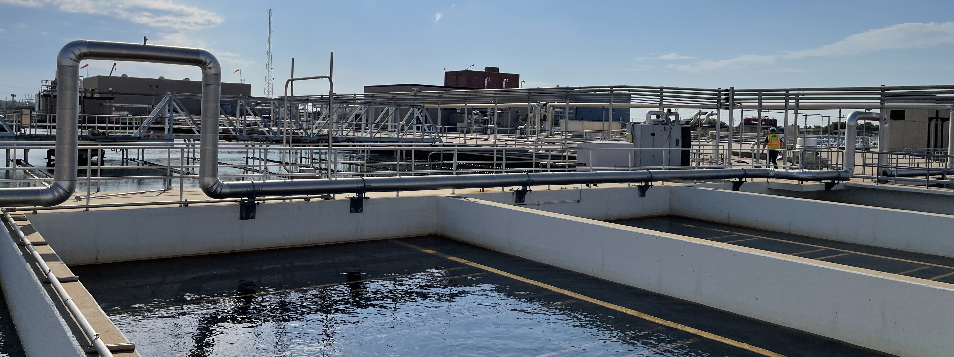
Q&A

