Slide 1


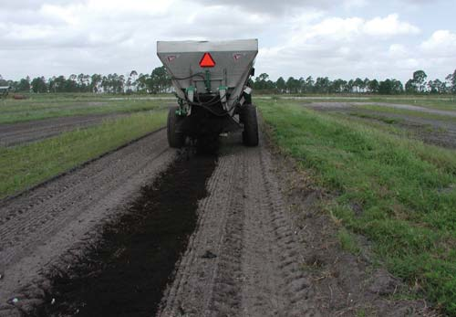
Understanding Biosolids: The Complex Journey of PFAS to Soils
Source: Localized application of compost directly to bed. Photograph by: Monica... | Download Scientific Diagram
Caitlin Ruff (Black & Veatch)
Matt Berg (Jacobs)
Noe Martinez (Austin Water)
WEAT Biosolids Committee PFAS Task Force

Slide 2

The Task Force
Made up of committee members and some PFAS experts who got involved, for a total of 12 people.
Big thanks to, along with others:
  Felipe Gutierrez Ph.D, P.E., Texas State University
  Matt Berg P.E., Jacobs
  Ben Davis, Renda Environmental
  Samir Mathur P.E., CDM Smith
  Eric Spargimino P.E., CDM Smith
  Pavani Silaparasetty, GHD
  Grant Gayle, Brown and Caldwell
  Kyle Thompson, Ph.D P.E., Carollo
The A-Team (1983 - 1987) : r/nostalgia

Slide 3
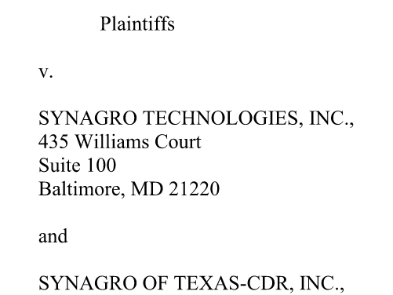
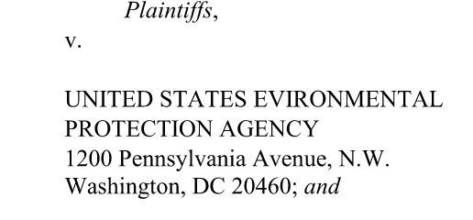
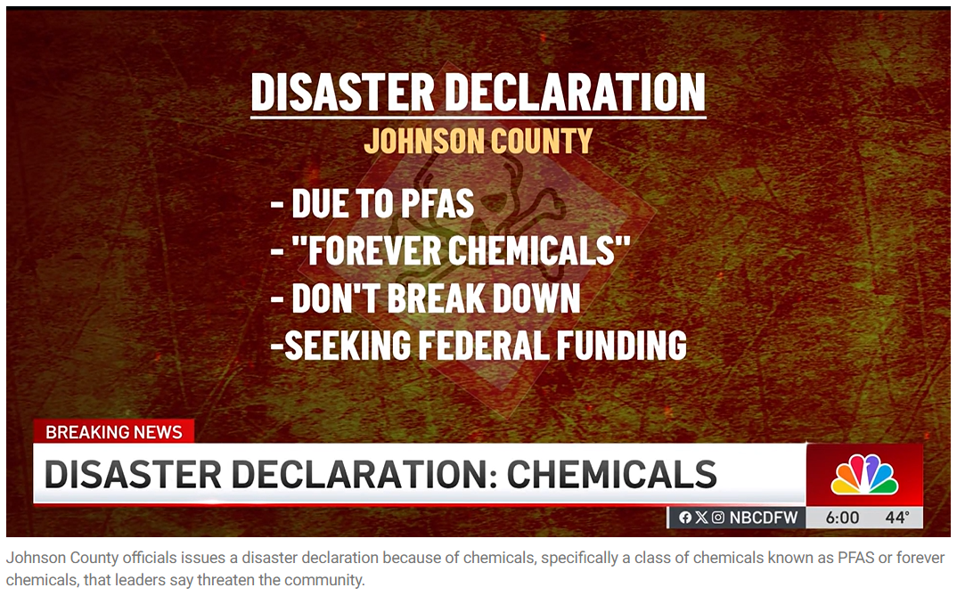
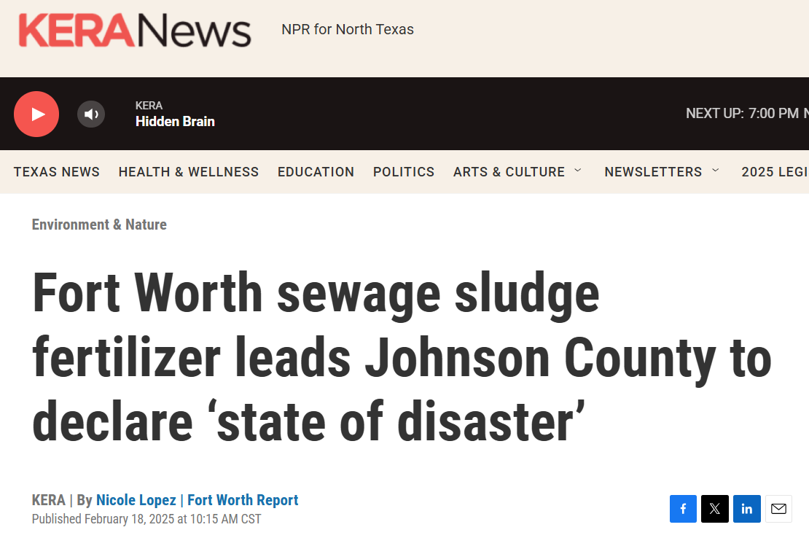
Motivation
Lawsuit by Johnson County residents, 2024, blaming Synagro for contamination of farm land and cattle.
“Testing confirmed the presence of forever chemicals in soil, groundwater, surface water, water wells and in animal tissue near the affected areas of the county,” according to press release
“None of the plaintiffs themselves used Synagro products, and the biosolids applied to neighboring properties met all EPA and Texas Commission on Environmental Quality requirements,” a Synagro spokesperson told KERA.
“This situation threatens the very foundation of our agricultural community and the safety of our residents,” Johnson County Judge Christopher Boedeker

Slide 4
Diving into Texas Legislation
SB 736 (Menéndez)- seeking to require 25% of soil used on TXDOT landscaping projects be compost products.
  Not specific to biosolids compost but does not exclude them.
  Overall seen as positive by the biosolids industry has potential to create new markets.
  Does not mention PFAS.
SB 768 (Menéndez)- Seeking to direct University of Houston to conduct a study on PFAS effects on public health in collaboration with Texas Railroad Commission and TCEQ.
  Identical Companion Bill: HB 1730 by Morales Shaw
  Explicitly includes water used for public consumption, food and its packaging
  Notably includes “materials that likely contain perfluoroalkyl and polyfluoroalkyl chemicals” which is likely to include biosolids.
  Overall seen as a positive by the biosolids industry.

Slide 5
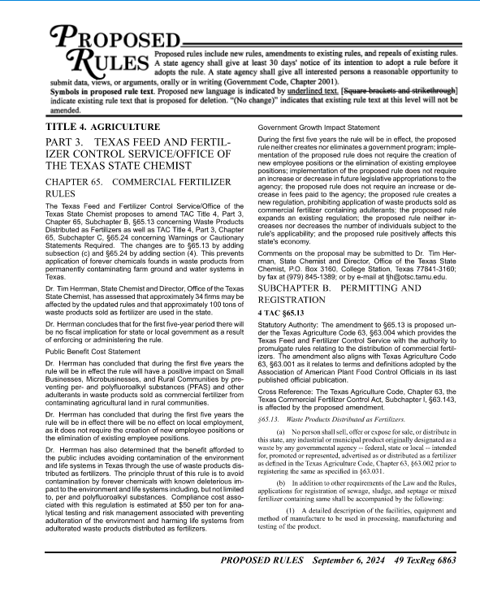
State Chemist
Proposed Rule Change: Sought to disallow the application and marketing of any fertilizer product that contained “forever chemicals”.
Set broad, subjective, limits on what could be in fertilizer products.
Abandoned after Early Filing opened for the 89th Texas Legislature.

Slide 6

The Texas House Bill
HB 1764 (Kerwin)- Relating to the production, sale, and use of agricultural products containing perfluoroalkyl and polyfluoroalkyl substances (PFAS); creating a criminal offense.
  Adds a definition for “perfluoroalkyl and polyfluoroalkyl substances” to Agricultural code (63.001): “any member of the class of manufactured fluorinated chemicals containing at least one fully fluorinated carbon atom”.
  Adds a definition for “Sewage Sludge”: “any solid, semisolid, or liquid residue generated during treatment of sewage or septage at a municipal, commercial, or industrial wastewater treatment facility”.
Five bills to watch in the Michigan legislature: January 2023

Slide 7
The Texas House Bill (continued)
Adds subsection 5 to section 63.002 which would make 63.002 apply to “any biosolid, compost, wastewater residuals, industrial or sewage septage, sewage sludge, lagoon residuals, or other material intended for use as a fertilizer, soil amendment, topsoil replacement, or other similar agricultural purpose that contains or was produced from sewage sludge”.
Adds section 63.096 which prohibits the manufacture, sale, distribution, or application of any material described by subsection (a)(5) with: See the following table

Slide 8
The Texas House Bill (continued)
Compound (HB 1674) | Measured by EPA 1633 | Abbreviation | CASRN | Trigger Level (ppt) | Assumed Correct Name: | Measured by EPA 1633 | Abbreviation | CASRN
Perfluorobutyric acid | No | Unknown | Unknown | 28,800 | Perfluorobutanoic acid | Yes | PFBA | 375-22-4
Perfluorobutane sulfonate | Yes | PFBS | 45187-15-3 | 40,300
Perfluoropentanoic acid | Yes | PFPeA | 2706-90-3 | 14,400
perfluorohexane sulfonate | Yes | PFHxS | 108427-53-8 | 300
Perfluorohexanoic acid | Yes | PFHxA | 307-24-4 | 9,400
Perfluoroheptanoic acid | Yes | PFHpA | 375-85-9 | 400
Perfluorooctanoic sultanate | No | Unknown | Unknown | 5,100 | Perfluorooctanesulfonic acid | Yes | PFOS | 1763-23-1
Perfluorooctanoic acid | Yes | PFOA | 335-67-1 | 900
Perfluorooctane sulfonamide | No | Unknown | Unknown | 2,700
Perfluorononanoic acid | Yes | PFNA | 375-95-1 | 1,500
Perfluorodecanoic acid | Yes | PFDA | 335-76-2 | 800
Perfluorodecane sulfonate | Yes | PFDS | 126105-34-8 | 800
Perfluoroundecanoic acid | Yes | PFUnA | 2058-94-8 | 800
Perfluorododecanoic acid | Yes | PFDoA | 307-55-1 | 800
Perfluorotridecanoic acid | Yes | PFTrDA | 72629-94-8 | 800
Perfluorotridecanoic acid | No | Unknown | Unknown | 800 | Perfluorotetradecanoic acid | Yes | PFTeDA | 376-06-7
GenX | Yes | HFPO-DA | 13252-13-6 | 800
Compound (HB 1674) | Measured by EPA 1633 | Abbreviation | CASRN | Trigger Level (ppt) | Assumed Correct Name: | Measured by EPA 1633 | Abbreviation | CASRN
Perfluorobutyric acid | No | Unknown | Unknown | 28,800 | Perfluorobutanoic acid | Yes | PFBA | 375-22-4
Perfluorobutane sulfonate | Yes | PFBS | 45187-15-3 | 40,300
Perfluoropentanoic acid | Yes | PFPeA | 2706-90-3 | 14,400
perfluorohexane sulfonate | Yes | PFHxS | 108427-53-8 | 300
Perfluorohexanoic acid | Yes | PFHxA | 307-24-4 | 9,400
Perfluoroheptanoic acid | Yes | PFHpA | 375-85-9 | 400
Perfluorooctanoic sultanate | No | Unknown | Unknown | 5,100 | Perfluorooctanesulfonic acid | Yes | PFOS | 1763-23-1
Perfluorooctanoic acid | Yes | PFOA | 335-67-1 | 900
Perfluorooctane sulfonamide | No | Unknown | Unknown | 2,700
Perfluorononanoic acid | Yes | PFNA | 375-95-1 | 1,500
Perfluorodecanoic acid | Yes | PFDA | 335-76-2 | 800
Perfluorodecane sulfonate | Yes | PFDS | 126105-34-8 | 800
Perfluoroundecanoic acid | Yes | PFUnA | 2058-94-8 | 800
Perfluorododecanoic acid | Yes | PFDoA | 307-55-1 | 800
Perfluorotridecanoic acid | Yes | PFTrDA | 72629-94-8 | 800
Perfluorotridecanoic acid | Yes | PFTrDA | 72629-94-8 | 800 | Perfluorotetradecanoic acid | Yes | PFTeDA | 376-06-7
GenX | Yes | HFPO-DA | 13252-13-6 | 800

Slide 9
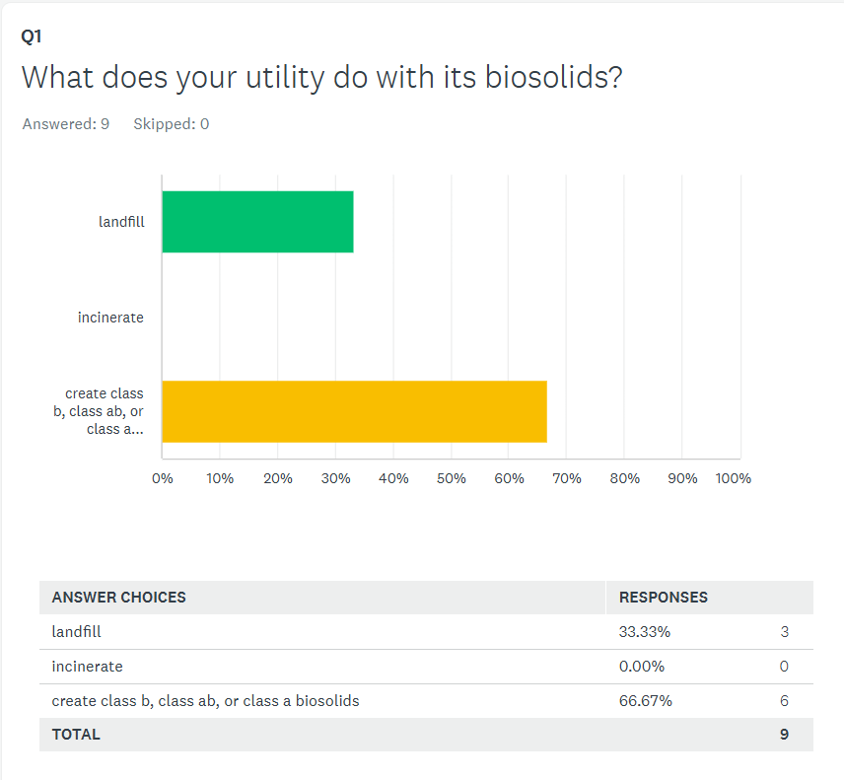
Utilities, Their Biosolids, and Their PFAS?
Survey Says…
2/3 of Utilities are producing a land applicable biosolids product.
This likely includes large utilities, Austin is a prime example.
PFAS could represent a real risk to the sustainability of the industry.

Slide 10
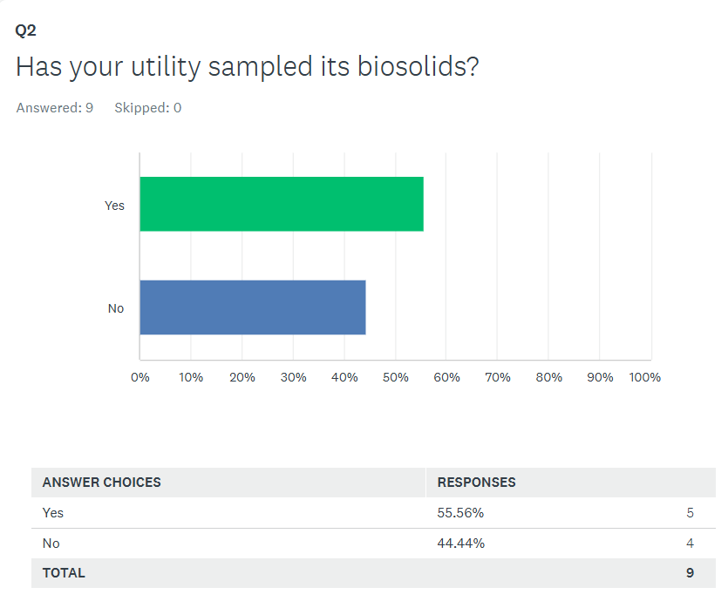
Utilities, Their Biosolids, and Their PFAS?
>50% have sampled for PFAS
Highlights Utilities concerns, but also their forward thinking.
The first step in solving the issue is understanding if your utility has a PFAS issue in their biosolids.

Slide 11
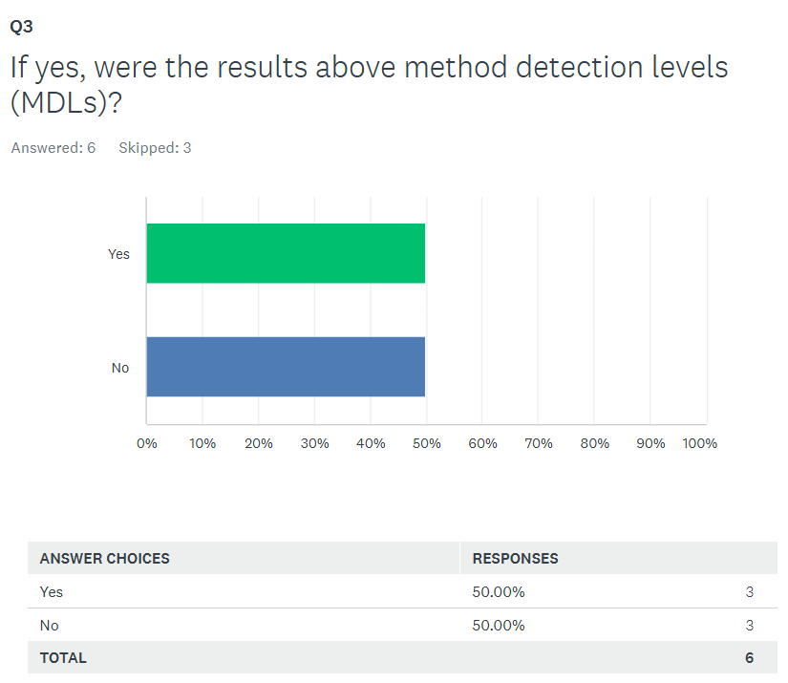
Utilities, Their Biosolids, and Their PFAS?
50% of those samples found PFAS in some quantity
While it may not be an issue for every utility, it’s a widespread issue and may require a response from every utility.

Slide 12

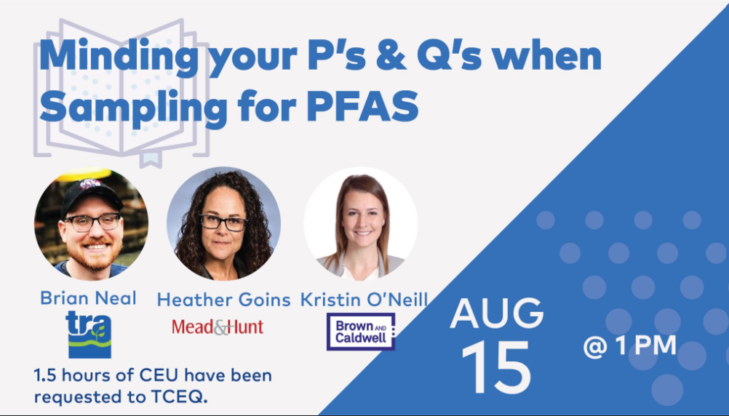
WEAT’s Work on PFAS
Active Engagement from the Biosolids Management Committee
  3-Webinar Series from June 17, 2021
  Webinar on PFAS Sampling, August 14th, 2024 (100+ attendees)
  White Paper for 89th Texas Legislature
  Comments produced on State Chemist’s proposed rule change, Comments to be provided on EPA’s draft risk analysis
  Actively engaged with the Legislators and Legislative Committees

Slide 13
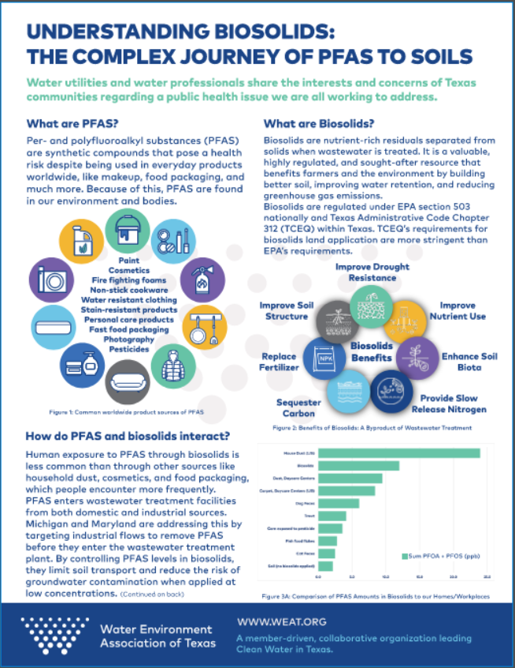
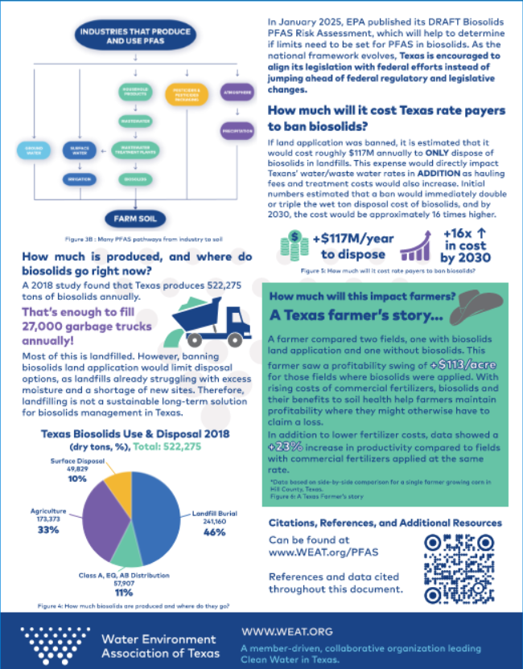
The White Paper

Slide 14
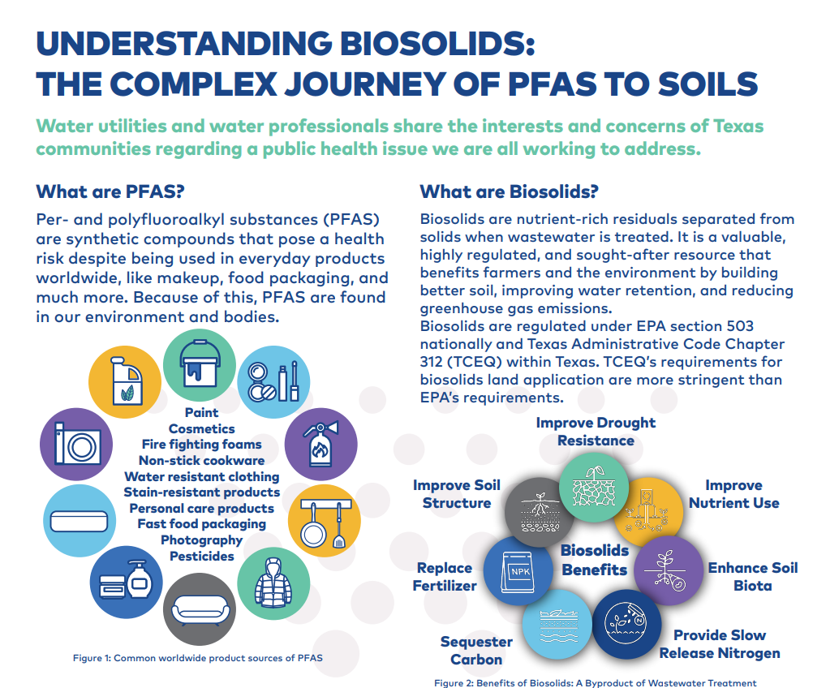

Slide 15
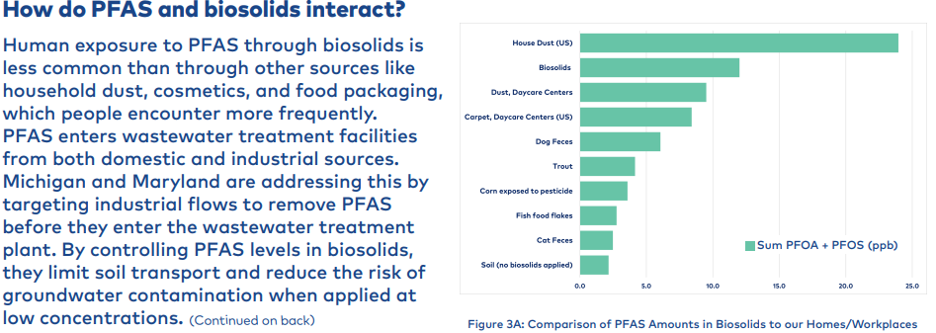
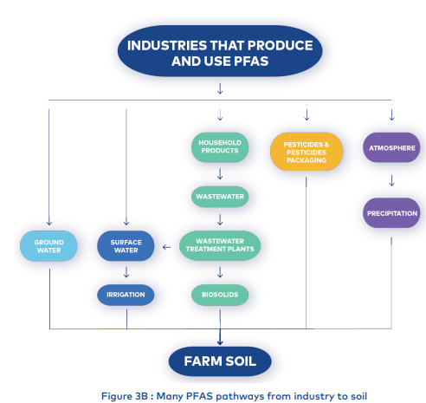
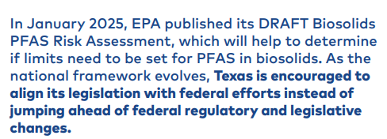

Slide 16
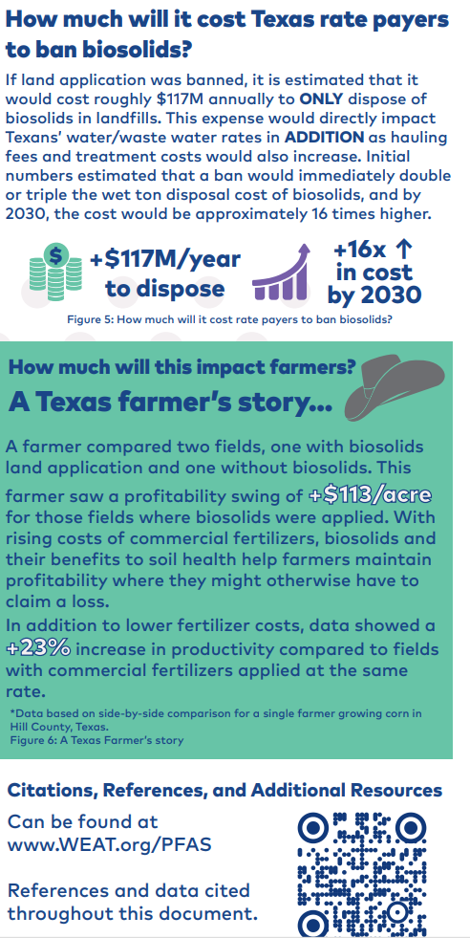
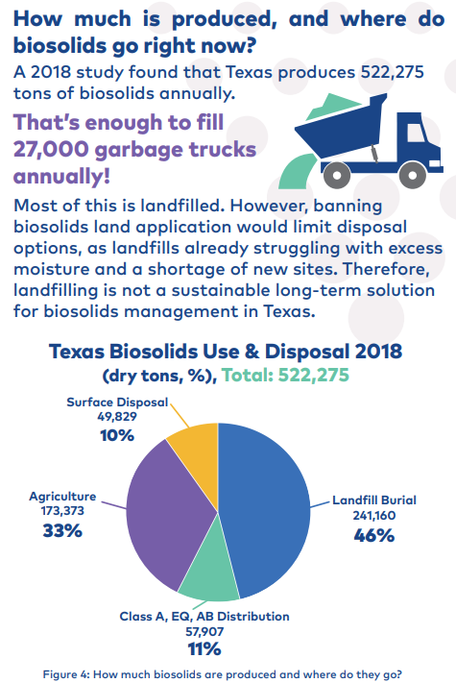

Slide 17

Recommendations to Utilities
Test your influent, effluent, and biosolids for PFAS!
Start work on a PFAS Plan:
  Where is PFAS at your facility coming from?
  Is a PFAS Pretreatment Program an option?
  What are the options for your biosolids?
    Landfill/Sewage Sludge Lagoon?
    Incinerate/Pyrolysis?
    PFAS treatment and continue land application?
    Life Cycle Cost Analysis! Rate impacts?
Communicate with Stakeholders:
  Here’s what we know
  Here’s what we need to find out
  Here’s our plan moving forward
Sports Coach Game Plan Stock Illustrations – 857 Sports Coach Game Plan Stock Illustrations, Vectors & Clipart - Dreamstime

Slide 18
The EPA Draft Risk Assessment
Assessment for human health and environmental risks associated with biosolids disposal including land application, surface disposal, and incineration.
Focuses on PFOS and PFOA due to their persistence through typical treatment processes, they bioaccumulate, and they sorb to solids.
3 land application scenarios:
  Pasture Farm
  Crop Farm
  Reclamation of Soil

Slide 19
The EPA Draft Risk Assessment
Risk Assessment estimated risks from land application are above the EPA’s acceptable threshold, but only for those who work on the farm and/or consume its products regularly.
  Risks are highest for those who consume the products from pasture farms and crop farms that received biosolids land application.
  Risk increases linearly with PFAS concentration.
Risk Assessment did not quantify risks from incineration, but noted risks are possible.
Risk Assessment does not contextualize risk by comparing to “average American” or to the risk associated with PFAS in cookware, food packaging, etc.

