Slide 1
Nutrient Limits, Aging Infrastructure, MOPO Challenges, Oh My!
Navigating the Transformation of the City of Wichita’s 40 MGD Sewage Plant 2
Chris Varnon, P.E.
November 14th, 2025
Notes:
Keeper of the Plains

Slide 2
Agenda
Background
Program Goals
Challenges
Design Overview
Planning Practices
Project Status
Lessons Learned

Slide 3
Background

Slide 4
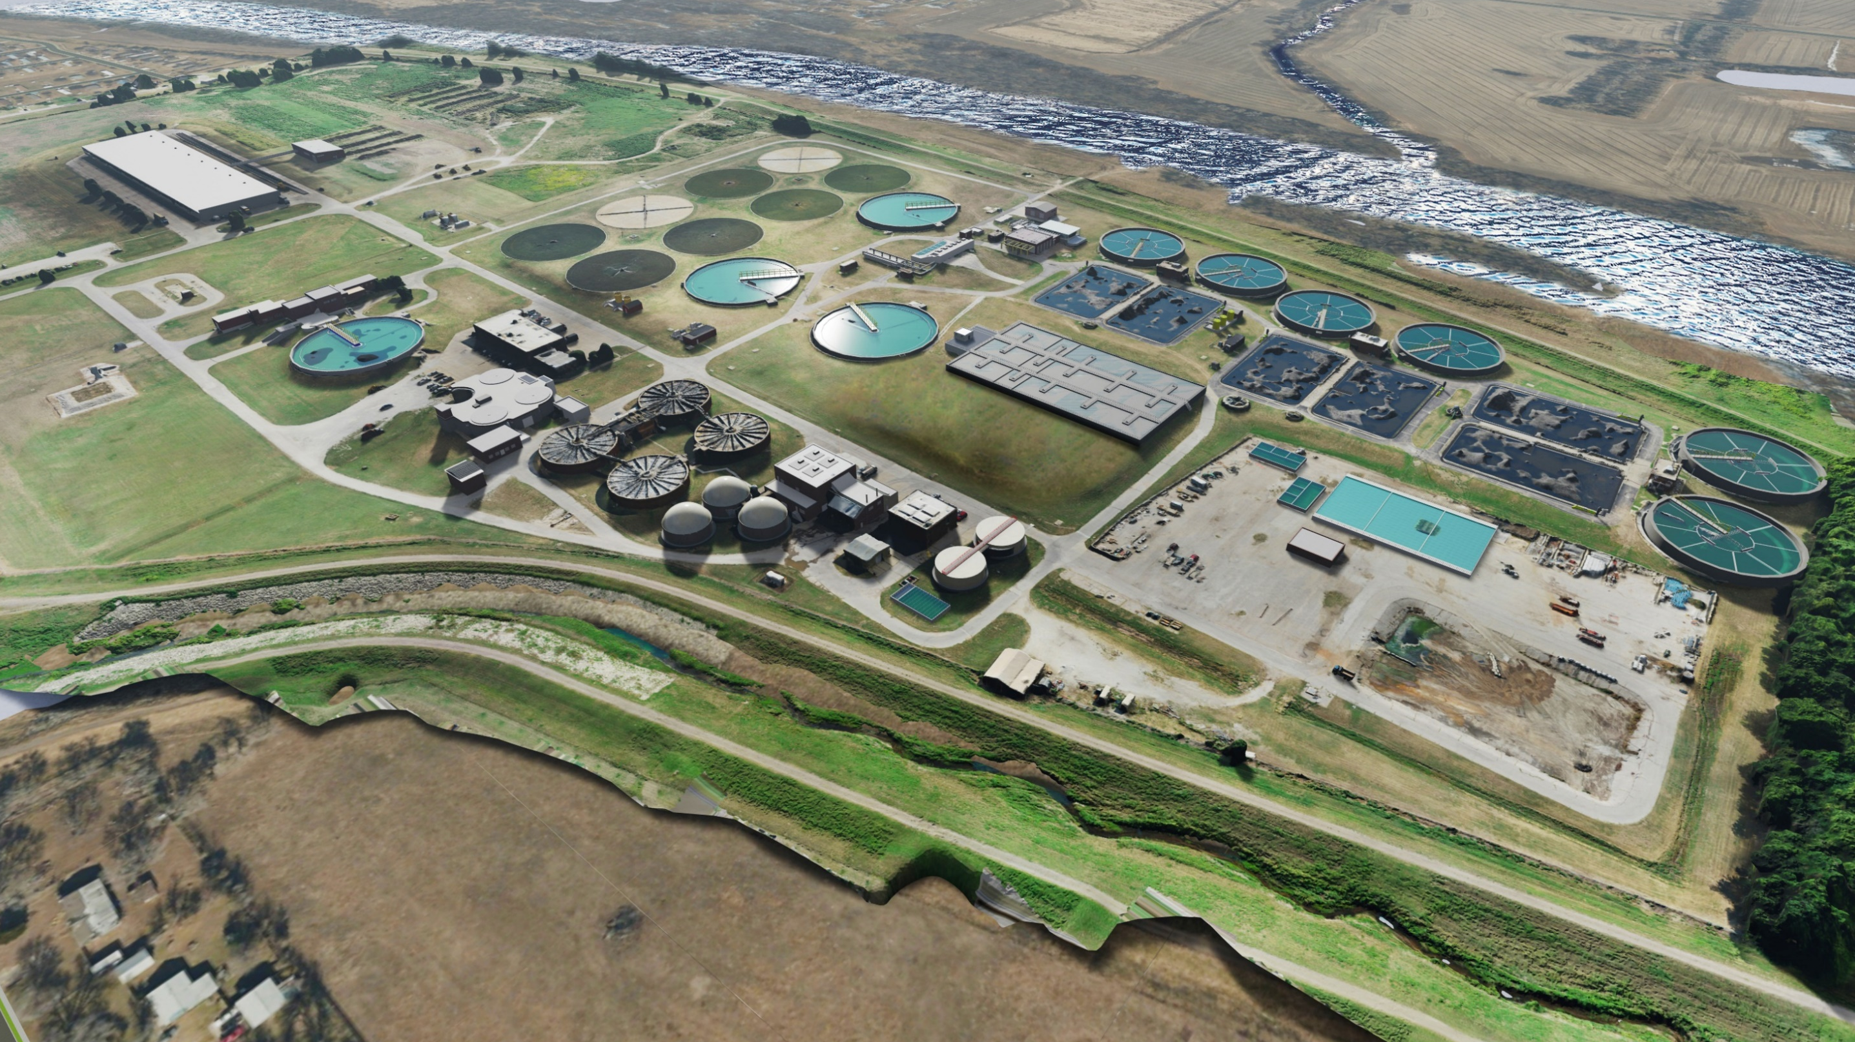

Wichita Sewage Plant 2
Permitted Capacity:
54 mgd ADF
80 mgd Peak Hour
Current Annual Average Flow:
30 mgd
About 2/3 of plant flow is pumped from Plant 1 to Plant 2 for treatment
Discharges to Lower Arkansas River

Slide 5
Wichita Sewage Plant 1
Diverts flow to Plant 1
Consists of:
  Screenings
  Grit Removal
  Pump Station
  Diversion Structure
  Wet Weather Clarifiers
  Extraneous Flow Basin
  Permitted Outfall for Extreme Wet Weather Conditions

Slide 6
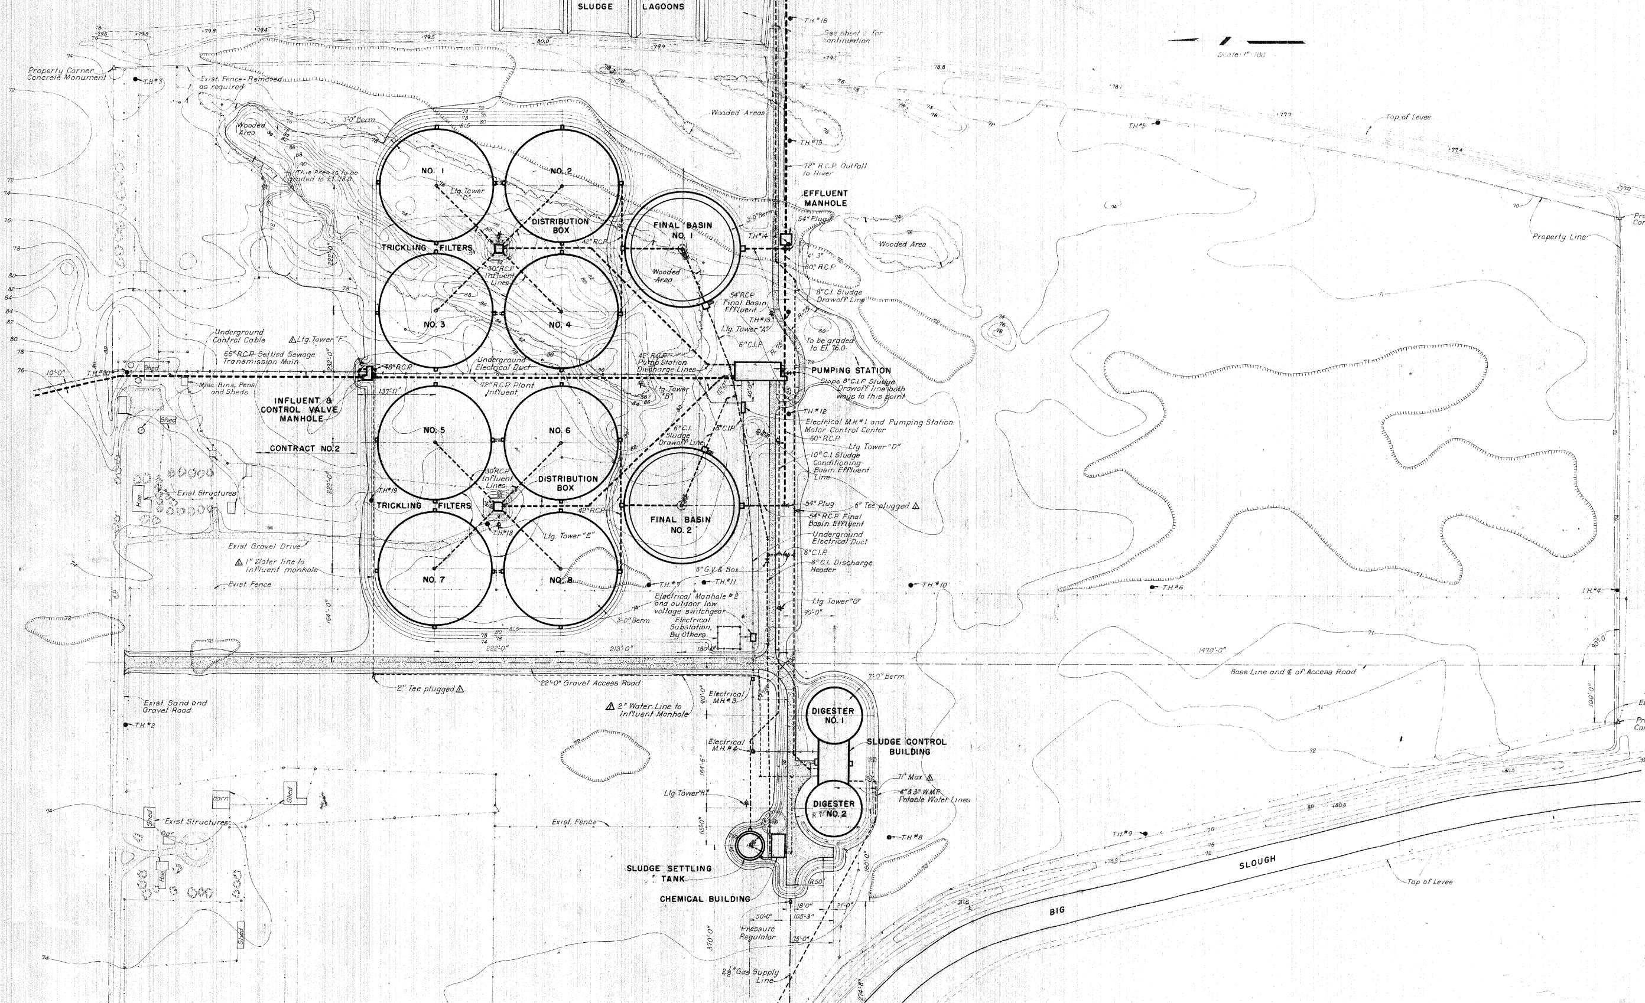
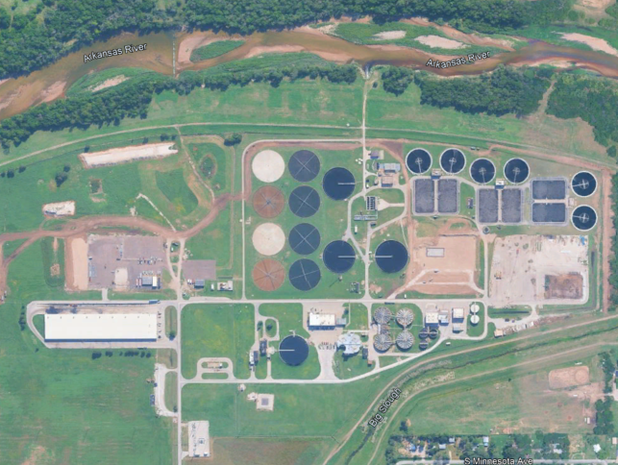
Wichita Sewage Plant 2 Evolution
1957 – Original Construction
1958 – 2nd Phase
1987 – Secondary Treatment
1995 – Biosolids Additions
2000 – Prelim. Treatment and UV
2004-2017 – Four other minor improvements projects

Slide 7
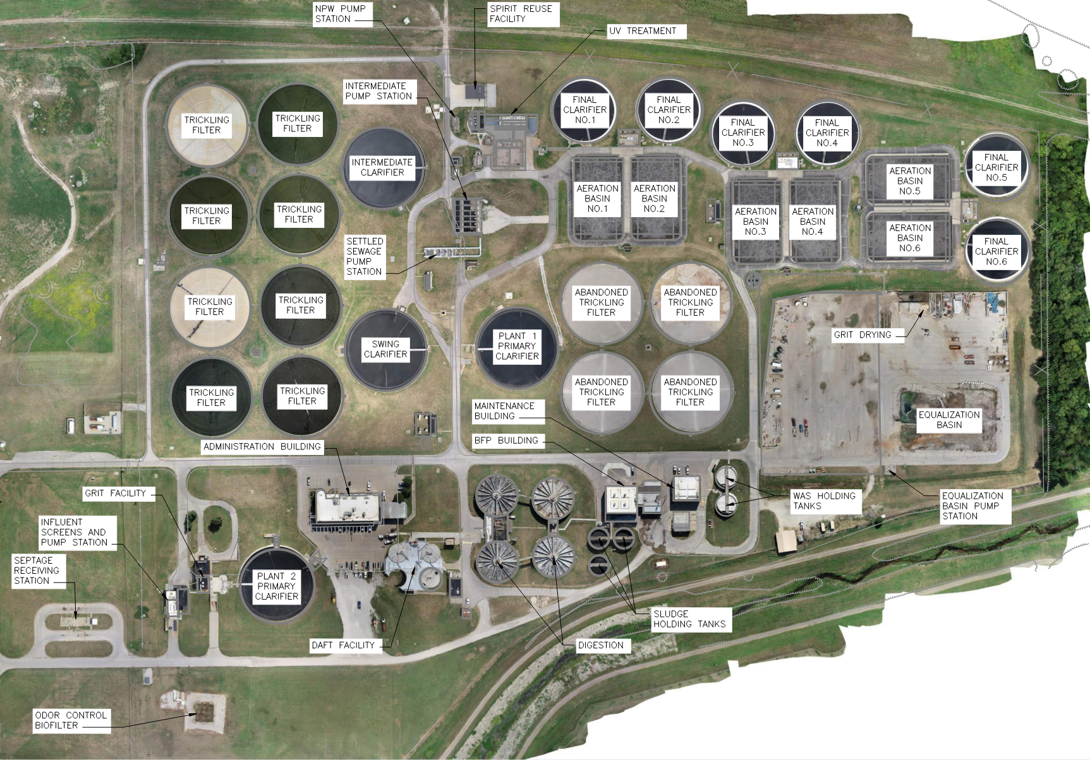
Existing Secondary Treatment:
Trickling Filters and Nitrifying Activated Sludge
Nitrifying activated sludge facilities were built in the late 1980s
Existing aeration basins
are not designed for BOD
removal or BNR
Three separate sludges:
      Aeration Basins 1 and 2
      Aeration Basins 3 and 4
      Aeration Basins 5 and 6
Snails

Slide 8
Ch-ch-ch-ch-CHANGES!
New Limits Issued in 2023 NPDES Renewal
Constituent | Interim Permit Limit | Final Permit Limit
Ammonia (NH₃-N) Monthly Average (mg/L)
Nov – Feb | 6.3 | 2.4 – 3.0
Mar-Apr, Oct | 3.4 – 3.8 | 1.4 – 1.7
May – Sep | 1.8 – 2.6 | 0.7 – 1.2
Nitrogen Annual Average
NOx-N Limit | - | 10.0 mg/L
TN Goal | - | 10.0 mg/L
TN Goal | - | 3,175 lb/d
Phosphorus Annual Average
TP Limit | - | 314.45 lb/d
TP Goal | - | 1.0 mg/L
Currently TN and TP are Goals only
Compliance schedule:
  Substantial completion by Dec 21, 2027
  Final limits to be enforced starting June 30, 2028

Slide 9
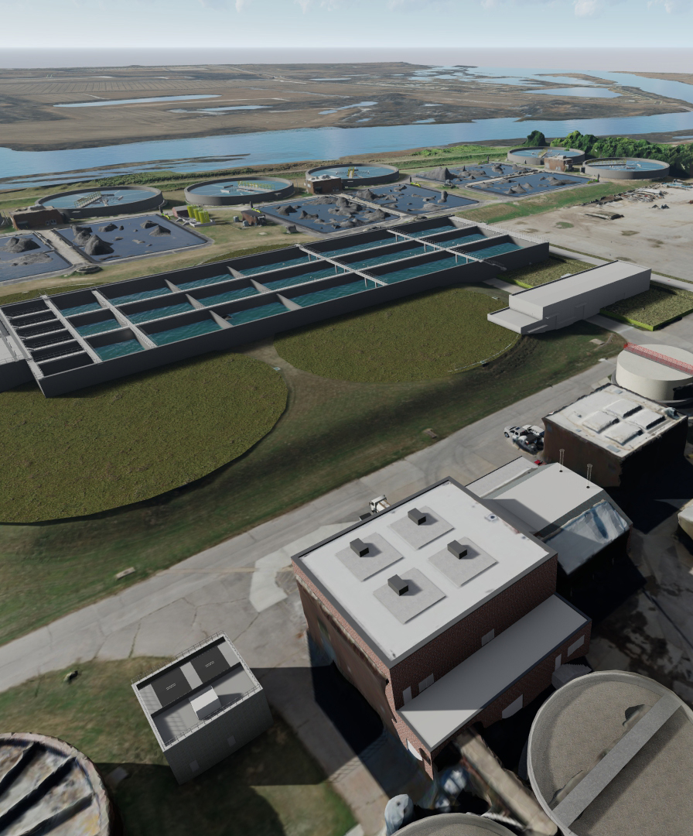
BNR Program Goals
Biological Nutrient Removal (BNR) driven by federal regulations regarding nitrogen and phosphorous removal from treated wastewater
Alleviate long standing odor concerns in the surrounding community
Rehabilitate, repair, or replace aging infrastructure near the end of its useful life

Slide 10
BNR Improvements Program Timeline
Timeline
Final Design Milestone
BNR Sub. Completion
| WIFIA Funding Notice
Construction Start
Concept Development and LOI
Design RFP & Selection
Design
New NPDES Permit Limits
Construction
Concept Engineer Approval
Owner’s Advisor Approval
Owner’s Advisor Amendment Approval
Concept Approval
LOI Submittal Approval
Construction Contract Approval
Design Contract Approval
Public Hearing about Funding Applications and Design Contract Amendments
WIFIA Loan Approval
SRF Loan Approval
2020
2021
2022
2023
2024
2025
2026
2027

Slide 11
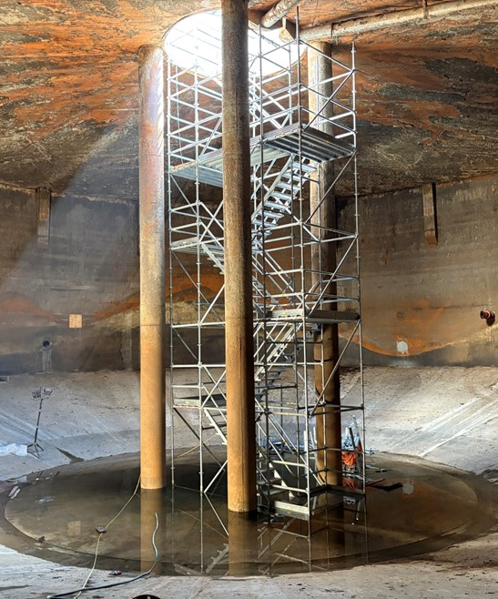
Challenges
Aging Infrastructure
Maintenance of Plant Operations (MOPO)
Challenging Influent
  Intensive sampling indicated 2-3 mg/L refractory dissolved organic nitrogen (RDON)
Hydraulic Constraints
  Increasing Peak Hour Flow to 94 MGD
  Updated flood maps
Notes:
2-3 mg/L RDON

Slide 12
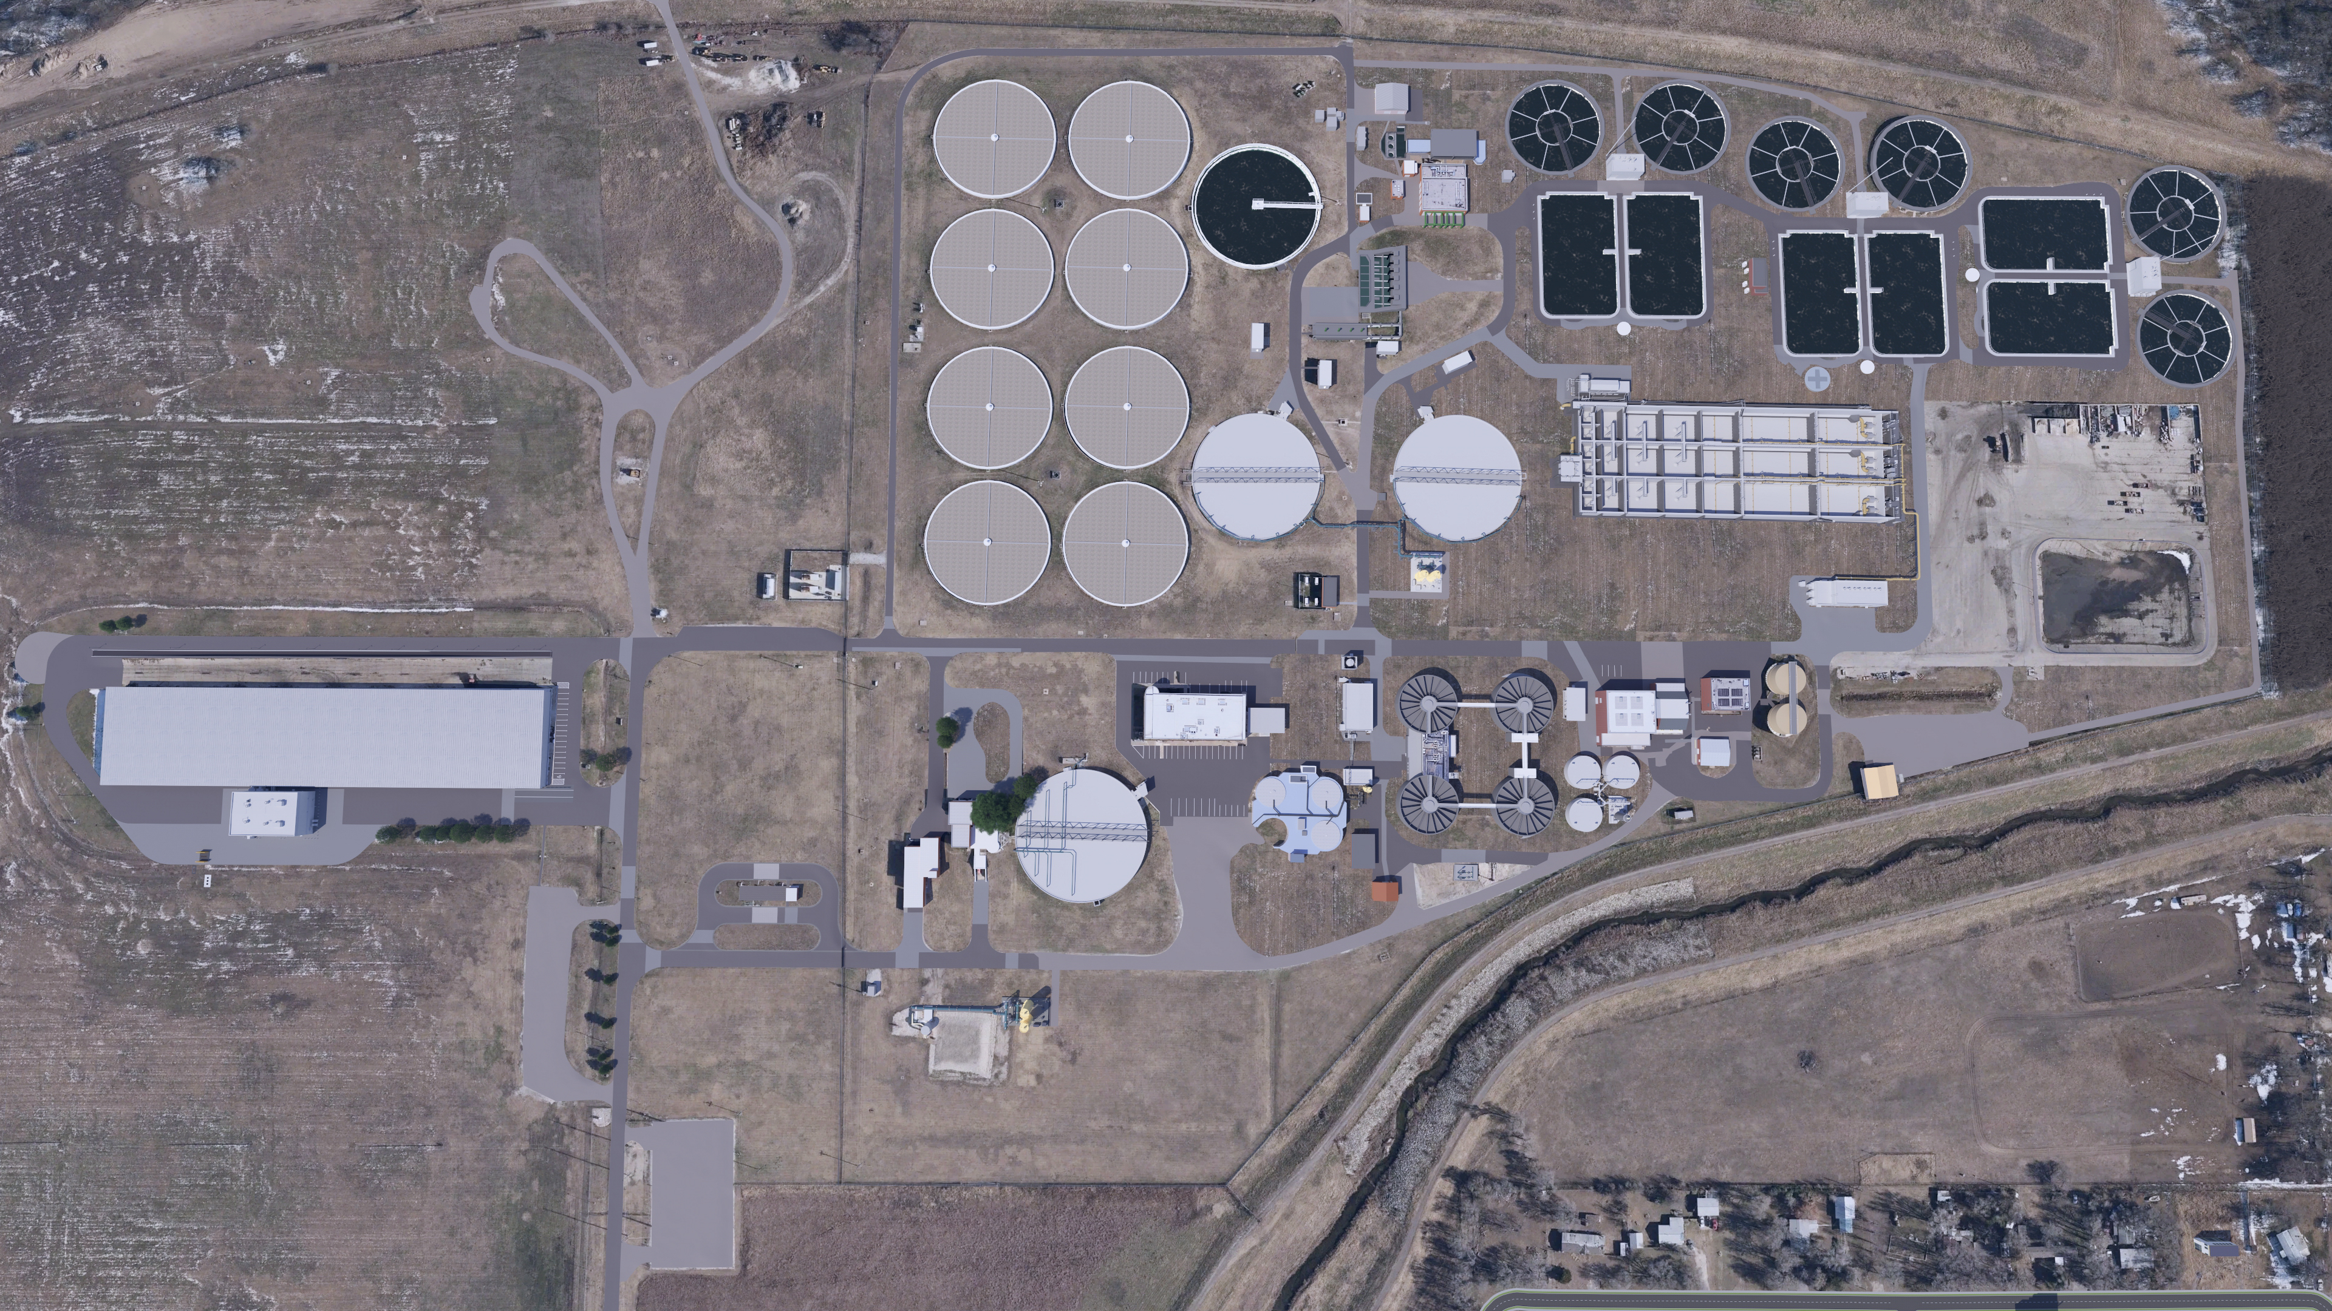
UV & NPW Upgrades
Blower Bldg Mods
Plant 2 BNR Improvements
Overview
TFs
Out of Service
A-Basin Mods
SSPS Mods
Primary Clarifier Mods
EQ Basin Repairs
BNR Structure
Grit Handling Imps.
BNR Bldg
Dewatering Bldg
SHT Covers
Screen Replacement & Screenings Handling
Digester Mods
Thickening Imps
Odor Control

Slide 13
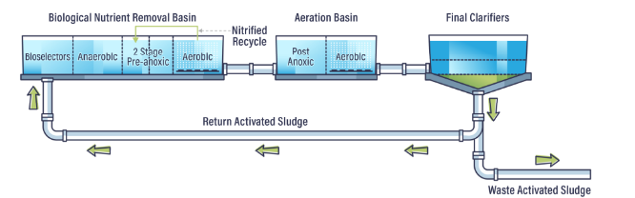
Process Selection: 5-Stage BNR Process
Two stages of high F/M unaerated bioselectors to promote granulation
VFDs for the selector zone and anaerobic zone mixers to fine-tune mixing energy
Two stages of anoxic volume and 600% recycle rate capacity for nitrate removal
Large Post-anoxic zones that produce endogenous carbon for nitrate removal

Slide 14
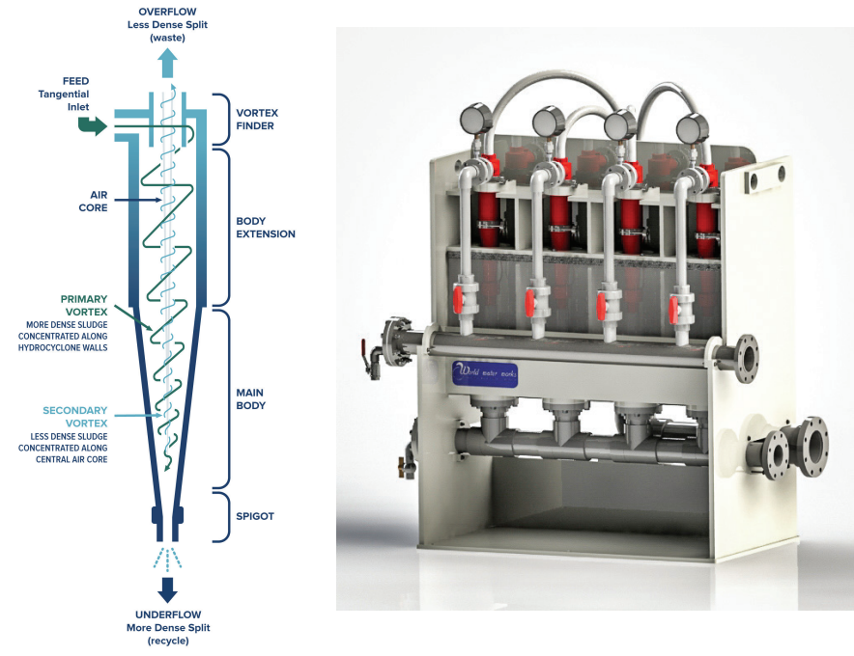
Design for Reliability and Resiliency: Selective Sludge Wasting with Hydrocyclones
Benefits:
Improved settleability (SVI)
Retained organisms beneficial to
BNR including:
  Nitrifiers (ammonia removal)
  PAOs (phosphorus removal)
Increased activated sludge (and BNR) system capacity due to:
  Higher MLSS
  BNR inside granules under aerobic conditions
Image Credit: World Water Works
Image Credit: World Water Works

Slide 15
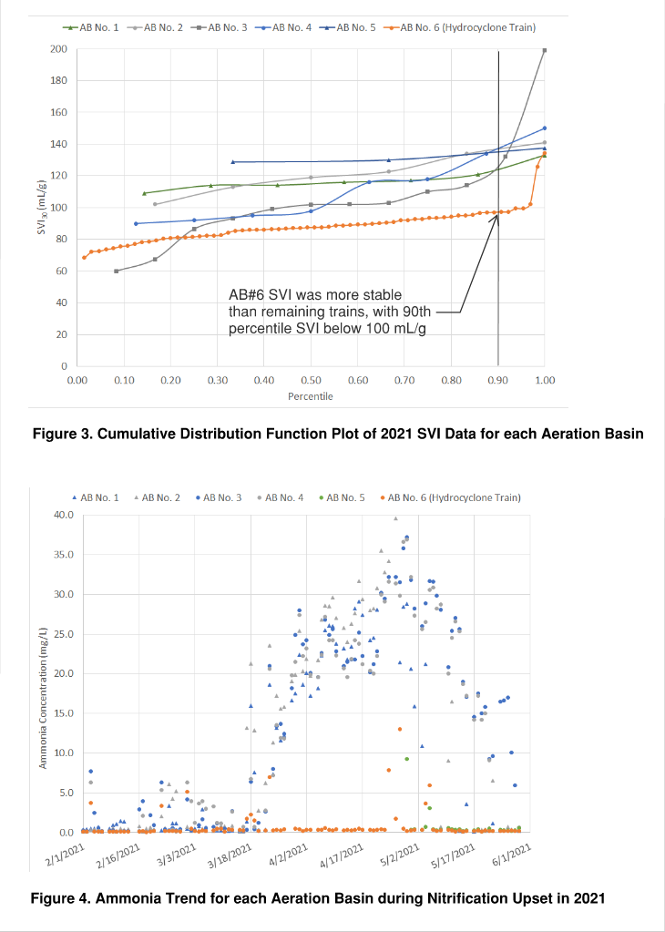
Pilot Results: Settleability
Pilot basin (AB6) had mixed liquor and consistently lower Sludge Volume Index measurements throughout 2021
90th percentile SVI₃₀:
    < 100 mL/g in AB6
    >120 mL/g in ABs 1-5

Slide 16
Pilot Results: Ammonia Removal
Pilot basin (AB #6)
retained nitrification during winter storm in February 2021 when other basins stopped nitrifying for over two months
City spent substantial funds and over 400 hours
re-seeding the remaining five basins to bring facility back into compliance

Slide 17
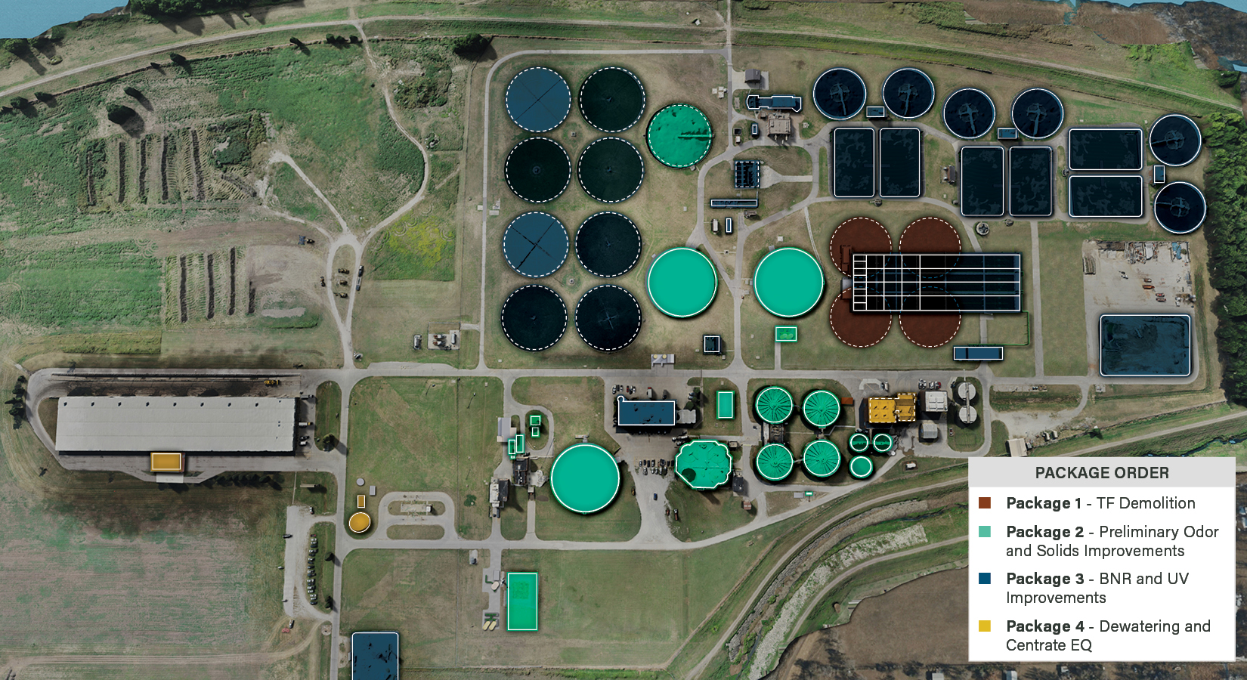
Plant 2 Construction Packaging Plan
A-Basin Mods
EQ Basin Repairs

Slide 18
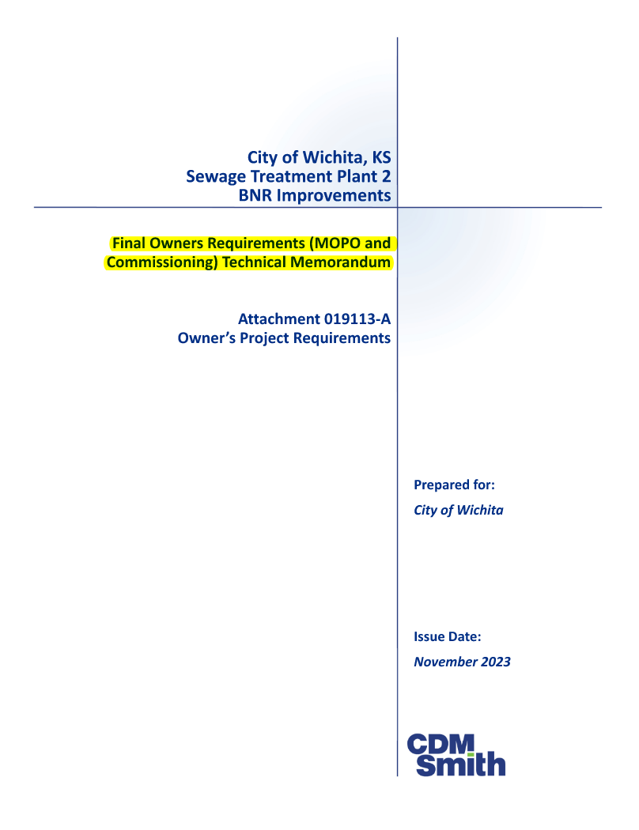
Planning For Success
MOPO Technical Memorandum
  Detailing MOPO requirements for each process area
  Included as attachment to project requirements
Hazard and Operability (HAZOP) Workshop
  Detailed review of each process, how it will be operated, failure modes, safety considerations, etc.

Slide 19
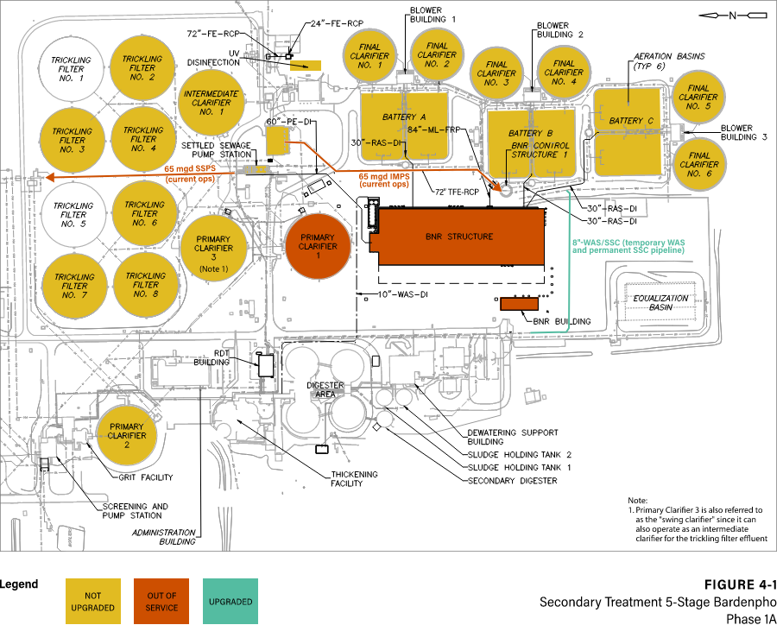
BNR Phase 1A
Maintain 6 ABs with 6 clarifiers in service
Sufficient WAS pump capacity to maintain MLSS concentration within clarifier capacity
During portions of this phase when some TF effluent bypasses clarification, need all installed Blower capacity unless bid-alternate for bypass pumping is used
MLSS
  Predicted: 2,750 mg/L
  Allowable: 3,850 mg/L

Slide 20
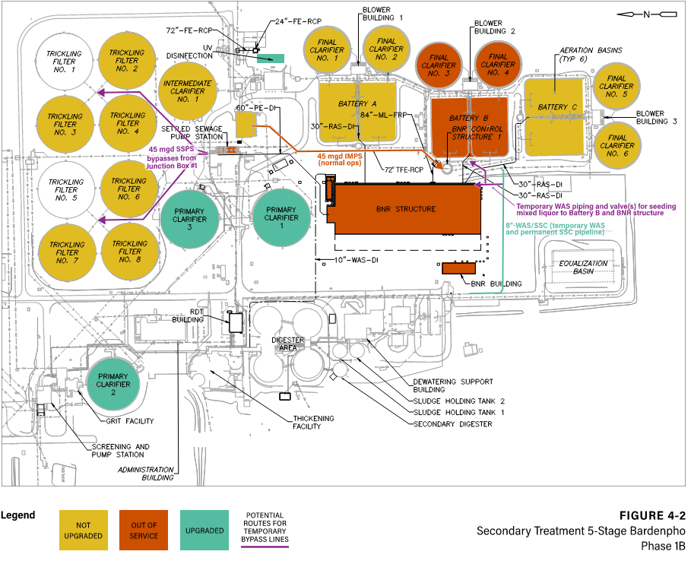
BNR Phase 1B
Bypass pumping around SSPS for upgrades: 45 mgd
MLSS with 4 basins in operation:
  Predicted: 3,440 mg/L
  Allowable: 3,400 mg/L
Specification requirements included in contract to reduce risk:
  Work to be completed June-November
  Maintain 5 ABs with 5 clarifiers in service for longest extent feasible before second basin in Battery B is removed from service for upgrades
Battery | Needed airflow (available) | Diffuser flux
A/C | 11,510 scfm (12,800 scfm) | 1.0-2.3 (<2.5 scfm/diffuser)
B (preupgrade) | 5,760 scfm (12,800 scfm) | 1.0-2.3 (<2.5 scfm/diffuser)
B (postupgrade) | 4,920 scfm (7,000 scfm) | 0.9-2.4 (<2.5 scfm/diffuser)

Slide 21
Use of Plant 1 EFBs During Construction
With multiple rainstorms back-to-back during SSPS bypass pumping, City will need to use EFBs at Plant 1 more frequently.
  During bypass pumping, it will not be possible to pass 54 mgd through Plant 2
Might it be allowed to use the Plant 1 EFB outfall with Plant 2 flows less than 54 mgd during this period of construction?
  This would be treated as an Incident Report regardless of whether the Plant 2 flow is above or below 54 mgd
  The discharged water will be dilute due to rainfall-induced I&I. It is recommended to sample any discharges from Plant 1 outfall; these will be submitted as part of an Incident Report.

Slide 22
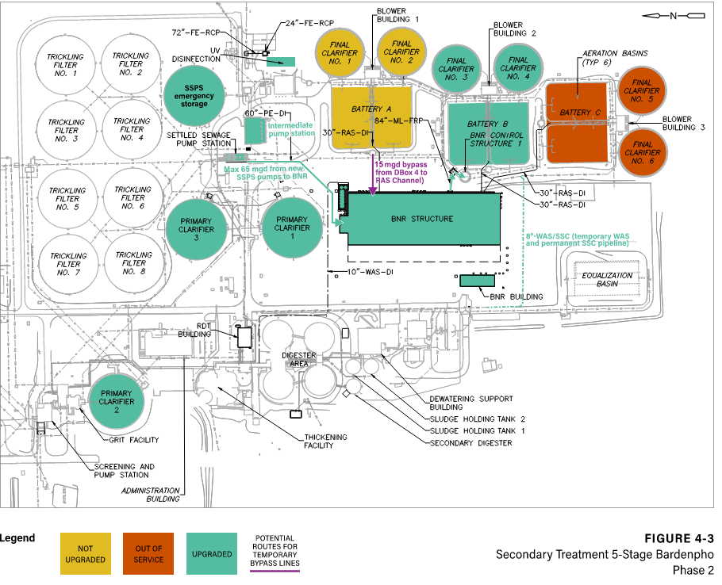
BNR Phases 2 and 3
Phase 2: With temporary RAS pumping in Battery A, can use new capacity of BNR Structure for treatment while construction continues
Waste through new hydrocyclone facility to control SRT and MLSS and promote a well settling sludge

Slide 23
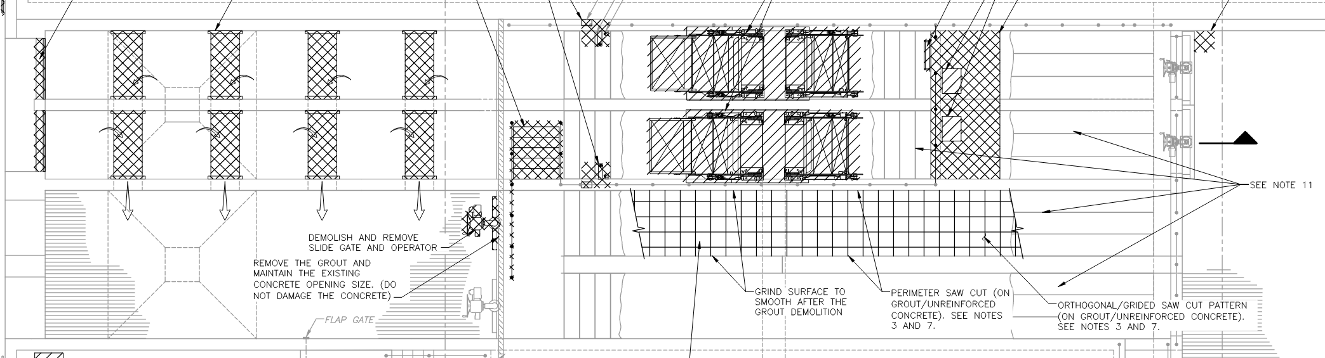
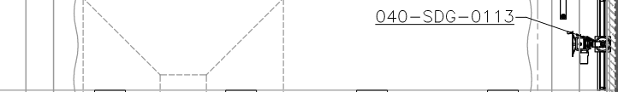
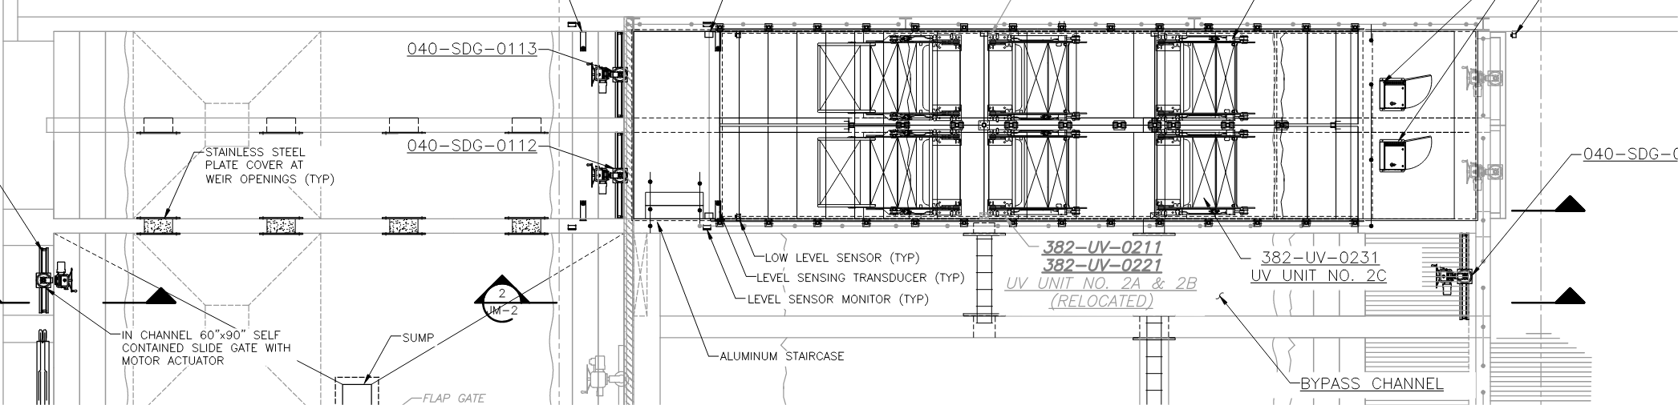

Disinfection: UV
1
Raising floor of existing channels, demolishing finger weirs/installing level control modulating weir gates, and adding one bank per channel
Construction is required to take place from Nov-March, when E. coli limits are higher
Flow limitations during construction:
  Expected < 2-month duration for each channel modification
  Maintain West Channel with finger weirs, which will require limiting flow to < 46 mgd
  After East upgrade, limit flow to < 56 mgd
Expect total of four whole-plant shutdowns to complete UV and Oxycharger work
  Specifications limit to Low Flow periods and less than 8 hours each
2
3
4

Slide 24
Construction Update

Slide 25
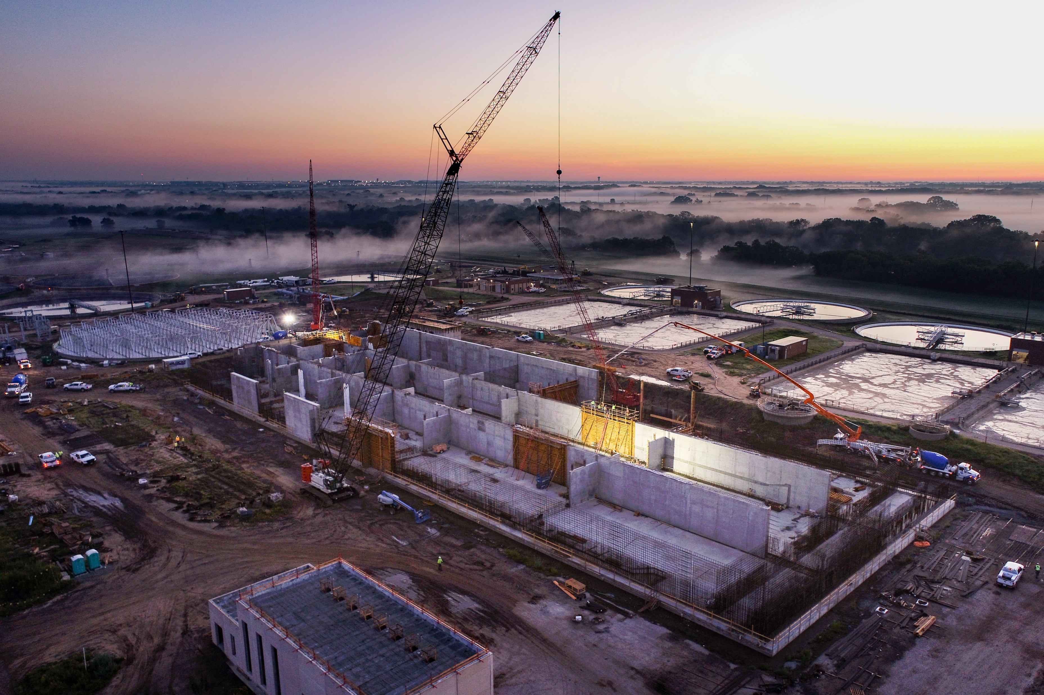
Nutrient Removal
2 football fields
23,000 cubic yards of concrete
  ~2,500 trucks!
Capacity to meet updated permit limits

Slide 26
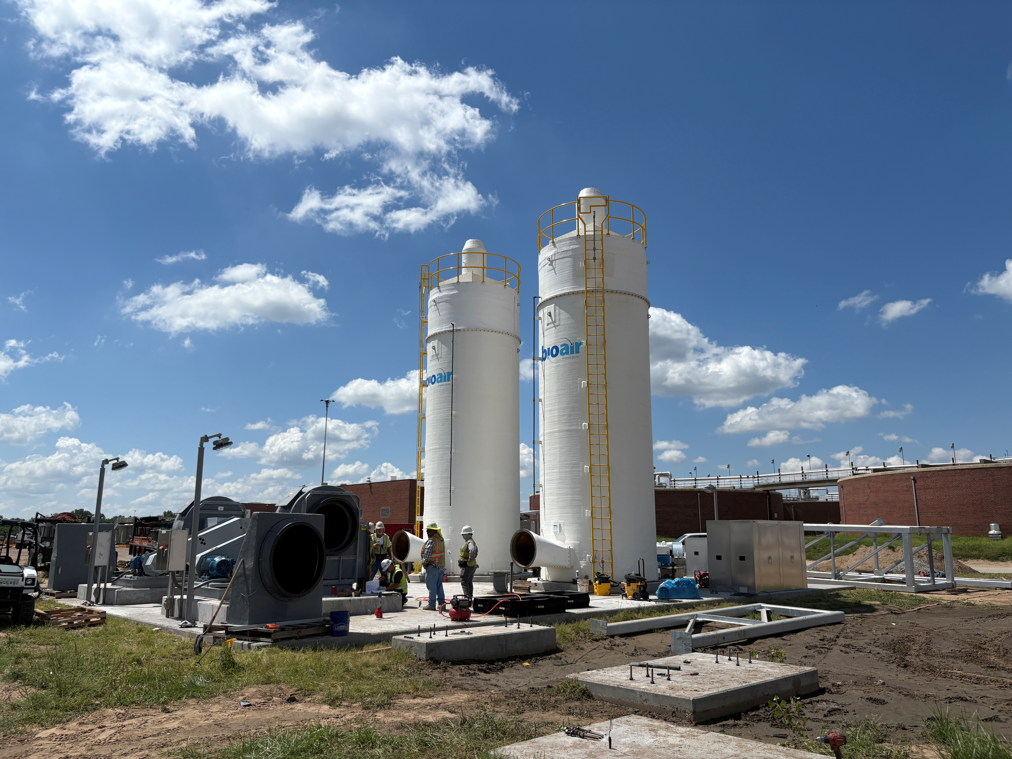
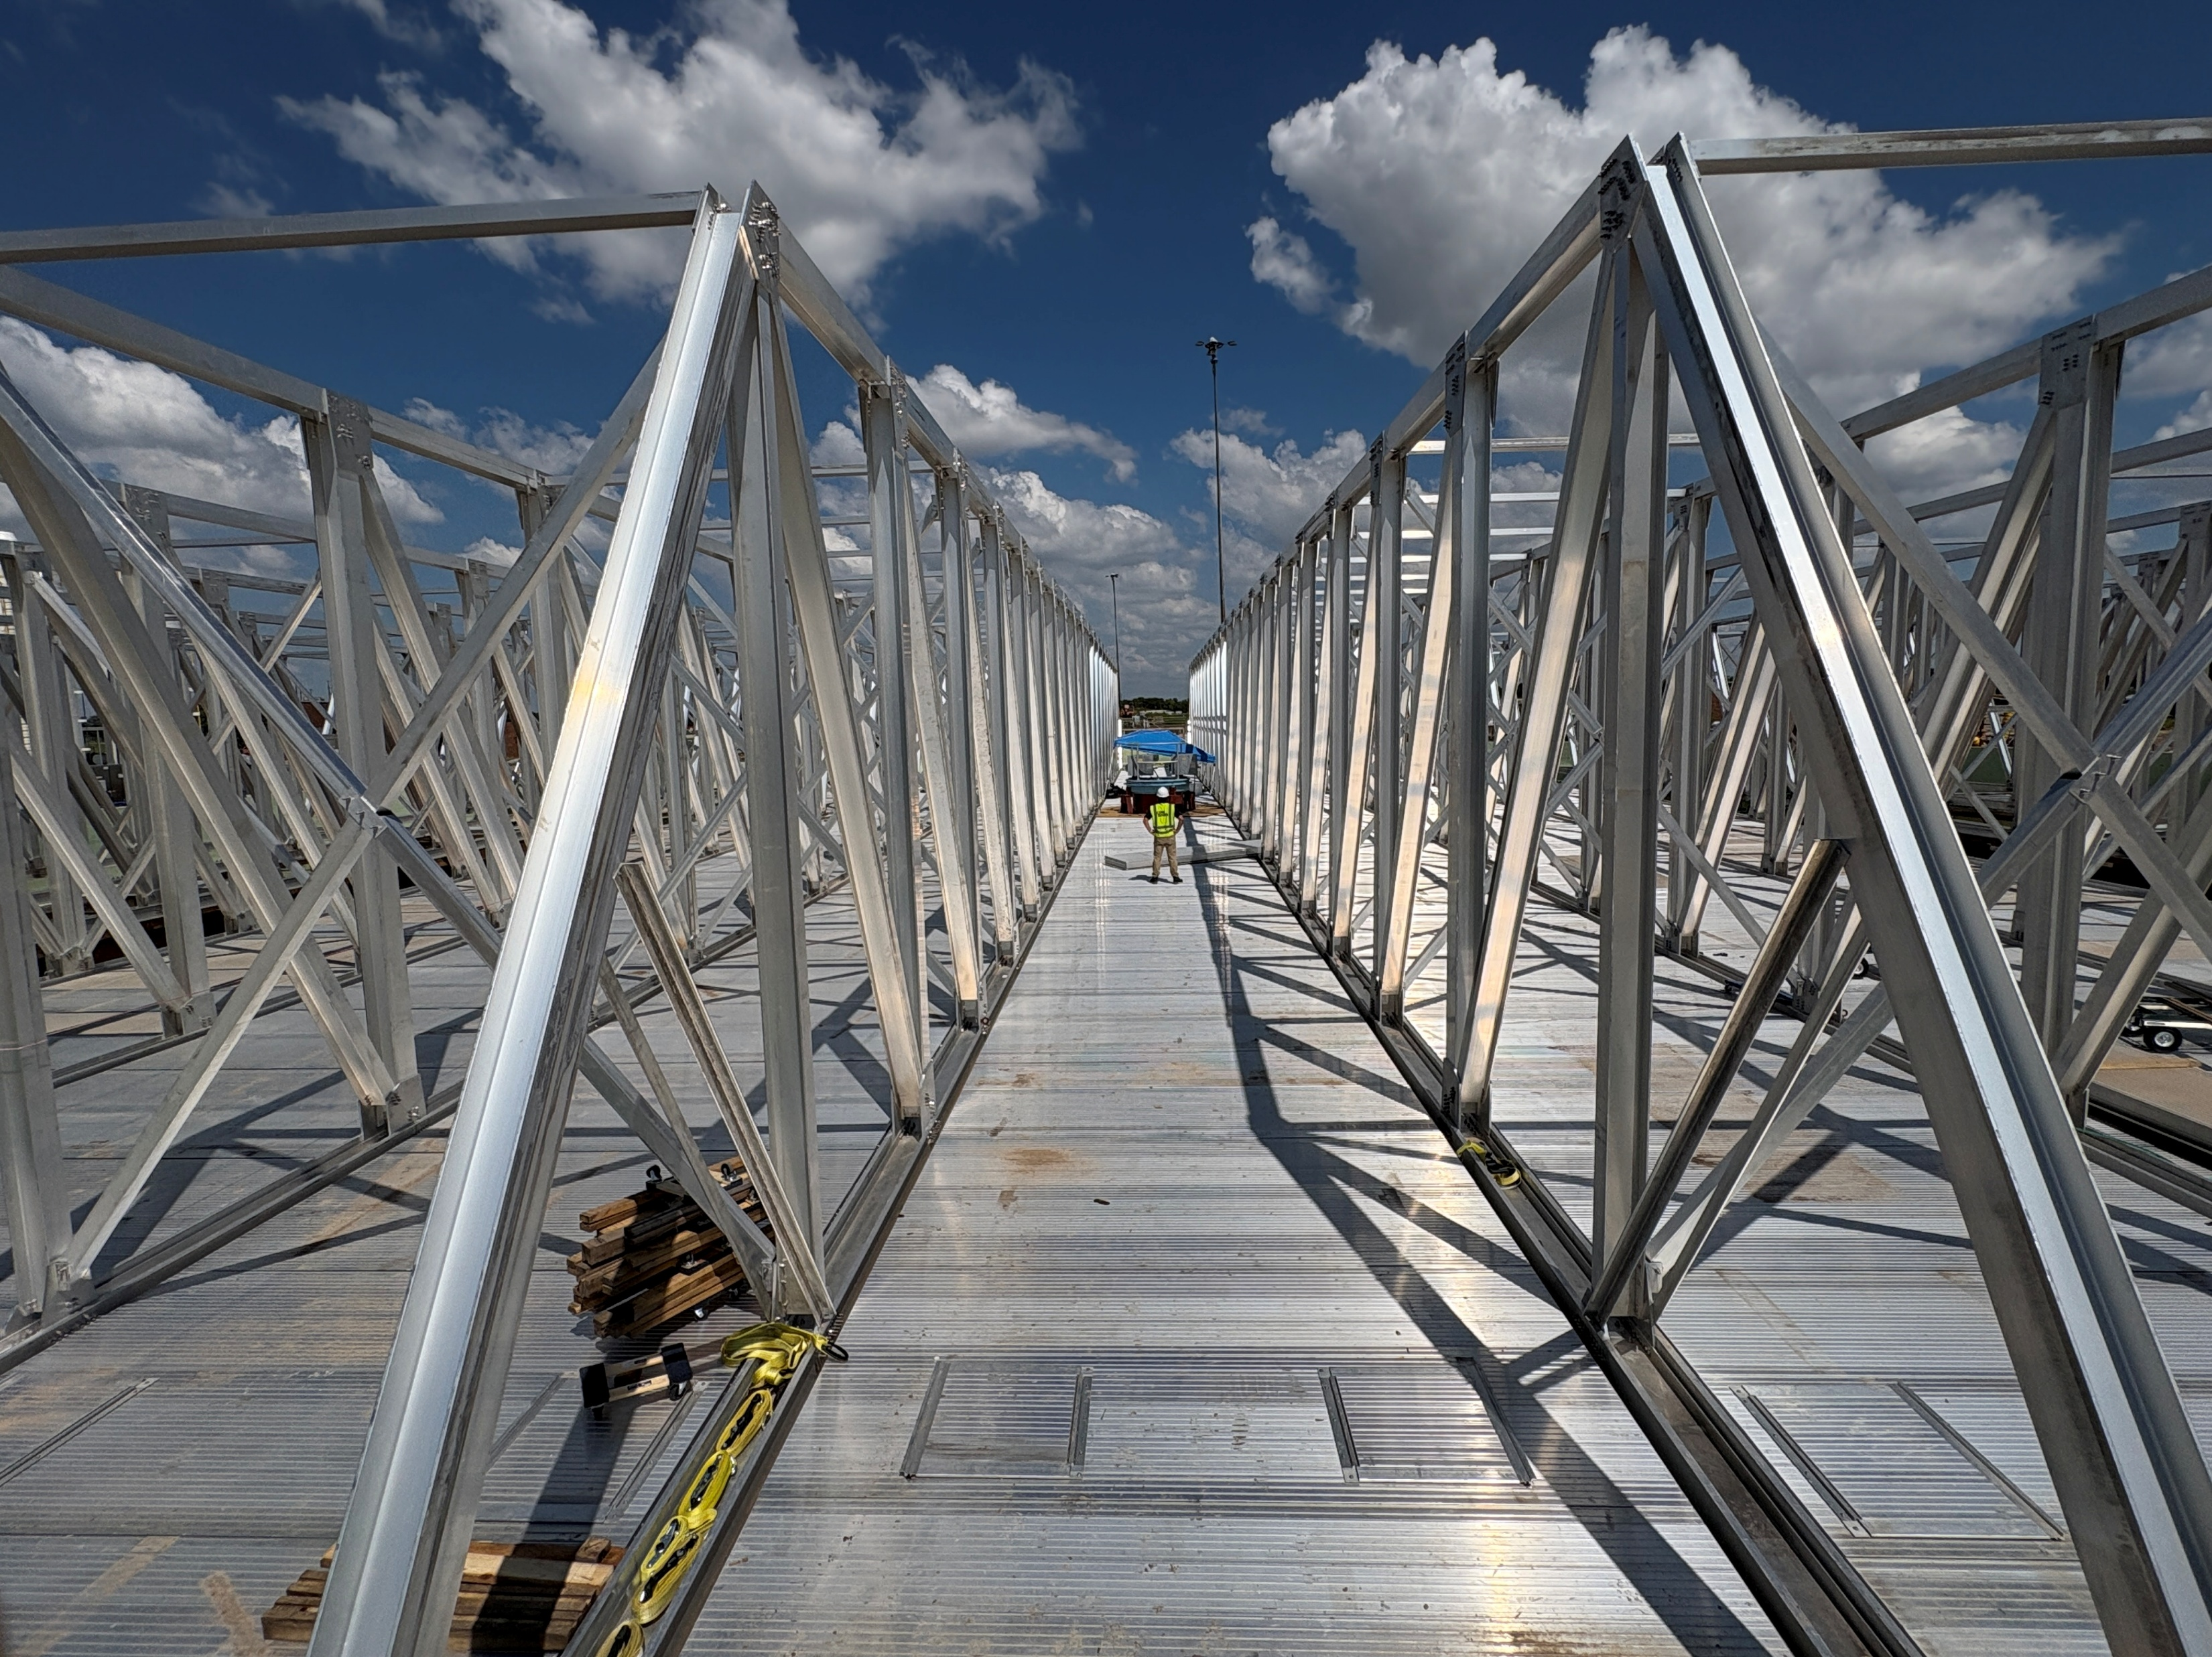
Odor Control

Slide 27
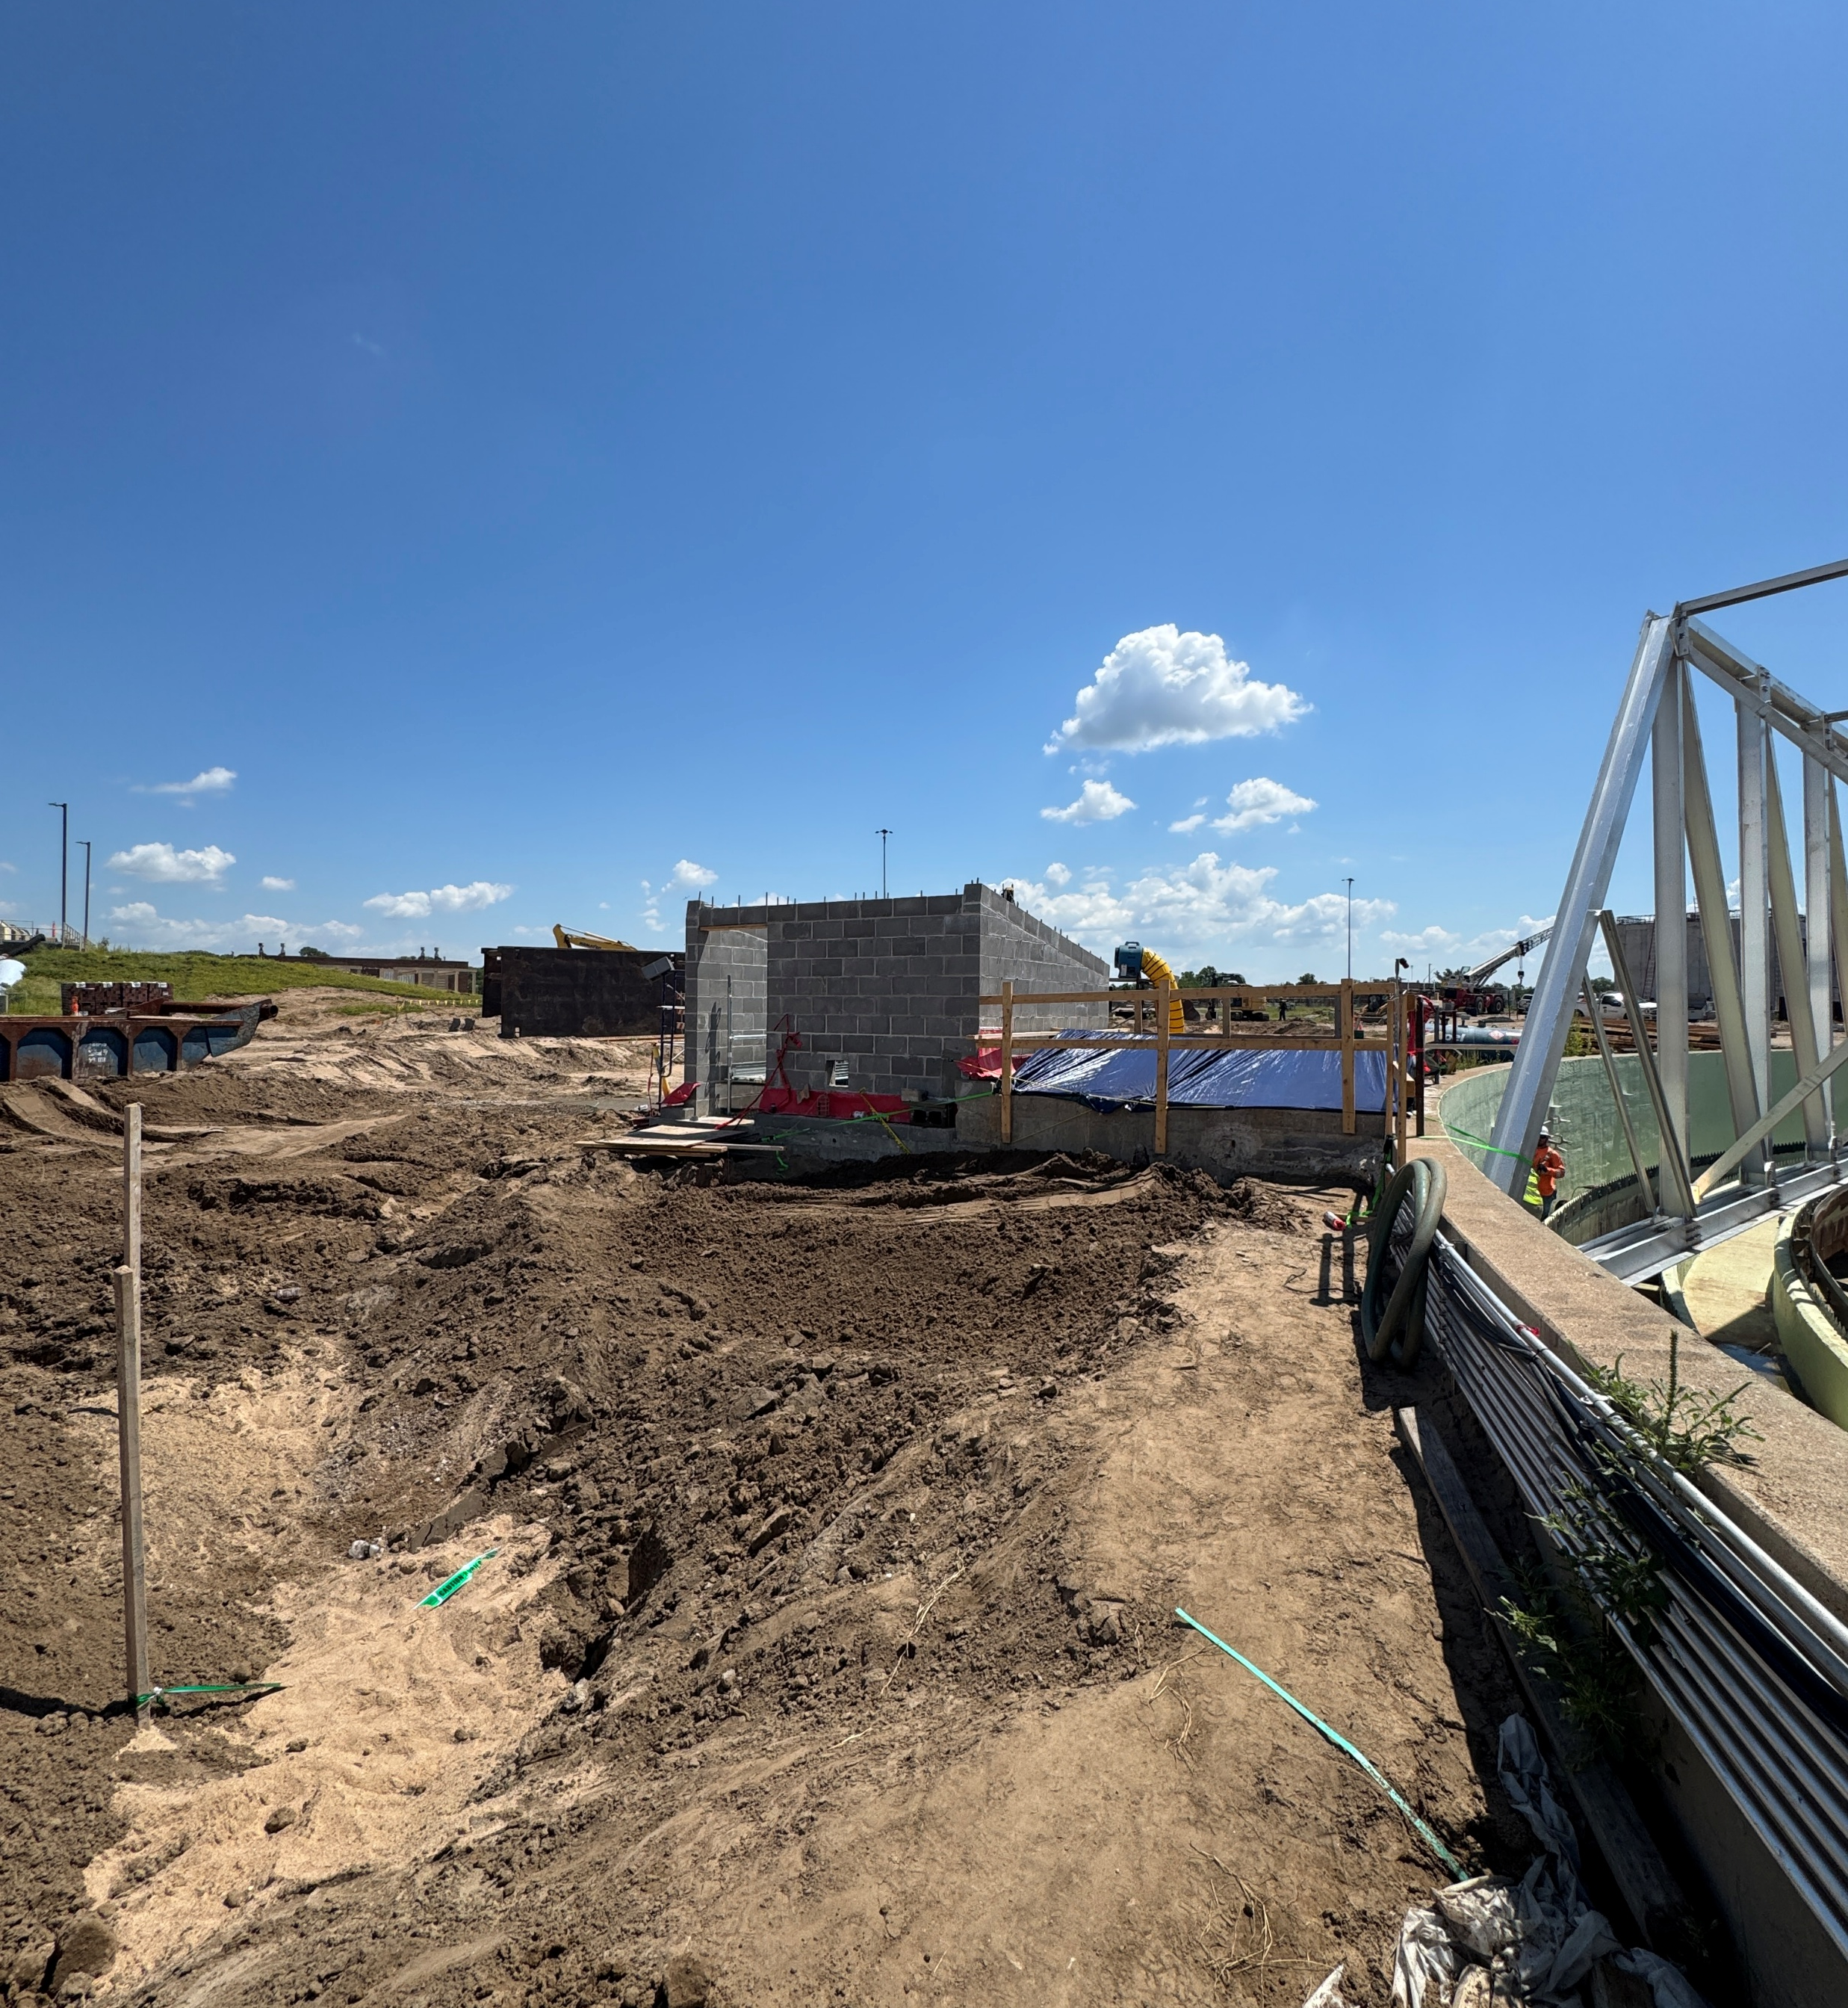
Maintenance and Safety
Improved maintenance and safety access

Slide 28

Improved Solids Treatment
Trade DAFTs for RDTs
Clean Digesters
Improved Mixing
More Gas!

Slide 29
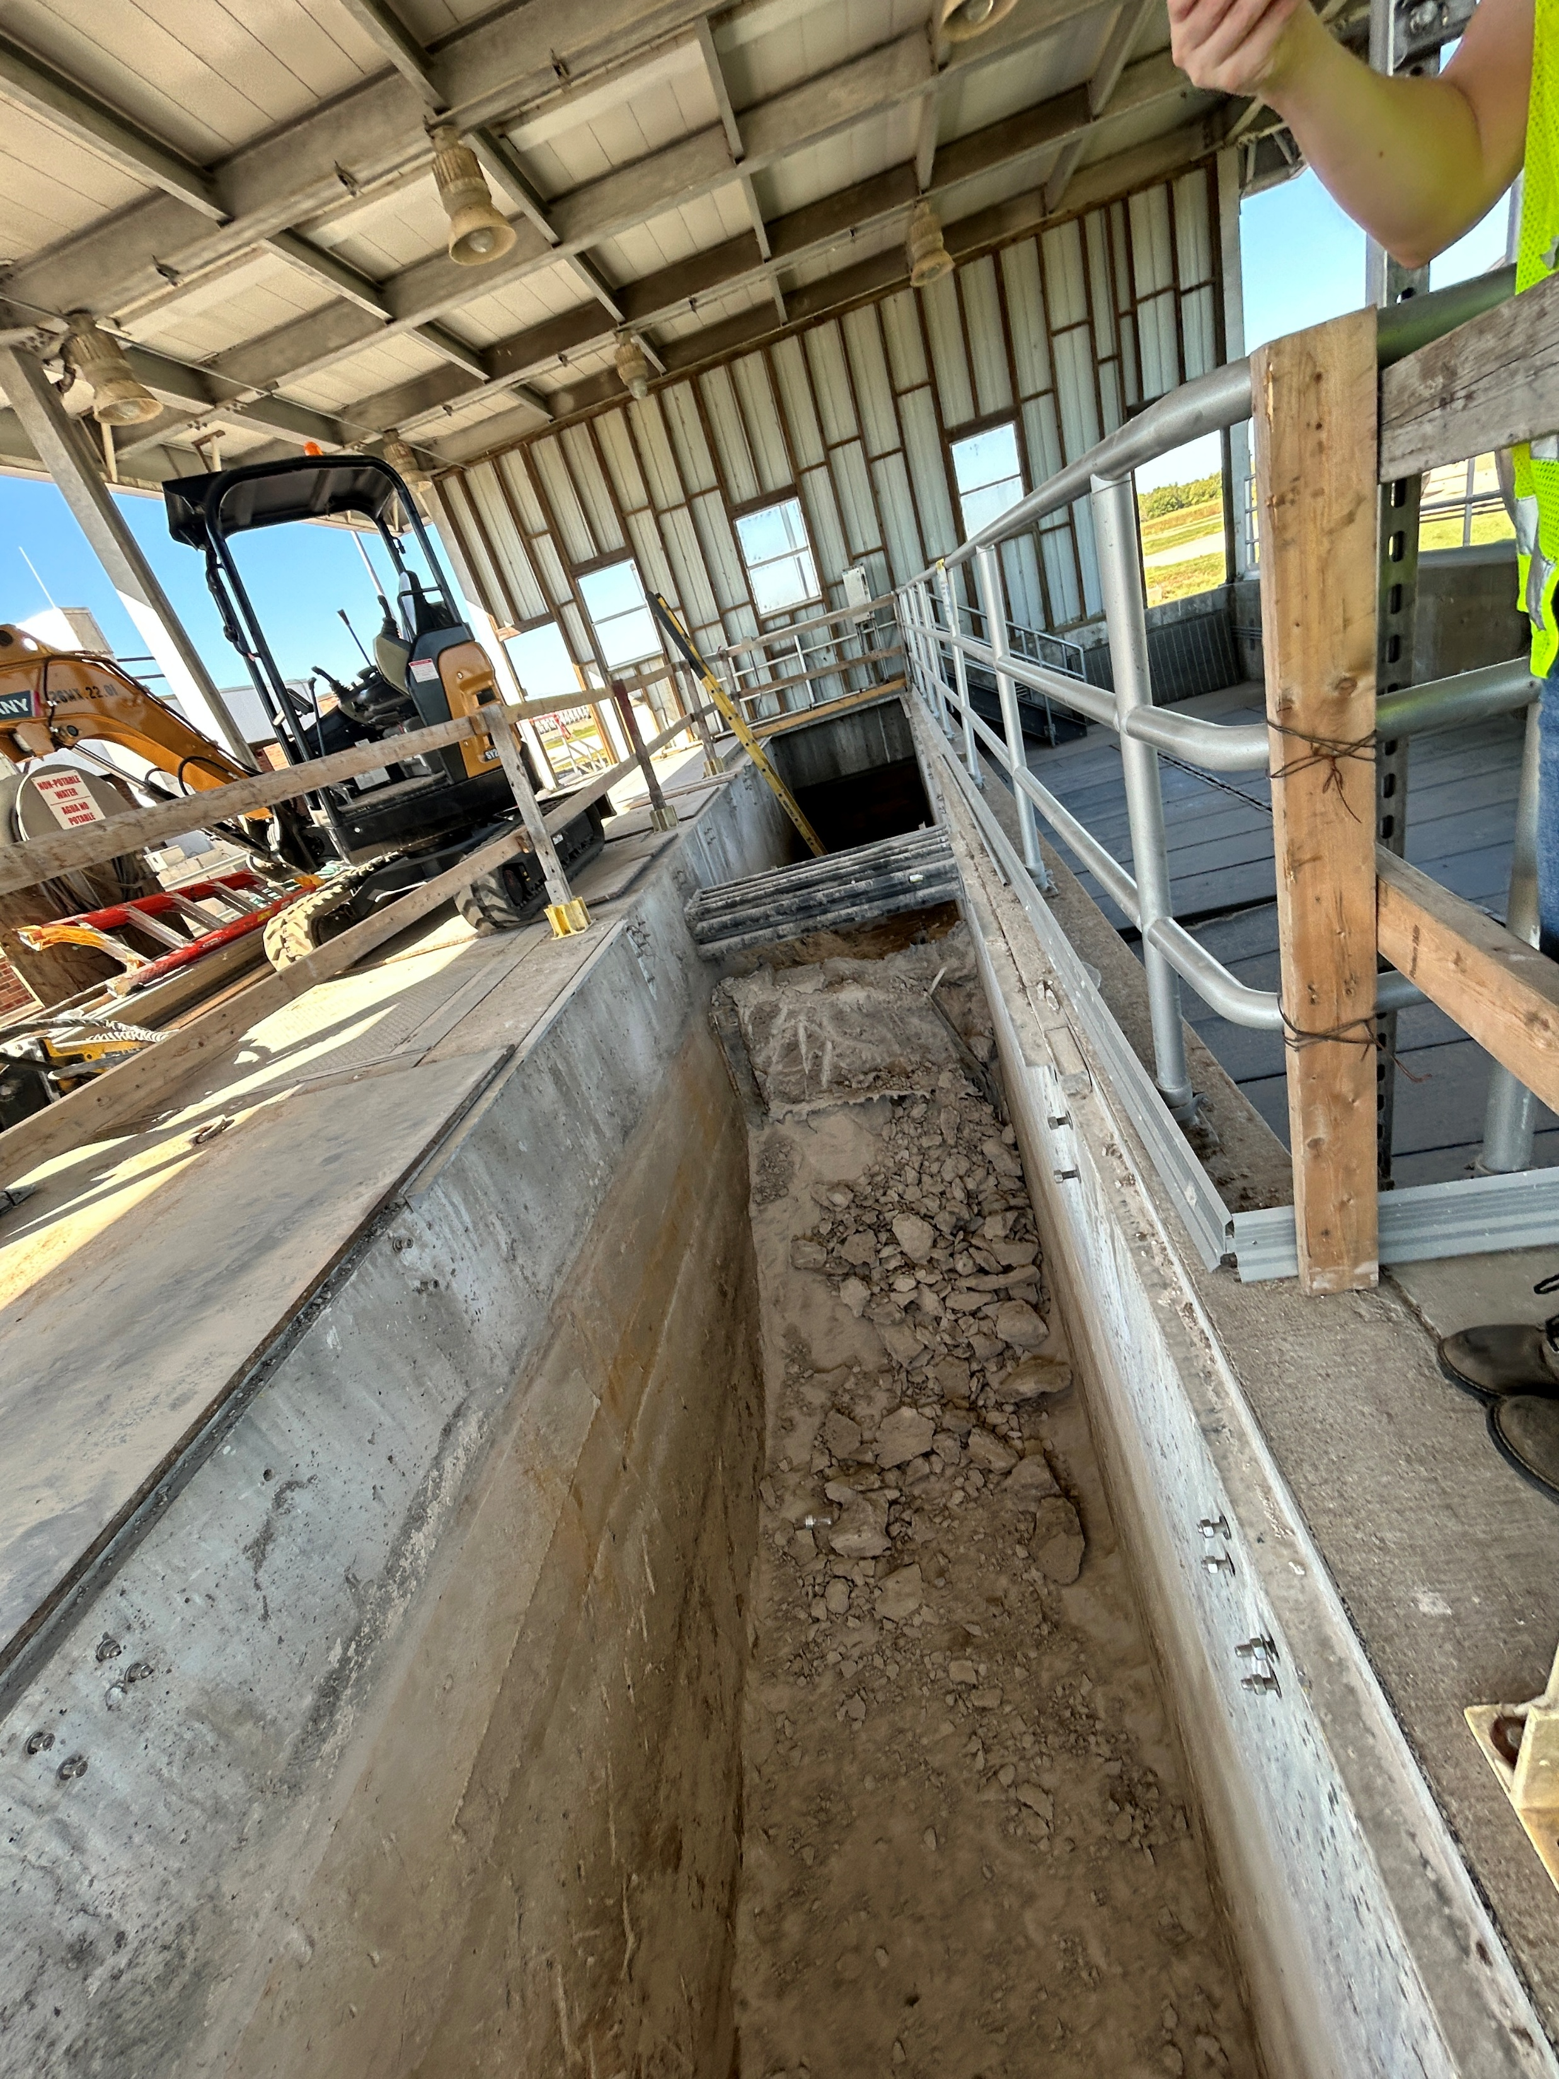
Disinfection Improvements
Reusing existing structure
Adding treatment capacity and operational flexibility

Slide 30
What Have We Learned?
A good HAZOP goes a long way
No matter how good you plan is, be prepared to change it
Teamwork makes the dream work
Engage regulators early and keep them informed
Pay it forward and produce quality record drawings

Slide 31
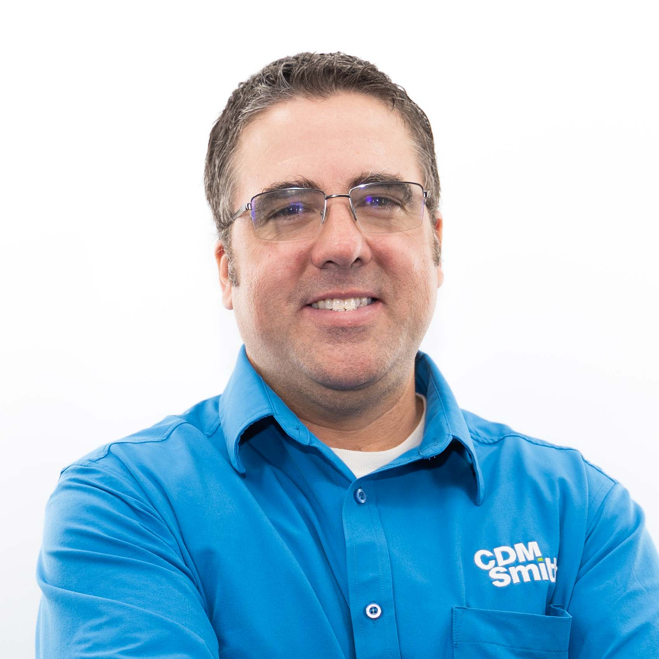
Thank you!
To learn more, please contact:
Chris Varnon, PE
Principal Engineer
West Central Water Reclamation Discipline Leader
CDM Smith
varnonck@cdmsmith.com
(713) 423-7313

Slide 32
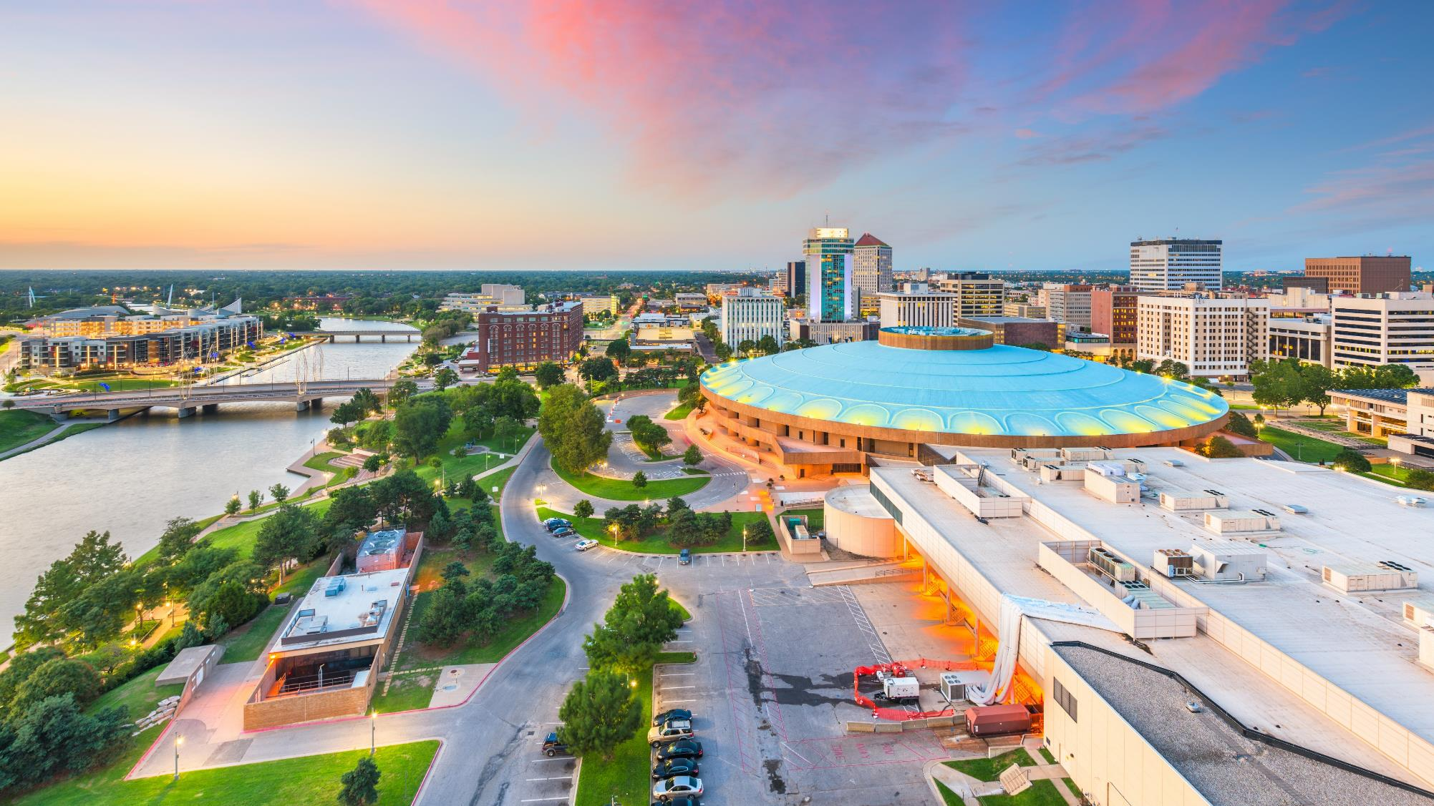
Questions?

